Slide 1
Compare and contrast the ottoman, qing, and mughal empires in terms of the creation and maintenance of a state where a minority (ethnic or religious) group ruled over a majority group

Slide 2
Figure out what each group did
Agree with
Refute
And/or modify what they did to create your own state
You are a minority group ruling over a majority population
How will you change?
How will the people change?
Who will be the ruler? The elite? The politicians? The generals? The soldiers? If any are from the majority group, how can you trust them?
How will you deal with rebellions?
“Unlike the ____ Empire, which did _____, we will do _____”
Like the ____ Empire, we will _________”

Slide 3
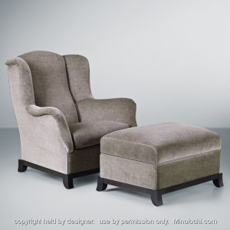
The Ottoman Empire (1299-1919)

Slide 4
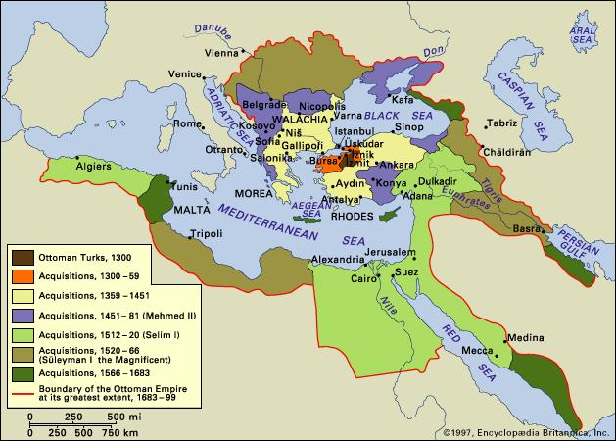
Ottoman Empire
Founded by Turks
Started in Anatolia (Turkey)
Controlled Balkan Peninsula and parts of eastern Europe
Acquired much of the Middle East, North Africa, and region between the Black and Caspian Seas

Slide 5
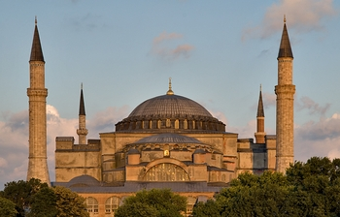
Ottoman Islamic Civilization
Borrowed many elements from the Byzantine, Persian, and Arab cultures (especially in architecture)
Turned Christian church of Hagia Sophia into a mosque

Slide 6
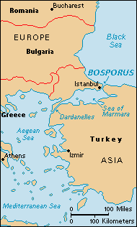
General Characteristics
Maintained strong navy in Mediterranean region to protect trade routes
Conquered much of the Byzantine Empire’s territory -- captured capital of Constantinople in 1453 & renamed it Istanbul
https://www.youtube.com/watch?v=7sl4XCVmoXg

Slide 7
Suleiman the Magnificent?

Slide 8
Labels for Suleiman
Read the information sheet
Write each of the labels down in your notes
Provide evidence to support each.
Which label seems most appropriate?

Slide 9
Accomplishments under Suleiman I
Most famous Ottoman Sultan
Organized Ottoman law
Strengthened military
Devshirme: System of taking young Christian boys from Balkans, converting them to Islam, and having them serve the empire
Either became Janissaries (elite infantry force) or bureaucrats

Slide 10
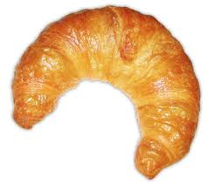
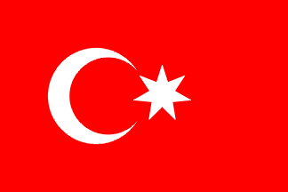
Ottomans v. Europe
Conquered Byzantines
Took over Eastern Europe (Balkans)
Nearly sacked Vienna (capital of Austrian Empire)

Slide 11
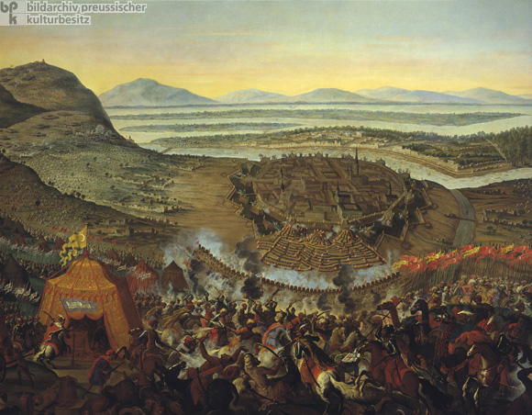

Slide 12
Ottoman Law
Ottomans (Muslims) ruled diverse people: Arabs, Greeks, Slavs, Armenians, Jews, etc.
Millets = separate communities of non-Muslims --> each millet controlled its own affairs
Jews, Catholics, Greek Orthodox, etc.

Slide 13
Decline of the Ottomans
By 1600, empire had reached its peak and started to decline
Faced constant attacks from enemies on its borders
Finally collapsed after its loss in WWI (it fought with the Central Powers)

