Slide 1
Chapter 3
First Civilizations: Cities, States, and Unequal Societies
3500 BCE-500 BCE

Slide 2
The Agricultural Revolution!
https://www.youtube.com/watch?v=Yocja_N5s1I

Slide 3
Civilization
A civilization is generally defined as an advanced state of human society containing highly developed forms of government, culture, industry, and common social norms.
Characteristics:
Cities/Urban Centers
Specialization (different jobs)
Record Keeping/Writing
Technological Developments
Complex Institutions (government, religion, etc.)
Social Stratification

Slide 4
Where did civilization develop?
Mesoamerica: Olmec civilization
South America: Norte Chico civilization
North Africa: Nile Valley civilization
Middle East: Mesopotamian civilization
South Asia: Indus Valley civilization
East Asia: Chinese civilization (Shang dynasty)
All between 3500 BCE-1000 BCE

Slide 5
“How did it all get started?” – the question of origins

Slide 6
Where did civilization come from?
Emerged from pre-existing chiefdoms with social stratification.
Had roots in agricultural revolution but...
…not all agricultural societies became urbanized “civilizations.” (Why not?)

Slide 7
Claim: the need for large scale irrigation led to the birth of civilization
Counterclaim: large-scale irrigation seems to have developed after the emergence of civilization.
-Civilizations manipulate and adapt to their environment

Slide 8
Claim: as agricultural societies organized, elites established “power structures” to protect their privileges, so strong centralized states emerged. (What’s a “power structure”?)
the way power and authority is distributed in groups

Slide 9
Claim: As societies grew more crowded, competition between people led to the need for large-scale organization.
This organization provided internal stability but competition with outsiders led to a need for military organization.
(“Winners” became upper class, “losers” became lower class.)

Slide 10
Cities
Served many different functions
Seat of the government/political system
Cultural center (Art, architecture, language, etc.)
Marketplaces/cultural exchange centers
Home to specialized trade and crafts
No longer know everyone in the area around you
Class and occupation became important markers
Led to the creation of class structure and the inequality of wealth, status, and power

Slide 11
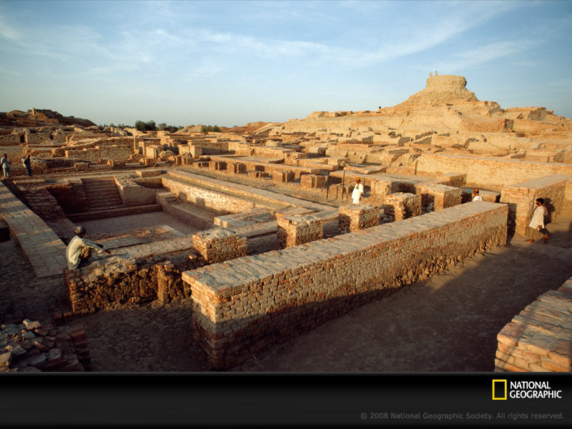
Mohenjo-Daro

Slide 12
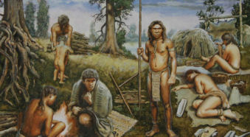
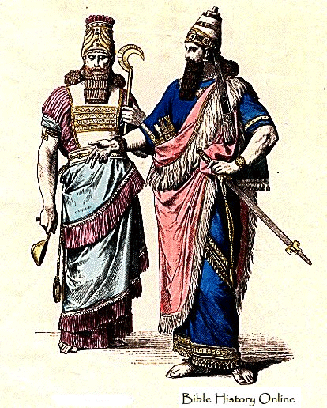
Class Structure and Social Inequality
Upper classes enjoyed many advantages
No physical labor
Great wealth
Fine goods (clothing)
Elaborate burial practices
Head of political, military, and religious systems
Started from the bottom…

Slide 13
But the whole team isn’t here…
Far more people were commoners and did not have the privileges of the wealthy
Included guards, soldiers, artisans, officials, and farmers
Even lower were the slaves—often enemies captured during a war
Slavery was a feature of state-based societies, but varied place-to-place

Slide 14
Gender Hierarchies and Patriarchy

Slide 15
Mesopotamia
Egypt
Written law codified and sought to enforce a patriarchal family life.
The law supported unquestioned authority of men while offering women a measure of paternalistic protection.
Central to these laws was the regulation of female sexuality by men.
Women in Mesopotamian civilization were sometimes divided into two sharply distinguished categories:
(1) respectable women, those under the protection and sexual control of one man, who were often veiled outside the home; and
(2) nonrespectable women, such as slaves and prostitutes, who were often forbidden to wear a veil.
While Egypt was still a patriarchal society, it afforded women greater opportunities than did Mesopotamia.
Women in Egypt were recognized as legal equals to men. They were able to own property, sell land, make their own wills, sign their own marriage contracts, and initiate their own divorces.
Royal women occasionally exercised significant political power as regents for their young sons or, more rarely, as queens in their own right.
Women were not veiled in Egypt, and art depicting married couples showed women and men in affectionate poses as equal partners.

Slide 16
PUT YOUR HOMEWORK IN THE BLACK BOX ON THE STOOL

Slide 17
Warm-Up
What are some of the main jobs of the State? (the government)

Slide 18
The RISE OF THE STATE

Slide 19
Rise of the State
Need for an authority to regulate and administer the varied and complex communities…
Organize irrigation
Solve conflicts between people from different cultures
Laws!
Defend the city from outsiders
Walls!
Solved (or at least addressed) the big problems, gained support of population

Slide 20
Downsides of the State
Mainly concerned with protecting upper class
Compelled farmers to pay tax (give away food)
Forced people to create public work projects (irrigation canals, ziggurats, pyramids)

Slide 21
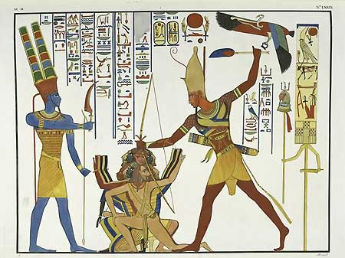
How does a state gain its authority?
Generally, connecting the king/pharaoh/ruler to God
Chinese kings were called the Son of Heaven—special responsibilities to keep universe in check
Mesopotamian rulers—Officials of the gods
Egyptian pharaohs—Embodiment of the gods, ensured that the Nile flooded and enemies were defeated

Slide 22
Writing/Accounting
Literacy was reserved for the elites
Served as a tool of social mobility as well (commoners could learn)
Tool for propaganda
Accounting tool for recording taxes
Calendars were invented (agricultural and religious purpose)
Used to codify and publicize laws

Slide 23
Code of Hammurabi
Series of laws created by Babylonian king Hammurabi
With 2-3 other people, you are going to create a poster of important laws that you will display around your city center
Hammurabi created hundreds of laws, so include at least two notable laws from each of these four categories: theft, family, assault, and liability (fault)
Summarize the remaining laws in those categories
Mention if laws apply differently to people of different classes or genders
You will present your poster to the class

