Slide 1
CHAPTER TWO
THE AGRICULTURAL REVOLUTION

Slide 2
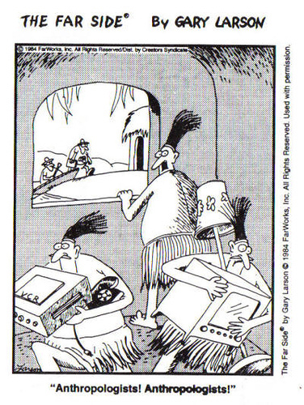

Slide 3
CHAPTER TWO QUIZ

Slide 4
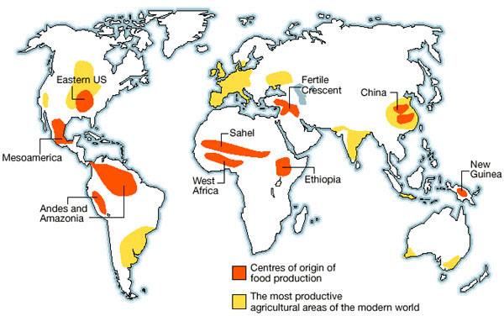
The Agricultural revolution
Occurred between 12,000-4,000 years ago, independently, across the world
the Fertile Crescent
Mesoamerica
Sub-Saharan Africa
China
New Guinea
the Andes
eastern North America

Slide 5
Why did the Agricultural Revolution occur after 10,000 BCE?
Human migration into new regions of the world
Extinction of large mammals (why?)=need to find new food sources
End of the last ice age
Climate Change!

Slide 6
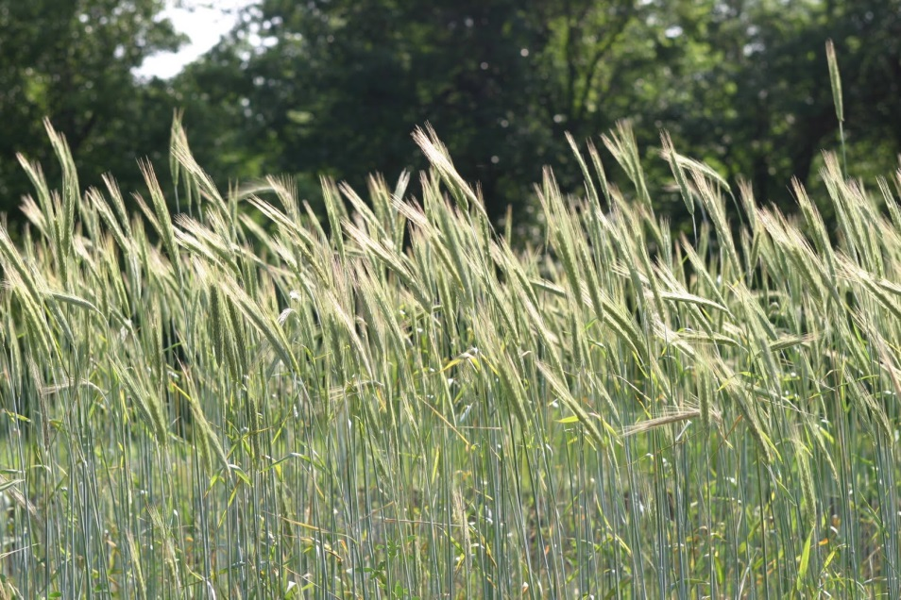
So what?
How did climate change affect the development of agriculture worldwide?
Warmer, wetter, more stable conditions
Helped cereal grasses grow
Ancestors of wheat, barley, other grains

Slide 7
Next steps…
Favorable conditions allowed agriculture to happen, but didn’t cause it
Hunter-gatherers began settling down, becoming more sedentary as climate improved
Settled near resource-rich marshes, rivers, etc.
Led to a population increase and greater strain on food resources
Need to create more food
Only then was agriculture developed in various places

Slide 8
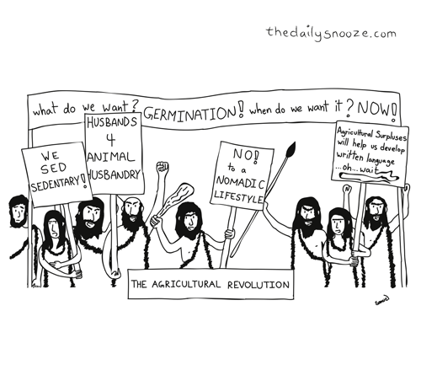

Slide 9
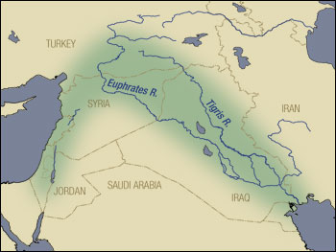
Fertile CRESCENT
Present-day Middle East, first to develop agriculture
Why there?
Mini climate shift threatened the larger settled populations, leading to domestication
Shifted to agriculture within 500 years, as evidenced by growing and shifting settlements
Domesticated wheat, barley, lentils, sheep, pigs, etc.

Slide 10
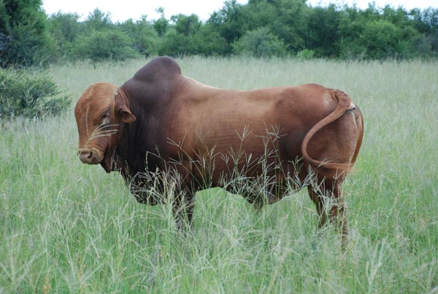
Saharan Africa
Cattle were domesticated in the present-day Sahara
The Sahara was a grassland until 5000 years ago
Animal domestication came before plant domestication here, unlike elsewhere

Slide 11
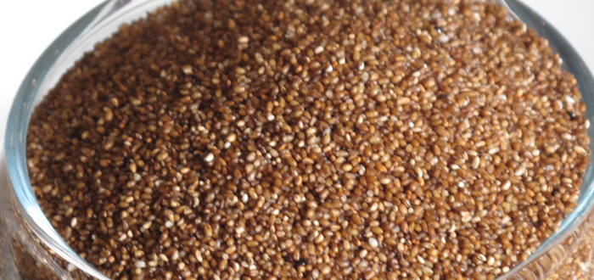
SUB-SAHARAN AFRICA
Scattered and independent farming practices developed, dependent on region
Ethiopia: Teff (nutritious grain)
West Africa: Yams, okra, kola nut
Not as expansive or productive as Fertile Crescent

Slide 12
Americas
Few large domesticated animals (only llama/alpaca)
Less meat than elsewhere
Less animal power for farming than elsewhere
No cereal grains
Only maize/corn
Developed from grain called teosinte
Genetically selected over long period
Less nutritious than Fertile Crescent foods, so transition away from hunter-gatherer took longer
Food developments spread less in Americas due to wide climate differences when moving North/South

Slide 13
http://learn.genetics.utah.edu/content/selection/corn/
Discuss whether we can use modern-day genetic technology to make historical discoveries
What does genetics tell us about the development of corn/maize, and of agriculture more generally

Slide 14
How did farming develop?
Diffusion: Spread of techniques/crops/animals without the spread of agricultural people
Colonization/Migration: As farmers spread out, they absorbed/conquered/displaced hunter-gatherer groups
Language spread with agriculture
Indo-European language family spread as Middle Eastern agriculture spread

Slide 15
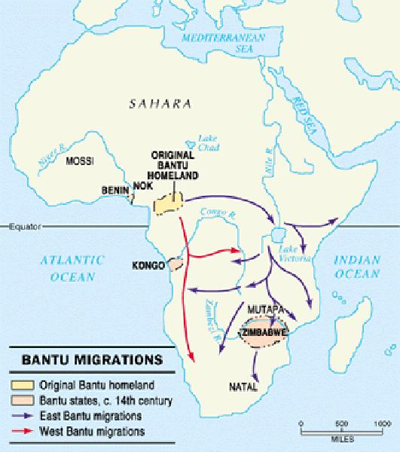
Spread of agriculture
Bantu Migration: Over millennia, the Bantu-speaking people of Nigeria migrated into Central and Southern Africa
Displaced, absorbed, or killed hunter-gatherers
Similar process for Austronesian people as they migrated into SE Asia
The hunter-gatherers had…
No resistance to animal-borne disease
Less resources

Slide 16
What makes it revolutionary?
Population explosion (6 million to 250 million in 10000 years)
Diminished life expectancy, exposure to animal diseases, susceptible to famine
Large settled communities
New technological innovations
Weaving
Metallurgy
Irrigation
Secondary Products Revolution: Uses for domesticated animals—skin, fur, milk, eggs
As well as for riding and labor (not in Americas)

Slide 17
Agricultural revolution and society

Slide 18
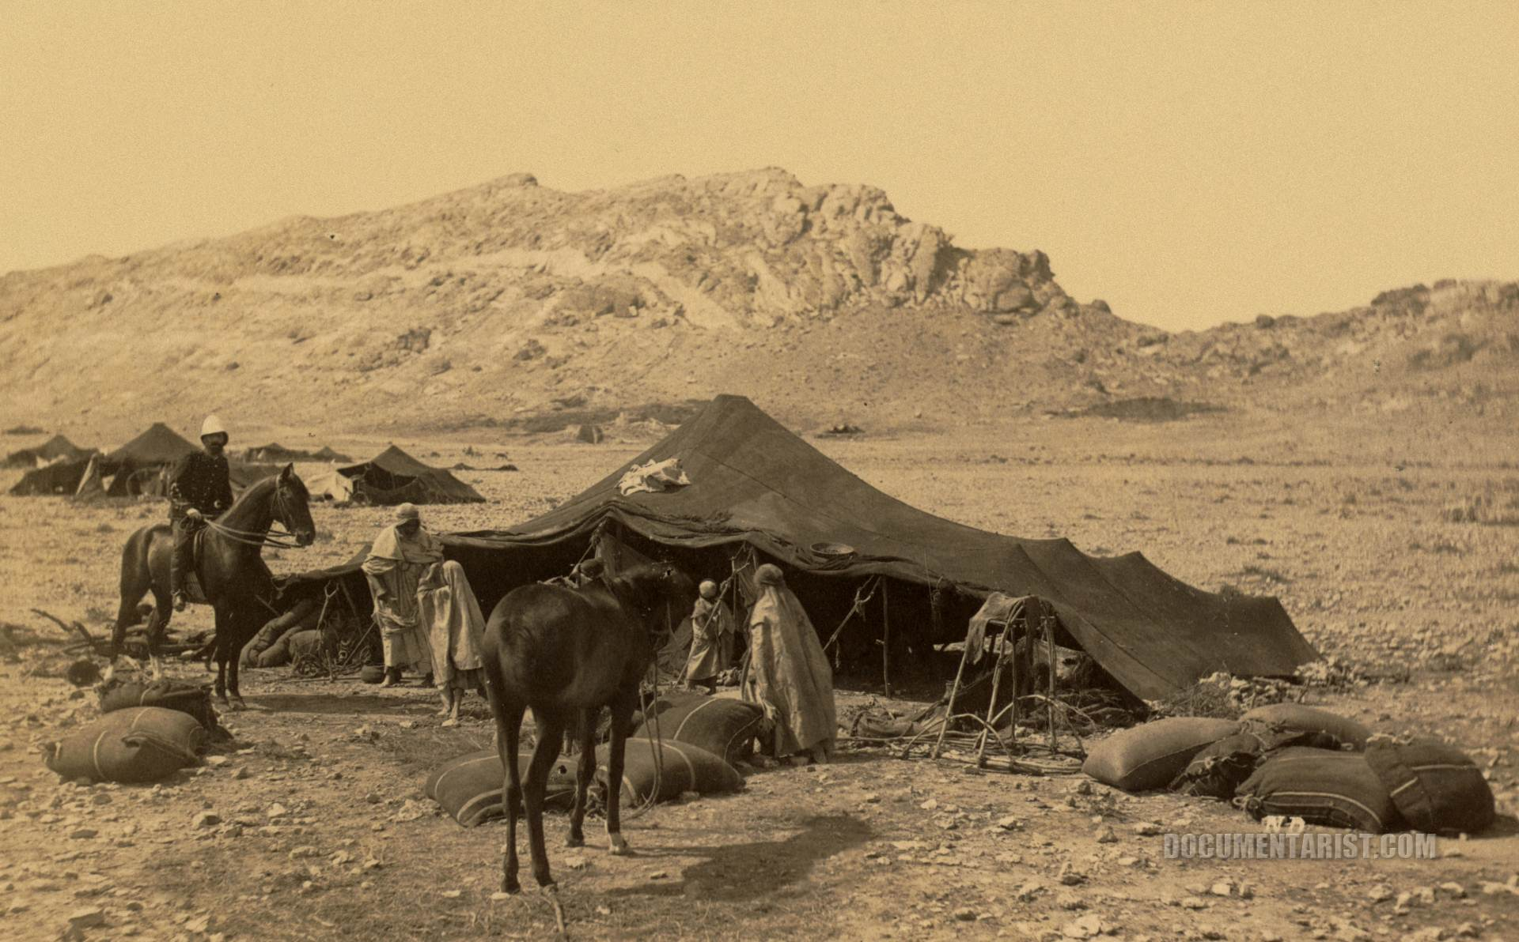
Pastoral Societies
Herders/pastoralists/nomads
Tended to domesticated animals
Known as “animal husbandry”
Tended to be in areas where agriculture was difficult
Steppes of Central Asia
Sahara
Arabian Peninsula
Parts of Africa
NOT in the Americas!

Slide 19
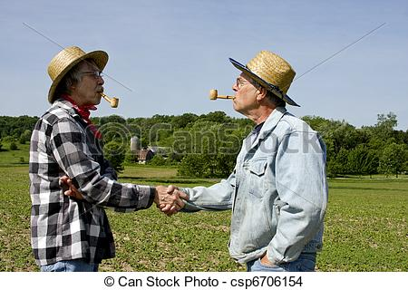
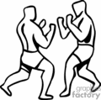
Pastoralists vs. farmers
Often a relationship of conflict
Attraction to wealth and resources of agrarian societies
Such as their crops—good for grazing!
Also a relationship of mutual exchange—ideas, technologies, products, people, etc.

Slide 20
Agricultural Village societies
We will look into bigger civilizations next week
Agriculture required settlement (be near your crops)
Banpo: Northern China, 45 houses that were home to 500 people, farmed rice, millet, chickens, pigs
Found decorated pots and vases
Catalhuyuk: Southern Turkey, built dirt homes on top of homes, population of several thousand
Cahokia: Missouri circa 1100 C.E., large earthen mounds, chief-based society
Political systems differed: Lineage-based, Chief-based, etc.

Slide 21
CREATE A POSTER
Your poster should advertise to hunter-gatherer groups why they should join your society (Advantages of Agriculture)
Choose an actual region of the world where agr. developed
You should also provide a few disclaimers/warnings about why joining the society may not be advantageous to them
Explain # of people, types of crops, customs/laws, political organization, gender/class equality, etc.
Include at least one illustration of your society (village layout, crops, etc.) Use the book sources and printed sources for help! (pg. 64, 66, 77)

Slide 22
The Agricultural Revolution!
https://www.youtube.com/watch?v=Yocja_N5s1I

