Slide 1
The Reformation in Europe

Slide 2
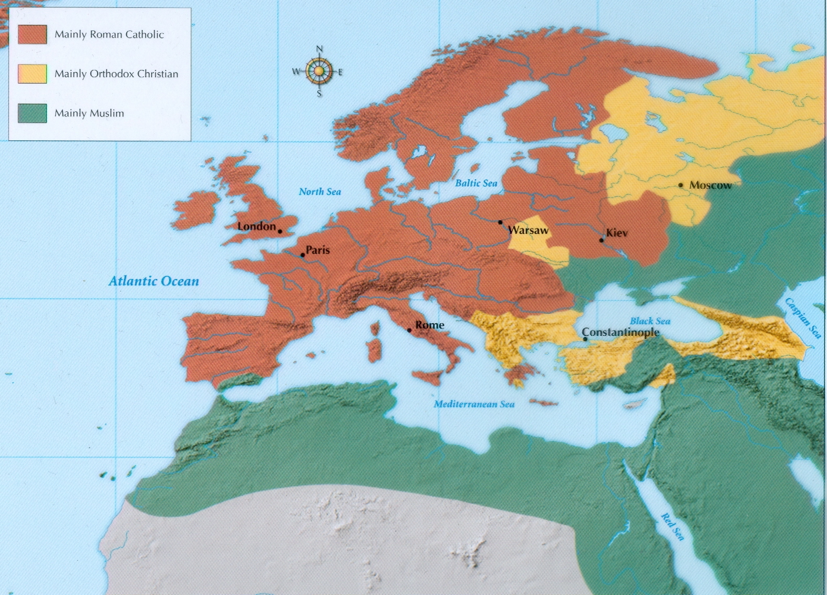
Europe in the 16th Century
Divided between Catholic Church (West) and Eastern Orthodox (East)—both against Islam
Catholic Church wielded lot of power and influence

Slide 3
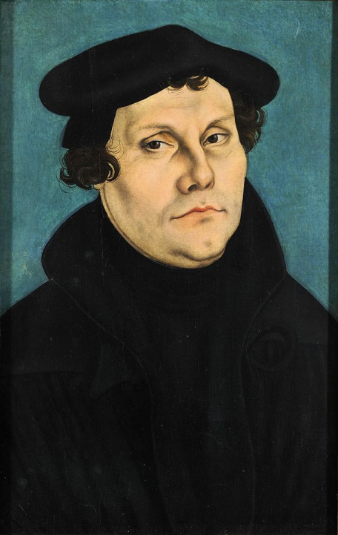
Martin Luther (Not King)
Catholic friar who began the Reformation
Saw problems in the Catholic Church—wrote his ‘95 Theses’ in 1517 outlining his objections
Nailed one copy on church door
Others translated it into German, distributed via the printing press
Luther objected to the selling of indulgences (people would pay the church to have their sins forgiven)
“As soon as the coin in the coffer rings, The soul from purgatory springs.”

Slide 4
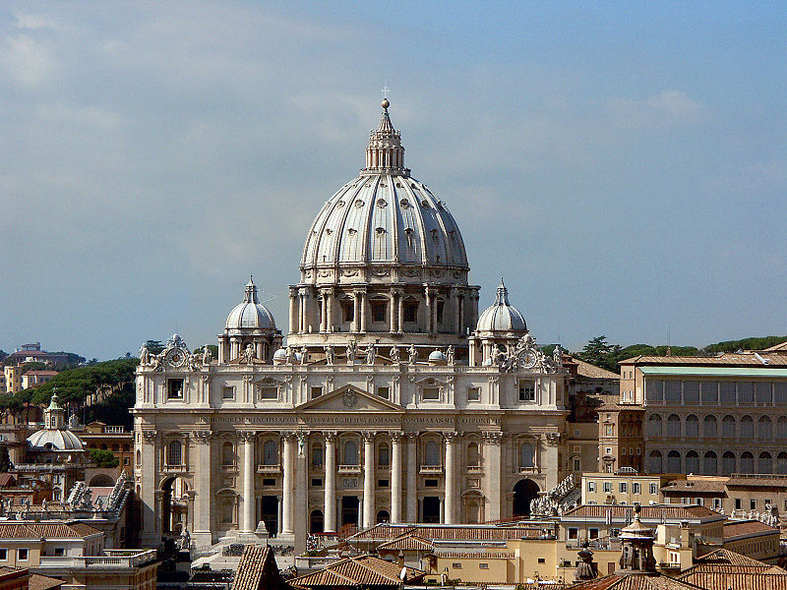
ST. PETER’S BASILICA (Vatican City)

Slide 5
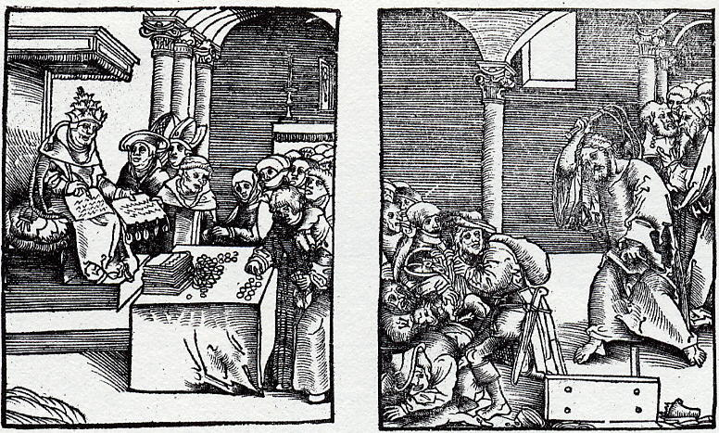
Pope as Antichrist
True Christ
“Why does not the pope, whose wealth today is greater than the wealth of the richest Crassus, build the basilica of St. Peter with his own money rather than with the money of poor believers?”

Slide 6
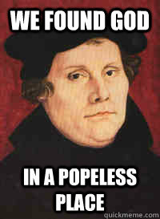
95 Theses
Main beliefs of Martin Luther
The Bible [NOT the Catholic Church or Pope] is the central religious authority
Translated the Bible from Latin to common languages like German
Believed that humans may reach salvation through “faith alone,” not by their deeds
Didn’t need to pay indulgences

Slide 7
Martin Luther Reading

Slide 8
Card Sort

Slide 9
Diet of Worms [pronounced Vurmz]
Luther’s questioning of the Catholic Church did not go unnoticed (or unpunished)
Luther was excommunicated by Pope Leo X in 1521
The Holy Roman Emperor Charles V called upon Luther to appear at Worms to defend himself against charges of heresy
Luther refused to recant (take back) his writings
Luther was declared an outlaw, though he never faced punishment or execution—protected by followers and powerful princes

Slide 10
Martin Luther Rap
https://www.youtube.com/watch?v=L4piapxaT0k

Slide 11
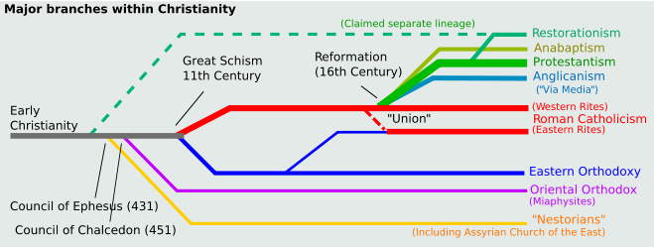
THE VARIOUS IMPACTS OF PROTESTANTISM

Slide 12
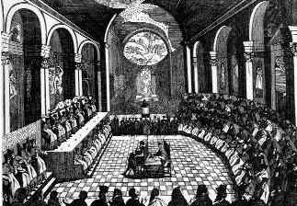
Counter-REFORMATION
Council of Trent: A series of assemblies by the Catholic Church in the mid-1500’s to strengthen and clarify church teachings
Addressed some Protestant complaints but maintained church doctrine
End corruption, indulgences
Better educated priests

Slide 13
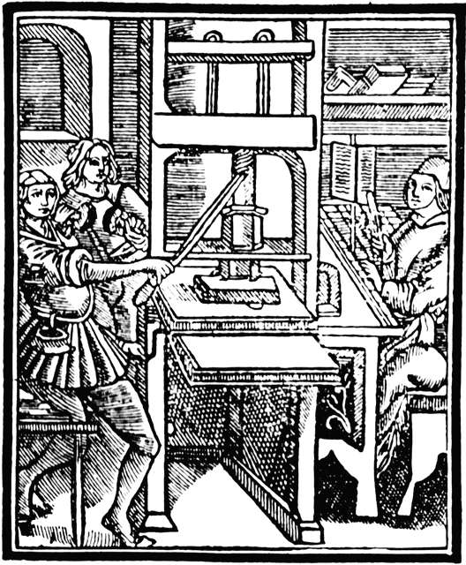
Spread of Protestantism
Even after Luther’s death, the new Protestant religion began to spread outside of Germany and create new denominations
The Catholic Church would never again dominate Europe as it had
Spread due to the Printing Press, invented by Johannes Gutenberg in the 1460’s
Quick dissemination of ideas

Slide 14
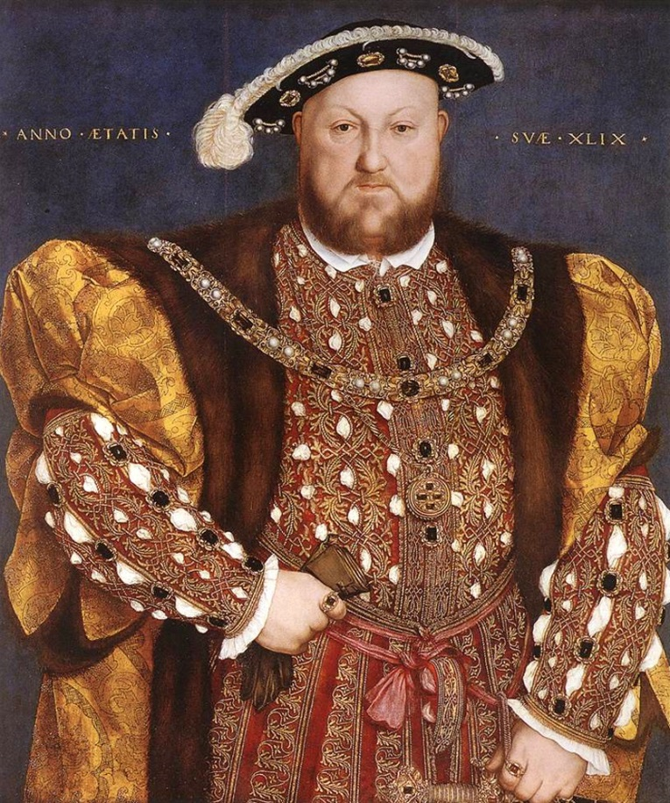
Protestantism in England
The end of Catholic power occurred in England under King Henry VIII
Henry married Catherine of Aragon (Spain), but wanted to divorce her when she couldn’t produce a son
Divorce had to be approved by the Pope

Slide 15
Protestantism in England
The Pope refused to permit a divorce and excommunicated Henry when he married Anne Boleyn
In response, the Church of England (Anglican Church) was created, all land and treasures were confiscated from the Catholic Church in England
https://www.youtube.com/watch?v=Pb4j29AbQXQ

Slide 16
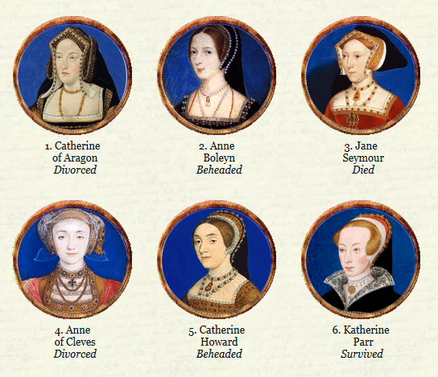

Slide 17
The Tudors and religion
https://www.youtube.com/watch?v=3m6iSe_xsPM
Britain switched between Catholic and Protestant rulers after Henry VIII
Some “heretics” (people of the other religion) were burned at the stake, had land confiscated
In 1688, William and Mary of Orange became the monarchs, make Britain Protestant (as it remains today)

Slide 18
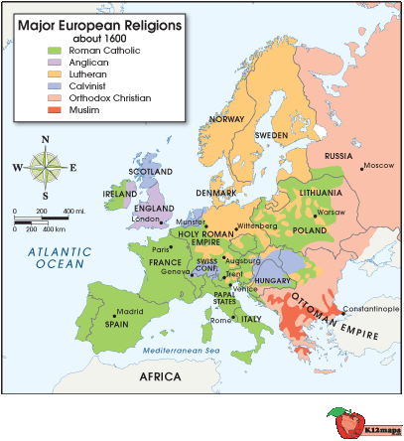

Slide 19
Religious Disputes
French society was torn by violence between Catholics and the Protestant minority known as Huguenots
Catholic mobs in France massacred thousands of Huguenots
Finally, Henry IV of France issued the *Edict of Nantes* (1598) granting a measure of religious toleration to French Protestants

Slide 20
Impact of the reformation: The Thirty Years’ War
Write summaries (3-5 sentences, NO QUOTING but you can paraphrase) for each of the 4 paragraphs
Finally, write a paragraph about what the Thirty Years’ War tells us about Europe at this time.

