Slide 1
Chapter 14 Quiz!

Slide 2
Qing (Manchu) Dynasty
Shang, Zhou, Qin, Han
Sui, Tang, Song
Yuan, Ming, Qing, Republic
Mao Zedong

Slide 3
What came before?
Yuan (Mongols)—Adapted some Chinese culture, implemented own policies
Ming (Han Chinese)—Reclaimed China for the Chinese, fixed problems of Yuan dynasty, exploration and trade with Zheng He

Slide 4
Qing (Manchu Dynasty), 1644-1911
Begins in Manchuria in Northern China
Manchus are a nomadic people, similar to Mongols
Steadily expanded into Ming territory, which had been weakened by internal conflict and natural disasters

Slide 5
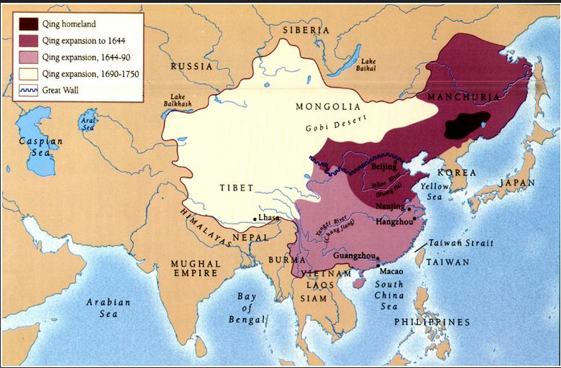

Slide 6
Qing Dynasty
Manchus served as emperors
Former Ming officials, generals, bureaucrats, etc. remained in power to serve the Qing Dynasty
Recognized by former Yuan Dynasty as legitimate
Adopted Chinese culture and political system but preserved own military and customs
Expanded China’s borders to more modern-day size

Slide 7
Qing Visual Sources
What can we learn about the Qing Dynasty and its emperors from visual sources?

Slide 8
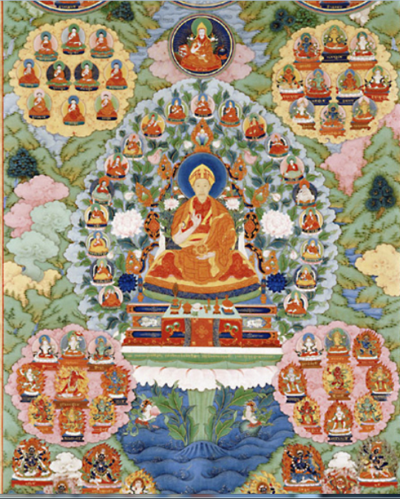

Slide 9
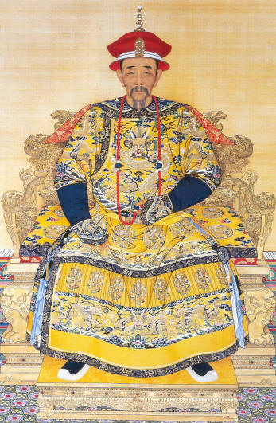
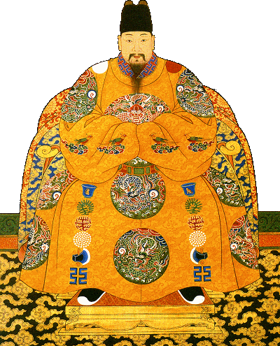
Ming Emperor Zhu Yuyuan
Qing Emperor Kangxi

Slide 10
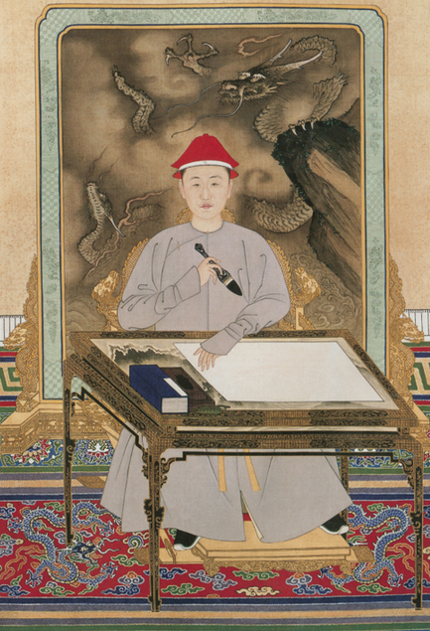

Slide 11
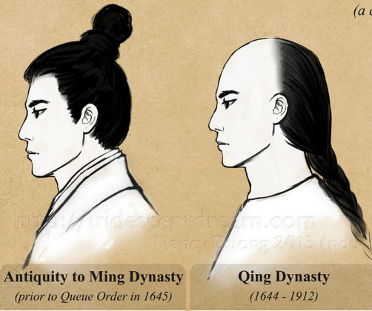
"To keep the hair, you lose the head; to keep your head, you cut the hair."

Slide 12
Emperor Kangxi Self-Portrait
Document 14.1

Slide 13
Yangzhou Massacre

