Slide 1
The Worlds of the 15th Century
AP World History Notes
Chapter 13

Slide 2
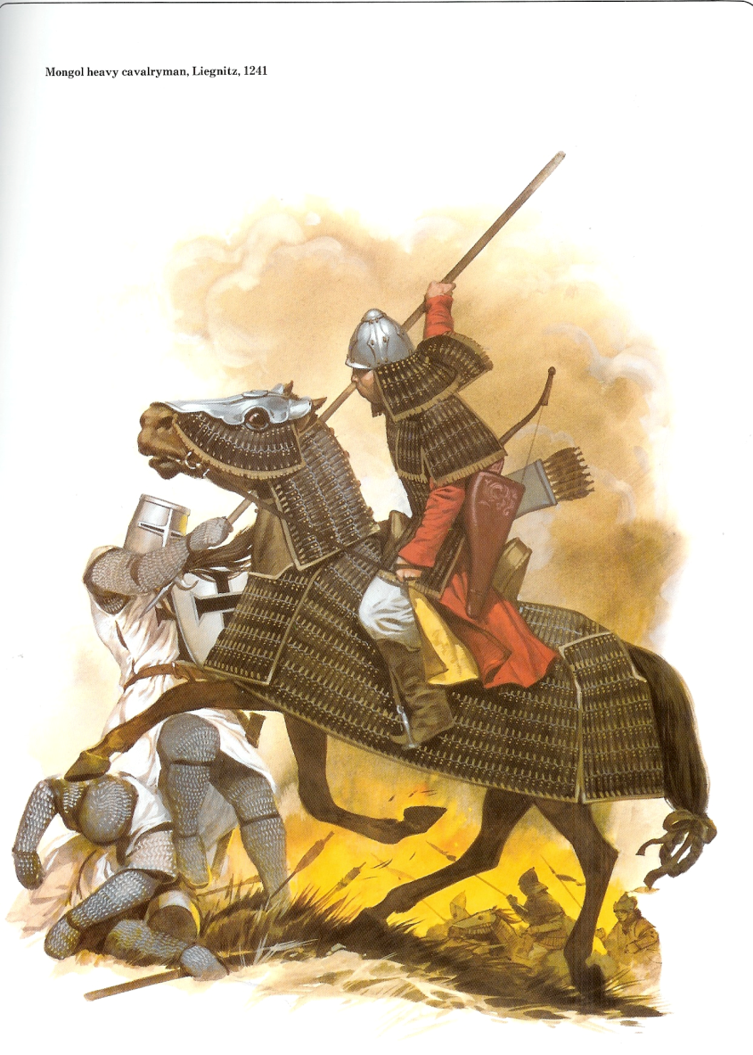
Herding Peoples
Nomadic pastoral peoples
Had more direct and dramatic contact with larger civilizations than agricultural village societies or hunter-gatherers
Where? → Central Asia/the steppe, parts of Africa
Arguably the most significant = the Mongols

Slide 3
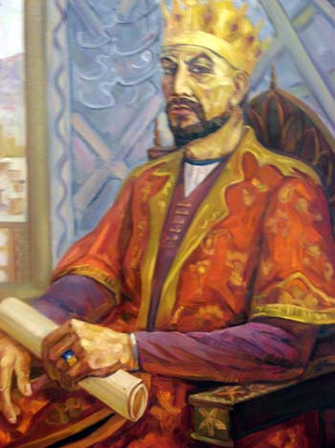
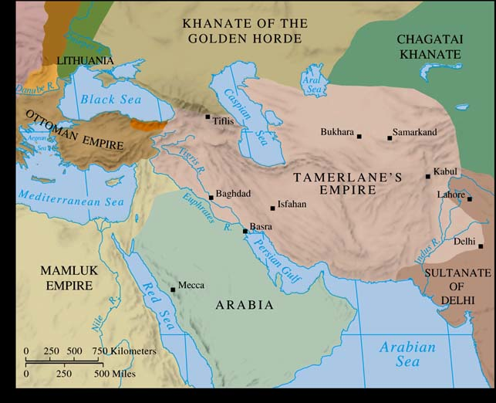
Timur
Turkic warrior who tried to restore the Mongol Empire in the late 14th & early 15th centuries
Devastation once again to Russia, Persia, and India
Died (in 1405) while preparing an invasion of China
Empire didn’t last → conflict among his successors
Last great military success of Central Asian nomads

Slide 4
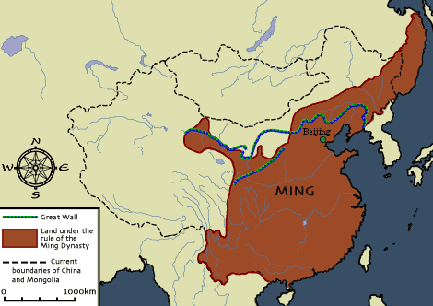
Ming China (1368-1644)
Rebuilt strong central government
Reinstated civil service examinations and made them even harder
Increase in food and trade production
Increase in population

Slide 5
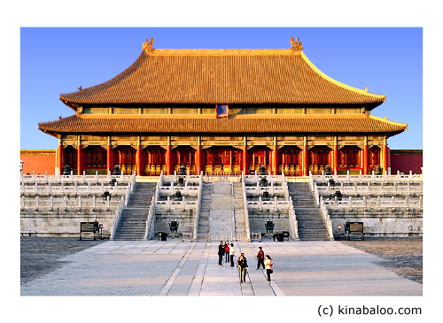
Ming China
Capital = Beijing
Emperor Yongle built Forbidden City = magnificent imperial residence
Also built Temple of Heaven = where rulers performed Confucianrituals to ensure the well-being of Chinese society

Slide 6
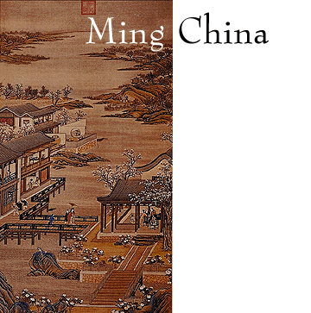
Ming China
Focus on repairing the damage caused by Mongol rule
Restored millions of acres of cultivation
Rebuilt: canals, reservoirs, and irrigation systems
Planted millions of trees to reforest China

Slide 7
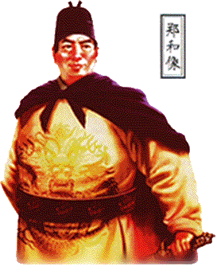
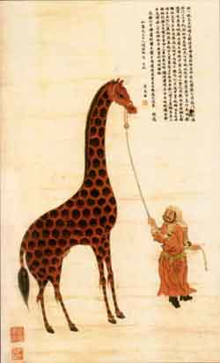
Chinese Exploration
China undertook large and impressive maritime expeditions
Largest = launched in 1405 and led by Zheng He
300 ships; 27,000 crew members; variety of different people on board
He made 7 voyages between 1405 and 1433

Slide 8
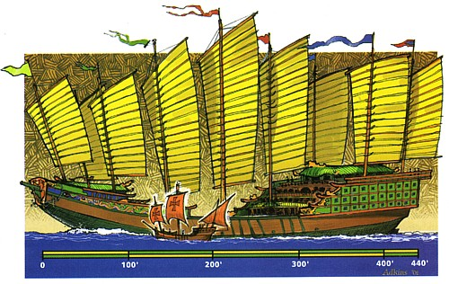

Slide 9
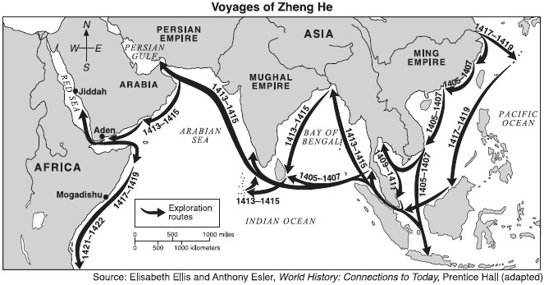
Voyages of Zheng He

Slide 10
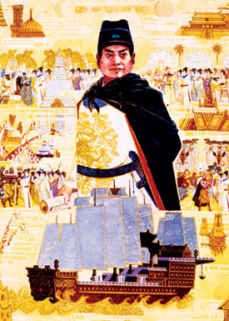
Chinese Exploration
Goals of Chinese exploration:
Enroll distant peoples and states in the Chinese tribute system
Bring back exotic goods from foreign lands (ex: zebras, giraffes, etc.)
Establish Chinese power and prestige in the Indian Ocean
Exert Chinese control over foreign trade

Slide 11
Chinese Exploration
Abrupt and deliberate end to Chinese exploration in 1433
WHY?
Death of Emperor Yongle = chief supporter
Many officials saw expeditions as a waste of money and resources
Believed focus should be on real threat: nomads to the north
Thought people should come to Chinese…not other way around!

