Slide 1
Chapter 23 Quiz
Have your reading notes and a pen/pencil on your desk

Slide 2
Chapter 23 Quiz
1. What was satyagraha? (Don’t write ‘truth force’)
2. How did the cultural revolutions in Turkey and Iran differ with respect to the role of Islam in society?
3. What obstacles impeded the economic development of 3rd-world countries?

Slide 3
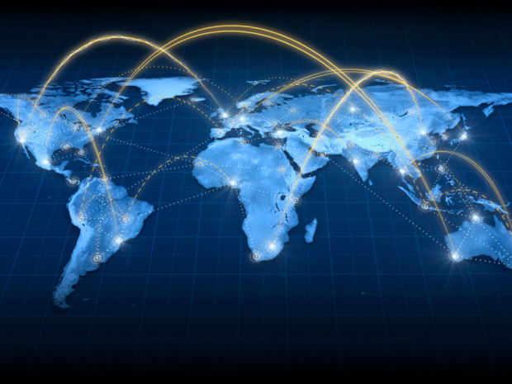
Accelerating Global Interaction Since 1945

Slide 4
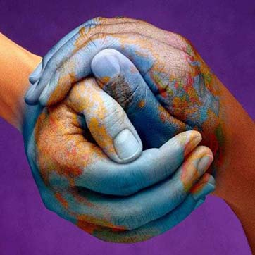
Benefits of Globalization Globalization: The integration of economies, societies, and cultures around the world

Slide 5
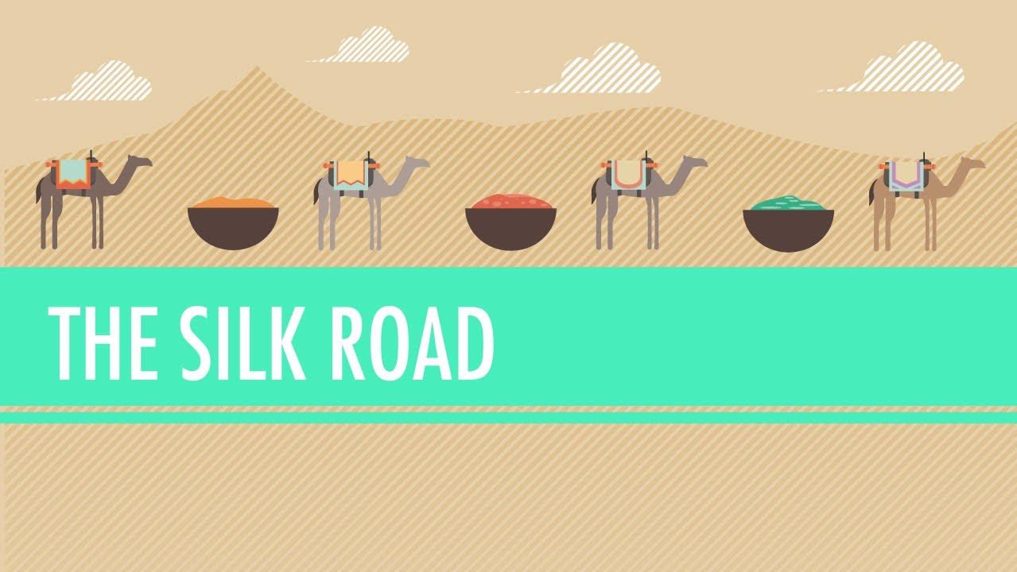
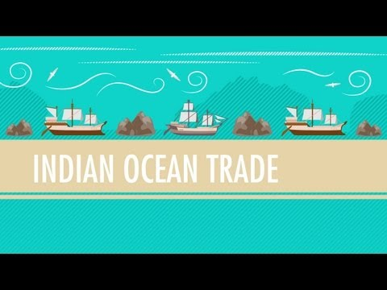
Is cultural exchange and integration a new phenomenon in world history?
NO

Slide 6
Shift Happens
https://www.youtube.com/watch?v=emx92kBKads
Simulating 1 second of human brain activity takes 82,944 computer processors August 5, 2013

Slide 7
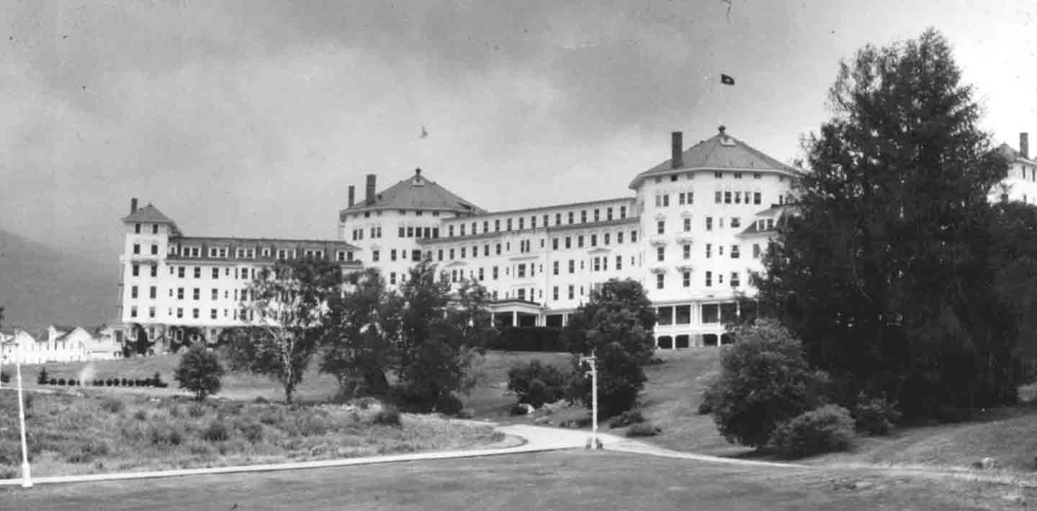
Why did Globalization happen after WWII?
“The Bretton Woods System”
Established financial institutions that would support U.S.-style capitalism worldwide
International Monetary Fund (IMF)
World Bank
World Trade Organization (WTO)
monetary controls/regulations/standards

Slide 8
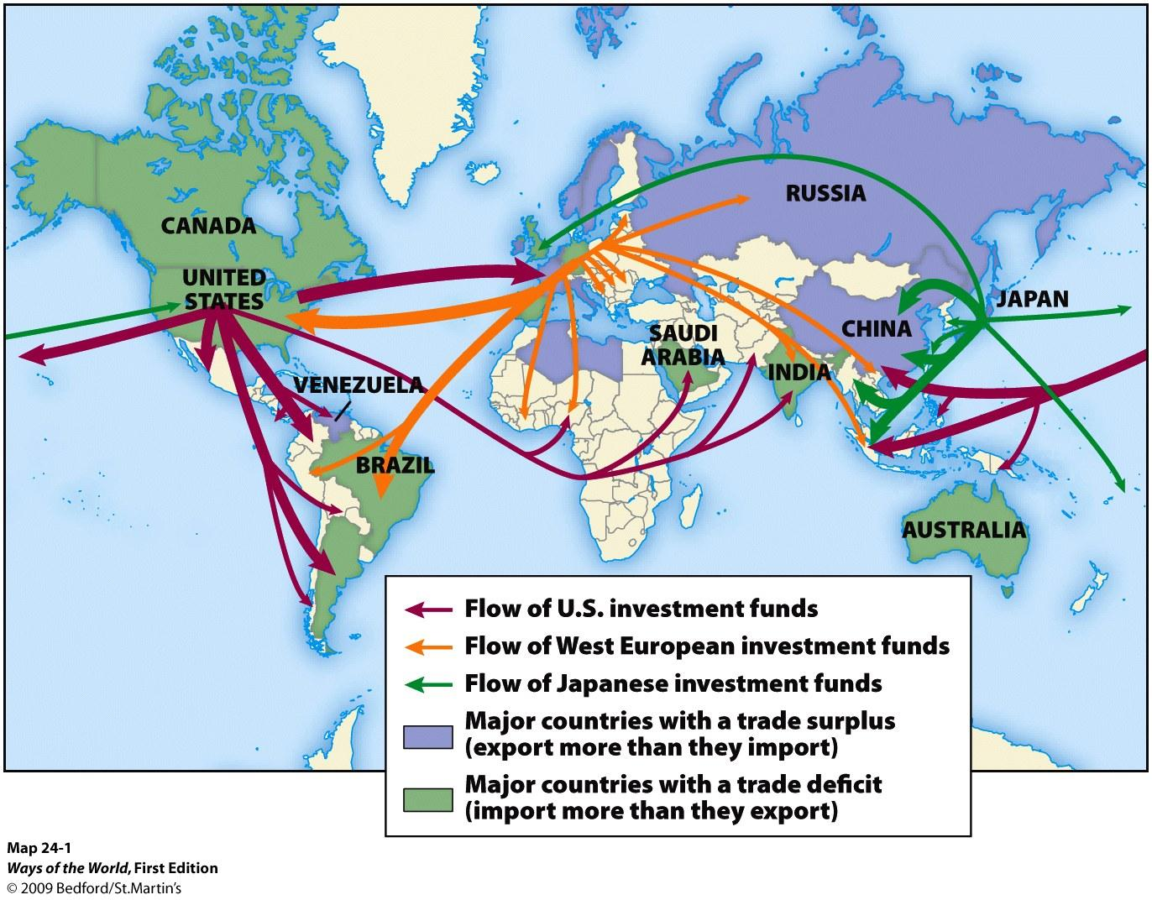

Slide 9
Causes of Global Integration
Economic liberalism
Free trade, privatization, deregulations
Policies imposed on 3rd world countries in exchange for Western loans
Furthered by breakdown of Communism
Technological innovation
Communications (telephone, television, internet)
Mass production (cheap, quality consumer goods)
Transportation (faster, bigger, cheaper)

Slide 10
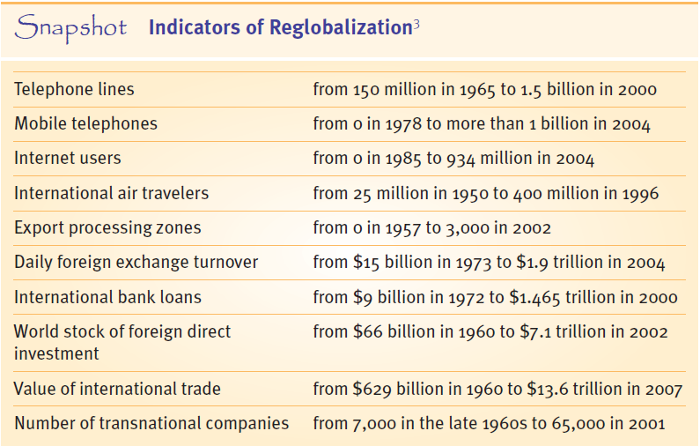
How do these metrics demonstrate accelerating global interaction?

Slide 11
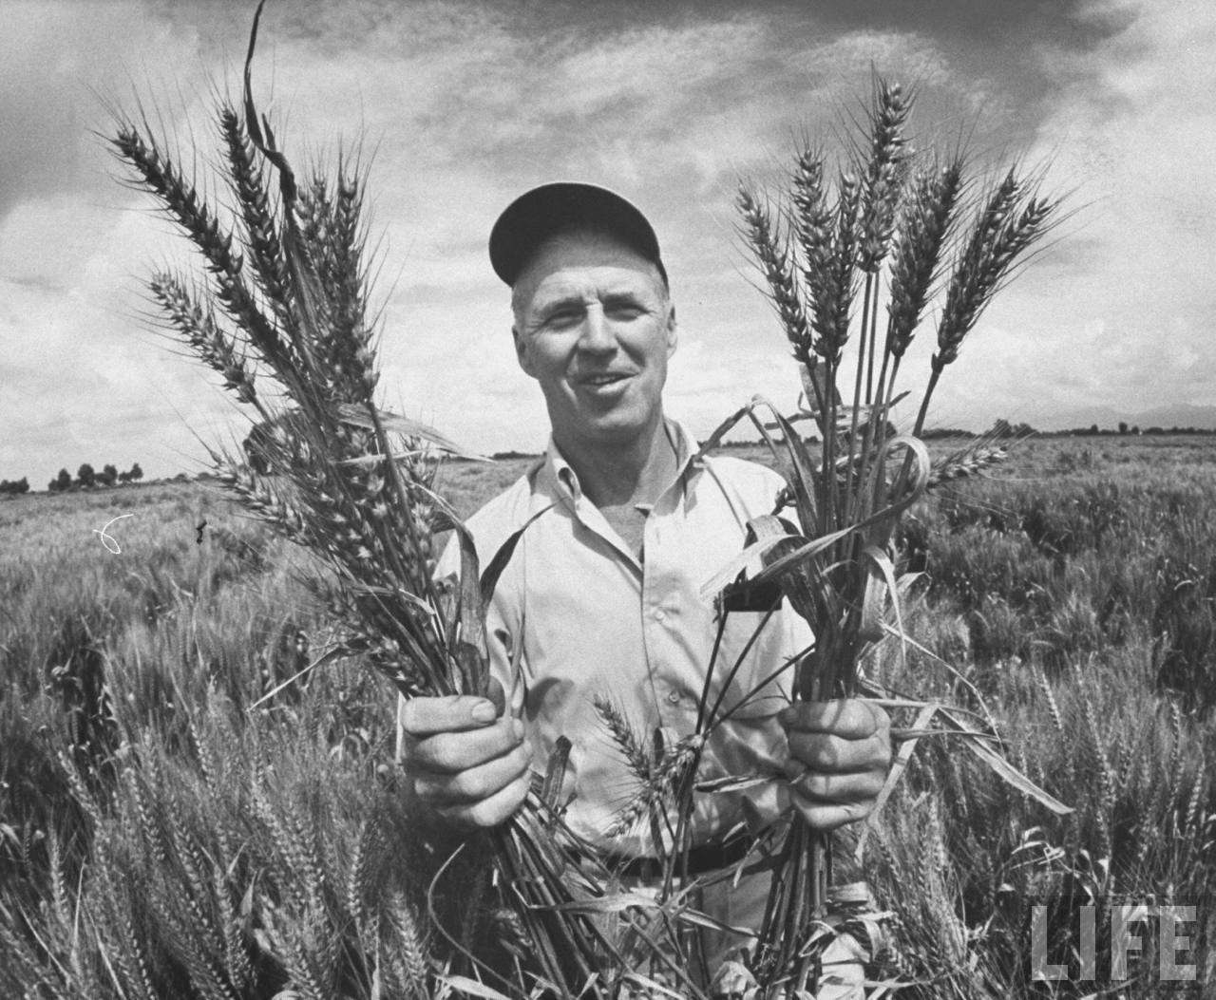
Globalization Case Study —Norman Borlaug
What are some benefits and drawbacks to globalization?

Slide 12
CC Globalization 1
https://www.youtube.com/watch?v=5SnR-e0S6Ic&list=PLBDA2E52FB1EF80C9&index=41

Slide 13
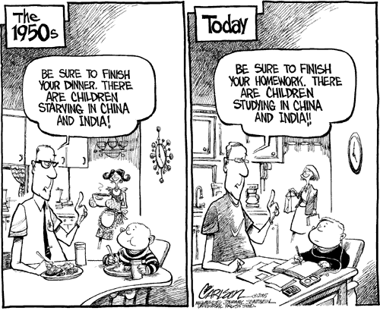
Downsides to Globalization

Slide 14
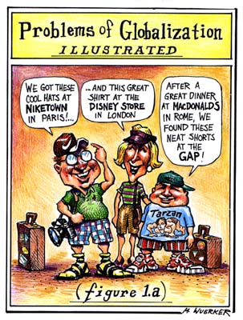
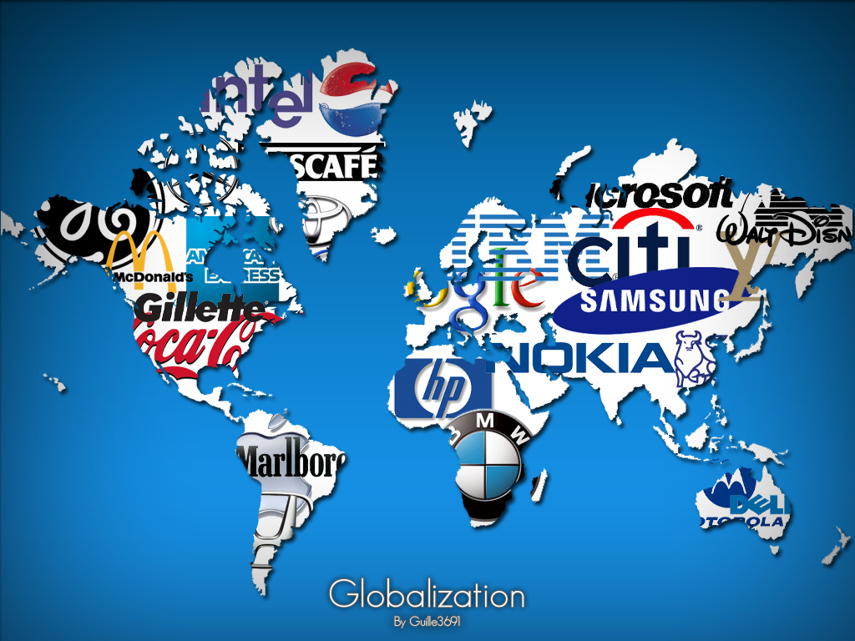
Consequences of Economic Integration on the World:
Globalization of culture
food/media/music
U.S./Japan/European culture spread globally

Slide 15
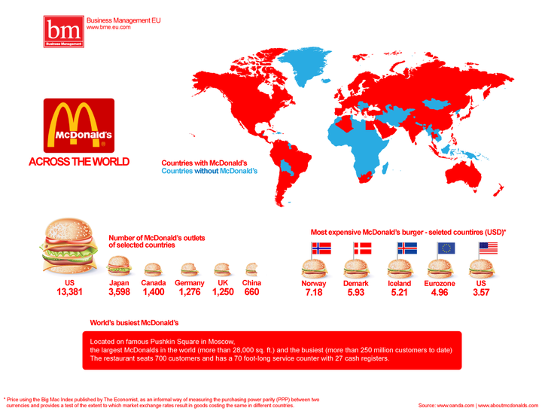

Slide 16
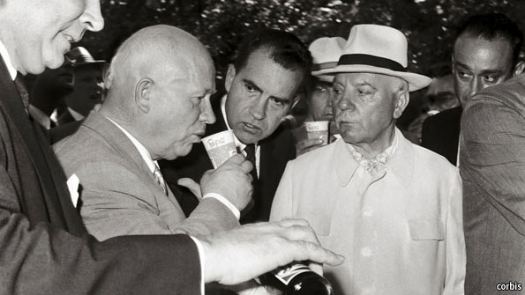
Pepsi and the Soviet Union
LA Times, April 10th, 1990
What are some benefits and drawbacks to globalization?

Slide 17
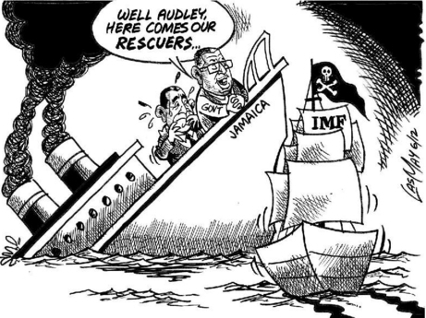
Consequences of Bretton-Woods
The IMF forced borrowing countries to privatize businesses, deregulate markets and slash social spending.
Resulted in enormous social and political strife in places.
In developing countries, IMF programs hurt economic growth and redistributed incomes to create large wealth gap.

Slide 18
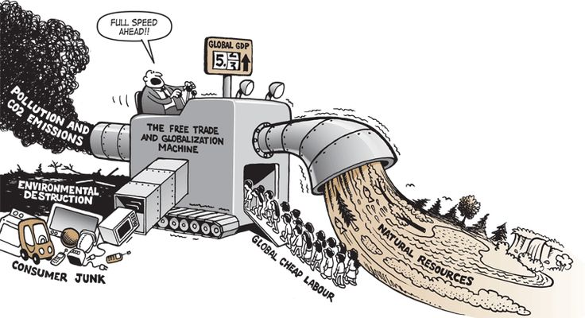
Consequences of Integration
Environmental damage
fisheries, forests, global warming, loss of species
Climate change resulting from increased industrialization

Slide 19
Ag and Climate
https://www.youtube.com/watch?v=3F8e8s39sCs

Slide 20
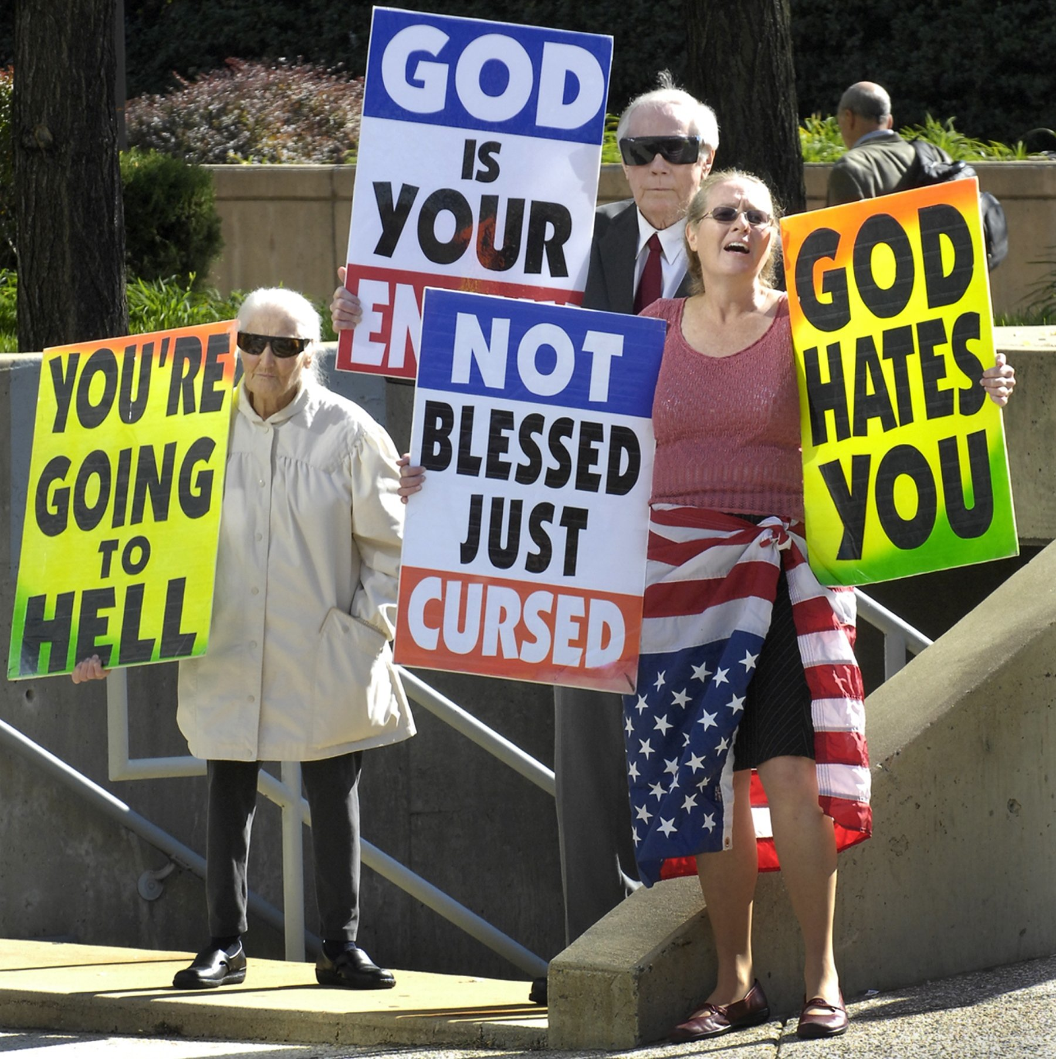
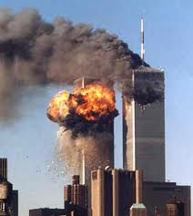
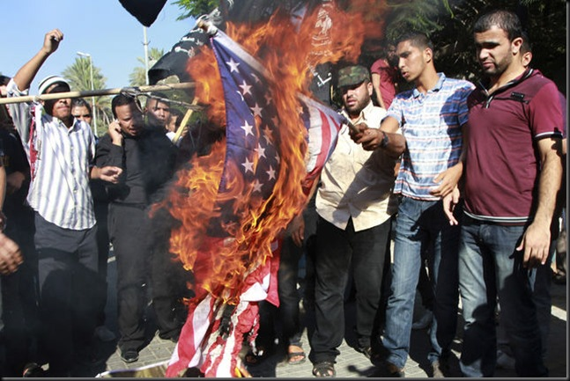
Consequences of Integration
Transformation/replacement of older cultural forms, values and systems
challenges to tribalism
challenges to religion
expansion of Western science
frugality replaced by consumerism
radical responses to change

Slide 21
CC Globalization 2
https://www.youtube.com/watch?v=s_iwrt7D5OA&list=PLBDA2E52FB1EF80C9&index=42

