Slide 1
The Seven Years’ War and The American Revolution

Slide 2
The Seven Years’ War (1754-1763)
Argued to be the first “World War”
Involved most great European powers
Fought in Europe, North America, India, South America, and Africa because of all of the colonies in play
Known in America as the “French and Indian War”
The war begins between Britain and France over disputed territory in North America
France, its colonists, and its Native American allies
Vs.
Britain, its colonists, and its Native American allies

Slide 3
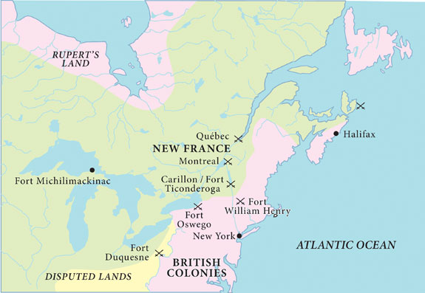

Slide 4
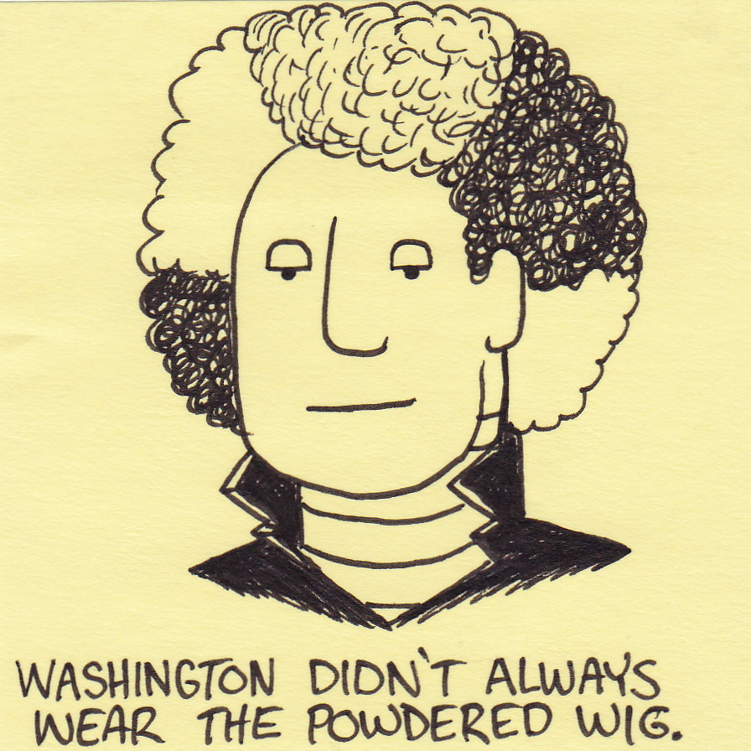
George Washington Starts the War (by accident)

Slide 5
Impact of the Seven Years’ War
France loses its foothold in North America
Britain gains all French territory east of the Mississippi River (including Canada)
Native American allies didn’t get anything out of the treaty…
Britain needed to start taxing its North American colonists more, since it just spent a boatload of money defending them…
And we all know how that’s going to go over!

Slide 6
Crash course
https://www.youtube.com/watch?v=j0qbzNHmfW0

Slide 7
Chapter 17 Quiz
You can use your chapter notes

Slide 8
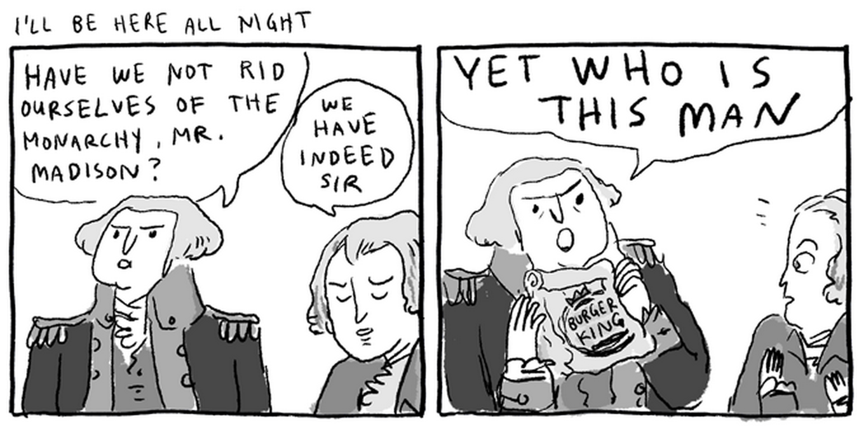
Was the American Revolution truly Revolutionary?

Slide 9
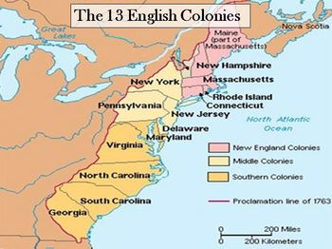

Slide 10
Life in the North American Colonies
Before 7 Years’ War, relative freedom from British Crown
Policy of “Salutary Neglect”—Britain busy dealing with wars and more profitable colonies
Many advantages to being tied to Britain
Kept some self-autonomy and self-governance
Access to British markets and goods
Little social tension in the colonies
All free men treated equally before law
No aristocracy, landed gentry, established religion
Still, there were class, gender, and racial differences…
So why have a revolution???

Slide 11
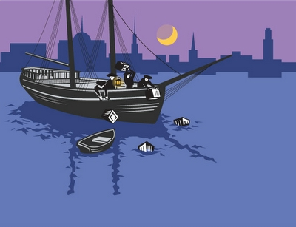
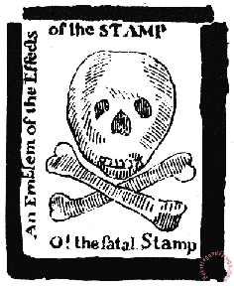
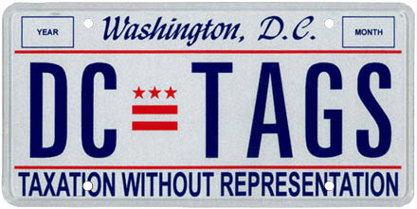

Slide 12
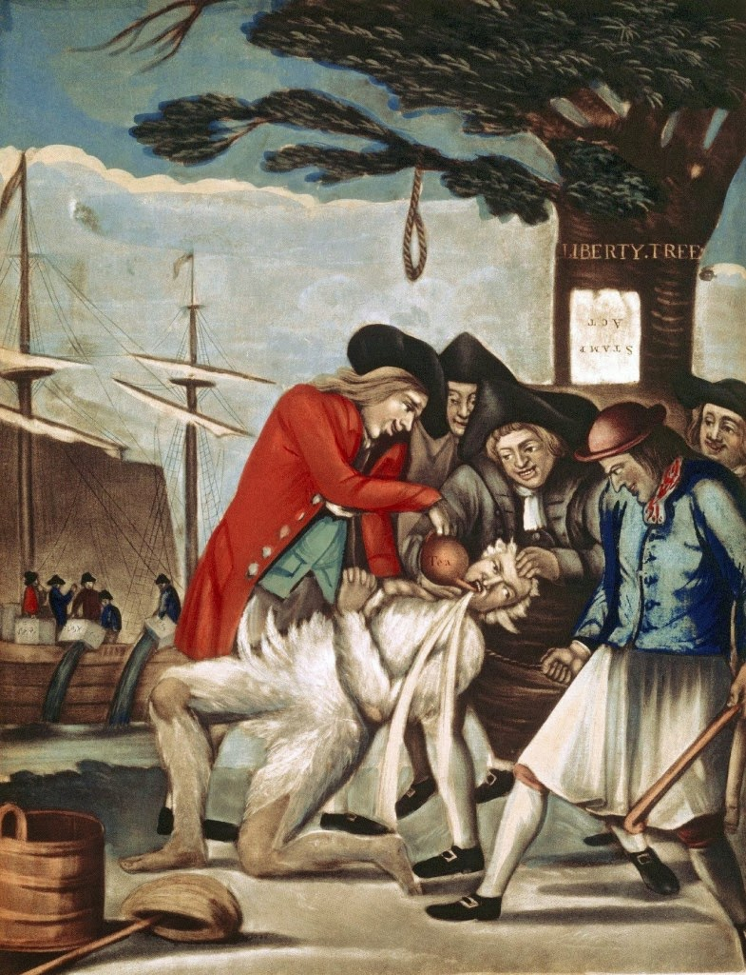
Economic Tensions with Britain
The Seven Years’ War will drain Britain’s finances.
Britain swiftly changes from salutary neglect to a domineering and money-hungry imperial power
Imposes numerous taxes and tariffs, limits trade with foreign nations
Stamps, Tea, Paper, Molasses, Sugar, Paint, Glass, you name it, they tax it

Slide 13
The Boston Tea Party
The Tea Act of 1773 granted the East India Company exclusive license to import and distribute tea to the American colonies.
Their tea was sold for half the price of tea previously, and for less than the cost of smuggled tea.
However, the law damaged the position of independent shippers, smugglers and local shopkeepers.
In December 1773, the Sons of Liberty dumped 342 chests of tea (valued today ~$1,000,000) into the Boston Harbor.

Slide 14
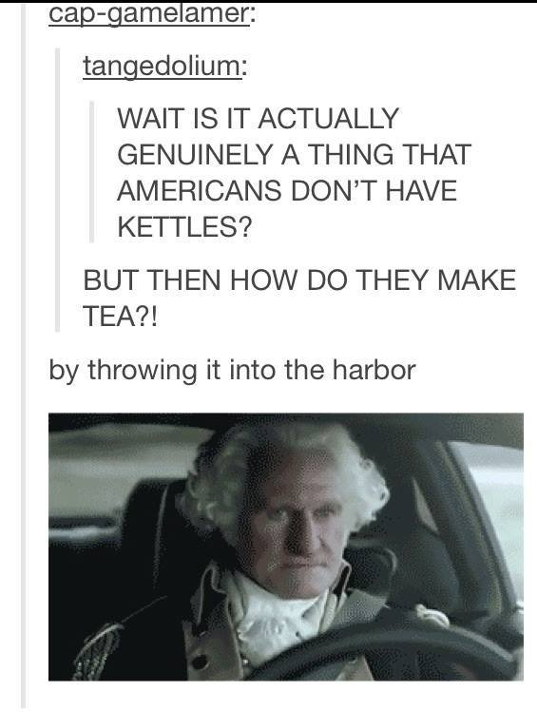

Slide 15
Should the British have raised taxes on the American colonies?
Use the reading to answer this question

Slide 16
the revolution
https://www.youtube.com/watch?v=Y6ikO6LMxF4

Slide 17
After the revolution

Slide 18
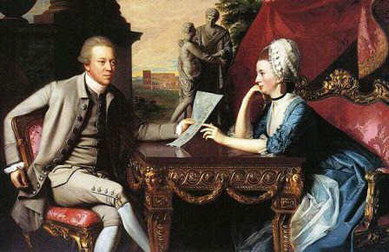
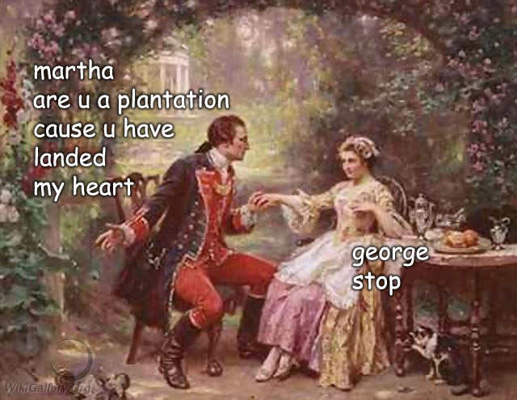
American Revolution: Change or Continuity?
America transitions from a patriarchal society dominated by rich, land-holding white men to…
A patriarchal society dominated by rich, land-holding white men.
With some more political power for middle-class white men!

Slide 19
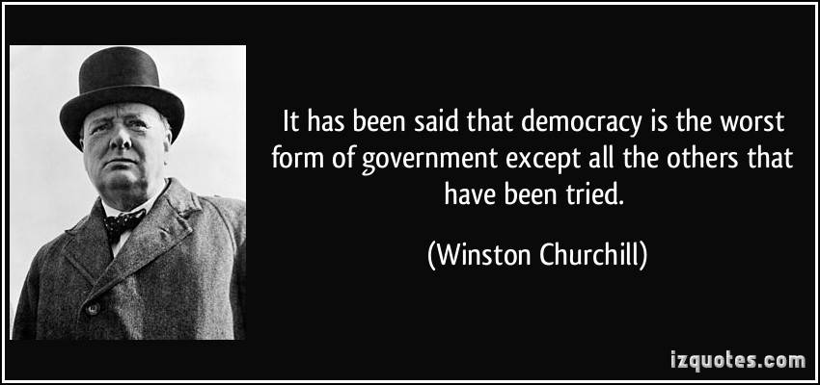
American Revolution: Change or Continuity?
The idea that ALL of the leaders of the country should be chosen by the people? THAT’S revolutionary.
“Government of the people, by the people, for the people”
Ideas of democracy, equality, freedom, that come out of the Enlightenment are tested on a grand scale

Slide 20
How Revolutionary was the Revolution?
Use the following two readings to identify…
Changes
Socially
Politically
Continuities
Socially
Politically

Slide 21
Crash Course
https://www.youtube.com/watch?v=HlUiSBXQHCw

Slide 22
