Slide 1
The Vikings
Raid. Trade. Repeat.

Slide 2
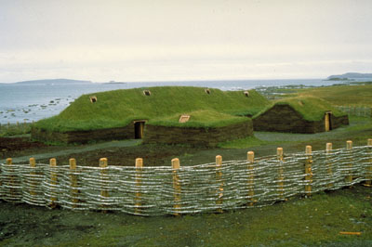
Vikings
From Northern Europe
Seafaring and trading people
Constructed large, ocean-ready vessels
Encountered and traded with people throughout Europe
Made it as far as Newfoundland, Canada and Baghdad, Iraq
Spread Scandinavian culture, brought back the culture of places they visited

Slide 3
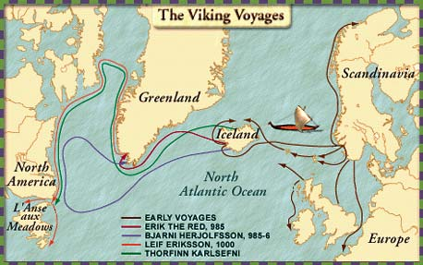

Slide 4
Vikings
Also famed for their brutality
Attacked and destroyed villages
Enslaved men and women
Raped and pillaged
Arab account of Viking funeral rituals
Viking Quest Challenge!

