Slide 1
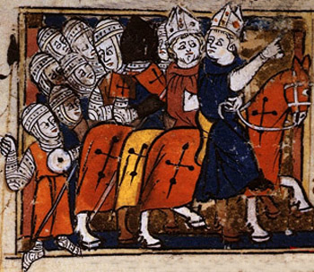
Crusade. Invade. Raid. Trade.

Slide 2
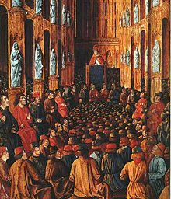
The Crusades
The Crusades = Series of “holy wars” led by European Christians to recapture the holy lands and spread Christianity
Lasted several centuries
Authorized by the Pope
Belief that it was “God’s command”
Pope Urban II calling for the Crusades

Slide 3
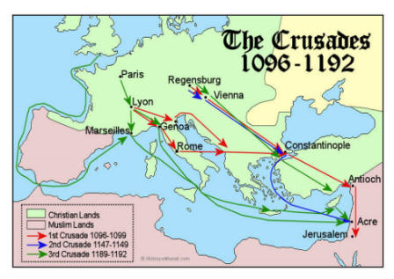
The Crusades

Slide 4
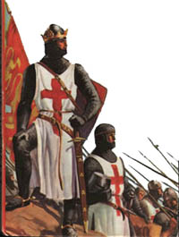
The Crusades
Participants received:
Indulgences = removed any penalties for their confessed sins
Cancellation of debts
Honor and glory
Involved men from all classes
Crusades were attractive to kings: gain favor from the Pope

Slide 5
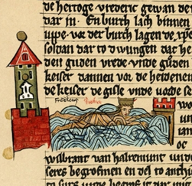
The Crusades
Most famous Crusades: Reclaiming Jerusalem and other holy places in the Middle East from the Muslims
Other targets:
Muslims on the Iberian Peninsula (Spain)
The Byzantine Empire and Russia
Opponents of the Catholic Church (Albigensian Crusade)

Slide 6
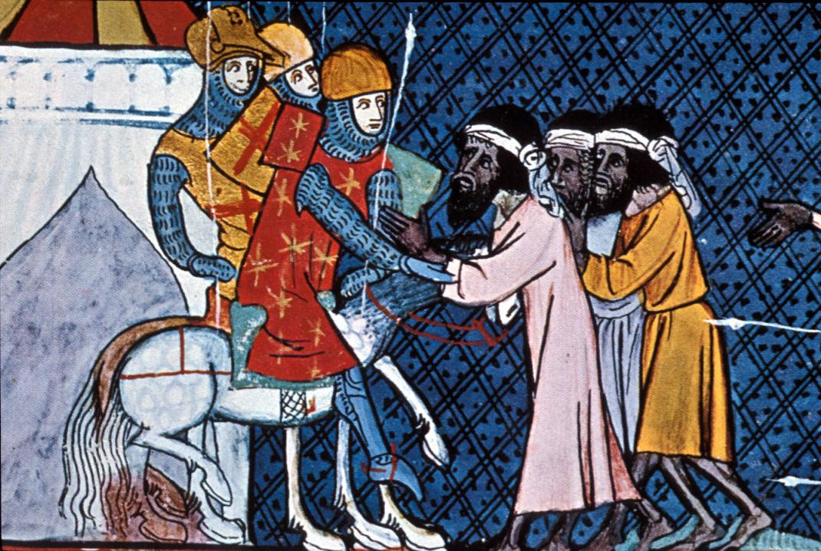
The Crusades: Results
Relatively unsuccessful
Increased power of the popes
Anti-Semitism (Jews)
As a result of contact with the Islamic world, Europeans gained:
A demand for Asian goods
Muslim scholarship
New inventions
Distinct cultural barriers (within and between religions)

Slide 7
Your Task
With a group of 2-4, create an advertisement commanding kings, lords, vassals, and peasants to join the Pope’s crusade against…?
But must be somewhere they ACTUALLY crusaded
How will you incentivize people to join?
How will you convince them the crusade is righteous?
How will you appeal to different classes?

