Slide 1
Turn in your 1 paragraph response up front!

Slide 2
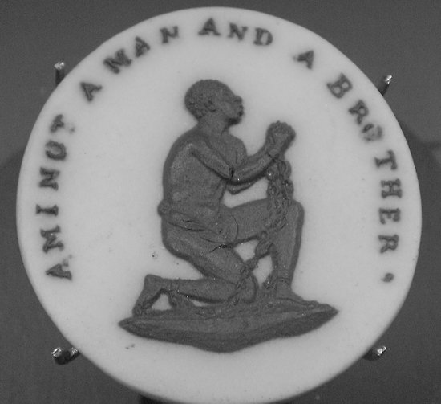
Origins of the Slave Trade

Slide 3
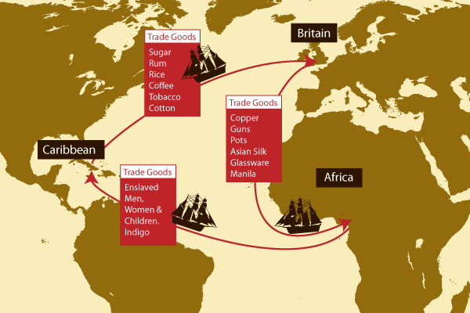
Triangular Trade
Raw Materials
Manufactured Goods

Slide 4
Why Slavery?
Historical slavery (Greece, Rome)
Need for laborers for sugar plantations (and mines and other plantations)
Why was sugar important?
Why was sugar difficult to produce?
Who originally produced the sugar in the new world?
What were the conditions like for African slaves?

Slide 5
Why Africans?
Arab traders had enslaved Africans for centuries—beginning of anti-black racism?
Ottoman Empire cut off access to white slaves in Eastern Europe (Slavs)
Portuguese established contact and trade (of goods and slaves) with Africa
Great Dying
Complicity of some Africans in the slave trade

Slide 6
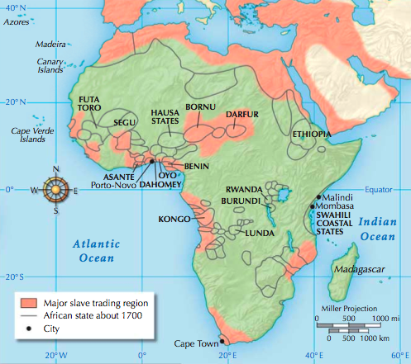

Slide 7
How did the slave trade function?
Trade from Interior to Coast facilitated by Africans
Minimized risk to Europeans (disease exposure)
Enriched particular African kingdoms with European goods: cowrie shells, guns, textiles, etc.
Sold outsiders (people from different tribes, POWs, criminals, debtors, etc.)

Slide 8
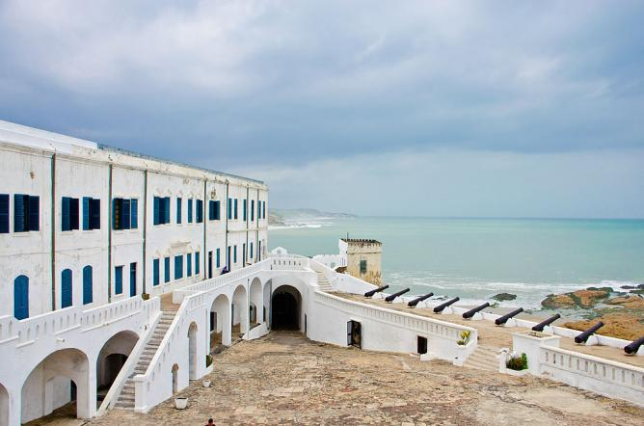
Slave Castles
https://www.youtube.com/watch?v=Ow2rItUTQtY

Slide 9
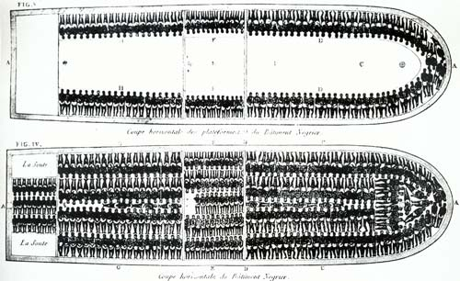
The Middle Passage
Forced transportation of Africans across the Atlantic Ocean
10-15 million enslaved and shipped
Mortality rate was > 10%

Slide 10
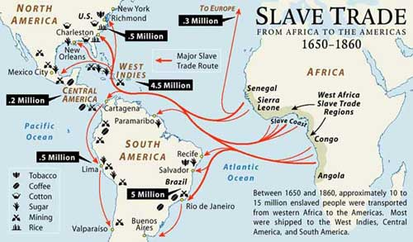

Slide 11
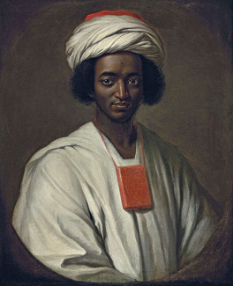
Ayuba Suleiman Diallo
What is unique about Ayuba’s life story?
Ayuba Suleiman Diallo, called Job ben Solomon by William Hoare of Bath, 1733
British National Portrait Gallery

Slide 12
What were the various effects of the slave trade on Africa?
15.3 & 15.4
Take notes on the bullet point questions
Be ready to discuss both sources on Wednesday

Slide 13
Have your textbook and your notes on documents 15.3 & 15.4 on your desk

Slide 14
African Kings and the Slave Trade
What problems does each king face?
How did the slave trade affect the power of the king?
How did the king view the slave trade?
What does the king tell us about the advantages and disadvantages of the slave trade for…
Africans?
Europeans?
What is the relationship between goods and the slave trade?
What is the relationship between war and the slave trade?
What do the kings seek from the Europeans?
USE QUOTES!! (even if you have to abbreviate them)

Slide 15
Group Assignments
Affonso I (Kongo)
Jacob
Sam
Trevor
Emma
Charlotte
Cole
Eileen
Osei Bonsu (Asante)
Lucero
Macklin
Grace
Margot
Amarachi
Ian
Mikaila
Tim

Slide 16
Crash course
https://www.youtube.com/watch?v=dnV_MTFEGIY

