Slide 1
China and the World 500 - 1300
AP World History Notes
Chapter 9

Slide 2
China after the Han Dynasty
Political disunity following the collapse of the Han dynasty
During this time, many Chinese people began to migrate south
Partly a natural migration
Partly due to the nomads from the north creeping in
Result = by 1000 CE, about 60% of China’s population was in southern China
Result = the Chinese destroyed forests and land in southern China as they brought their intensive agriculture with them

Slide 3
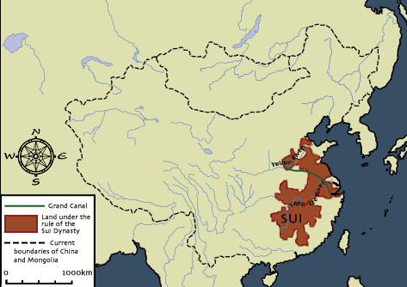
The Reunification of China
China regained its unity under the Sui dynasty (589-618)
Reunified China with the construction of the Grand Canal
Short-lived dynasty
Ruthless emperors = unpopular
Failed attempt to conquer Korea → wasted resources and upset people
Sui dynasty = overthrown

Slide 4
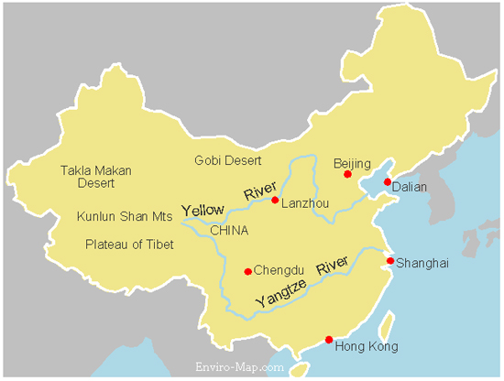

Slide 5
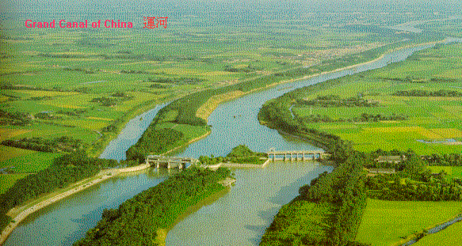
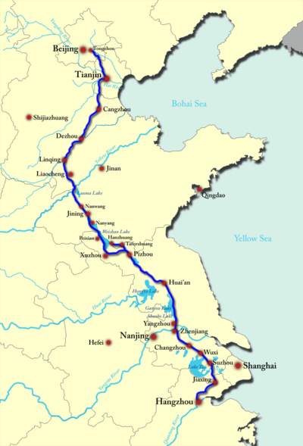
The Grand Canal
Unified the north and south of China
Transported grain to armies in the North

Slide 6
The Golden Age of China
Sui dynasty was followed by: the Tang dynasty (618-907) and the Song dynasty (960-1279)
Both used the same state structure:
Centralized government
6 major departments = personnel, finance, rites, army, justice, and public works
Censorate = agency that watched over the rest of government to make sure everything ran smoothly
Government officials chosen based on a revived Confucian-based examination system

Slide 7
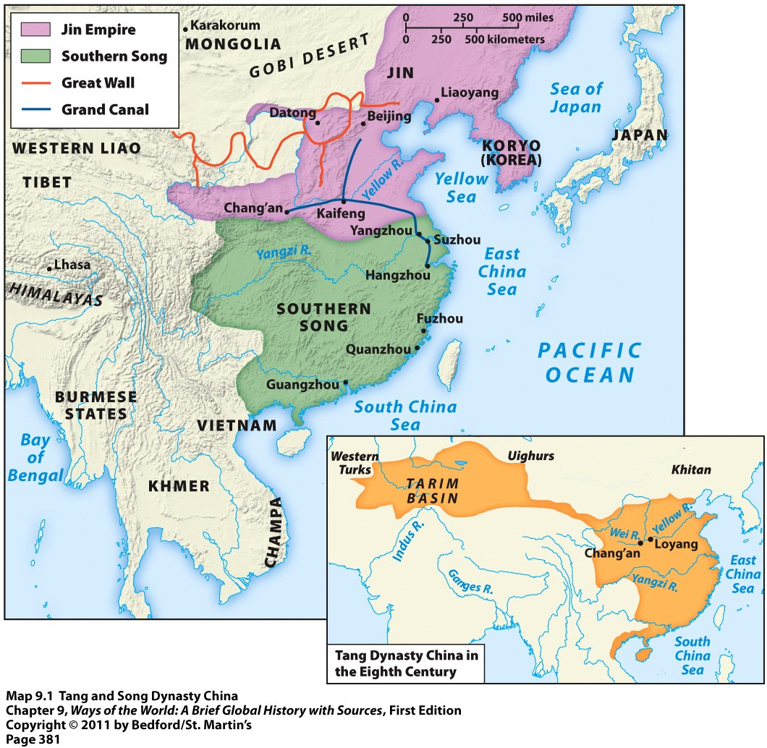
Tang and Song Dynasties

Slide 8
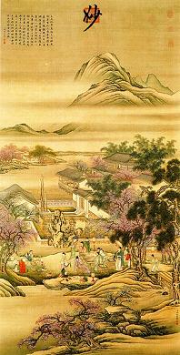
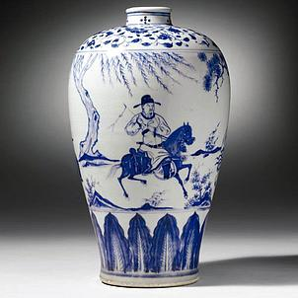
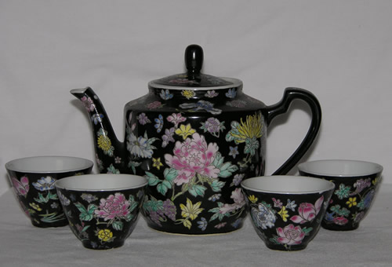
The “Golden Age” of China
Focus on arts and literature
Excellence in poetry, landscape painting, and ceramics
Neo-Confucianism = revival of Confucianism mixed with Buddhist and Daoist elements

Slide 9
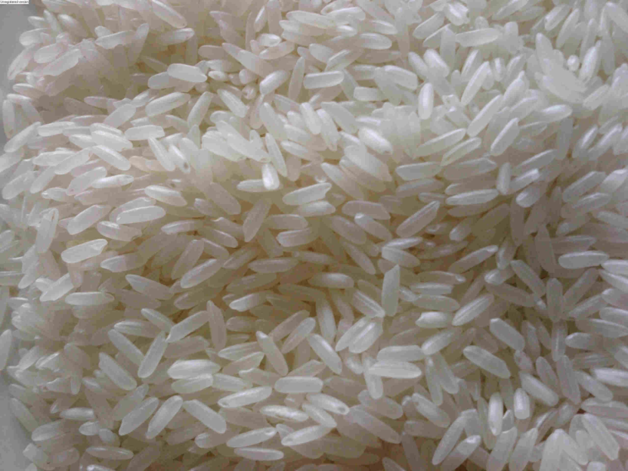
The “Economic Revolution” of China
Advancements in agriculture
Most important = adoption of a better strain of rice from Vietnam
Result = rapid population growth
Jumped from 60 to 120 million people by 1200 CE

Slide 10
The Urbanization of China
Many people began to move to cities
Many Chinese cities had over 100,000 people
Capital of Song dynasty, Hangzhou, had over 1 million people
Modern picture of Hangzhou

Slide 11
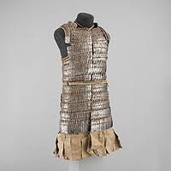
Chinese Industrial Production
Iron industry boomed
Used to make: suits of armor, arrowheads, coins, tools, bells in Buddhist monasteries, etc.

Slide 12
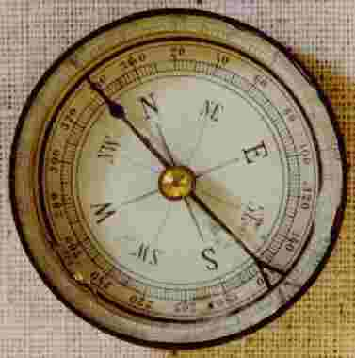
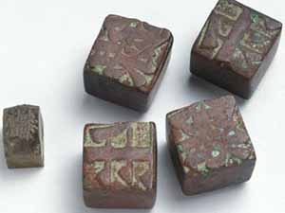
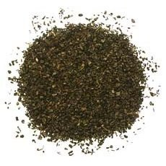
Chinese Innovations
Woodblock and moveable type → led to the first printed books
Paper
Larger ships and magnetic compass
Gunpowder

Slide 13
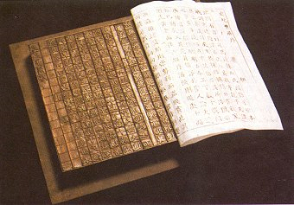
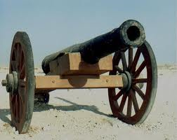
Major Chinese Influences on Eurasia
Two major Chinese innovations that would impact the world for centuries to come:
Printing and books
Gunpowder

Slide 14
Printing and Books
Effects of printing and books in the future:
Mass literacy
Increased education and scholarship
Spread of religion
Exchange of information

Slide 15
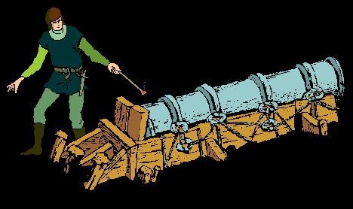
Gunpowder
Effects of gunpowder in the future
Cannons and firearms
“Gunpowder Revolution” = when “gunpowder” empires started and grew as a result of their use of firearms, cannons, and other explosives

Slide 16
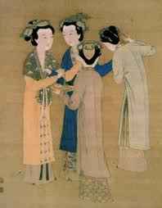
Women in the Song Dynasty
Chinese women HAD been enjoying a looser patriarchal system
With Song dynasty = major revival of Confucianism = belief in female subordination
Patriarchal restrictions began to tighten again

Slide 17
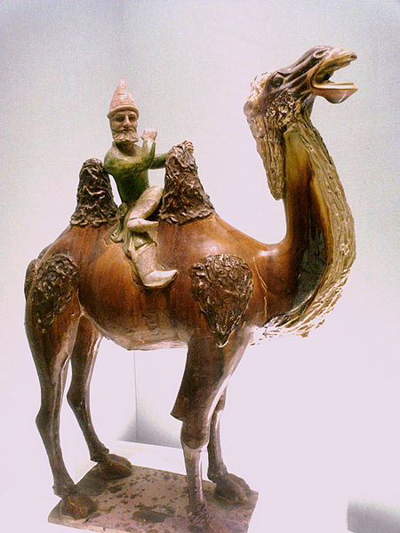
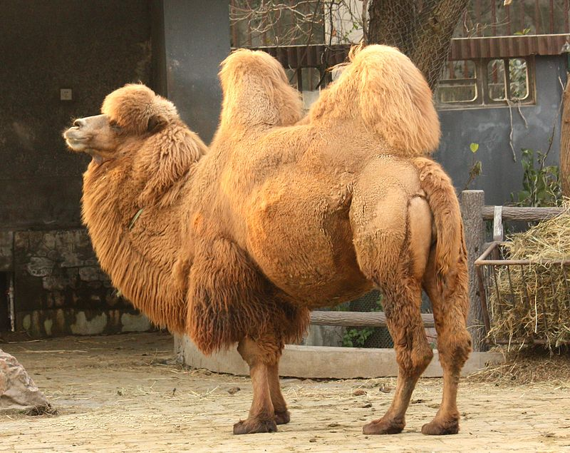
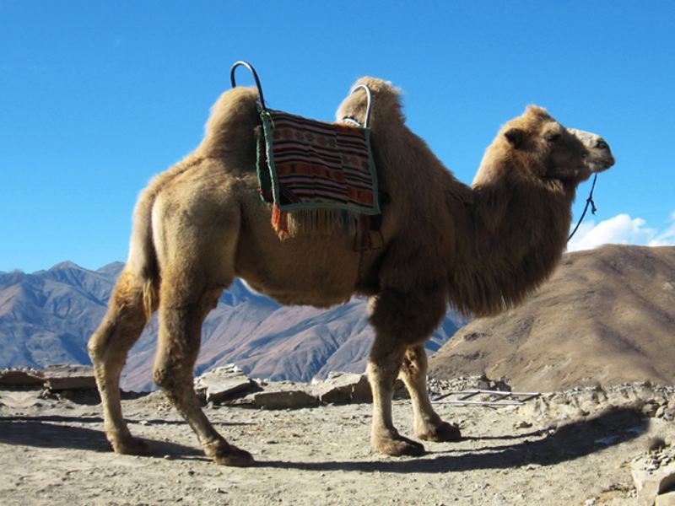
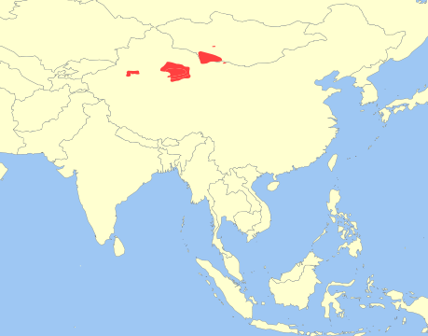
Westerner on a camel, Tang Dynasty
The Bactrian Camel

Slide 18
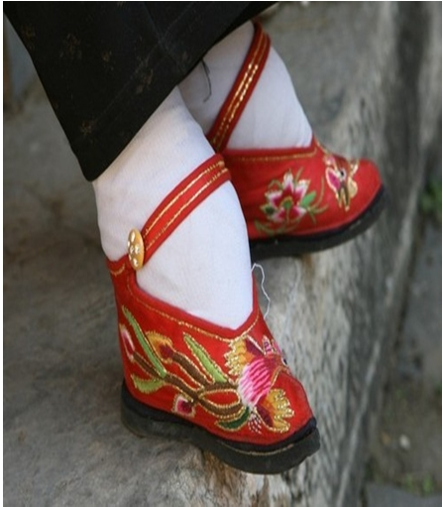
Foot Binding
Began between the ages of 4 and 7
Involved the tight wrapping of young girls’ feet
Broke the bones and caused intense pain
Goal—make feet small and delicate
Sign of female beauty
Kept the women at home
Began with just elite women, but soon became a common practice with all classes

Slide 19
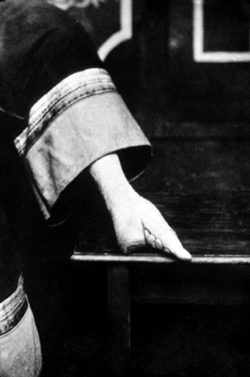
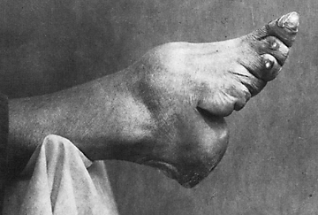
Foot Binding

Slide 20
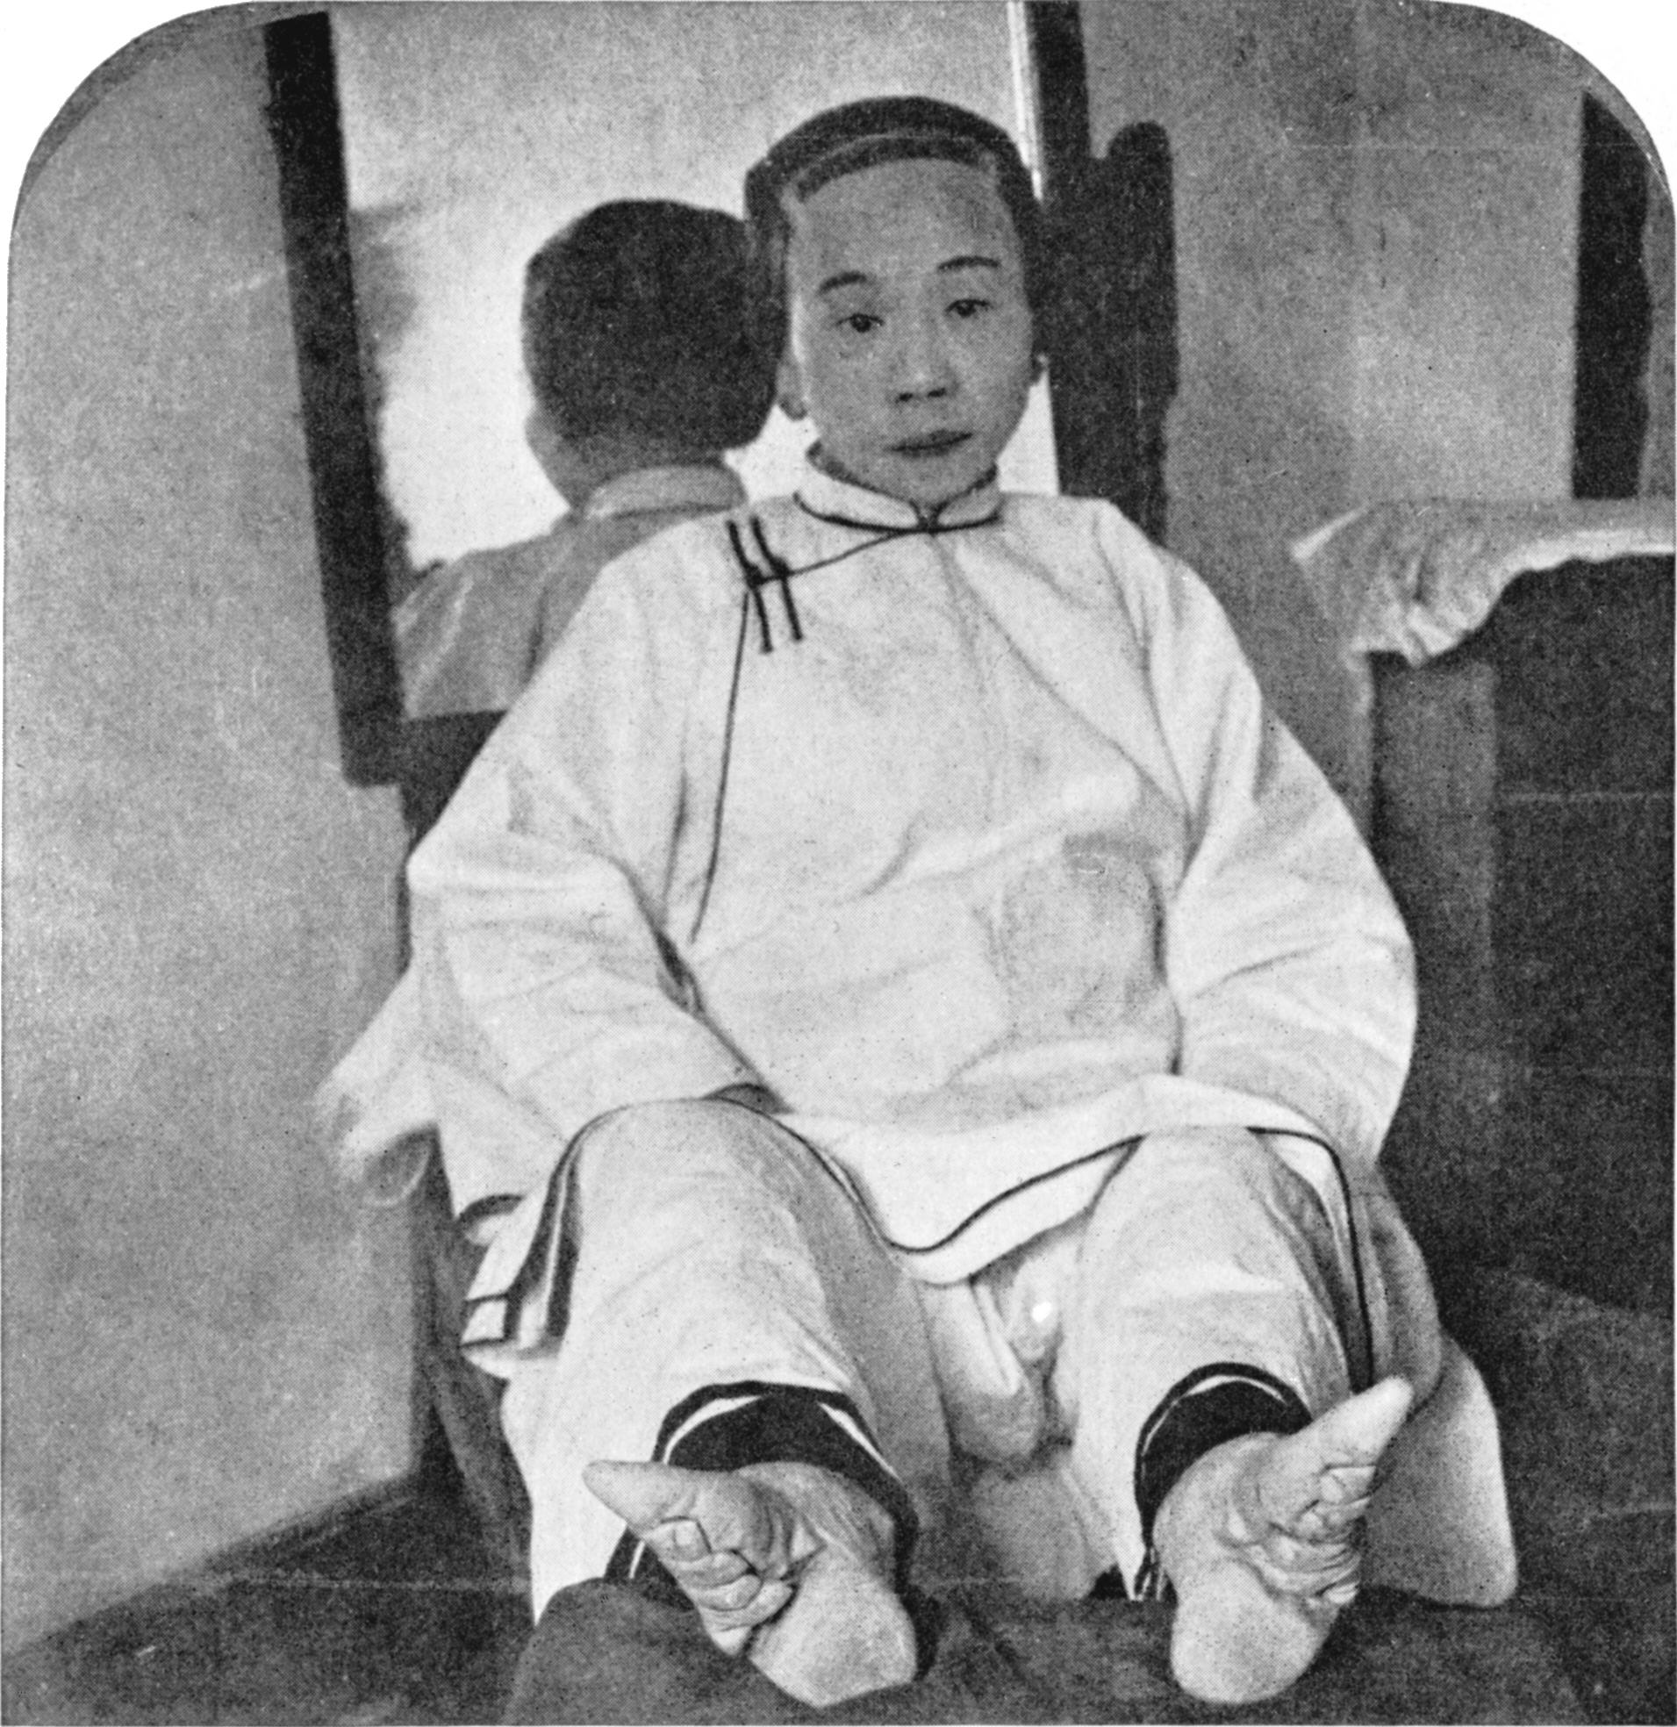
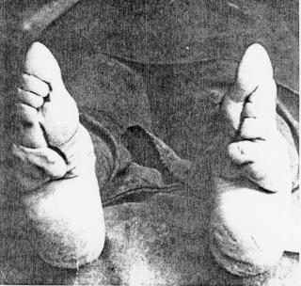
Foot Binding

Slide 21
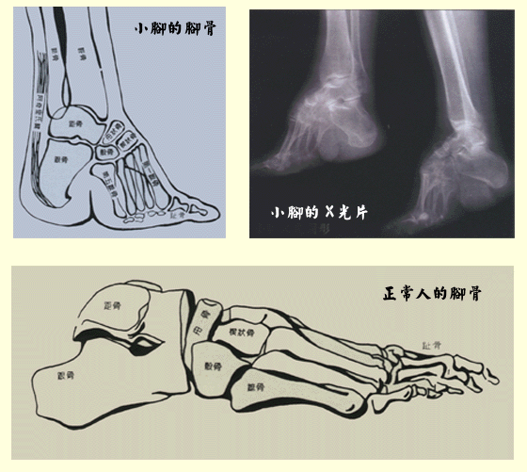
Foot Binding

Slide 22
Foot binding reading

Slide 23
Women and the Economy: Textiles
China’s economy became more commercial
More factories and workshops means less home-made (by women) products
Workshops and factories run by men
Factories now used to produce silk and other textiles
Takes this job away from women

Slide 24
Women and the Economy: Other Jobs
What did women do instead?
Operated restaurants
Sold fish and vegetables
Maids, cooks, dressmakers
Concubines
Courtesans
Entertainers
Prostitutes

Slide 25
Positive Trends for Women
Property rights expanded
Women could inherit family property
Promotion of further education for women
To raise sons effectively
To increase family’s fortune

Slide 26
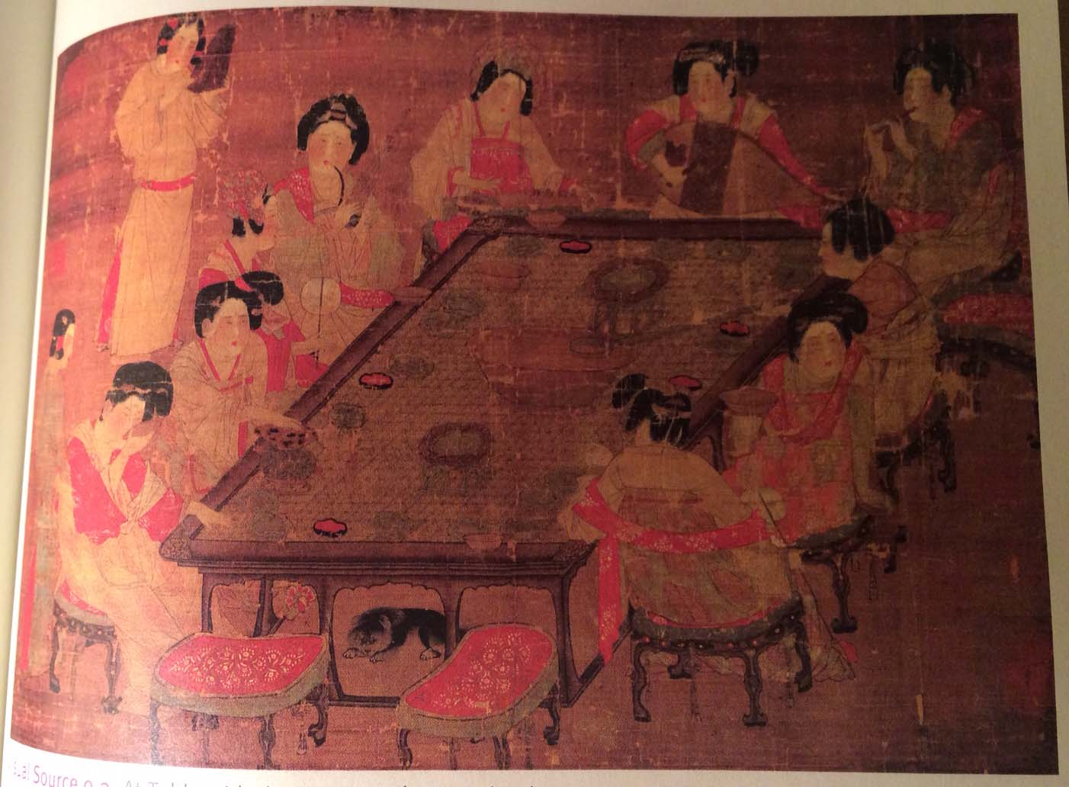
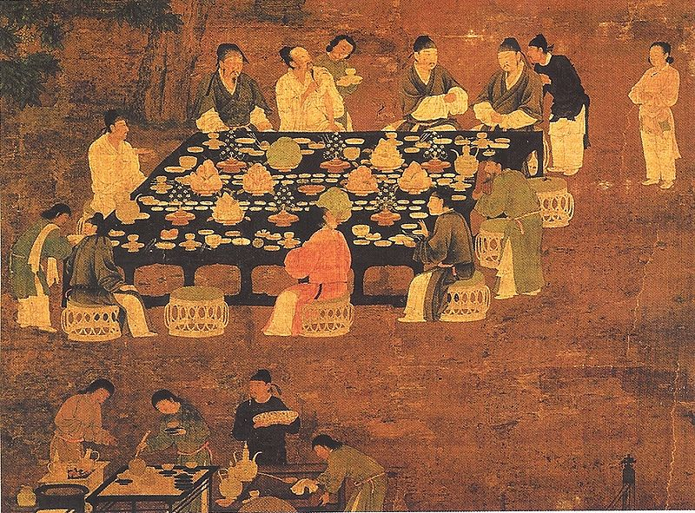
Visual Sources (418-419)
Tang Empress
Song Emperor

Slide 29
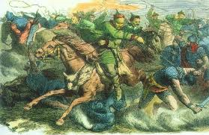
China & the Northern Nomads
Most ongoing and intense interaction with outsiders
Nomads focused on raising livestock, riding horses
Relationship began as a result of TRADE
Centuries-long relationship filled with trading, raiding, and extortion

Slide 30
Nomadic Point of View
Nomads saw the Chinese as a threat
Chinese built the Great Wall to keep them out
Used military against nomads
Made trading difficult
In reality: the Chinese needed the nomads
Needed horses for their military
Needed other goods like: furs, hides, amber
Many important parts of the Silk Road network were in nomad territories

Slide 31
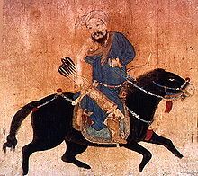
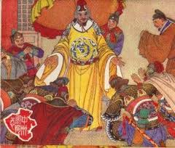
Chinese Point of View
Nomads = barbaric and primitive
Chinese = sophisticated and civilized
Chinese = felt superior to ALL non-Chinese cultures/people, not just the nomads
This resulted in the Chinese tribute system
versus

Slide 32
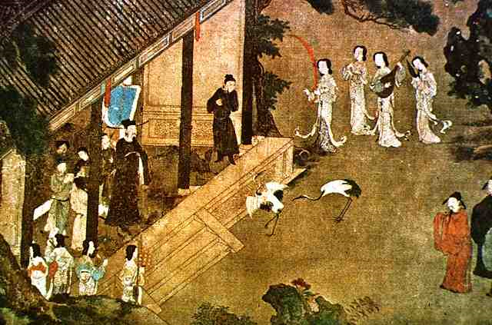
The Tribute System in Theory
Acknowledgement of Chinese superiority by foreigners and non-Chinese authorities
Foreigners would go to the Chinese court and:
Perform a series of ritual bowings and gestures
Present their tribute (goods/gifts)
In return, the Chinese emperor would:
Grant them permission to trade
Provide them with gifts or “bestowals”

Slide 33
The Tribute System—not always what it seems!
China also paid off large nomadic empires (like the Xiongnu) that had powerful militaries
Like protection money…
Tribute system in reverse
China = gave the nomads “gifts” of wine, silk, grains, and other goods
Married off a princess
In return = the nomads promised to not invade or attack China

Slide 34
Chapter 9 Quiz!

Slide 35
China and its Neighbors

Slide 36
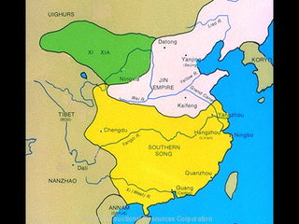
China and Korea
Initial Chinese influence through temporary conquest of Korea during Han dynasty
Korean resistance led to withdraw of military
Tribute system & trading relationship still existed
Chinese cultural elements adopted by the Koreans:
Buddhism
Confucianism
Government set-up
Chinese models of family life and female behavior

Slide 37
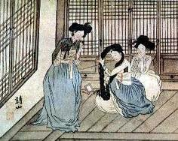
Impact on Korean Women
No longer allowed to live and raise her children in her parents’ home with her husband
Practices that faded away:
Husband buried with the wife’s family
Remarriage of widowed or divorced women
Female inheritance of property
Plural marriages for men

Slide 38
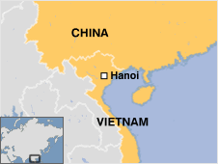
China and Vietnam
Vietnam was part of the Chinese state for over 1000 years (111 BCE to 939 CE)
Chinese cultural elements adopted by the Vietnamese:
Confucianism
Daoism
Buddhism
Administrative techniques
Examination system
Artistic and literary styles

Slide 39
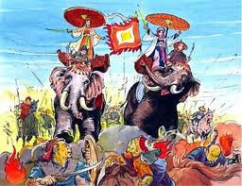
China and Vietnam
Chinese elements forced upon the Vietnamese:
Confucian-based schools
Chinese = official language for businesses
Chinese clothing and hairstyles = mandatory
Chinese-style irrigated agriculture
Result = Vietnamese resistance and rebellion
Several failed rebellions → Ex: the Trung sisters
Successful rebellion = 10th century when Tang dynasty weakened in China

Slide 40
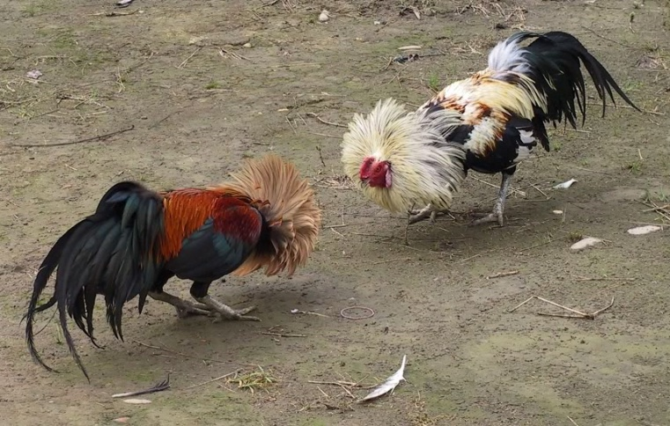
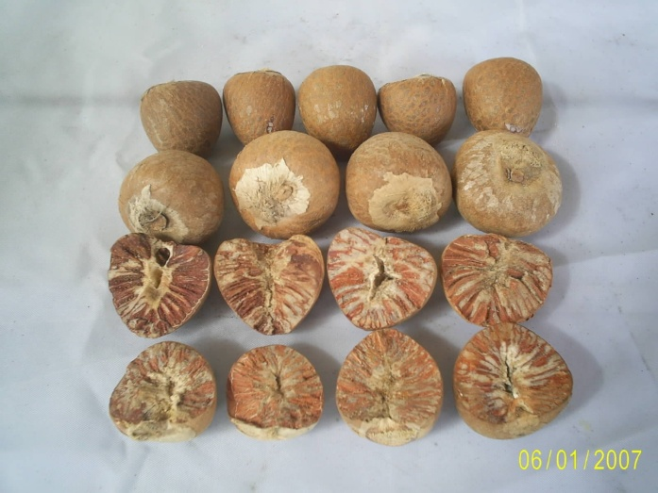
China and Vietnam
Uniquely Vietnamese cultural elements that remained in Vietnam despite Chinese influences:
Distinct Vietnamese language
Cockfighting
Chewing betel nuts
Greater role for women in social and economic life

Slide 41
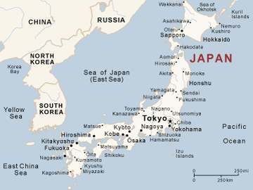
China and Japan
Unlike Korea and Vietnam – Japan is physically separated from China
Japan was never successfully invaded or conquered by China
Any Chinese cultural elements adopted by Japan = 100% voluntary
Japan retains a very unique & distinct culture

Slide 42
Japan
As these clans began to unify into a Japanese “state”, Japan began to model itself after China in some ways
Elements adopted from China:
Buddhism and Confucianism
Chinese-style court rituals and court rankings
Chinese calendar
Chinese-based taxation systems
Chinese-style law codes and government departments
Chinese-style writing system

Slide 43
JAPAN

Slide 44
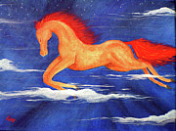
Japan
Early Japan was organized around family-based clans that controlled certain regions
Each family descended from a different common ancestor
Each clan worshipped this ancestor as a special kami = spirit
Shinto = belief that kamis live within all people, animals, and nature

Slide 45
Japan
Nara: First Japanese capital—modeled after Chinese capital, many Buddhist monasteries
Heian Period = 800 – 1200
New Capital of Japan = Heian (later renamed Kyoto)
Focus of this period = pursuit of beauty
Japanese influenced by Chinese art, literature, calligraphy, poetry, etc.
Spent hours each day writing letters and poems
Rise of literature → ex: The Tale of Genji, Pillow Book

Slide 46
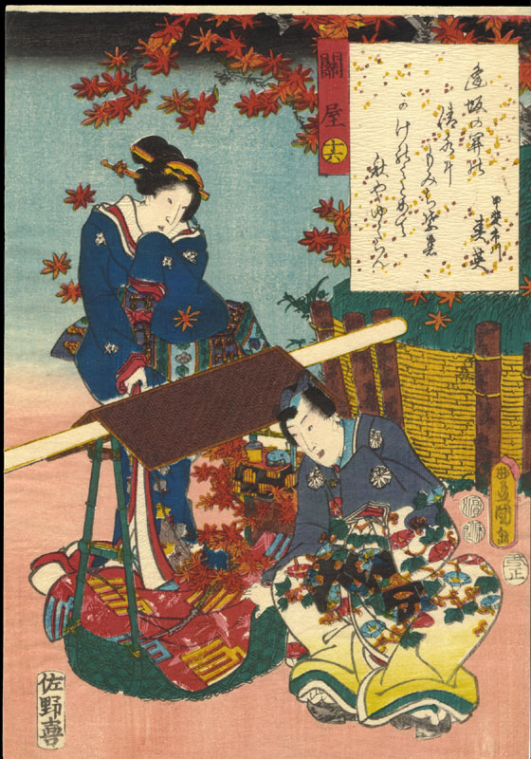
Japan
In their “search for beauty” during the Heian period, governmental responsibilities were neglected
Centralized government broke down
Emperor lost power
Gave way to “feudal” Japan
Rigid class system
Wealthy landowners

Slide 47
Feudal Japan
Shoguns = generals and powerful lords
Most political and military power
Mikado = emperor
Very little power; figurehead
Always fighting each other
Daimyos = local lords
Owned estates
Had private armies
Code of Bushido = samurai code of honor
Seppuku = ritualistic suicide
Samurai = warriors
Loose-fitting armor
Fought with swords AND on horseback with bows & arrows
Peasants → worked on the land; paid heavy taxes; received protection in return

Slide 48
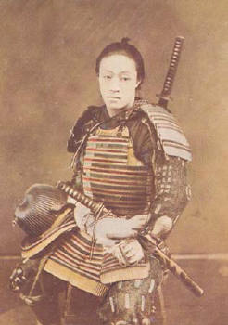
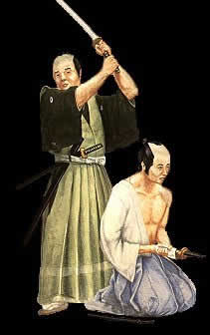
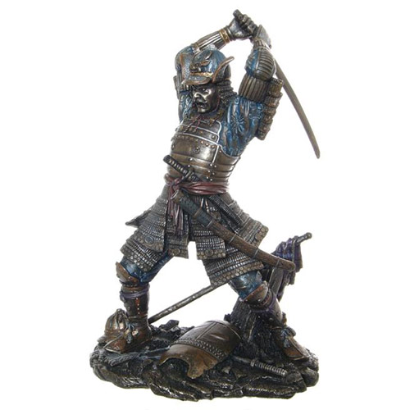
Japanese Samurai

Slide 49
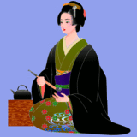
Japanese Women
Escaped the more oppressive features of Chinese Confucian culture; could:
Inherit property
Live apart from their husbands
Get divorced easily
Remarry if widowed or divorced

Slide 50
Pillow Book Reading

Slide 51
Document 9.1
Title paper “Japanese Seventeen Article Constitution (604 CE)”
Divide paper into 2 sections: Buddhism and Confucianism
Each group will read the constitution, looking for the influence of either school of thought
After compiling your list, your group should write its findings on the board
Don’t just write the article number…explain what ideas are present, short quotes

