Slide 1
Chapter 4
Eurasian Empires

Slide 2
Chapter 4 quiz

Slide 3
Decline of the first civilizations
The first civilizations disintegrated…(why?)
War
Invaders
Climate change
Political change
However, the idea of “civilization” didn’t go away
New civilizations, big and small, would emerge around the world

Slide 4
Continuity & cHANGE
Ruled by monarchs
Patriarchy
Social hierarchy dominated by elites
Slave systems
No revolutionary new technologies
Rapid population growth
Sprawling, diverse empires
New philosophies/religions
Modest technological gains (mostly China)
Networks of trade, interaction, and cultural exchange

Slide 5
Classical civilizations (600 BCE-600 CE)
So what is an Empire?
A large and aggressive state
Conquer, rule, tax people
Single political system
Encompasses diverse range of people
Fosters cultural mixing, exchange of ideas, art, goods, commerce

Slide 6
The Persian Empire
Notable Rulers: Cyrus (557-530) and Darius (522-486)
Stretched from Egypt to India, and into Anatolia (Turkey)
Over 35 million people, dozens of cultures, languages, etc.
Respect for other cultures within empire
Cyrus allowed Jews to return from Babylonian exile
Gained support of local leaders

Slide 7
Persian Empire
Ruled by a god-king, kept apart from commoners, “King of Kings”
Also used decentralized authority to rule
Satraps: Persian governors who had authority over a province (23 in total), chosen by central government
Lower authorities were drawn from local people
Built loyalty
Imperial spy network

Slide 8
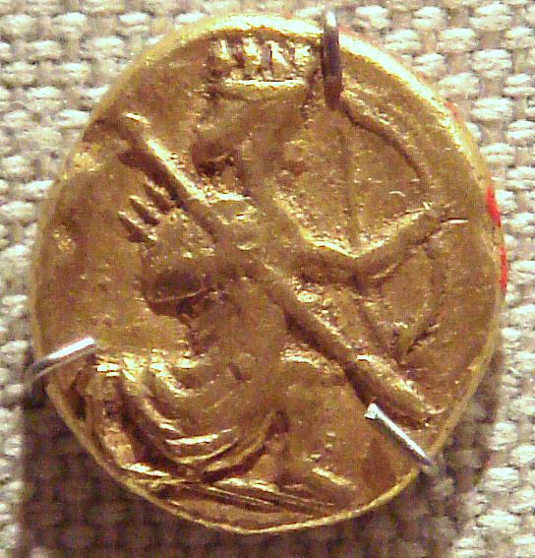
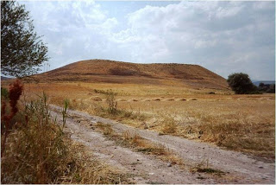
Persian Empire
Imperial bureaucracy
Made up of tax collectors, translators, scribes, etc.
Standardized monetary system
Lots of taxes!
Royal road helped travel and communication across vast empire
1700 miles could be covered in a week or two

Slide 9
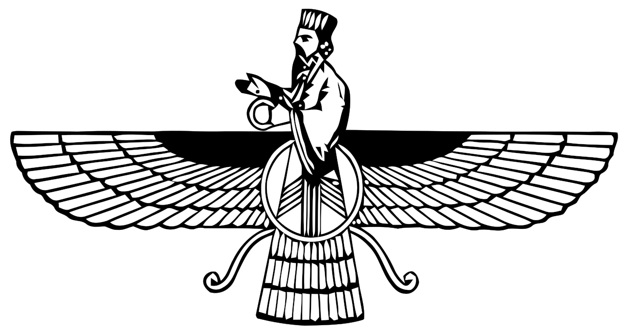
Zoroastrianism
Created by the prophet Zoroaster/Zarathustra in the Persian Empire
Simplified religion into a war between good and evil
Ahura Mazda (wise, good) vs. Angra Mainyu (destructive, bad)

Slide 10
Hand back Test and essay

Slide 11
Points of order
Tests may be difficult, but are meant to prepare you for AP test questions
Your grade is cushioned by other assignments if you didn’t do well on the test
When writing an essay, your thesis should be a roadmap to the rest of your paper
Tells the reader how the paper will be organized
“Farming was superior to foraging because of… (1), (2), (3).
Put it at the START of your paper!!!!!!
When you read a document, you should consider author POV (who is he/she, what is their perspective, how may they be biased)
When writing about an additional useful source, please explain why it’s useful!

Slide 12
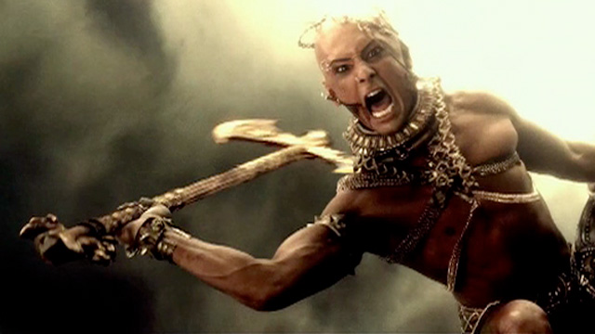
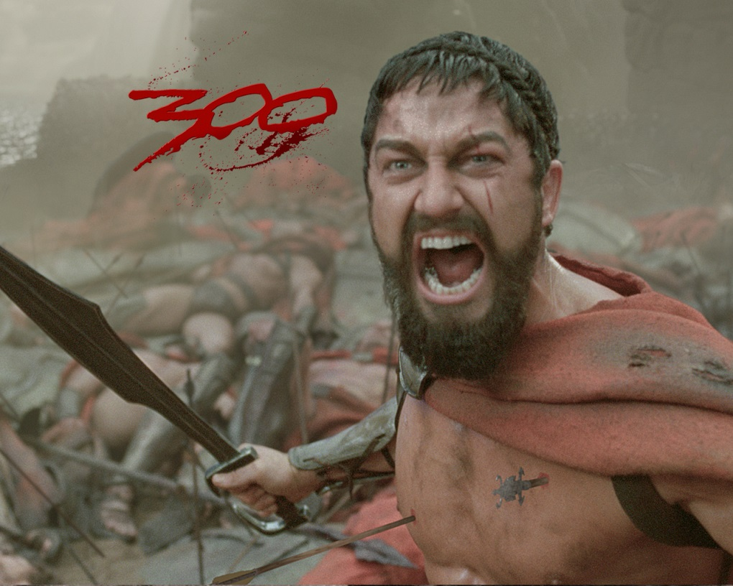
The persians and the greeks

Slide 13
Comparison
Persians
Greeks
Central monarch (king) in charge of empire
35 million
Large empire, thousands of square miles, 23 satraps
Conquered distant lands
Cult of kingship
Competing and warring city-states (Athens, Sparta)
2-3 million people
Divided by geography, small peninsula, hundreds of city-states
Settled distant lands
Experiment with democracy in Athens

Slide 14
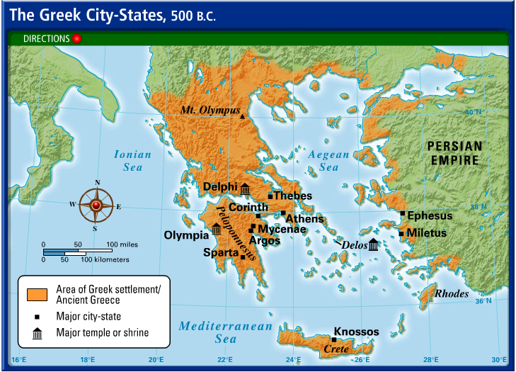

Slide 15
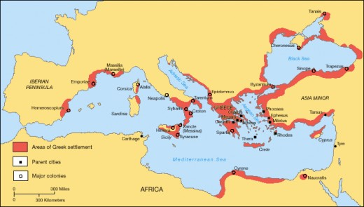

Slide 16
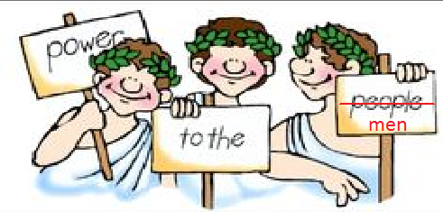
Athenian democracy
Democracy, participation in politics by citizens, was the opposite of the Persian Empire (and elsewhere…)
Democracy was only tried in Athens, no other Greek city-states
At first, only wealthy, well-born men could be citizens
Intense class conflict and the Greco-Persian Wars would later extend that right to middle and lower class (men) as well.

Slide 17
Conflict between Persians and greeks
As Greeks expanded their reach, some settled in Anatolia (Turkey), known as the Ionian Greeks
Persians tried to take over, Ionians rebelled with Athenian support
Persia tried and failed to defeat Greece twice (The Greco-Persian Wars, 490 & 480 BCE)
The East/West Divide: Greece represented freedom and Western civilization, Persia represented Asia and despotism (tyranny)

Slide 18
Effect of the greco-persian wars
Persia
Greece
Little effect: they still had a huge empire!
Source of pride
Greece unified in fight
Athens gets a big head, tries to take over other city-states
Peloponnesian War (Athens v. Sparta, Athens loses)
Greece not unified, weak

Slide 19
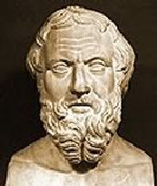
Herodotus reading
"Herodotus of Halicarnassus hereby publishes the results of his enquiries, hoping to do two things: to preserve the memory of the past by putting on record the astonishing achievements both of the Greek and the non-Greek peoples; and more particularly, to show how the two races came into conflict.“
As we read, fill out both sides of the chart, Persian customs and Greek customs, that we can derive from his account.

Slide 20
Persians and greeks
http://www.youtube.com/watch?v=Q-mkVSasZIM&index=5&list=PLBDA2E52FB1EF80C9

Slide 21
Alexander the great & the roman empire

Slide 22
Alexander the Great
Phillip II of Macedon conquered and unified all of Greece
His son, Alexander, won the support of the Greeks by taking on the Persians
10 year mission led him to conquer the Persian empire, from Anatolia to the Indus River to Egypt
Hailed as the “King of Macedon, Shahanshah of Persia, Pharaoh of Egypt, Lord of Asia”
Died of a “fever” (alcoholism? poisoning?) in 323 BCE, at the age of 32.

Slide 23
The hellenistic era
323 BCE-31 BCE (Bookended by Alexander’s death and the emergence of the Roman Empire)
Three main generals of Alexander divided his empire
Ptolemaic: Egypt
Seleucid: The old Persian Empire (India to Anatolia)
Antigonid: Macedonia/Greece (sometimes…)

Slide 24
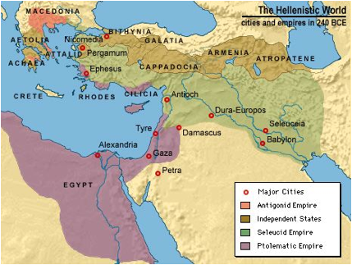

Slide 25
Impact of the Hellenistic kingdoms
Cultural dissemination of Greek ideas, languages, art, etc. across a large swath of the world
Especially through cities such as Alexandria in Egypt
Ashoka, Indian emperor, published decrees in Greek
Some Greeks stayed in India, became Buddhist and part of caste system
Bactria, Hellenistic kingdom in Afghanistan
Made contact with the Han dynasty in China
Kush, African Kingdom (Nubia)
Traded and had contact with Ptolemaic kingdom
The kingdoms would fade away, but the Roman Empire would continue to spread the culture of the Hellenistic Greeks.

Slide 26
The rise of Rome: City-state to empire 753 bce-476 ce or 753 BCE-1453 CE…

Slide 27
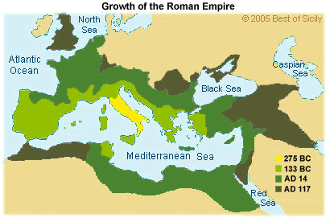
Rome started as a Mediterranean city-state and grew into a vast empire.

Slide 28
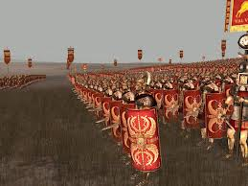
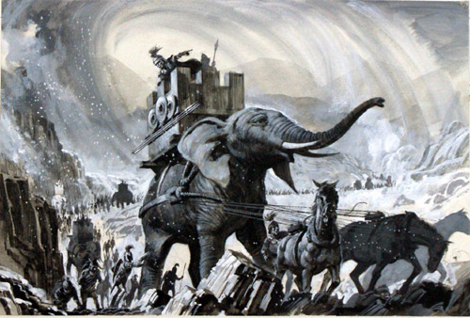
Enemies the Romans “accidentally” subdued:
Greeks: Pyrrhic War
Carthaginians [North Africa]: Punic Wars
Persians
numerous tribes

Slide 29
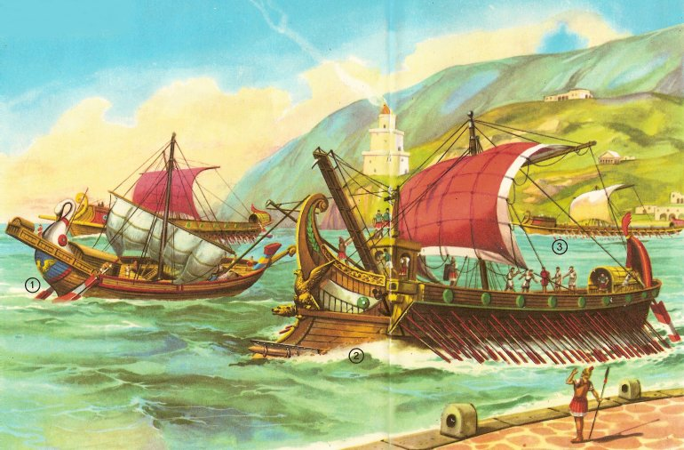
Rome became rich on trade
ways they increased/protected trade
fortified trade outposts which grew into cities
connected empire with roads (military + trade)
established common laws
centralized Latin language across all parts of empire
protected sea lanes with huge navy
minted coins

Slide 30
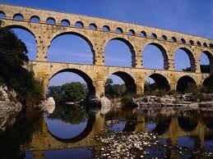
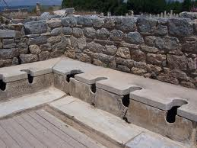
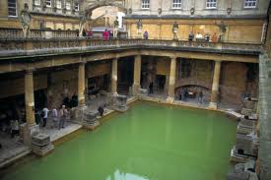
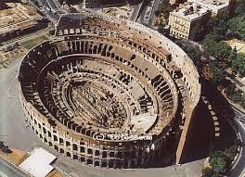
Rome invested in civic infrastructure and public works
aqueducts, baths, stadiums, toilets, Roman Roads

Slide 31
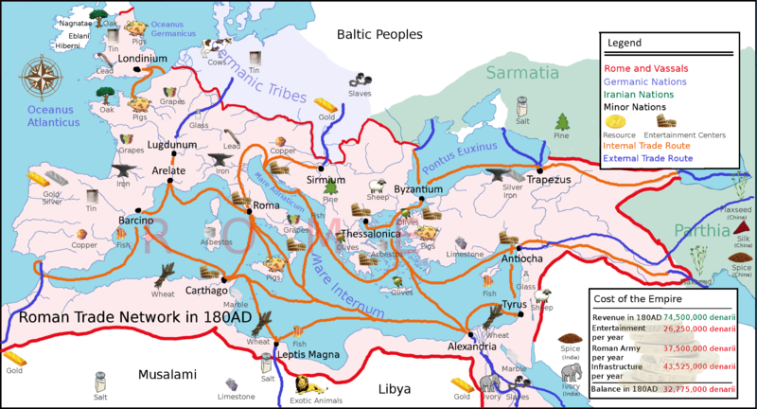
Roman commerce connected Europe, Africa & Asia
indirect trade to Persia, China & India

Slide 32
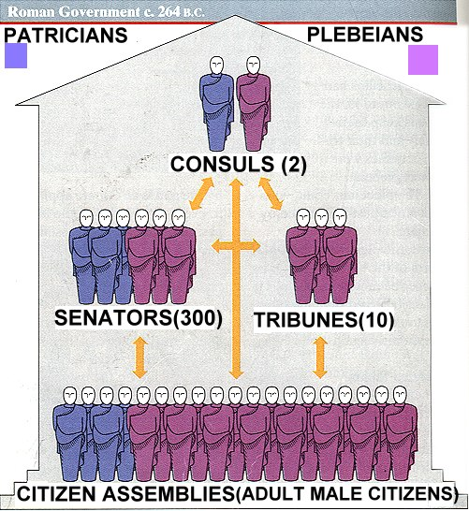
Roman Government
Executive (Consuls, Emperors, Governors)
Legislative (Senators)
Judicial (Tribunes)
(Power was centralized in Rome but provinces had smaller versions of this structure, similar to how States mirror our Federal government)

Slide 33
Cultural “glue”
common language
pride in citizenship (patriotism/republicanism)
tolerance of diversity (usually…)
Romans (and Italians) were a small percentage of the total people in the empire
faith in military to protect and promote stability
class hierarchy: Patricians/Plebians, Citizens/Slaves, (little mobility but slaves could emancipate),
gender hierarchy: paternalistic (women were property)

Slide 34
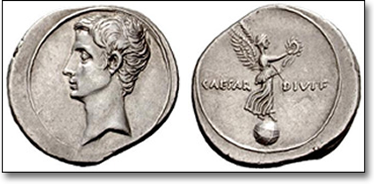
Roman Religion
borrowed much culture & early religion from Greece
later emperors viewed as “sons of god” & “saviors”
various local gods & “mysteries” (salvation cults)
Cybele, Isis, Persian Mithraism, Sol Invectus
mono- and polytheistic faiths
a messianic Jewish cult eventually took over (Christianity)

Slide 35
Republic to empire
As Rome expanded, wealthy men acquired more and more power and land
As did military generals like Julius Caesar
Octavian (Augustus) became the first emperor in 27 BCE
Kept the Senate around, keeping the illusion of the Republic
Pax Romana: Time of the Roman Peace—imperial Rome’s greatest authority

Slide 36
Warm Up
Look at “The Fall of Rome” by Gallieni
In your notebook…
Describe the setting
Describe the expressions of the people
Describe the actions in the image
What is the message of this image?

Slide 37
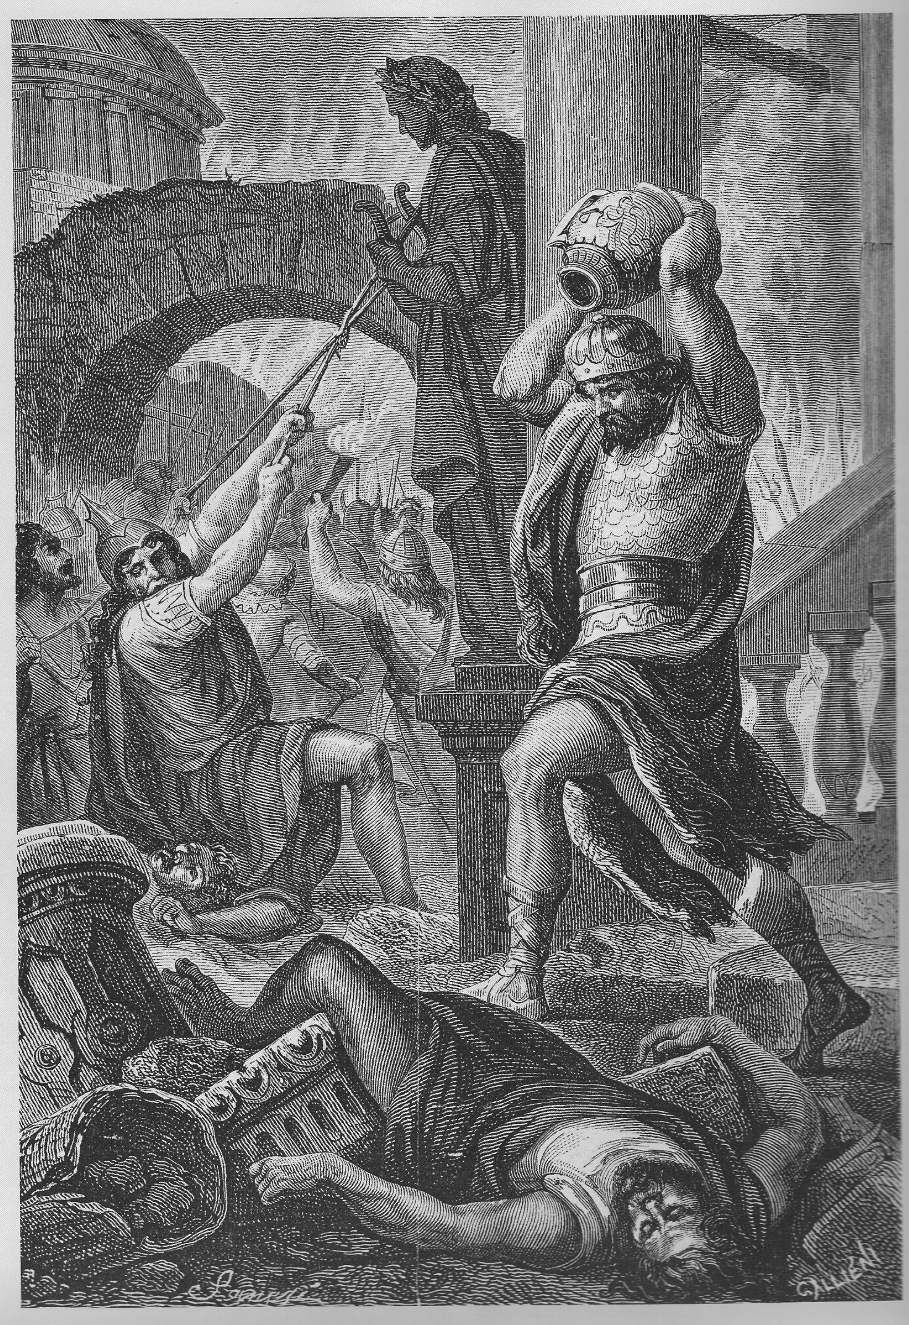

Slide 38
Collapse Timeline
14CE Octavian (Augustus)
235-284 Century of 27 emperors
378 Adrianopolis
395 Division of the Empire
410 Sack of Rome
476 Romulus Augustulus (last Emperor)
1453 Collapse of the Eastern Roman Empire (Byzantium)

Slide 39
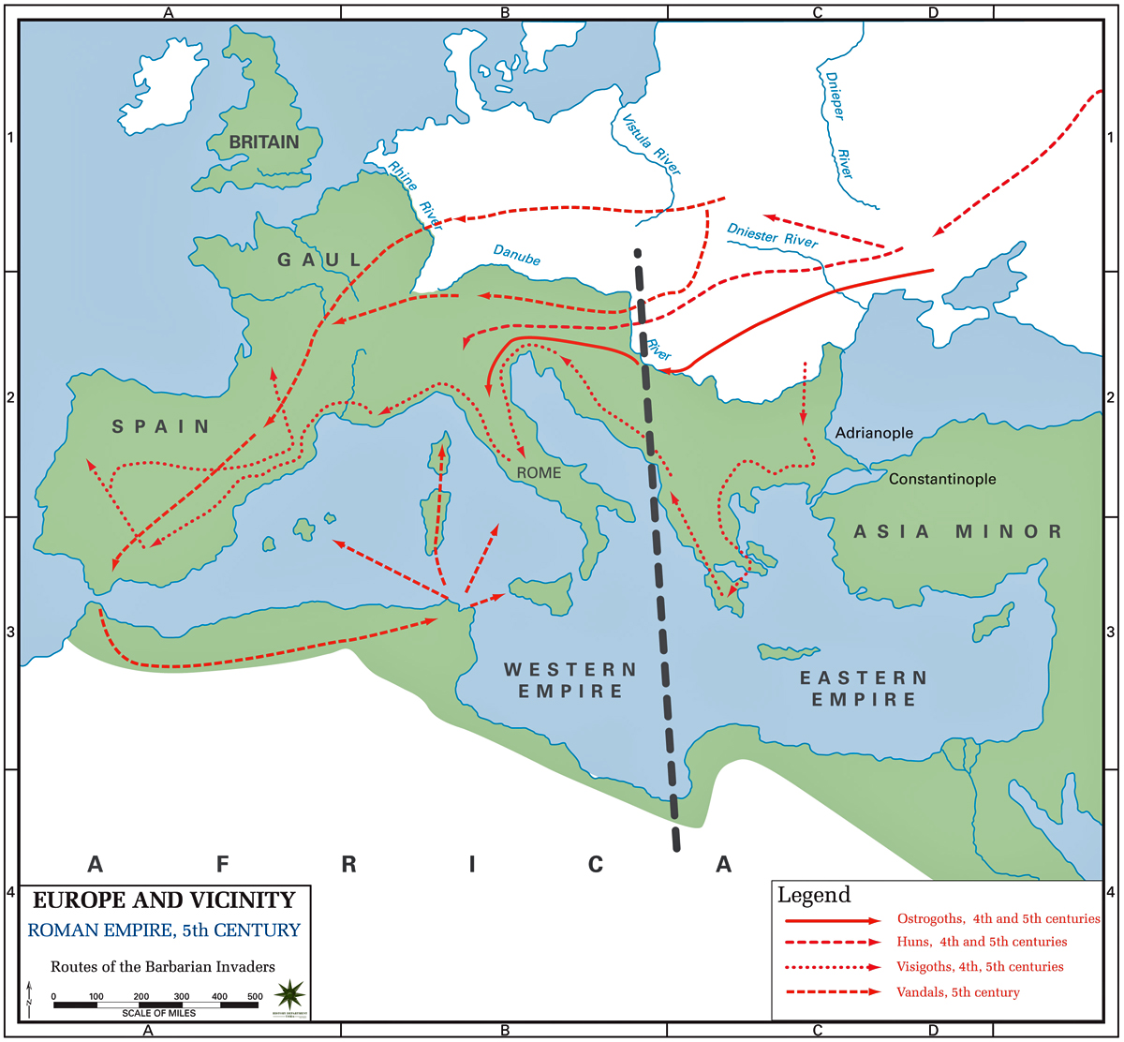

Slide 40
Historiography Cards
Look at the cards in your envelope.
Put the cards into chronological order
Identify the main point that each historian is making (write down in your notes).
Organize them into groups by main idea.
Which group provides the best interpretation of the Fall of Rome?
Which historian changed the way we think about the fall of the Roman Empire the most?

Slide 41
Why did the Fall of Rome occur?
Thesis 1: “Barbarians at the Gate” destroyed Rome
Thesis 2: “Internal corruption” destroyed Rome (holidays, economic problems, lazy emperors, coups)
Thesis 3: “Christianity weakened Rome” Gibbon says it weakened Roman cohesion & warmaking
Thesis 4: “Rome gently disintegrated and transformed” (peaceful barbarians within Rome)
Thesis 5: “Rome did not collapse until the 15th century.” (it lived on in Byzantium)
Notes:
Which thesis (or multiple theses) does each historian argue for?
Which historians make similar arguments? Which historians disagree? Which theses seem the most credible (based on the evidence given)?
Glue cards on poster paper, draw connections

