Slide 1
Origins of Chris ianity

Slide 2
Judaism
Started by Abraham, a shepherd from Ur (Mesopotamia)
Spoke to God, founded a monotheistic faith
Most faiths at this time were polytheistic
The God (Yahweh) was originally conceived as jealous, angry, and powerful
Eventually began to favor social justice, morality

Slide 3
Jews and Rome
The Jewish kingdom was at peace with the Roman Empire for a time.
Internal strife weakened Jewish kingdom, Romans established control in 63 BCE.
Romans, not Jews, would condemn Jesus to death by crucifixion
A punishment reserved for rebels, slaves

Slide 4
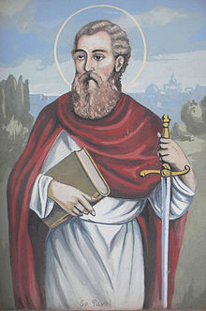
Spread of Christianity
Accounts of Jesus’ life and teachings were recorded in the Gospels several decades after the death of Jesus
Christianity began to be seen as separate from Judaism
St. Paul spread Christianity to Jews and non-Jews, throughout the Roman Empire
Helps Christianity become a world religion

Slide 5
Persecution of Christianity
Christianity and monotheism was antithetical to the Roman cult of emperors, religion
Several Roman emperors persecuted Christians
Reading

Slide 6
Rome and Christianity
Emperor Constantine converted to Christianity in the 300’s C.E.
Edict of Milan: Decriminalized Christianity
Rome began to protect and support Christians
Became official state religion

Slide 7
Institutions and Schism
The spread of Christianity throughout the Roman Empire led to the desire for unity and order in the faith
Development of institutions, church hierarchies (dominated by men)
Western Roman Empire’s religious leader, known as the Pope, became the leader of the faith
His authority was not recognized in Eastern Roman Empire
Would eventually lead to Schism (split): Roman Catholic and Eastern Orthodox churches

Slide 8
Crash course
http://www.youtube.com/watch?v=TG55ErfdaeY&index=11&list=PLBDA2E52FB1EF80C9

