Slide 1
Mughal empire 1526~1857

Slide 2
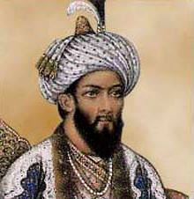
Creation of the Mughal EMpire
Created by Babur, descendant of Timur (Tamerlane)
Unable to conquer Afghanistan
Invaded Northern India, established new Muslim kingdom in 1526

Slide 3
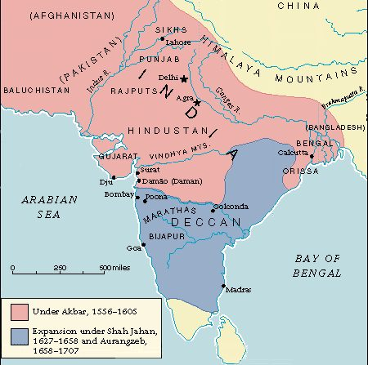

Slide 4
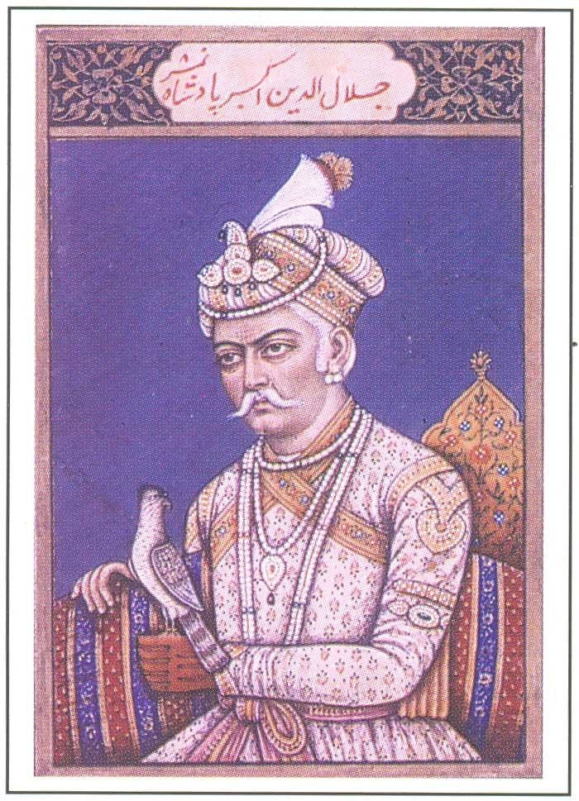
Akbar (Ruled 1556-1605)
Most famous emperor
Oversaw expansion of empire
Religious toleration
Created own religion (Din-I-Alahi), blending of other religions [Christianity, Hinduism, Islam, Jainism, etc.)
Ended Jizya (Tax on non-Muslims)

Slide 5
Story of birbal

Slide 6
Janhangir memoir
1605-1627

Slide 7
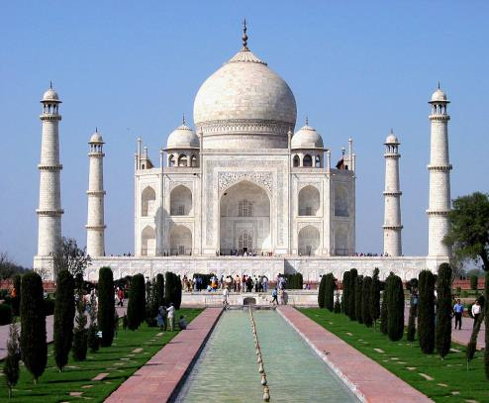
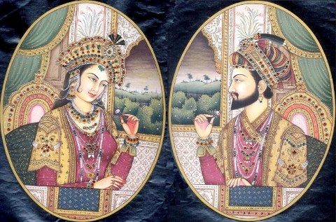
Shah Jahan (RULED 1628-1658)
Constructed the Taj Mahal as a tomb for his wife, Mumtaz Mahal

Slide 8
Aurangzeb (1659-1707)
“World Conqueror”—Sought to expand the empire, costly military campaigns and frequent rebellions
Less $ for art, literature, etc.
Less tolerant towards Hindus
Reinstated jizya
Wanted to impose sharia (Islamic law)
Led to slow disintegration of empire

Slide 9
Crash course
https://www.youtube.com/watch?v=nbuM0aJjVgE

