Slide 1
Islam
AP World History Notes
Chapter 11

Slide 2
Birth of Islam
Same monotheistic tradition & God as in Judaism & Christianity
Major prophet: Muhammad
Major religious text: The Qur’an/Koran
Direct words from God to Mohammed, rather than interpretation
Begins in the Arabian Peninsula
Many tribes, many polytheistic religions

Slide 3
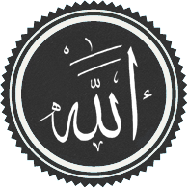
Tenets of Islam
Umma: Community of all believers (no tribalism)
Five Pillars
Testifying to God (“There is no God but Allah and Muhammad is His prophet”)
Prayer (5 times towards Mecca)
Charity to poor
Fasting during Ramadan
Hajj (Pilgrimage to Mecca)

Slide 4
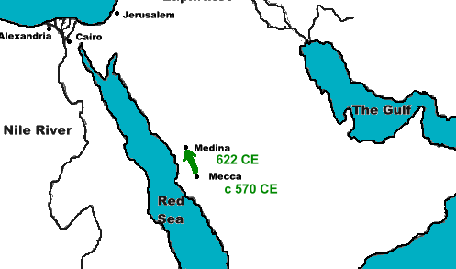
Early Islam
570CE – Birth of Mohammed in Mecca
610CE – Beginning of revelations
622CE – Hijra: Forced migration of Mohammed and his followers from Mecca to Medina
630CE – Conquest of Mecca
632CE –Mohammed’s death
633CE–onward: Conquest of Persia and Byzantium.

Slide 5
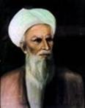
Divisions and Controversies
The “Rightly Guided Caliphs” (632 – 661)
First 4 caliphs after Muhammad
(Caliph = the political and religious leader of the Islamic community)
Division surfaced almost immediately (Sunni vs. Shia Muslims)
Abu Bakr
The 1st Rightly
Guided Caliph

Slide 6
Sunnis vs. Shi’ites
Believe the caliph is the rightful political and military leader of Islam
Believe the caliph should be chosen by the Islamic community
Believe that the leader of the Islamic community should be a blood descendant/relative of Muhammad

Slide 7
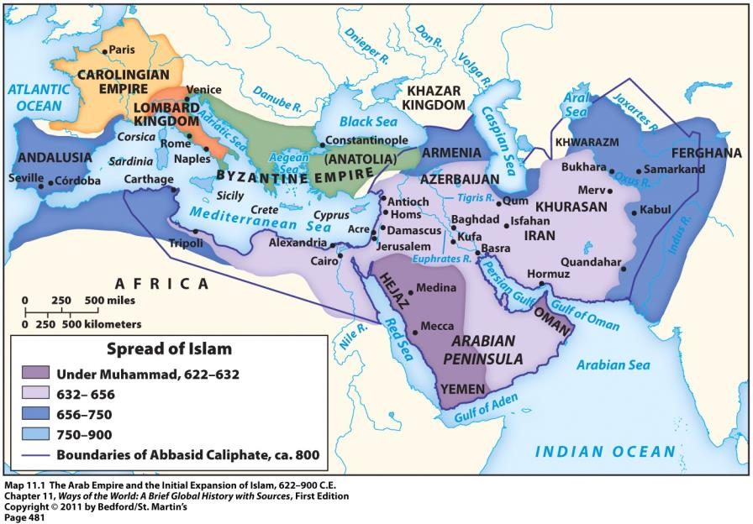

Slide 8
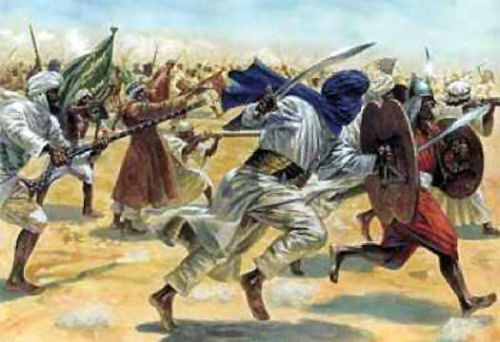
War and Conquest
650s = Arab forces defeated the Persian Empire and took over about half of Byzantium’s territories
Both had been weak for a long time due to fighting with each other
Early 700s = Arab forces took North Africa, Spain, parts of Central Asia

Slide 9
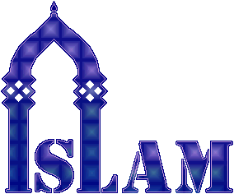
War and Conquest
Conversion to Islam not forced on anyone in the Arab Empire
Zoroastrians, Jews, and Christians all considered “people of the Book,” given protection
Non-Muslims paid “jizya”—special tax

Slide 10
Widespread Conversion to Islam – WHY?
Not such a dramatic change for many Zoroastrians, Jews, and Christians
Wealth and prestige of Arab Empire attracted people
Many incentives for converting
Didn’t have to pay jizya = tax on non-Muslims
Could hold official positions; social mobility

Slide 11
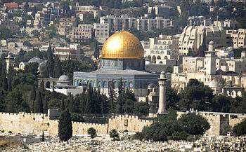
Umayyad Dynasty (661 – 750)
Vast expansion of Arab Empire
Caliphs became hereditary rulers
Ruling class = Arab military aristocracy
The Dome of the Rock
Built in Jerusalem in 691 CE
Built by Umayyad Caliph Abd al-Malik

Slide 12
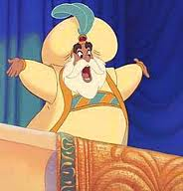
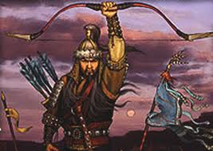
Abbasid Dynasty (750 – 1258)
Built up a new capital for the empire in Baghdad
Non-Arabs now played a prominent role
Persian culture became the culture of Islamic elites
By the mid-800s = many local governors or military commanders asserted autonomy over their regions
Islamic world fractured into multiple “sultanates”
Dynasty officially ended when conquered by the Mongols in 1258

Slide 13
Crash Course
https://www.youtube.com/watch?v=TpcbfxtdoI8&list=PLBDA2E52FB1EF80C9&index=13

Slide 14
Central Question in the Empire: What does it mean to be a Muslim?
Answer = strict adherence to the sharia = Islamic religious and civil law
Sharia created based on the Quran, the life and teachings of Muhammad, deductive reasoning, and the consensus of the ulama (Muslim scholars)
Sharia addressed virtually every aspect of life; Examples:
Guidance for prayer and ritual cleansing
Treatment of slaves
Rules for political life
Rules for marriage, divorce, and inheritance
Rules for business and commercial practices

Slide 15
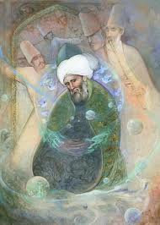
Sufis
Muslims who believed that the wealth and success of Islamic civilization was a deviation from the purer spirituality of Muhammad’s time
Searched for a direct and personal experience with the divine
Rejected the material world
Meditated on the words of the Quran
Believed teachings about the law and correct behavior didn’t bring people closer to Allah

Slide 16
Growing Restrictions
Occurred during the Abbasid dynasty
Arab Empire grew in size, wealth, and splendor
Result = role of women became more limited
Applied to upper-class women
Lower-class women = didn’t have servants; had to leave the house for shopping or work
These restrictions stemmed from the traditions and cultures within the Arab Empire; NOT the Quran itself

