Slide 1
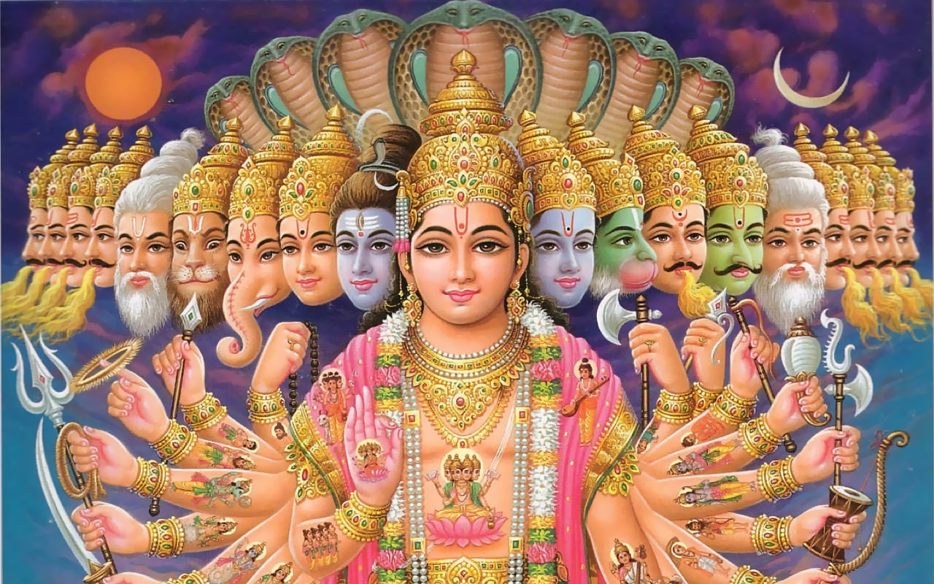
Classical India

Slide 2
Origins of india
Dravidians: People who created the Indus Valley Civilization
Aryan Migration/Invasion: Aryan nomadic people arrived from Central Asia, conquered or mixed with Dravidians
Brought own language, Sanskrit
Also brought own religion

Slide 3
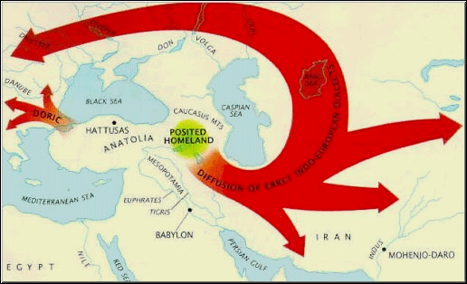

Slide 4
Vedic Religion
Blend of Aryan and Dravidian beliefs, precursor to modern-day Hinduism
Vedas: Collection of poems, hymns, rituals that were compiled by priests (brahmins)
Chronicled early civilization
Only Brahmins could conduct rituals

Slide 5
Upanishads
Sacred texts that emerged around the early classical period (800-400 BCE)
More philosophical, outline for Hindu beliefs
Brahman: World Soul, divine reality within all things
Moksha: Ultimate goal, becoming one with Brahman
Took many lifetimes to achieve Moksha
Samsara: Rebirth/Reincarnation
Dharma: The duties and responsibilities of each caste
Karma: Good actions during life would result in a higher station in the next life, closer to moksha

Slide 6
The caste system
Origins: somewhat unclear
Interaction of many diverse cultures, coupled with economic specialization, may have contributed to its development
Varna: Society is divided into 4 classes
Linkage of birth and occupation
Outside of the caste system (outcasts) were the “untouchables”

Slide 7
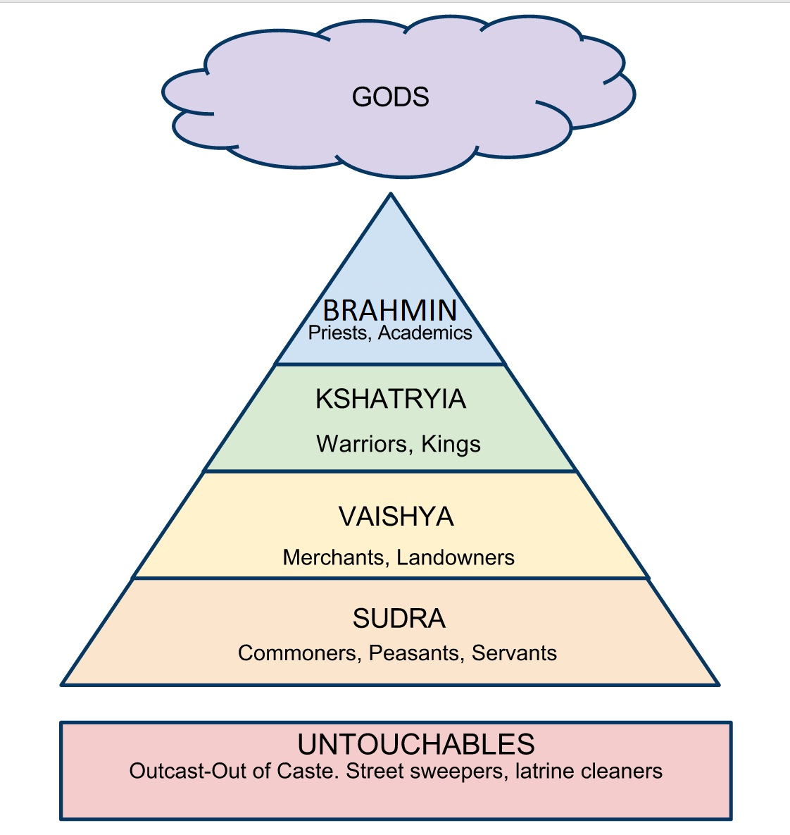
{
Four
Varnas

Slide 8
Jati
Social distinctions based on specialized occupation (sub-caste)
Jatis determined who you could marry and eat with
Set of rules, obligations, duties within each jati
Thousands of jatis
Very localized—no statewide jatis

Slide 9
Reading

Slide 10
What makes the caste system unique?
Many separate and stratified social groups
India had unique justifications for system
Ritual purity: Encountering lower caste members could make you unclean
Religious justifications preventing social mobility
Birth in your caste reflected actions of a past lifetime—deserved wherever you ended up

Slide 11
Caste system and newcomers
Caste system excluded outsiders, but it also provided a means for assimilation for those who came to India
You could retain your culture and still be a part of the caste system!
Alexander’s Greek soldiers became part of kshatryia caste

Slide 12
cLOSURE
“A modern caste is a group of persons who will eat with one another and intermarry, while excluding others from these two intimacies.[…] Definite rules for how to behave in the presence of members of other castes also become necessary.”
How close do we get to a “Caste System” in OMHS and our modern world?

