Slide 1
Turn in your test corrections up front!
Staple your Scantron to your corrections
Turn in your test packet as well

Slide 2
Global Commerce and Trade, 1450-1750

Slide 3
Mercantilism
Premier economic theory in Europe during the Early Modern Era
Encouraged government regulation of the economy to build the power of the state
European governments could help their economy by…
Encouraging exports
Accumulating bullion (silver and gold)
Establishing colonies (purchased the exports, supplied goods)

Slide 4
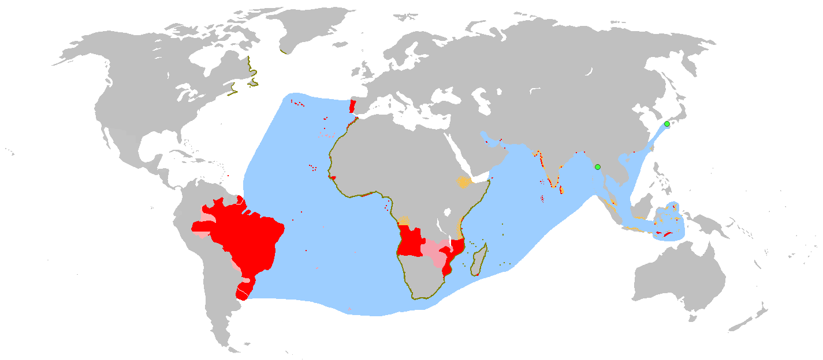
Portuguese Empire

Slide 5
Trading Post Empires
Founded by the Portuguese
Wanted to control commerce, not people
Established partial monopoly on Indian Ocean trade
Never fully exerted control over spice trade
Declines by 1600 (competition from other Indian Ocean kingdoms, other Europeans)

Slide 6
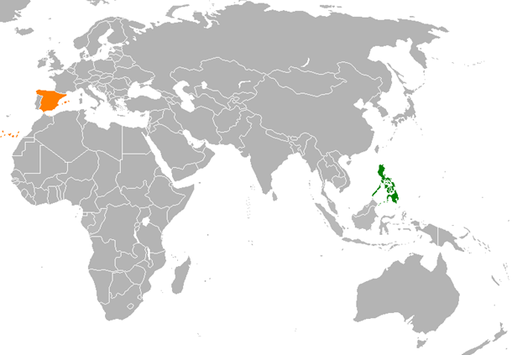

Slide 7
Spain and the (Philip)pines
Spain wanted to get involved in Indian Ocean trade
Philippines “discovered” by Ferdinand Magellan
Close to China and Spice Islands
Small, weak, unorganized societies
No other countries competing for control
Spain conquered Philippines, established colony (rather than trading post) from 1565-1898.
Catholic missionaries turned Philippines into Christian outpost

Slide 8
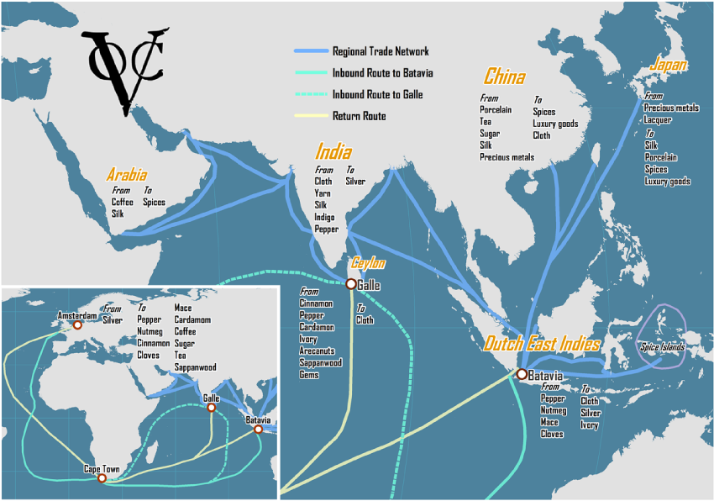
Dutch East India Company

Slide 9
Dutch East India Company
What were the goals of the Dutch in the 16th and 17th centuries?
Why was it important that the Company was a monopoly and linked to the state?
Why was Coen ruthless in his protection of the Company?
What did he do?
How did the Company impact the Netherlands?

Slide 10
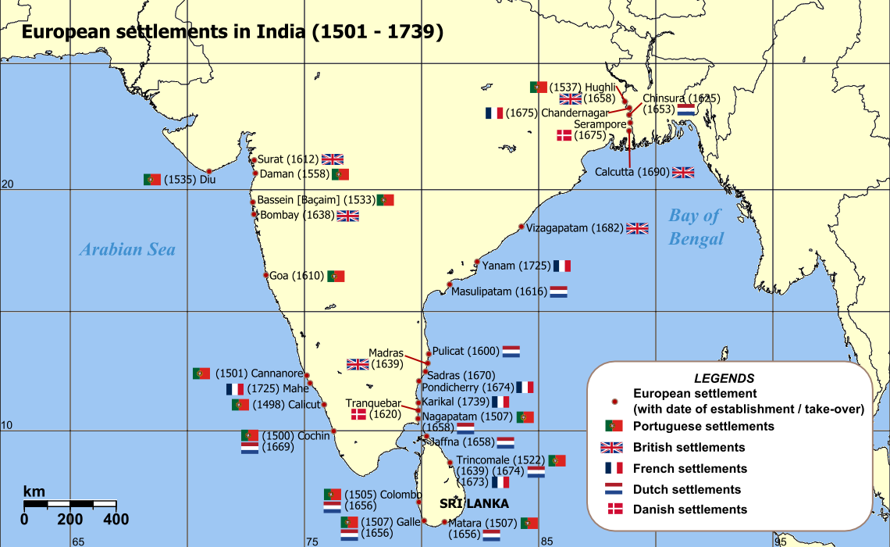

Slide 11
British East India Company
Similar motivations to the Dutch (which was their competition)
Funded by state and shareholders
Provided insurance and protection
Given broad powers by the Empire to protect and expand trade
Would use these powers to take over India
The Company, not the Empire, originally controlled India!

Slide 12
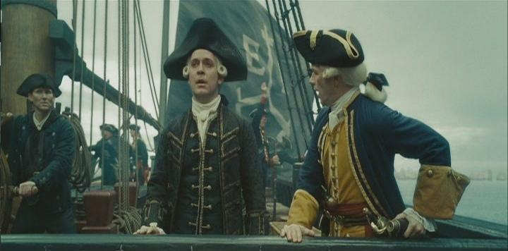
https://www.youtube.com/watch?v=mRQE44FClgQ

