Slide 1
Directions
Find a partner to trade your prewriting with:
Over the next five minutes, you are responsible for checking to make sure your partner has…
A fantabulous hook, intelligent historical context, and a thesis that approaches perfection
Three stellar body paragraphs with at least two killer documents per paragraph
A conclusion that is not the exact same as the introduction! (Yes, I know your introduction was amazing beyond measure, but imitation is not the sincerest form of flattery in this case)

Slide 2
Take out your Rough Draft

Slide 3
Directions
Find a partner to trade your rough draft with:
Over the next five minutes, read through their draft and check to make sure they have addressed all parts of the essay outline
Note any spelling/grammar issues

Slide 4
Events of WWI

Slide 5
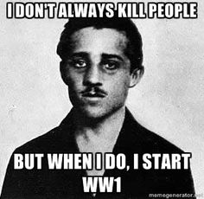
Short term cause
What were the four long term causes?
Gavrilo Princip
Franz Ferdinand

Slide 6
Before the war
Triple Entente
Triple Alliance
Britain
France
Russia
Germany
Austria-Hungary
Italy

Slide 7
The result
Notes:
Alliances vs. Central Powers

Slide 8
Events of world war I
Objective: What were the major events of World War I and how did they impact who won the war?

Slide 9
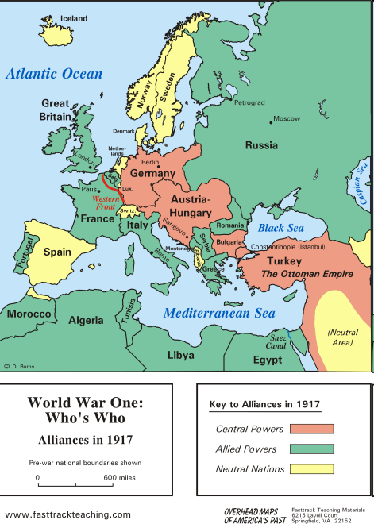
alliances
Nations of Triple Alliance mobilized against nations of Triple Entente.
New additions to both sides: Allies and the Central Powers.
Allies:
-United Kingdom
-Russia
-France
-Romania
-Serbia
Central Powers:
-Germany
-Austria-Hungary
-Ottoman Turkey
-Bulgaria

Slide 10
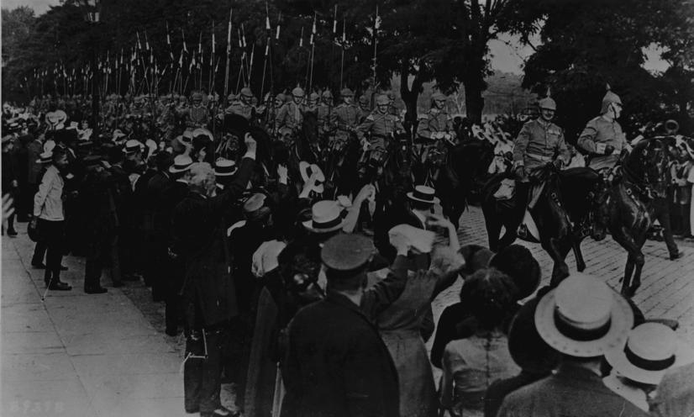
“August madness”
Militaries mobilize.
Excitement in the air.
Blood-lust, madness—militarism.
German cavalry mobilized during the “August Madness.”

Slide 11
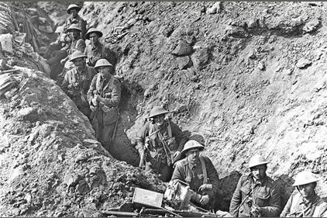
War began in august
By September: calls for a quick victory, as promised.
Soldiers marching
in a trench in Europe,
World War I.

Slide 12
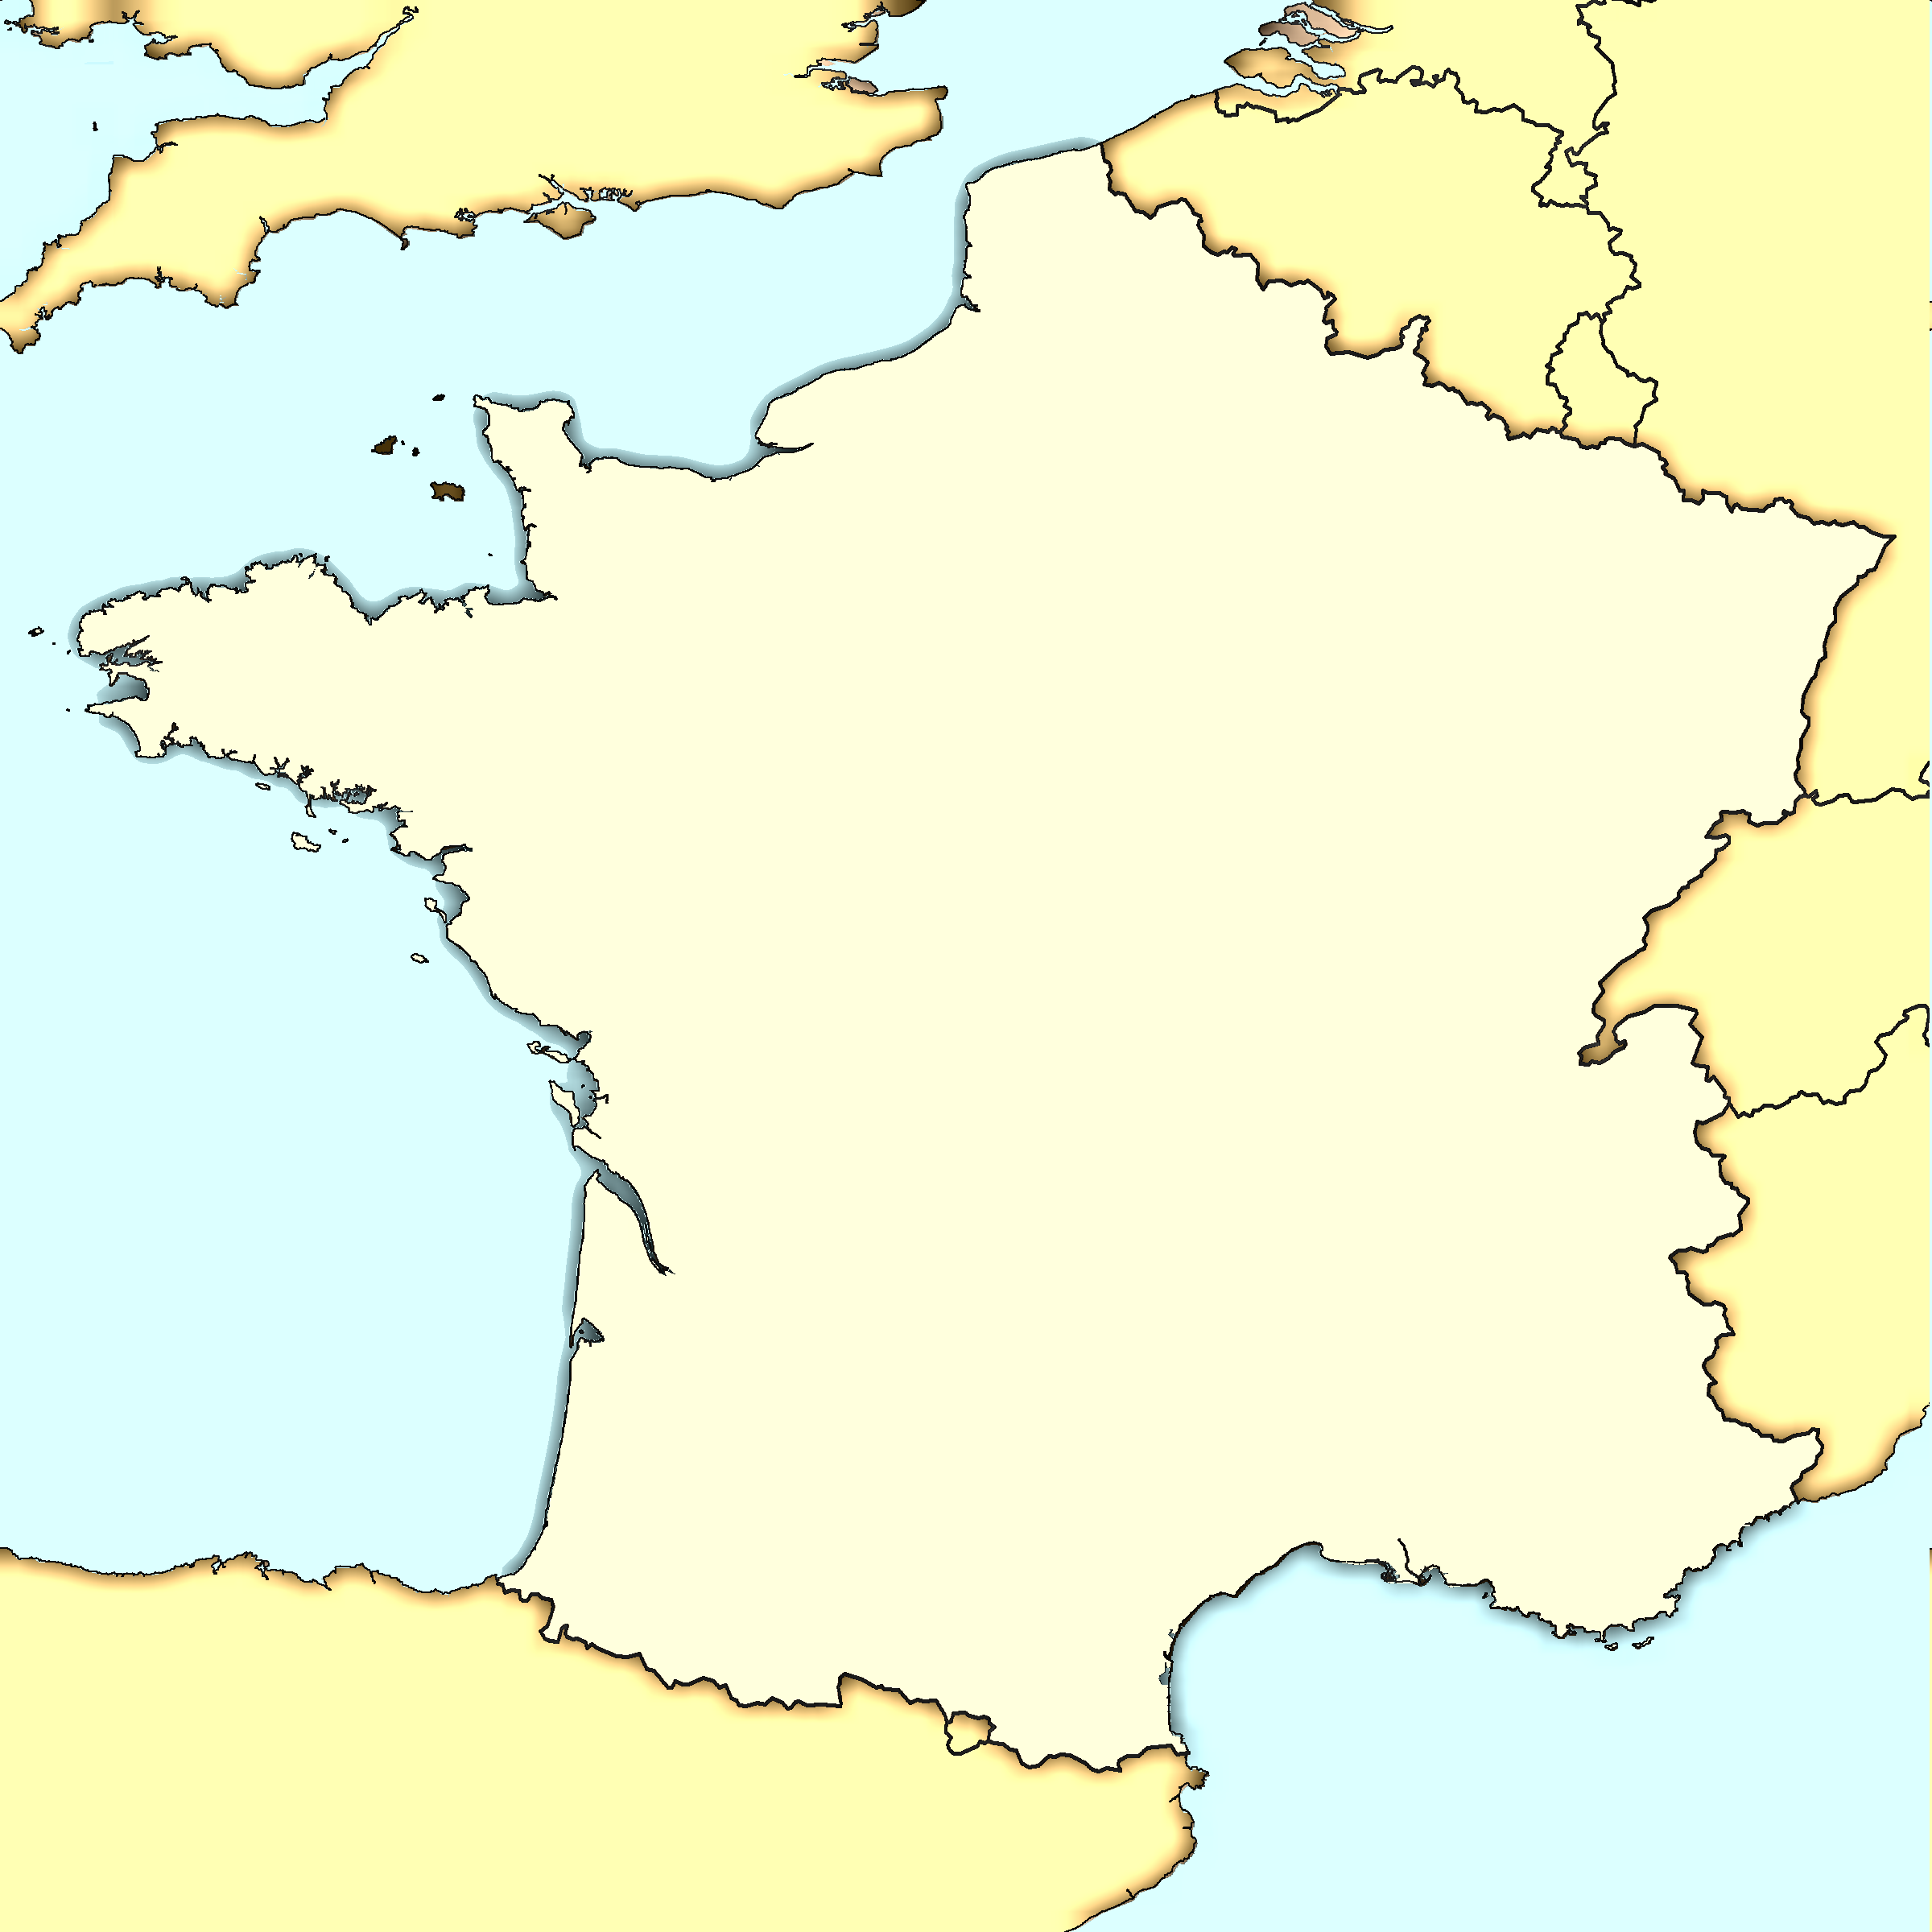
Germany wants france out
Germany
Germans want to knock out France.
Wants to focus on Russia.
France

Slide 13
Preventative measures
French forts.
How will Germans get through defenses?
Germany
France

Slide 14
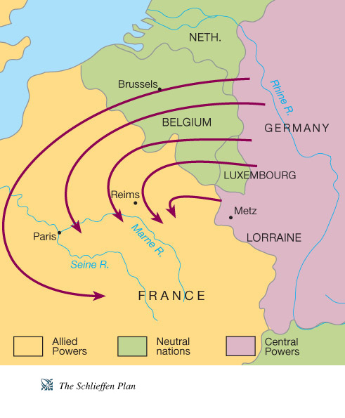
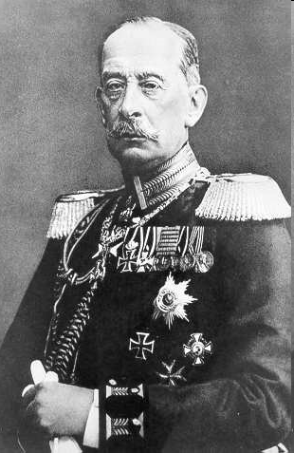
The schlieffen plan
The German plan to attack France through NEUTRAL Belgium.
Count Alfred von Schlieffen
Notes:
Wanted to attack France through neutral Belgium.
Belgium and Britain were allies—risking bringing Britain into the war.
Countries do not want other armies to march through their territory, as a general rule—dangerous.

Slide 15
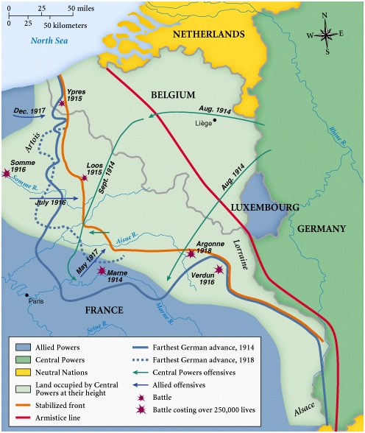
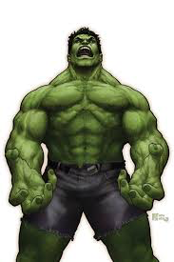
The schlieffen plan
The Schlieffen Plan worked, but it brought Britain into the war.
You’re not gonna like me when I’m angry!
The British

Slide 16
Battle of the marne
August 4th, 1914.
Germany invaded Belgium and then France.
Stopped by Marne River.
Notes:
Marched through Belgium—Britain declared war.
Early September, they were by the Marne River, 20 miles from Paris.
Belgians resisted—destruction of railroads, snipers.
British mobilized, French sent in taxicab troops.
DUG IN—literally.
September 6th-7th counterattack ended the German offense and began trench warfare.

Slide 17
stalemate
Stalemate—When two fighting forces can’t beat one another and are “stuck.” Leads to exhausting wars.
Had been thought to be quick war.
Now a stalemate.

Slide 18
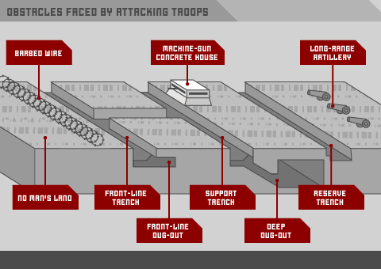
Trench warfare
Dug trenches into ground.
Survival.
“Trench Warfare.”
Trench Warfare on the Western Front, WWI.
Notes:
Trench warfare is new and attached to WWI.
Begins on the Western Front—the Western part of Europe.
Trenches were filled with rats, dead bodies, disease, unsanitary conditions.

Slide 19
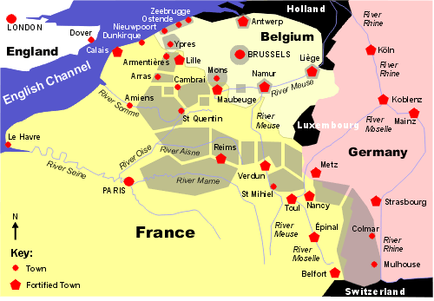
Trenches
Cut 400 mile path.
Across Europe.—from English Channel to Swiss border.

Slide 20
New weapons
Barbed wire. Machine Guns.

Slide 21
All Quiet on the Western Front
https://www.youtube.com/watch?v=SXtsiqrhqsU

Slide 22
Weapons invented to break stalemate
British Mark V tank, WWI.
And…
Flamethrower, WWI.

Slide 23
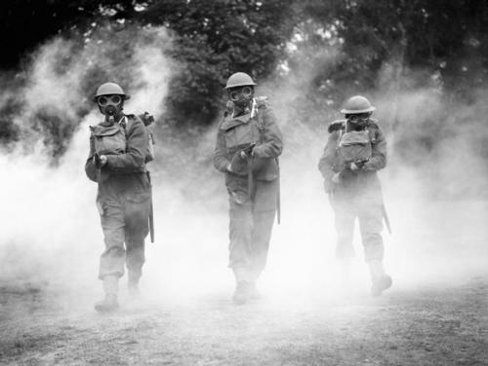
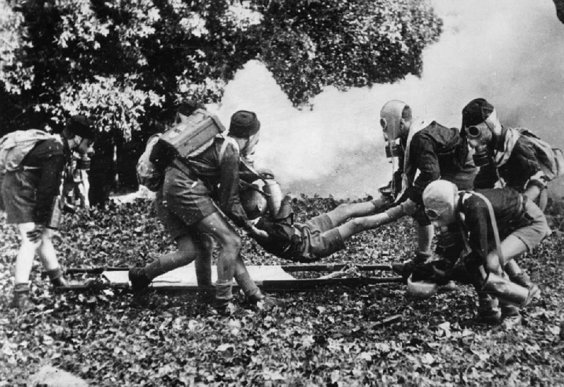
Poison gas: silent but deadly

Slide 24
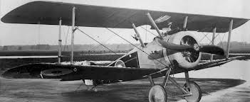
Aircraft
British Aircrafts, WWI.
Used to spy on enemy.
Eventually had guns.
Stalemate continued.

Slide 25
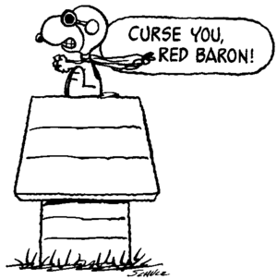
More aircraft
Manfred von Richtofen, the“Bloody Red Baron.”
German Zeppelin, WWI.

Slide 26
attrition
Nothing was working.
New strategy needed.
Attrition—Instead of capturing enemy territory, armies concentrated on killing as many enemy soldiers as possible.

Slide 27
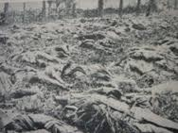
Death on the battlefield
Bloody battles fought.
Countries drained of their young men.
In places like Ypres, Lille, Arras and Cambrai, hundreds of thousands were killed.

Slide 28
The War

Slide 29
Battle of verdun
Germany vs. France.
Began February 21st, 1916.
German guns fired one million shells.
10 months.
Resulted in 700,000 casualties, 300,000 deaths.
Notes:
Germans fired 20 tons of shells per acre.
HUGE battle.
10 months of inconclusive battle.
One of every two Frenchmen between the ages of 20 and 30 were killed—lost a generation of men.

Slide 30
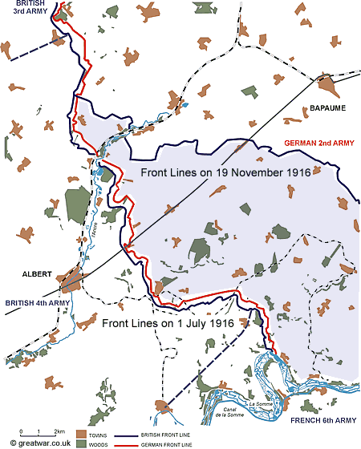
Battle of the somme
Britain troops vs. German lines on July 1st, 1916.
5 days of bombardment.
First day: 60,000 British casualties.
Bloodiest day in the history of the British Army.
By November: 7 miles were won—400,000 dead.
Notes:
British troops were sent out against German lines.
Bombarded them for five days to “soften” German troops.
Bloodiest day in the HISTORY of the British Army—think about how long Britain has been around.
Only seven miles won. Seven miles. 400,000 men dead or injured.

Slide 31
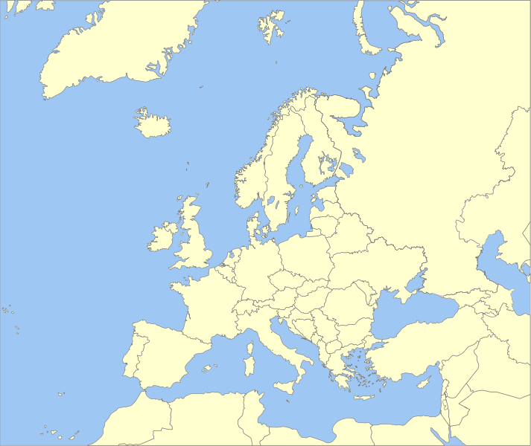
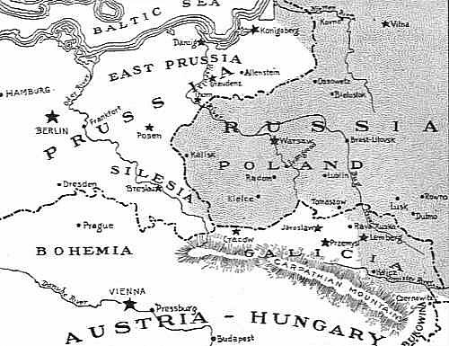
Eastern front
Eastern Europe—Russia vs. Austria-Hungary and Germany.
Just as brutal as Western Front.
Mass casualties.

Slide 32
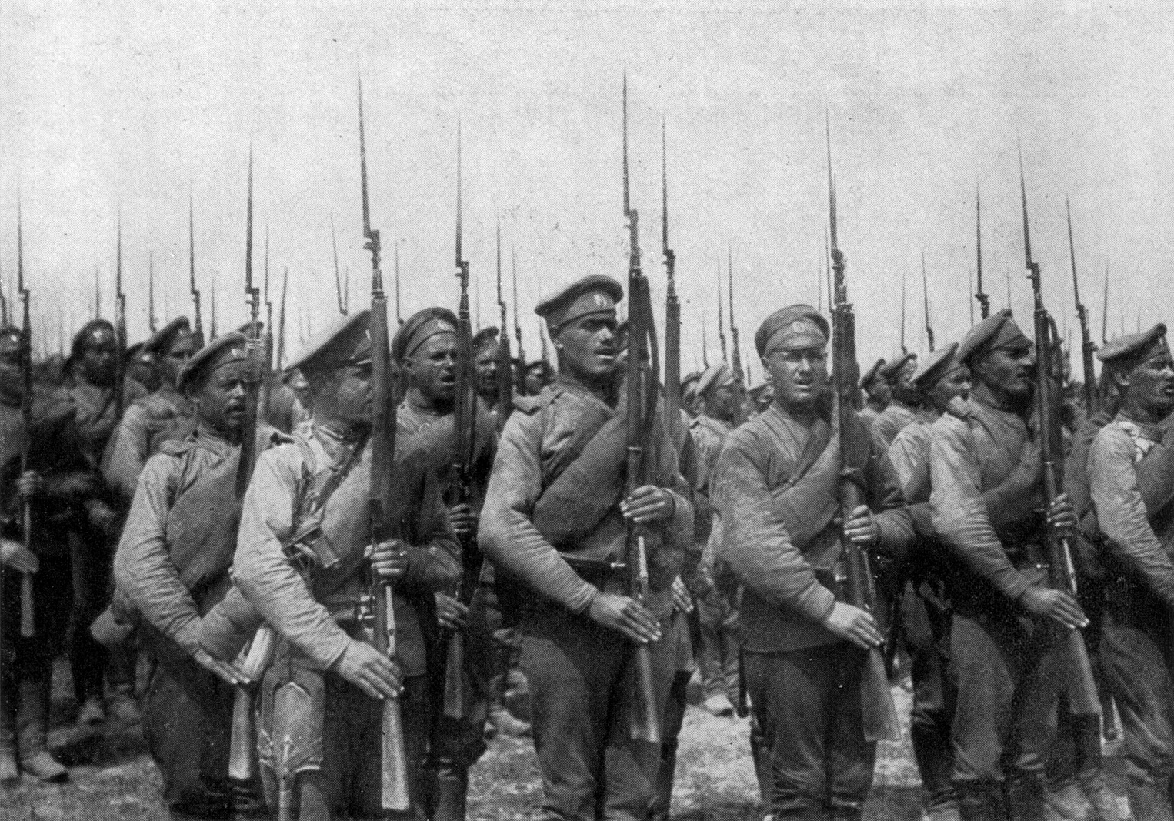
Brusilov offensive
Russian armies crush Austria-Hungary.
1,500,000 Austrians and Germans killed, wounded, captured.
500,000 Russian casualties.
Russian infantry near Lemberg.

Slide 33
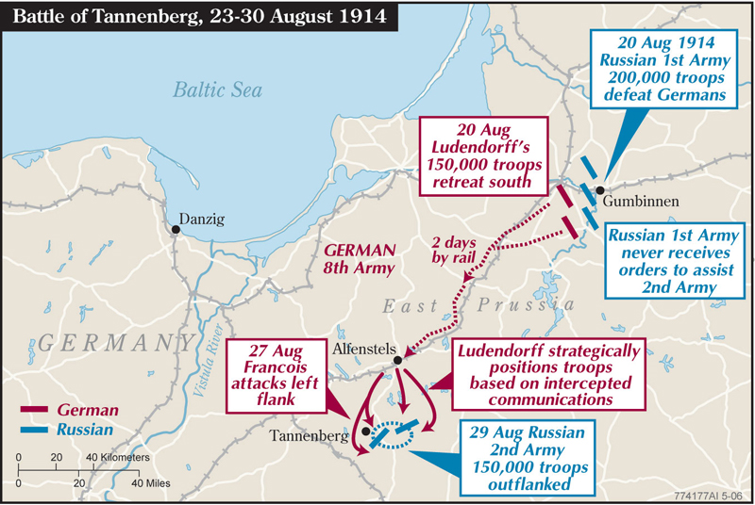
Battle of tannenberg
Russia invades Germany.
Germans intercept Russian message.
German victory: 92,000 Russian prisoners, 30,000 Russian deaths.
Notes:
Intercepted wireless message, Germans know attack already.
Decisive German victory.
Suicide of General Samsanov (Russian general).
Resulted in almost complete destruction of the Russian 2nd army.

Slide 34
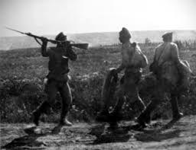
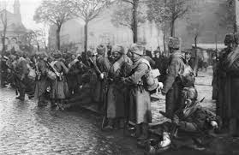
Russia is in trouble
After two years, Russia is losing the war.
Armies being defeated.
Empire collapsing.
People are starving.
Revolution is in the air…

Slide 35
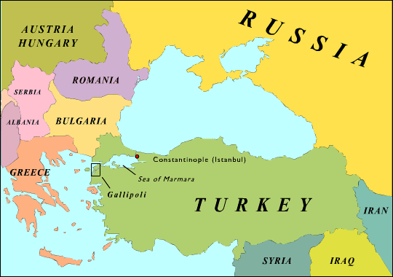
Attempt at help
Russian Czar is slowly losing power…
Allies attempt to help by attacking Turks at Gallipoli.
Notes:
Alliance tries to assist Russia against the Ottoman Empire.

Slide 36
Battle of gallipoli
1915—1916.
Allies planned to knock Ottoman out of war by securing sea route for Russia.
Planned by Winston Churchill.
Allies lost BADLY: 200,000 Allies died.

Slide 37
Winston churchill
First Lord of Admiralty in Britain.
Planned Battle of Gallipoli.
Disgraced after loss of so many soldiers.
Will be VITAL in WWII.
So remember the name…

Slide 38
U-Boat
Germans use the U-Boat to disrupt Allied (and U.S.) shipping.
Notes:
Or the submarine.
Germans used the U-Boat to disrupt Ally shipping.
As well as the U.S. shipping…even though they were not involved yet. This made Americans mad.

Slide 39
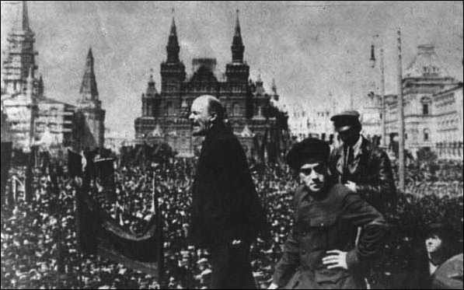
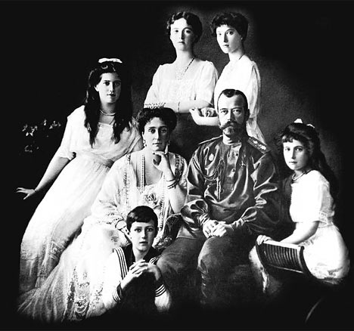
Russian revolution
Russia is collapsing.
Germany arranges for V.I. Lenin come back to Russia.
Lenin = Communist.
Russian monarchy falls apart.
Russia surrenders to Germany.
Out of war.
V.I. Lenin.
Romanov Royal Family.
Notes:
Germany decides to help Russia’s collapsing government.
Brings Lenin to Russia—had been exiled.
Lenin is a Communist, wants socialism in Russia, against the monarch.
Romanovs are murdered—we will talk about this during the Russian Revolution.
Germany is happy—Russia is out of the war.
Allies begin panicking.

Slide 40
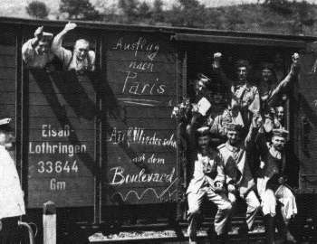
Germany close to victory
1917: Russia out of the war.
Germany appears to be close to victory.
Will the Allies win? How will they win?

Slide 41
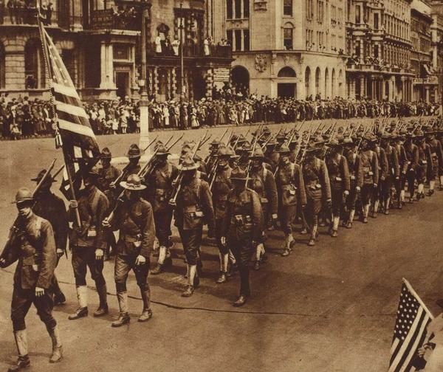
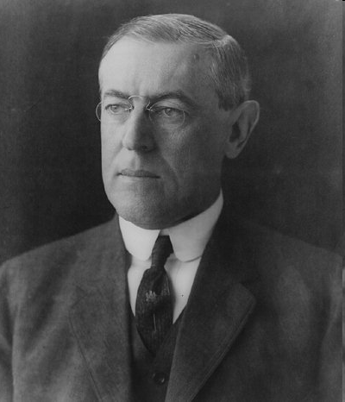
America!
Angry at German attacks on neutral ships in Atlantic.
U.S. enters on side of the Allies in 1917.
President W. Wilson
https://www.youtube.com/watch?v=5v33jF5TGLw

Slide 42
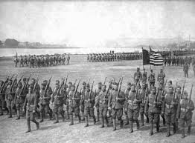
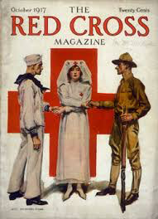
America brings…
Fresh troops.
Abundant supplies.
American troops march to war.

Slide 43
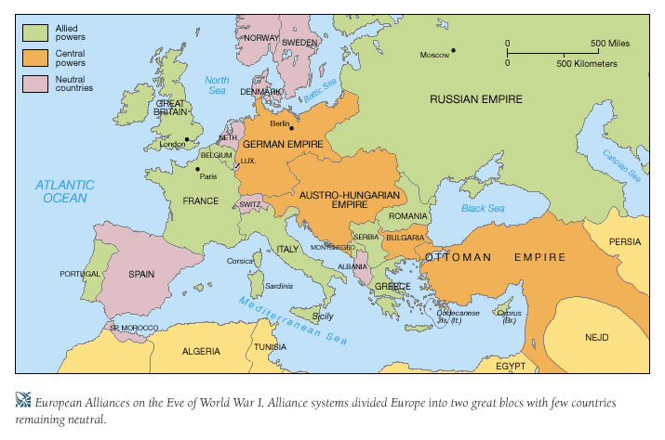
One year to go…
Another year of fighting after America enters war.
Slowly, Central Powers begin collapsing.
X
X
X

Slide 44
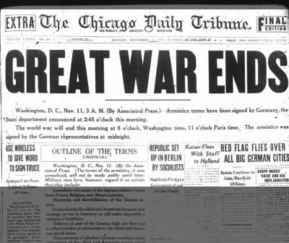
Within a year…
Germany has surrendered!
On the 11th hour of the 11th day of the 11th month in 1918, an armistice (peace treaty) is signed.

Slide 45
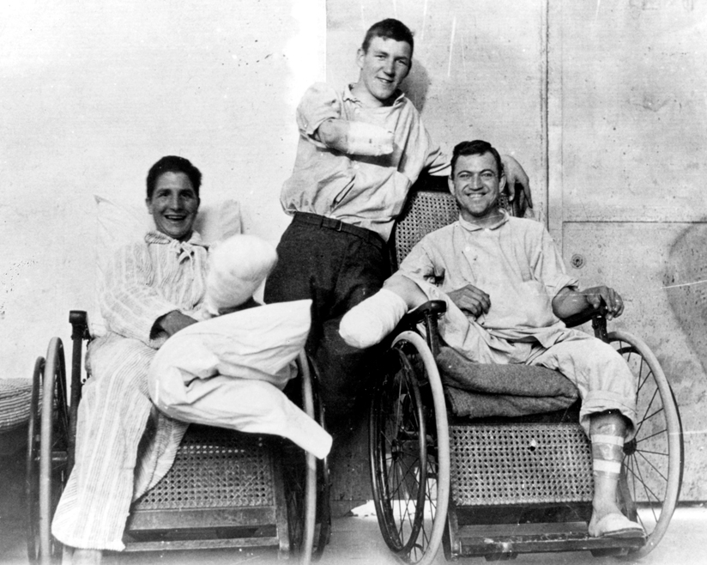
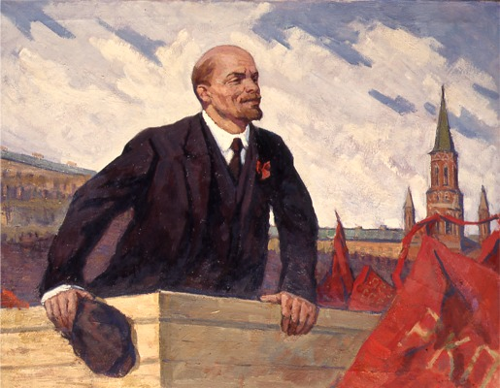
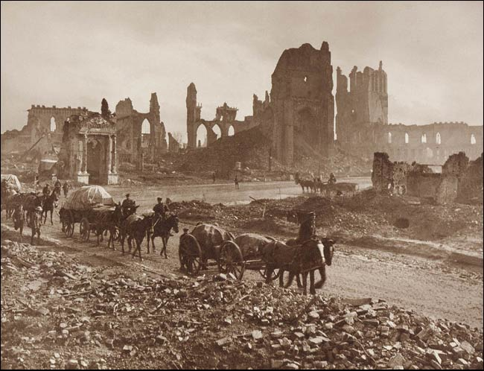
At what cost?
Generation of men dead.
Millions of people crippled, scarred.
Europe in ruin.
Russia = Communist.

Slide 46
What now?
European countries are gone or fatally weakened.
?
X
X
?
X
X
Notes:
Europe is in TROUBLE.

Slide 47
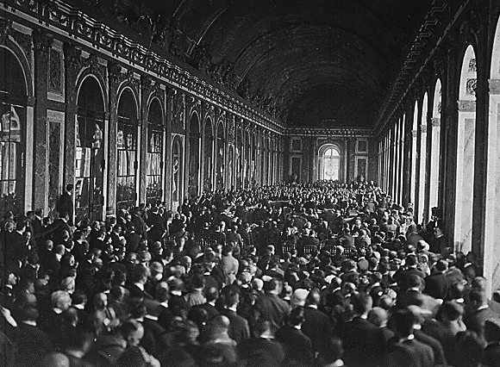
Paris Peace Conference
A conference after WWI to decide on the terms after the war
Created the Treaty of Versailles

Slide 48
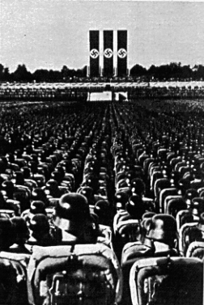
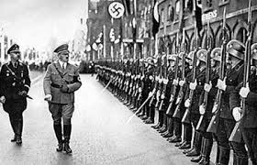
“Great war” will lead to…
…

