Slide 1
Early West African Civilizations

Slide 2
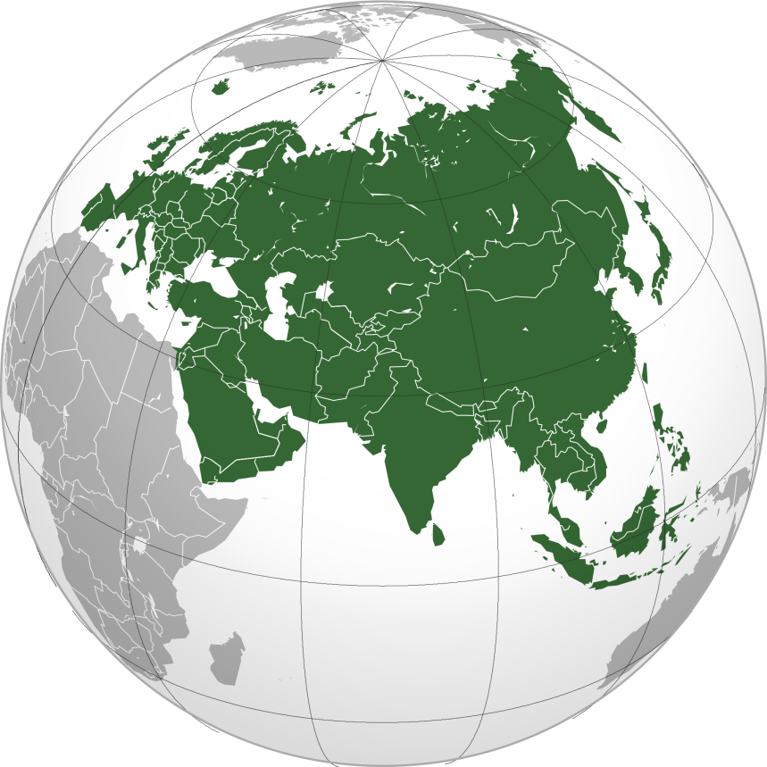
Why focus so heavily on Classical Eurasia?
More writing systems developed throughout
More and bigger civilizations
More people and more landmass covered by people

Slide 3
Niger Valley Civilizations
Niger Valley floodplain was fertile and had access to water
Introduction of ironworking and agricultural skills, domesticated cattle
Establishment of cities, but no overarching political structure or “state”
Larger towns were surrounded by areas of economic specialization
Iron smithing, weaving, pottery, etc.
Occupational castes—skills passed down to children, could only marry within group
Specialization within surrounding agricultural community

Slide 4
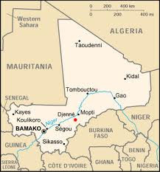
Trade Routes in West Africa
West African agricultural peoples began trading via the Niger River and overland via donkeys
Metal, cotton, gold, food
Nearly impossible to cross vast Sahara desert
Led to establishment of urban clusters (trade hubs)
Jenne-Jeno: Major city, site for “transshipment”—transfer of goods from boats to donkeys, or vice versa

Slide 5
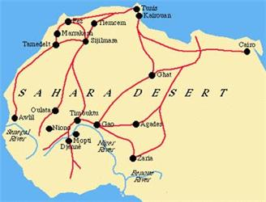
Trans-Saharan Trade Routes
Introduction of camels from the Middle East
Made travel across the Sahara possible
Sahara no longer an obstacle, but a trade route
Gold, ivory, kola nuts, slaves, horses, salt, cloth
Links West Africa to North Africa

Slide 6
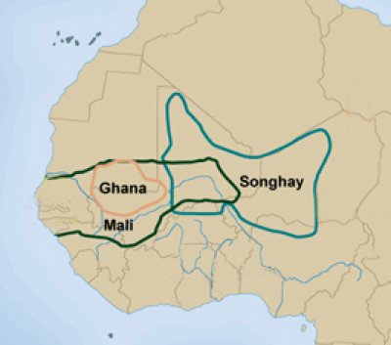
Impact of Trade
Construction of new city-states and empires
Kingdoms of Ghana, Mali, Songhay
Reputation for wealth, gained from taxing merchants
Elaborate court & administrative systems
Site of cultural exchange

Slide 7
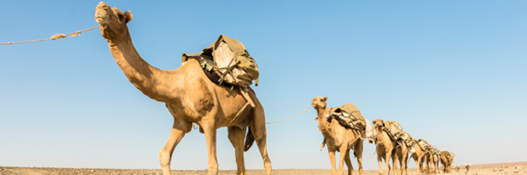
Salt Reading
What can we learn from present-day people about the past?

Slide 8
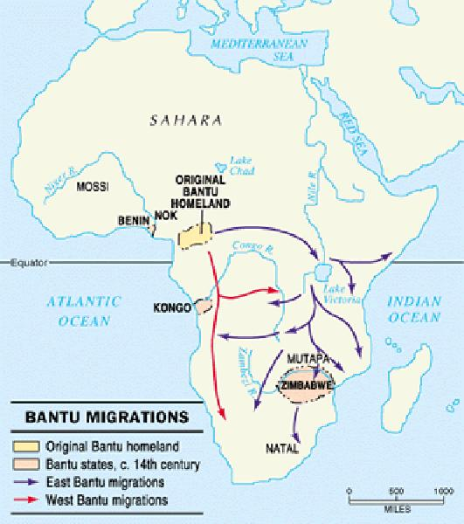
Bantu Africa
Bantu Migration: Over millennia, the Bantu-speaking people of Nigeria migrated into Central and Southern Africa

