Slide 1
Decolonization

Slide 2
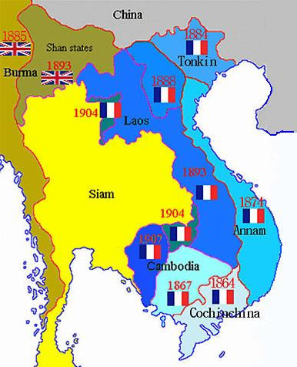
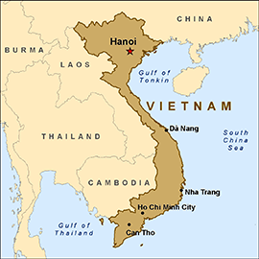
Vietnam: A Case Study in Communism and Decolonization

Slide 3
Cold War and Decolonization
After WWII, the once-mighty European empires began losing land and influence to native independence movements
Imperial breakups weren’t new; independence centered around a nationalist ideology was
Led to creation of new nation-states

Slide 4
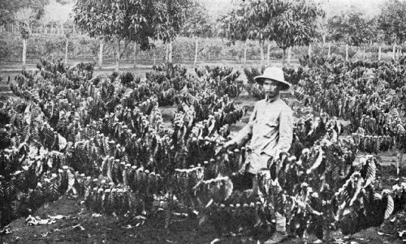
French Colonialism in Indochina
Large rice and rubber plantations
Poor working conditions, low-pay
Extensive taxation and opium sales
Vietnamese upper-class collaborated w/French

Slide 5
French Colonialism in Indochina
By the late 1880s France controlled Vietnam, Laos and Cambodia, known as French Indochina
Justified colonialism as a ‘civilizing mission’
In reality, driven by demand for resources, raw materials and cheap labor
Vietnam divided into three provinces—no national identity

Slide 6
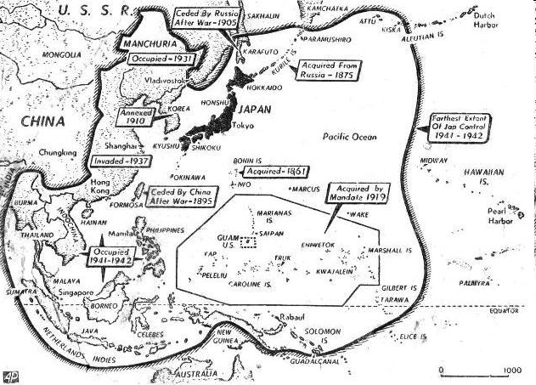
World War II
Vietnam had been an unwilling participant in Imperial Japan’s “Greater East Asia Co-Prosperity Sphere”
The defeat of Japan and the weakening of French colonial authority made independence possible

Slide 7
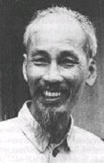
Viet Minh and Independence
Viet Minh: Vietnamese pro-independence group
Supported Communism
Supported by all classes of Vietnamese
Led by Ho Chi Minh
Expanded throughout northern Vietnam
Established new local governments, redistributed some lands, and helped to alleviate postwar famine.

Slide 8
Declaration of Independence of the Democratic Republic of Vietnam (September 2nd,1945)
1. How does the Viet Minh Declaration begin?
2. What grievances do the Vietnamese hold against the French?
3. According to the Vietnamese, what were the actions of the French colonialists during WWII? What effect did this have on the people of Vietnam?
4. How will the Vietnamese protect the independence they believed they have gained?
5. Why do the Vietnamese believe that other countries will recognize their independence?

Slide 9
Postwar Vietnam
DRV occupy the North (capital=Hanoi), French occupy the South (capital=Saigon)
French will recognize the North as a free state under the French, French troops still stationed in North (neither side happy)
Saigon (Ho Chi Minh City)

Slide 10
First Indochina War
Nov/Dec 1946, French and DRV forces attack each other in North Vietnam
France defined this more as a fight against communism than as a colonial war.
Beginning in 1949, the Chinese positioned troops along the Vietnamese border, sending weapons, supplies, etc.
The US declared that it would supply arms to the French in order to “contain” Communism

Slide 11
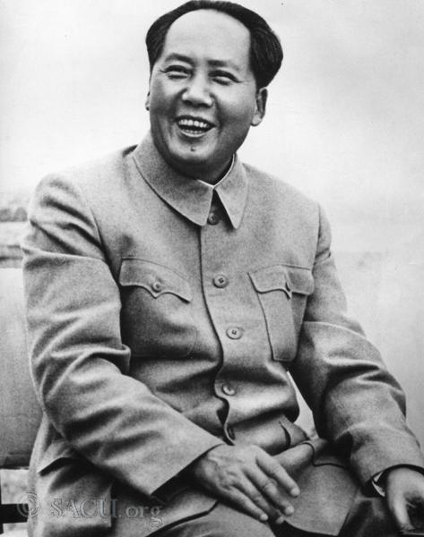
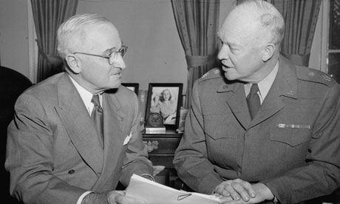
We will help our Communist brethren in Vietnam in their struggle to throw off the shackles of the oppressive colonial system which they have languished under for so long!
The U.S. is not in the business of helping European powers hold on to the last scraps of their dying empires…but we are in the business of stopping Communism wherever it rears its ugly head!
BETTER DEAD THAN RED!

Slide 12
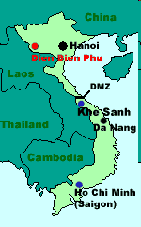
End of First Indochina War
DRV wins major battle at Dien Bien Phu (1954)
After eight years of war, French prepared to settle for a stalemate
Geneva Accord (1954)
Divided Vietnam into two separate cease-fire zones (French keep South)
Country to be unified in 1956 after a national election
DRV pressured to sign by China & USSR (don’t want U.S. getting involved)

Slide 13
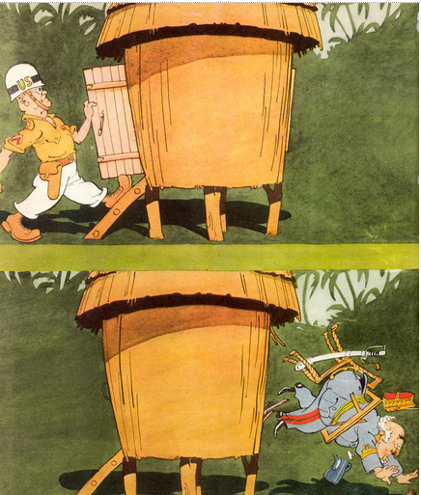
“A Friendly Meeting in Indo-China” (1955)

Slide 14
Aftermath
New government in the south led by Prime Minister/ Dictator Ngo Dinh Diem refused to hold national elections in 1956
Said that a free vote was impossible under the Communist government in the north
The US encouraged this violation of the accords
Wanted an independent South Vietnam
Wanted to resist the further spread of Communism in Southeast Asia
DRV tries to organize and gain support of factions in the South (Vietcong)
Leads to the Vietnam War

Slide 15
U.S. and Vietnam
1961, President John F. Kennedy provides military advisors and supplies for the South Vietnamese government
1964, Lyndon Johnson helps pass the Gulf of Tonkin Resolution, escalating the Vietnam War
1973, American troops withdraw
1975, North Vietnamese troops conquer Saigon, finally unifying Vietnam

Slide 16
Is it always Capitalism v. Communism?
Sometimes, Nationalism wins out
Vietnam invaded Communist Cambodia in late 1970’s
China invaded Vietnam in 1979 in retaliation

Slide 17
Panjabi MC
https://www.youtube.com/watch?v=DJztXj2GPfk

Slide 18
Decolonization and Independence in India

Slide 19
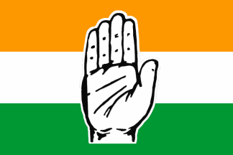
Indian Nationalism
Many Indians resented British control and rule
Indian National Congress (INC) (1885) – mainly made up of Hindus.
Muslim League (1906) - Islamic Indians
These groups began to call for independence

Slide 20
The Amritsar Massacre (1919)
https://www.youtube.com/watch?v=345aojByoGk
A British attack on Indian citizens who were holding a protest meeting
British soldiers fired on the crowd for 10 minutes, killing 379 and wounding more than 1,100 people
United all Indians (and much of the world) for Indian independence

Slide 21
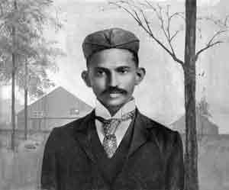
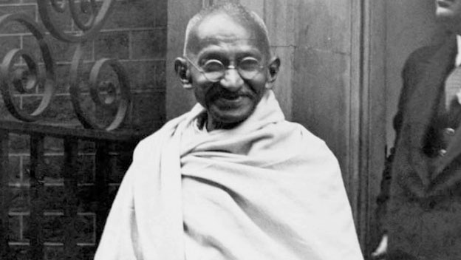
Mohandas (Mahatma) Gandhi
London-educated lawyer, civil rights activist in South Africa
Brings his philosophies of nonviolence and civil disobedience to India in 1915

Slide 22
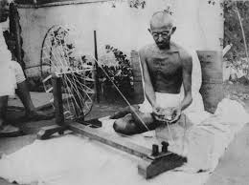
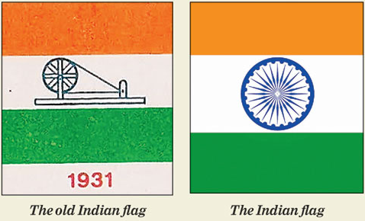
Civil Disobedience
Gandhi’s non-violent refusal to obey an unfair law.
Boycott British made goods
Refuse to attend second class schools
Refuse to pay unfair taxes.
Civil Disobedience had a noticeable affect on the British economy

Slide 23
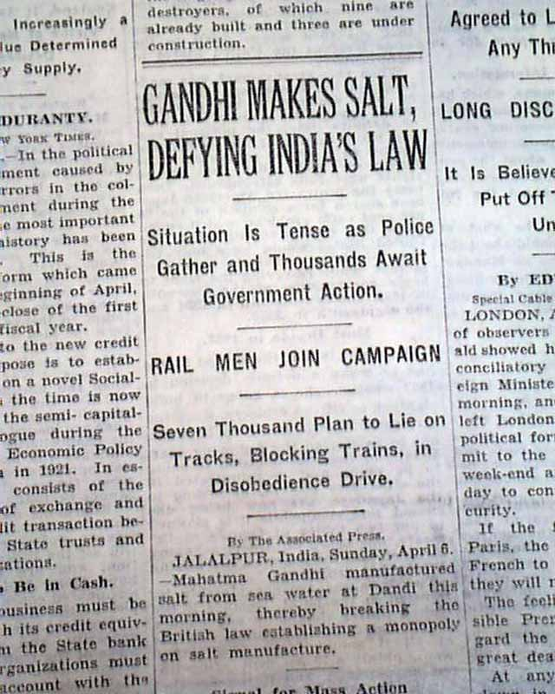
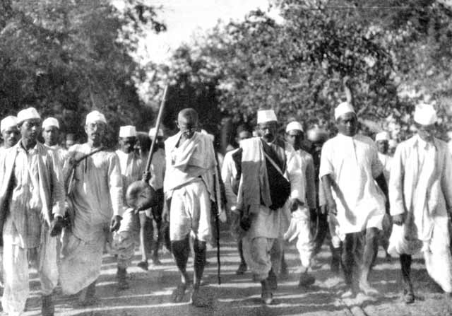
Salt March
Peaceful march and protest against the British salt tax in India in 1930.
Led by Gandhi who wanted to end the British monopoly on salt—walked 240 miles to the sea to collect salt.
Arrested, but gained favor of world press.

Slide 24
Independence
The British allowed more self government through the 1930’s—interrupted by WWII.
Many Indians fought for the British and some refused to fight.
India received complete independence in 1947.
Disputes broke out between Indian Hindus and Muslims about how the new country should be organized.

Slide 25
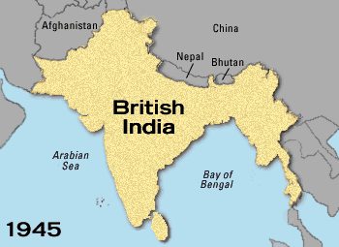

Slide 26
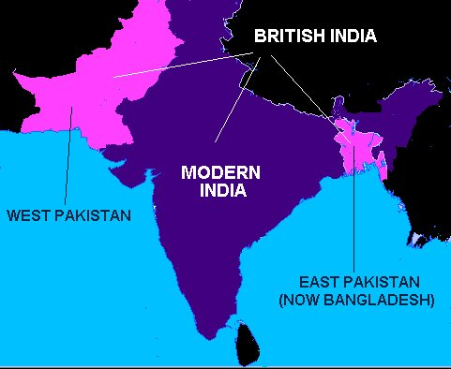
PAKISTAN=Punjab, Afghania, Kashmir, Sindh, and Baluchistan

Slide 27
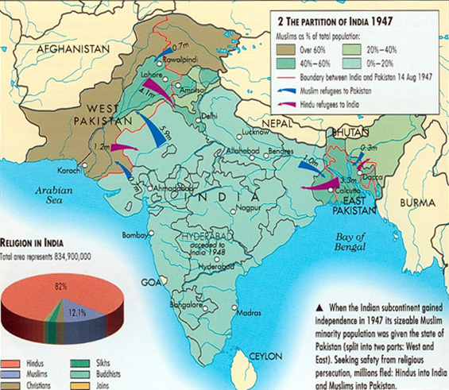

Slide 28
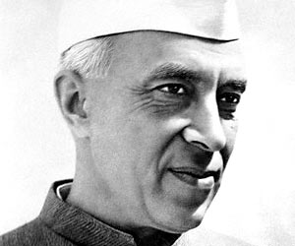
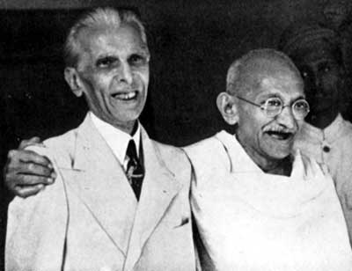
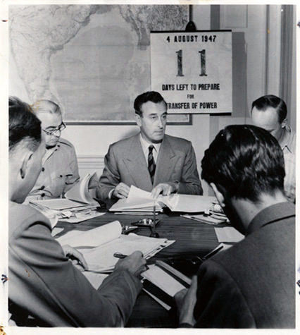
Partition of India
Nehru (Hindu)
Mountbatten (British)
Gandhi (Hindu)
Jinnah (Muslim)

Slide 29
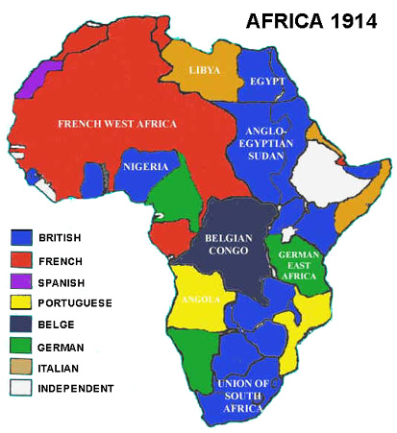
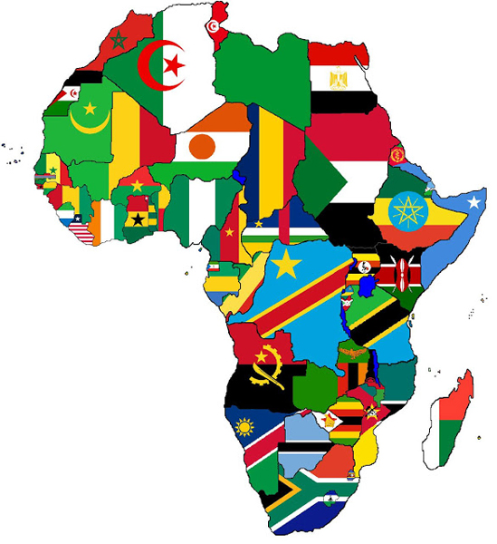
The Road to Independence South Africa and the African Continent

Slide 30
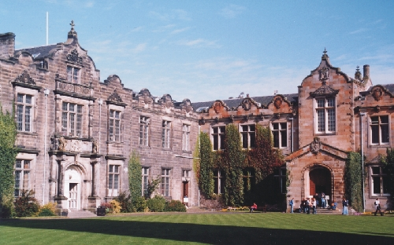
Moving Toward Independence
Colonial rule disrupted social systems and governments, robbing Africa of resources
1920’s-1930’s colonial rulers sent few Africans to attend universities; these people became educated; nationalism started to grow strong

Slide 31
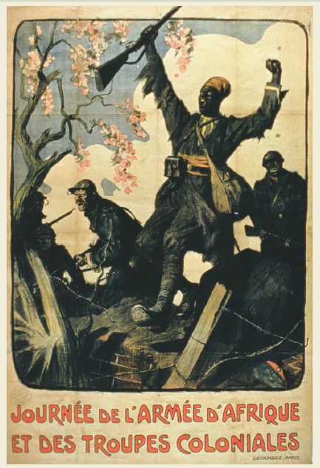
Pan-Africanism
Educated Africans believed they could govern themselves
Pan-Africanism: an idea that people of African descent around the world should work together for their freedom
1919: Pan-African Congress was organized
Series of meetings to address issues of decolonization and discrimination

Slide 32
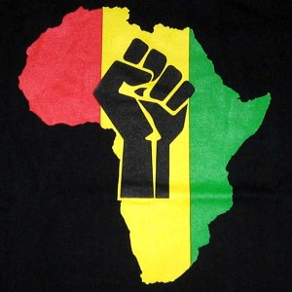
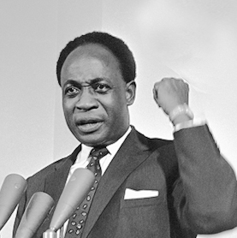
African Unity Reading—Kwame Nkrumah
Why did Nkrumah think unity was essential?
What challenges to unity did he identify?

Slide 33
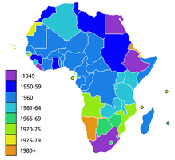
New African Countries
Between 1951-1980, most countries in Africa gained independence, but the paths to nationhood varied widely

Slide 34
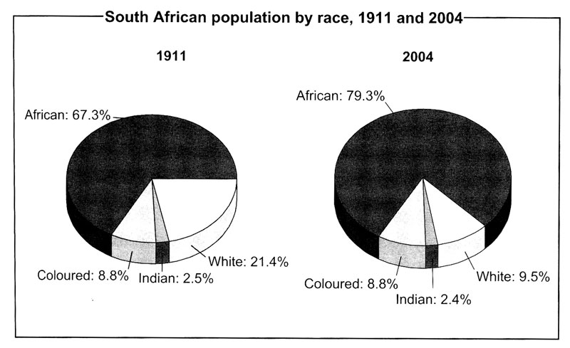
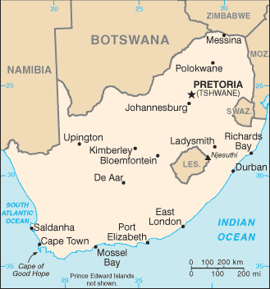
Independence of South Africa
British ruled South Africa, though there was a sizeable Dutch (Afrikaaner) population
UK gave SA independence in 1910; to appease Afrikaaners, heavy restrictions on black SA’s
Only white SA’s could vote; many laws passed to restrict nonwhites (segregation)

Slide 35
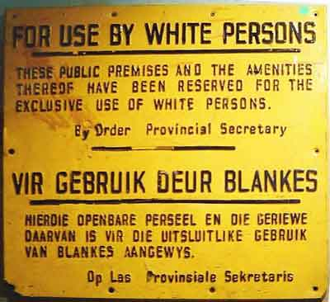
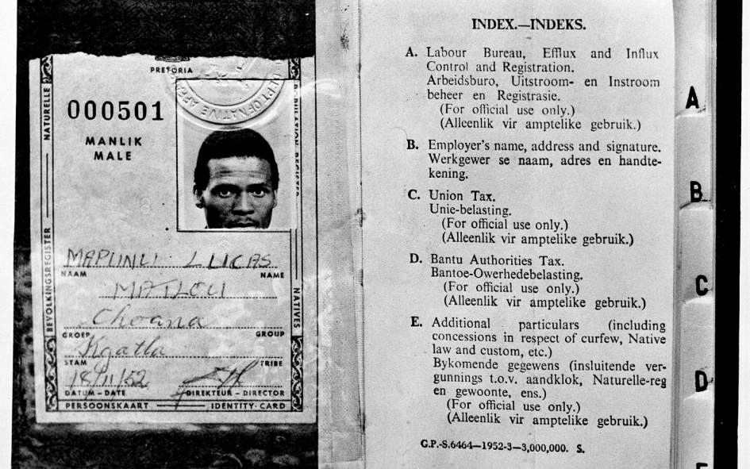
Apartheid
African National Congress (ANC) formed soon after independence to advocate for equality, political power for blacks
1948: official policy of racial segregation known as apartheid was adopted by Afrikaaner gov’t
Separate and unequal
Racial ID cards issued, separate facilities and differing treatment based on race

Slide 36
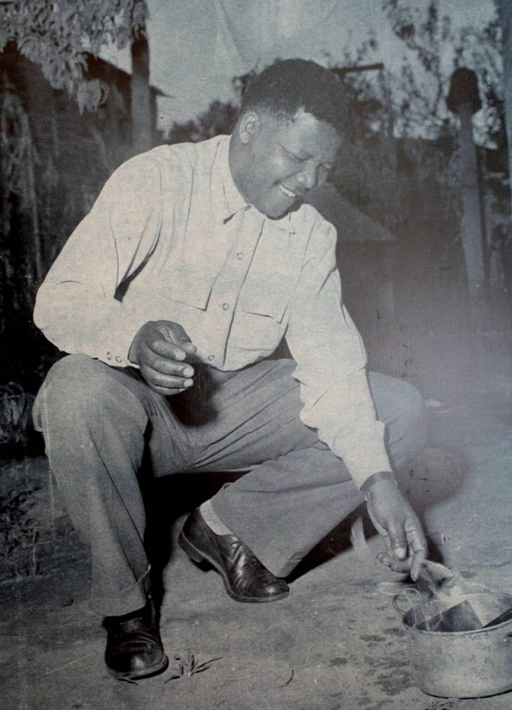
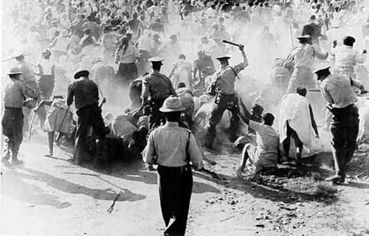
Sharpeville Massacre
Blacks protested having to travel with passes
During a nonviolent protest, 67 protestors killed by white police
Increased international pressure to end apartheid

Slide 37
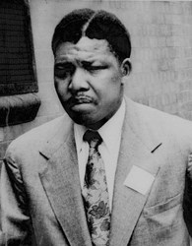
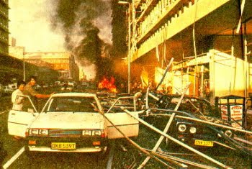
Nelson Mandela
Brought the ANC from nonviolence to ‘militant resistance’ to protest apartheid
Protests, bombings of power plants, gov’t buildings
Arrested several times for treason
Sentenced to life imprisonment in 1964

Slide 38
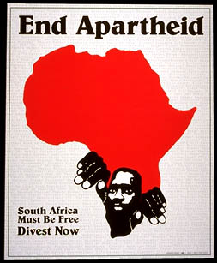
Soweto
Violence continued in apartheid SA
June 1976, black schoolchildren in Soweto staged protest against learning Afrikaan language
Resulted in police violence, 600 people killed over the ensuing months
Further international condemnation of gov’t
Soweto Blues: https://www.youtube.com/watch?v=p-rjW0Fg4QM

Slide 39
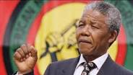
Fighting Apartheid
Mandela, offered freedom in 1973 only on the government’s terms, refused
Becomes symbol of freedom for South Africans
Britain and U.S. impose economic sanctions in 1985
Mandela freed in 1991 (27 years in prison)
1994: Apartheid ends, all South African adults could vote
Mandela elected as first president of post-apartheid republic

Slide 40
Independence in Nigeria
Nigeria gained independence from Great Britain in 1960.
Most expected the new country to be stable and calm.
Within a few months, war broke out between the Christian south and Muslim north.
WHY??
Many different ethnic groups living in Nigeria.
Many of these ethnic groups did not wish to be part of the same country.
This led to division and different treatment of the ethnic groups by the British.
British favored the south of Nigeria.

Slide 41
Independence in Nigeria
The religious war left many thousands dead.
Nigeria has the potential to have great wealth from their oil supplies.
Because of government corruption this resource has not been developed
As a result, Nigeria must rely on foreign aid and foreign supplies for their people.

Slide 42
Kenyan Independence
Many Kenyans thought the British had taken their land unfairly.
Rebellions against the British had begun in the early 1950’s.
Violence continued until 1960.
More and more Kenyans began to support the rebellions against the British.

Slide 43
Kenyan Independence
Eventually, their support convinced the British they would have to grant independence to Kenya.
The British helped Kenyans hold democratic elections.
They elected Jomo Kenyatta president in 1963. Kenya was independent was again.
Kenya claims to be a open and free democracy.

