Slide 1
Communism Short Answer Quiz
Describe the appeal of communism to people & nations who adopted it.
2. How were third-world countries impacted by the politics of the Cold War?
3. In what ways did the Soviet Union and China experience communism differently during the 20th century (NOT JUST the revolutions)?

Slide 2
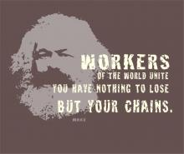
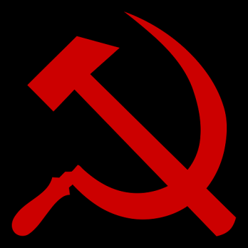
Communism
Karl Marx believed that the proletariat should unite, overthrow capitalism, set up a classless and propertyless society

Slide 3
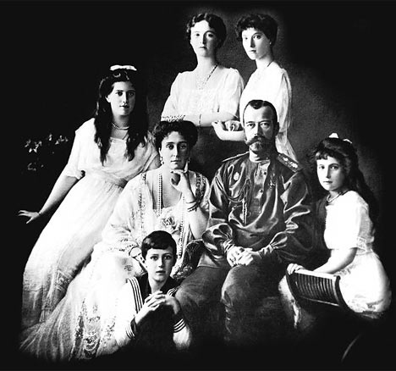
The Russian Revolution (1917 -1921)

Slide 4
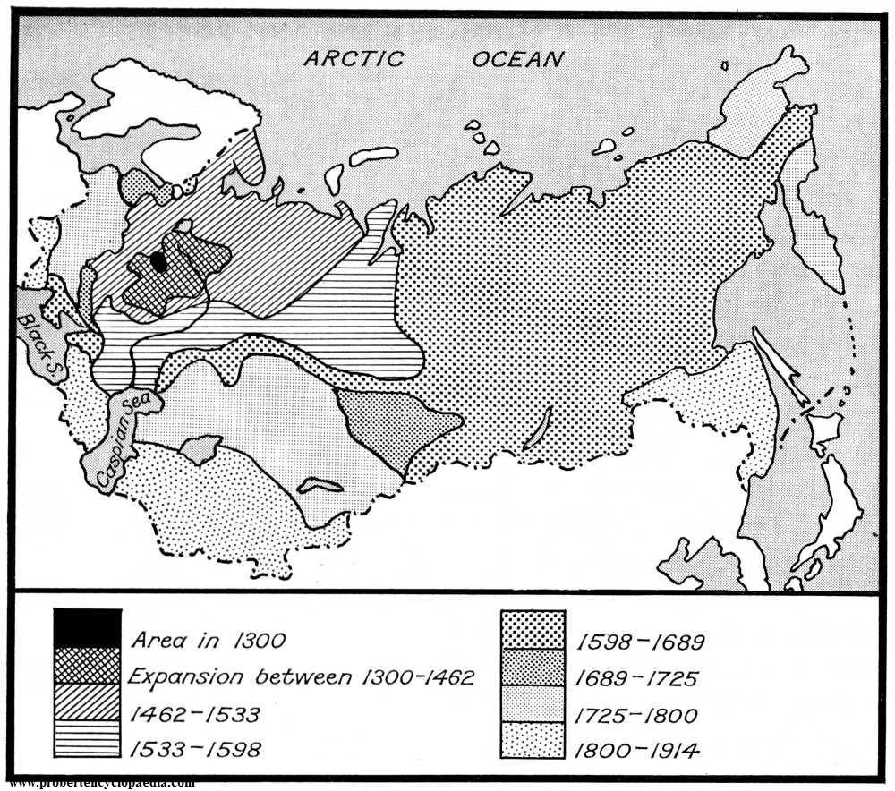
The Romanov Dynasty built Russia from a small duchy to the world’s largest nation.

Slide 5
Russia was ruled by Czars, run by nobles called boyars, and worked by poor peasants called serfs. Serfdom was abolished in 1861, but inequalities remained.

Slide 6
By the early 20th century, industrialization spread to a few major Russian cities, and created a new class of people – a middle class made up of factory workers. Class unrest remained.

Slide 7
Russia joined the allies in WWI, but was suffering heavy losses.

Slide 8
During the winter of 1917, soldiers at the front grew fed up with shortages and mismanagement. They threw down their weapons and went home. They were joined by factory workers and starving peasants. The revolution had begun.

Slide 9
To foment rebellion, the Germans sent Vladimir I. Lenin to St. Petersburg, where he began another revolution – the October Revolution.

Slide 10
Lenin’s simple message earned him the support of the masses.
“Bread, Peace, and Land!”

Slide 11
With the help of labor leader Leon Trotsky, Lenin’s Bolsheviks overthrew the government.

Slide 12
After taking power, Lenin did the following:
1. Declared himself the dictator of Russia
2. “Collectivized” all factories and farms (seized for “the people”)
3. Muzzled the press, abolished Christianity.
4. Put Trotsky in control of the Red Army
5. Set up a new secret police to silence his enemies (“Cheka” or “KGB”)
6. “Brainwashed” his people through propaganda, camps & terror.

Slide 13
Lenin also negotiated a separate peace with Germany at the Treaty of Brest-Litovsk.
(This allowed the Germans to concentrate on the Western Front where only the intervention of the USA saved the Allies from defeat.)

Slide 14
In addition, the Czar and his family were shot. (Romanov Dynasty 1613 – 1918)

Slide 15
At the end of the Civil War, Russia was a communist power on the rise. It would dominate the 20th Century by provoking revolutions, defeating Nazi Germany, and challenging the US for superpower status.
But Lenin did not live to see any of this. He died in 1925, to be replaced by one of the most powerful and feared leaders in world history:

Slide 16
Stalin’s Methods of Consolidating Power

Slide 17
The United States and Soviet Russia were not exactly friendly prior to World War II.
But something happened in the 1930s that allowed the U.S. and U.S.S.R. to put aside differences and become friendly…
Good Russians hate American Capitalist Pigs!
Good Americans hate Godless Soviet Communists!
Stalin, Dictator of USSR
FDR, President of USA

Slide 18
( Hitler happened.)
I hate Communists and Capitalists (and Jews and Poles and Blacks and talented artists and Gypsies and myself…)
Adolf Hitler’s rise to power caused Russia and the US to put aside their differences under the idea that “The enemy of my enemy is my friend.”

Slide 19
At the end of the war, relations were good between the U.S. and the U.S.S.R.
US soldiers
Soviet soldiers

Slide 20
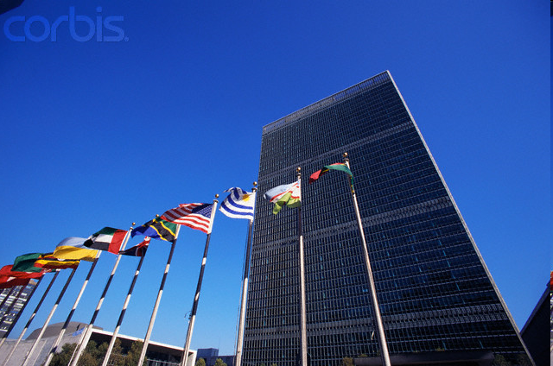
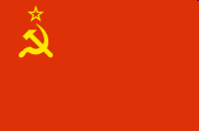
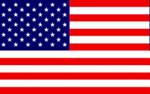
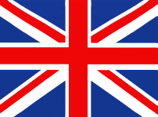
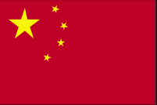
Many people thought that with Germany and Japan defeated, the world could begin a new era of prosperity and friendship.
The victorious Allies formed the “United
Nations” – an international organization
whose purpose was to peacefully
settle disputes between countries.
UN Members With Veto Power:

Slide 21
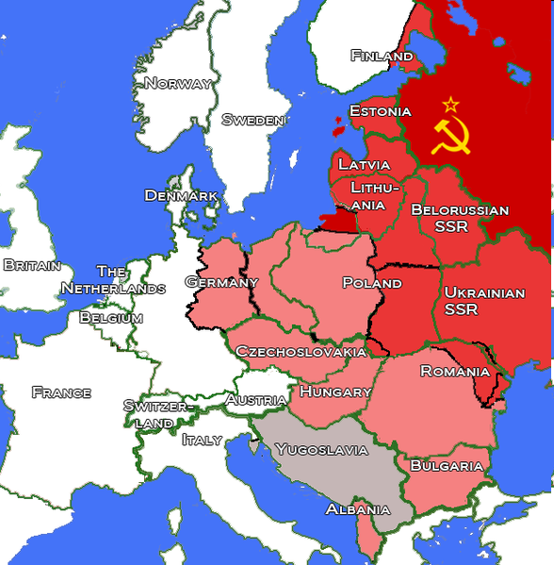
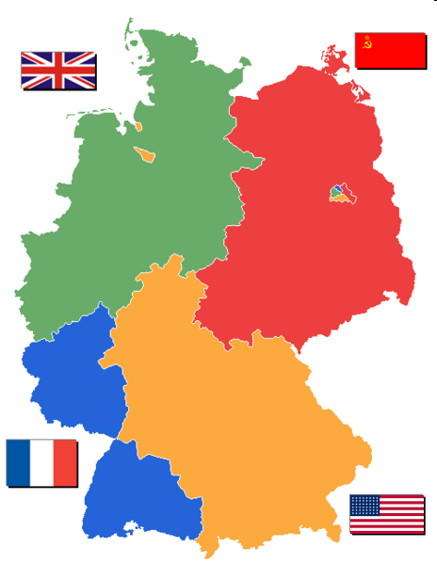
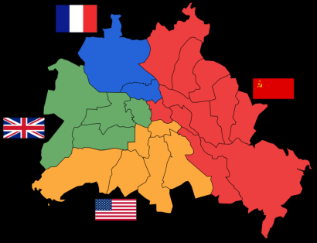
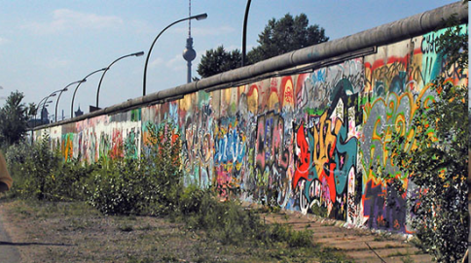
Problem 1: Divided Europe
Berlin
Germany
Europe
Berlin Wall

Slide 22
Problem 2: Stalin made promises that he did not keep.
“I promise to pull the Red Army out of Eastern Europe and allow the Poles and East Germans free elections.”
“But I don’t want to get invaded by Germany again, so I think I’ll just keep control over Eastern Europe if that’s cool.”
“Actually, I don’t care if it’s cool or not, I’m just going to do it anyway. YODO.”
Notes:
Was he just being mean? Yes & no. He was a ruthless, power-hungry dictator, but also he wanted a “buffer” between him and invaders from Western Europe.

Slide 23
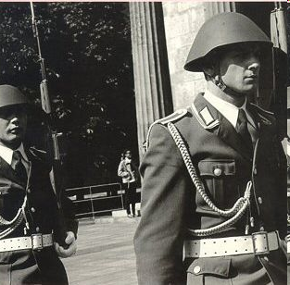
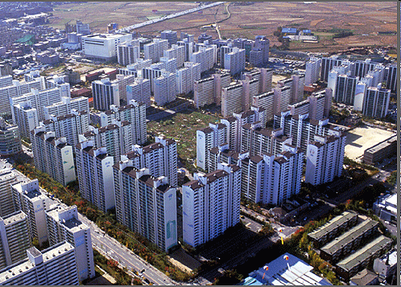
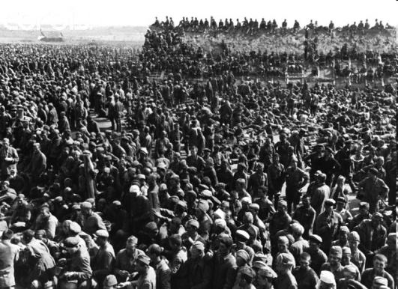
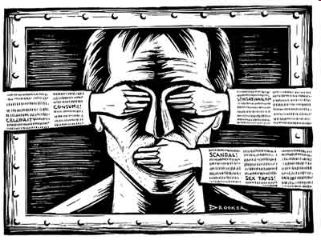
Problem 3: In Eastern Europe, Stalin’s allies set up Soviet-style dictatorships instead of democracies as promised. They became “satellites” to the USSR.
Communist
Dictatorships
Centralized economy
Oppression
Romania Hungary Czechoslovakia Poland Bulgaria East Germany
Censorship
Gulag prisons
Notes:
Remember to mention that Marx’s vision of equality for all was betrayed by Stalinism.

Slide 24
Within a few years, the West perceived that Stalin had built an “Iron Curtain” behind which the USSR called the shots.*
“…An iron curtain has descended across [Eastern Europe]. Behind that line [the people] all are subject, in one form or another, not only to Soviet influence but to a very high and in some cases increasing measure of control from Moscow. “
-- Churchill, 1946

Slide 25
To make matters worse, hunger and poverty allowed communist groups to gain influence in areas not yet controlled by the Soviets.
Iron Curtain
*Definition: The Iron Curtain was the militarized boundary between communist countries and the West.
France
Italy
Greece

Slide 26
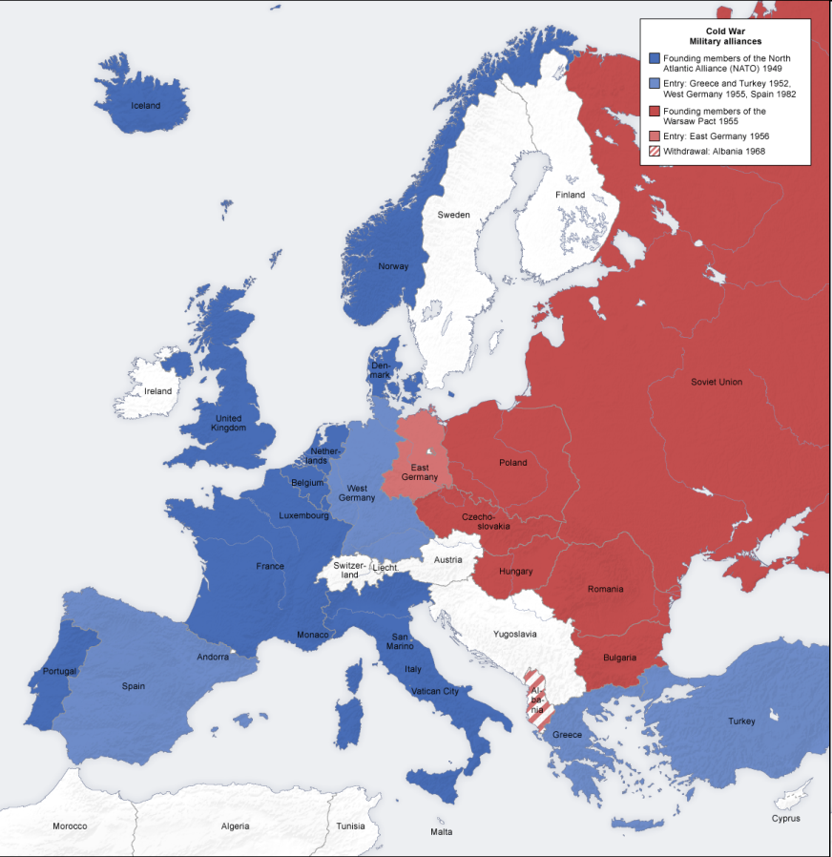
By 1948 Europe was split into hostile, armed camps. Each side formed a military alliance to defend itself from attack by the other.
“Western Europe”
American satellites
capitalist
NATO Alliance*
“Eastern Bloc”
Soviet satellites
communist
Warsaw Pact alliance
*NATO = North Atlantic Treaty Organization

Slide 27
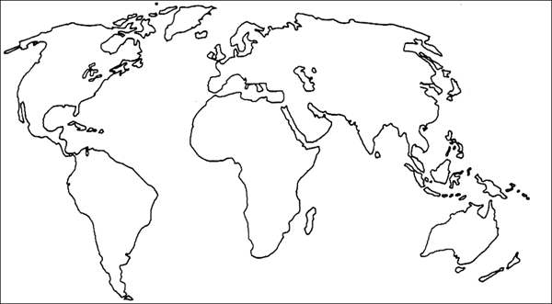
Competition between capitalism and
communism was not limited to Europe.
In Asia, communism was spreading, too.

Slide 28
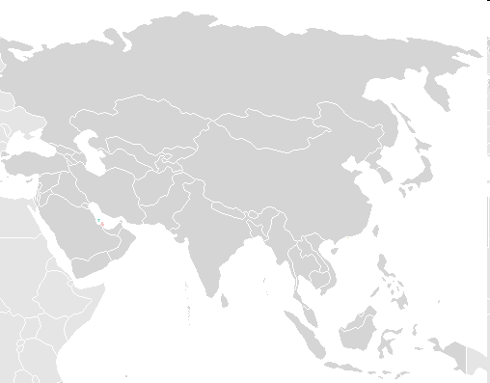
In Korea, a dispute between pro-Soviet and pro-U.S. forces led to the outbreak of war in 1950.
In China, Mao Tse Tung’s communists toppled the pro-US government of Chaing Kai Shek.
1946-1953
1945 - 1949
1945 - 1975
In Indochina, communist Viet Minh guerillas resumed their anti-colonial war against the French.

Slide 29
Shang
Zhou
Qin
Han
Sui
Tang
Song
Yuan
Ming
Qing
Republic
Mao Zedong/Mao Tse Tung

Slide 30
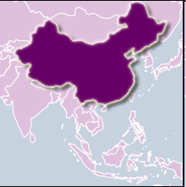
1949 China Becomes Communist
After 30 years of fighting, Mao Tse Tung’s Communist revolution succeeds in defeating Chiang Kai-Shek’s nationalist forces.
People’s Republic of China (mainland China)
Republic of China (Taiwan)
The pro-American Chinese forces flee to Taiwan, causing tensions that have remained high ever since.

Slide 31
Comparing and Contrasting USSR and Chinese Communism

Slide 32
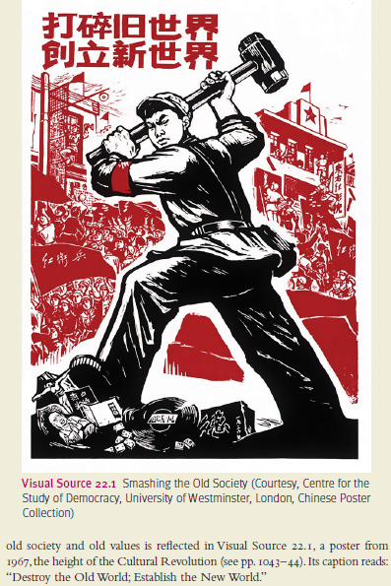
USSR v. Chinese Communism
Both achieved via violent revolution, cleansing of old society

Slide 33
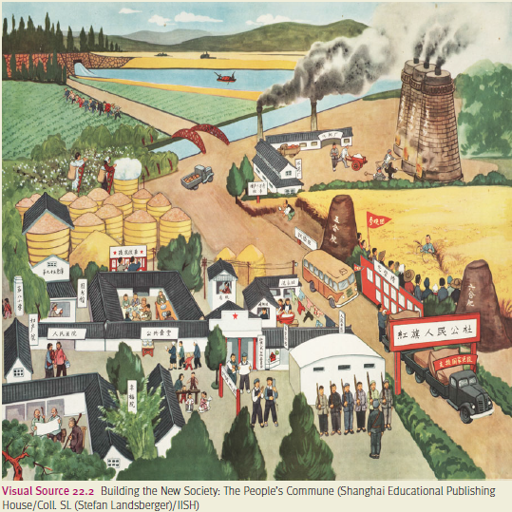
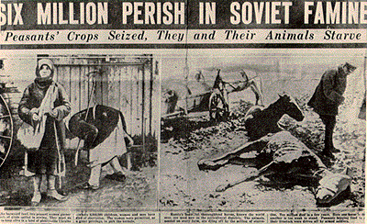
USSR v. Chinese Communism
Peasants claimed land peacefully after revolution
Resistance to collectivization, met with violence (see reading)
Millions of landlords executed after revolution
Peaceful collectivization

Slide 34
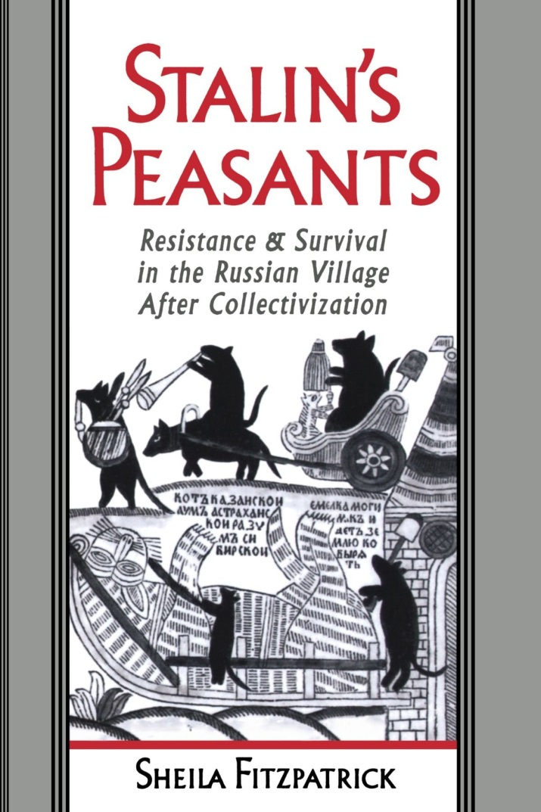
Collectivization Definitions
Kolhozy: The large collective farms
Muzhiks: Peasants
Kulaks: Rich peasants
Seredniak: Middle peasants
Bedniak: Poor peasants

Slide 35
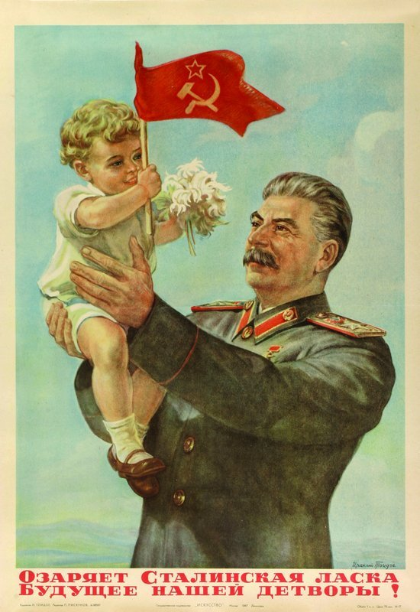
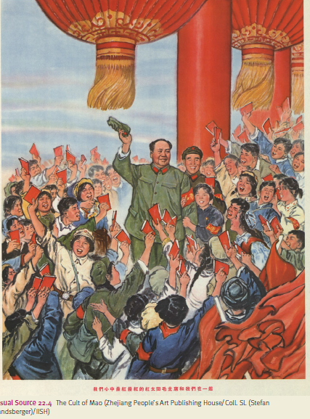
USSR v. Chinese Communism
Both rapidly modernized and industrialized
Both leaders had personality cults
Both purged Communist Party of enemies (Mao had Cultural Revolution)

Slide 36
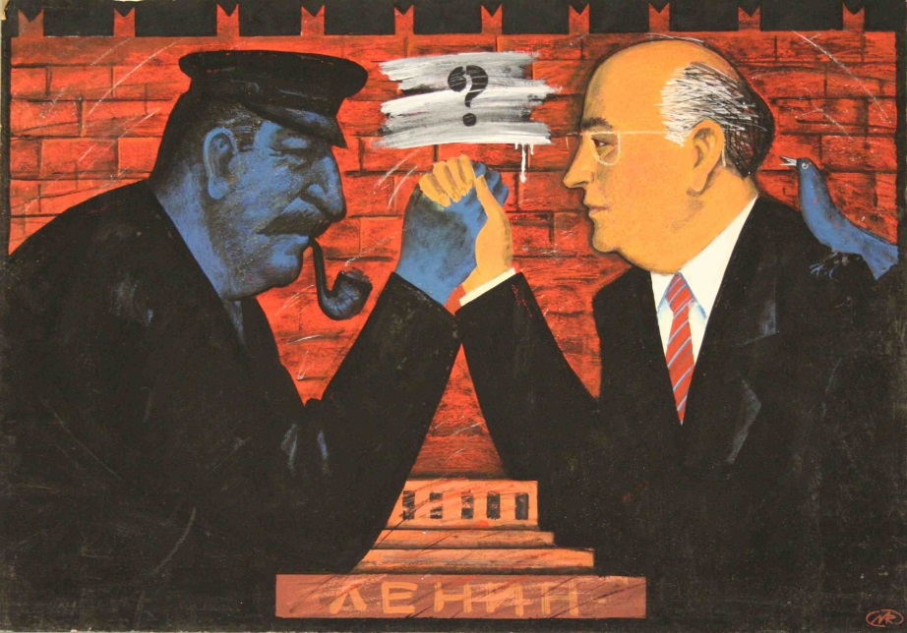
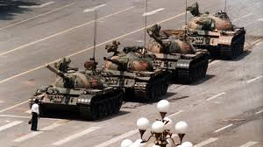
USSR v. Chinese Communism
In 1980s, began glasnost (openness) and perestroika (restructuring of economy)
Led to introduction of capitalist and democratic ideas, eventual fall of USSR
After death of Mao (1976), some economic reforms
Agitation for social and political reform met with violent reprisals

Slide 37
The Cold War

Slide 38
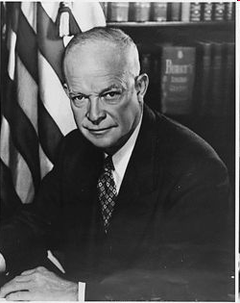
U.S. embarked on a policy of “containment” – fighting to keep communism from spreading wherever it appeared.
“[Countries vulnerable to communism are like] a row of dominoes set up, you knock over the first one, and what will happen to the last one is the certainty that it will go over very quickly..”
“Domino Theory”
President Eisenhower

Slide 39
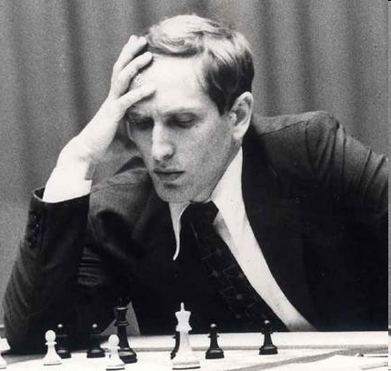
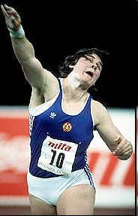
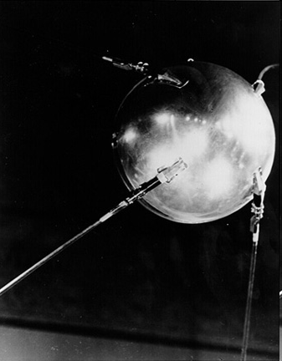
Chess
Both sides competed to be culturally and
scientifically superior to the other…
Olympics
Space Race
The Arts

Slide 40
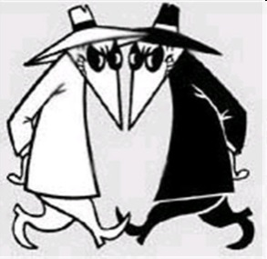
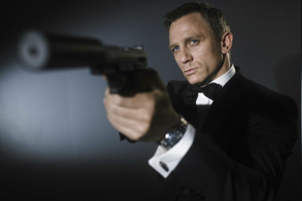
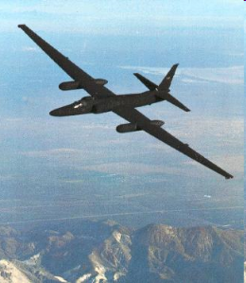
F.B.I.
Stasi
Both sides used spies and secret police to learn about the
enemy and terrorize “subversive” populations.
K.G.B.
C.I.A.
U2
Notes:
Georgi Markov assassinated in London by Bulgarian agents w/help from KGB (used ricin dart in umbrella)

Slide 41
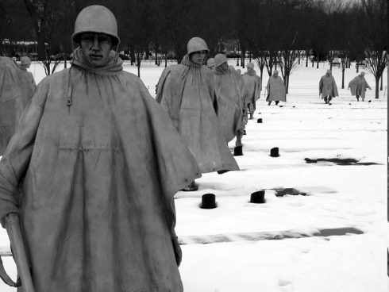
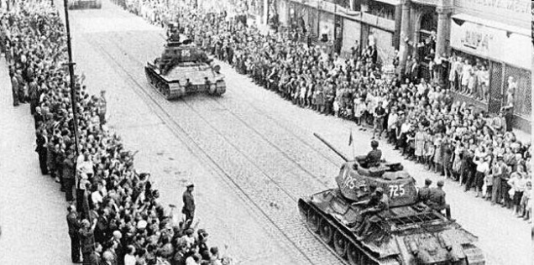
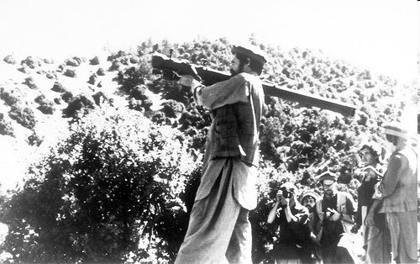
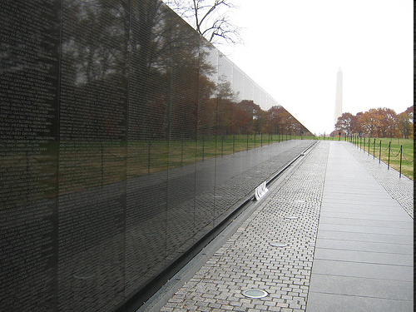
Czechoslovakia, 1968 (USSR)
Korean War (US), 1950-53
Both sides fought small-scale wars
to maintain influence over smaller nations.
Afghanistan (USSR), 1980 - 1987
Vietnam War (US), 1965-1975

Slide 42
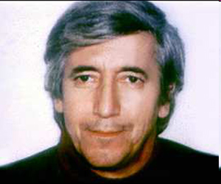
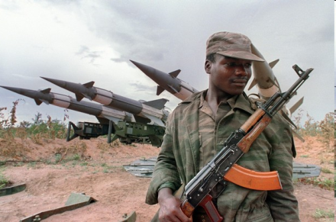
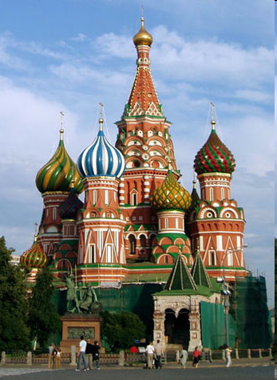
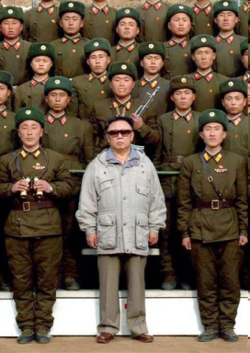
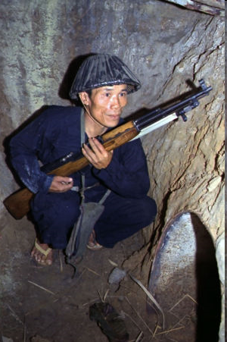
Both sides supported terrorism, assassination,
and revolution against
governments they considered hostile.
KGB Assassination
Military Support
Weapons and money in Angolan Civil War, 1975 - 1991
Georgi Markov, Bulgarian writer, killed with umbrella gun in London, 1978
Military Support
Military Support
Weapons and money to support N. Korean dictatorship, 1940s – 1990s
Support for Viet Cong overthrow of South Vietnam government, 1950s-1970s

Slide 43
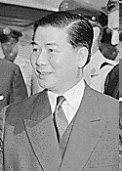
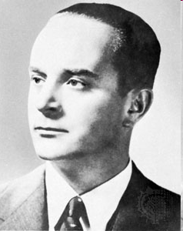
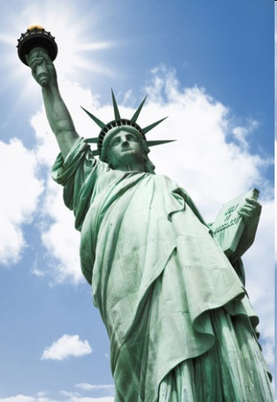
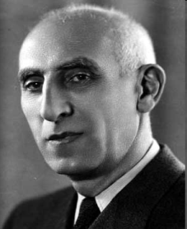
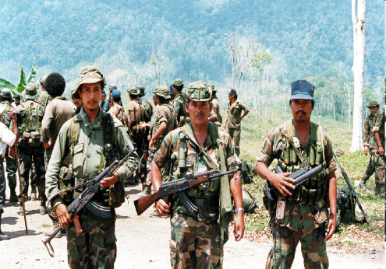
Both sides supported terrorism, assassination,
and revolution against
governments they considered hostile.
CIA Coup
CIA Coup
Ngo Diem, President of South Vietnam, assassinated with U.S. approval, 1963
J. Arbenz, President of Guatemala, 1954 replaced with dictator
CIA Coup
CIA Coup
CIA Coup
M. Mossadeq, President of Iran, deposed in CIA coup, 1953
Nicaraguan Death Squads, 1980s
Bay of Pigs Invasion, Cuba, 1963

Slide 44
Fear
What caused the Cold War?
Spying
Competition
Conquest
Arms Race

