Slide 1
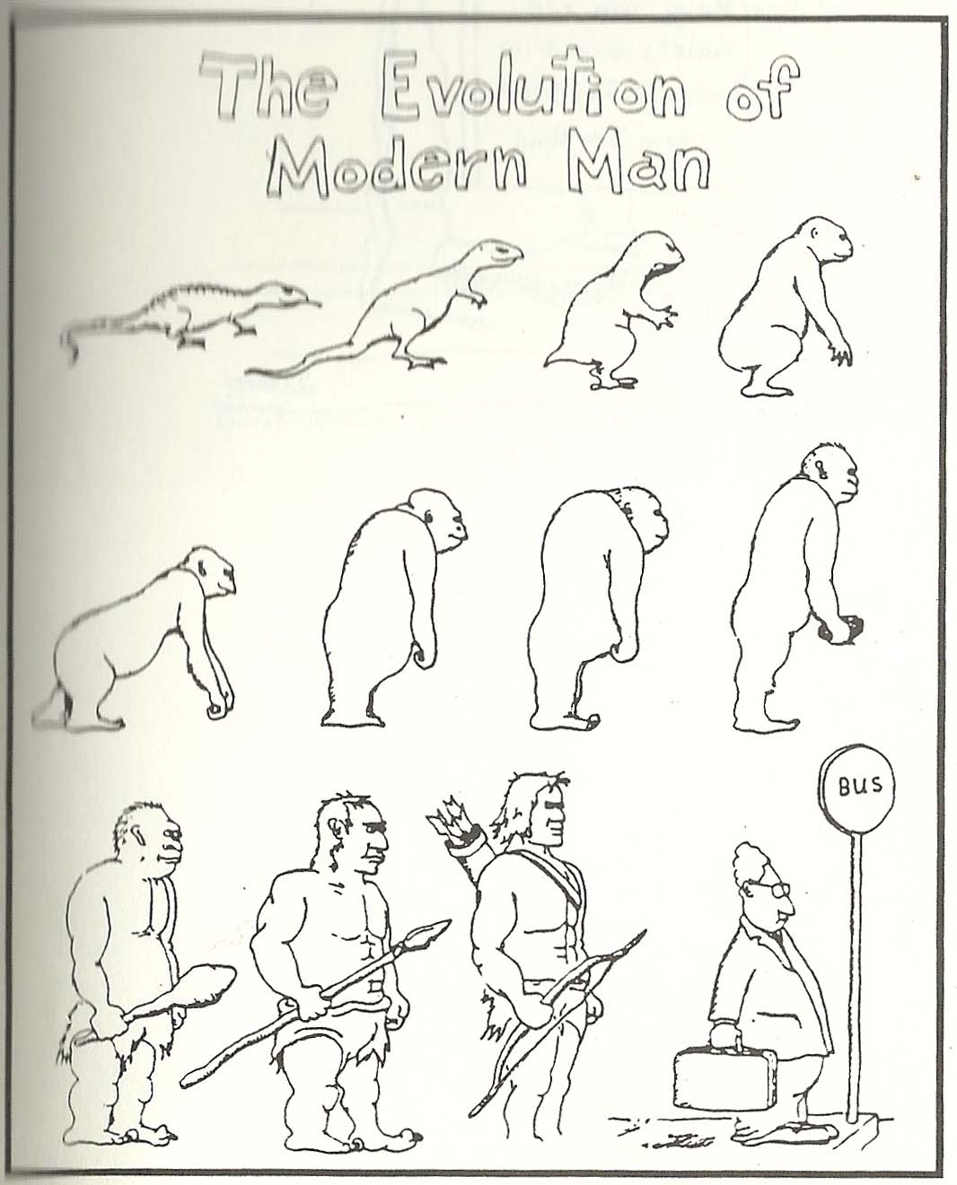
Chapter 1: Paleolithic Peoples and Prehistory

Slide 2
Beginnings
Hominids
Australopithecus (4 million – 1 million years ago)
Homo Erectus (1 millions years ago)
Homo Sapiens (200,000 years ago)
Migrations
Glaciers (60,000 – 15,000 years ago)
Following food supplies, changing environments

Slide 3
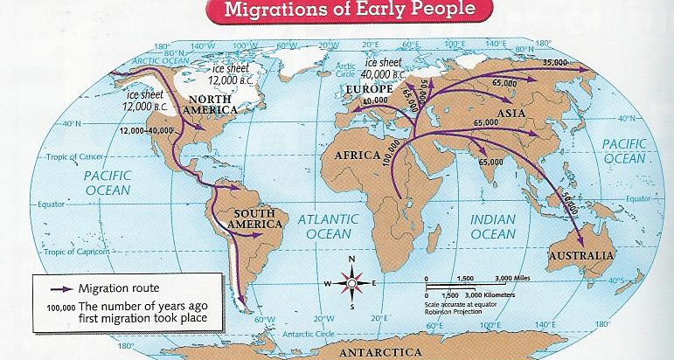
What was the sequence of human migration across the planet?
Flip to Page 14 in your textbook

Slide 4
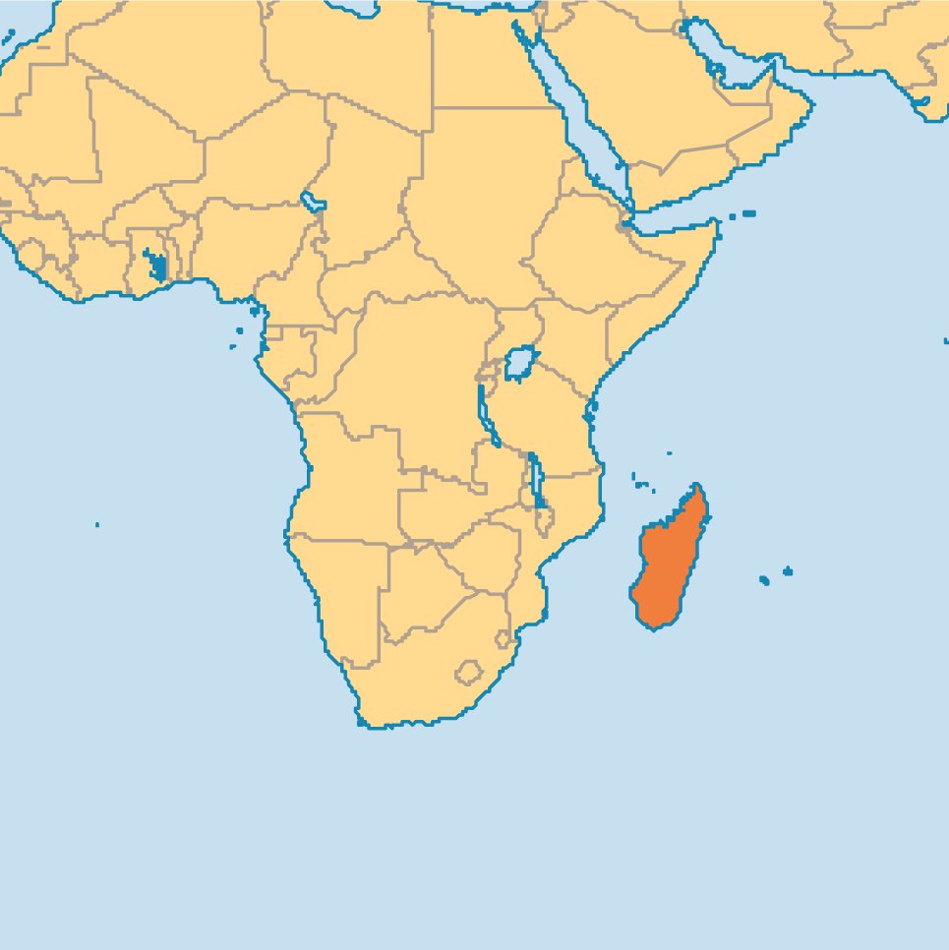
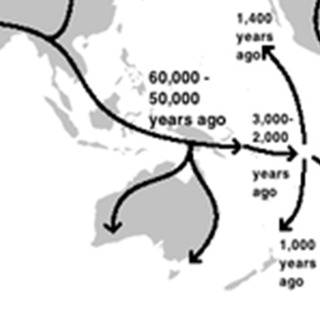
How did Austronesian migration differ?
Intent to colonize
Brought domesticated plants and animals
Created stratified society
Wreaked havoc on environment of islands

Slide 5
Economy
Hunter-Gatherer societies were usually…
Egalitarian
Small groups
Mobile
What made the Chumash culture different?
Permanence
Market economy
Stratified (hierarchical) society
Why were they different?
Abundance of resources
Led to permanence, trading of beads, hierarchy

Slide 6
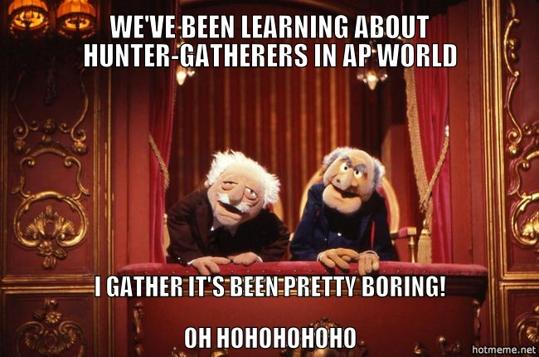

Slide 7
WARM-UP: How do historians learn information about hunter-gatherers?
For the most part, archaeological evidence.

Slide 8
Clovis Points
Distinctive “projectile point” created by the Clovis culture, found throughout North America (c. 12,000-11,000 years ago)
What does this tell us about their culture?

Slide 9
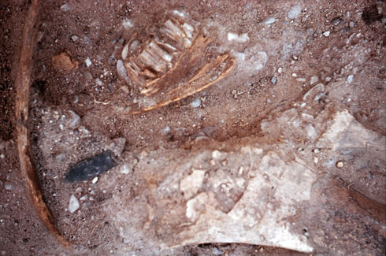
Clovis point
Bison jawbone
Mammoth bone

Slide 10
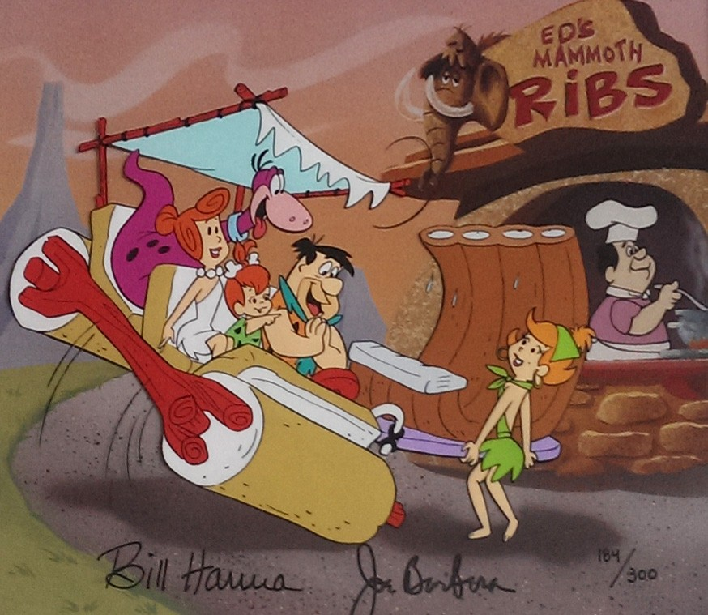

Slide 11
Clovis Points
Often used to take down “megafauna” (large animals like mammoths)
Archaeological records show a proliferation of Clovis points, until a sudden drop-off about 10,900 years ago.
Occurs at the same time as extinction of mammoths, horses, and camels in N. America
Did these animals get hunted to extinction, or did the climate shift? Experts disagree…
But people adapted! They hunted the bison, fished, moved into desert regions, farmed or settled in large hunter-gatherer states

Slide 12
Gender Relations
Usually, men were the hunters and women were the gatherers
How do we know? We find more males skeletons that had been attacked by animals, and male skeletons are sometimes buried with hunting tools

Slide 13
Way of Life
In many places, hunter-gatherers used art to document their way of life
Lascaux caves in France, Rock art by the San people of Southern Africa

Slide 14
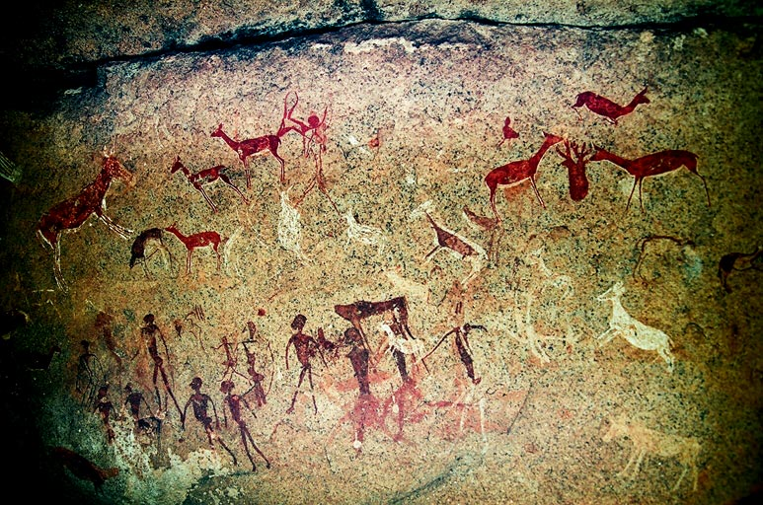

Slide 15
Can we use firsthand accounts to learn about the lifestyle of hunter-gatherers?

Slide 16
Classwork/Homework
Read the account of Nisa, a San woman interviewed in the 1970’s about her life. (pp. 34-39)
As you read, fill out the SPRITE chart.
You will be inferring information about the social, political, religious, intellectual/artistic, technological, and economic beliefs and practices of the San people from Nisa’s account/interview
Next class, you’ll have your World Regions quiz, then we’ll discuss our findings together as a class

