Slide 1
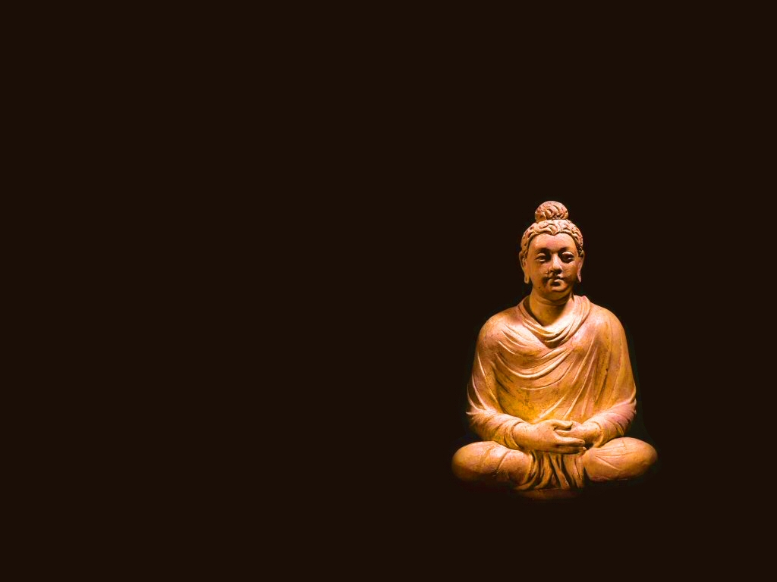
Buddhism

Slide 2
Siddhartha Gautama (566-486 BCE)
Originally an Indian prince
Set off on spiritual quest after encountering death & suffering
Achieved “enlightenment” at 35, traveled and taught for many years
Became the Buddha, the Enlightened One

Slide 3
Teachings of the Buddha
The Four Noble Truths
Life is Suffering
Suffering is caused by desire
To end suffering, remove desire
By removing desire, we can achieve perfect happiness and enlightenment (nirvana)

Slide 4
Buddhism and Hinduism
Buddhism maintained…
Ordinary life is not the be-all, end-all
Rebirth/reincarnation
Meditation
Buddhism challenged…
Religious authority of Brahmins (rituals, sacrifices)
Individual responsibility for spiritual development
Caste and gender inequalities: all can be enlightened
Order of Buddhist Nuns

Slide 5
Two Forms of Buddhism
Theravada (Lesser Vehicle) Buddhism
Buddha as wise teacher, not divine being
Individuals were on their own to achieve enlightenment
Mahayana (Greater Vehicle) Buddhism
Help was available in achieving enlightenment
Bodhisattvas: Enlightened individuals who assist others
More supernatural, centered on salvation

Slide 6
Decline of Buddhism in India
Mahayana Buddhism would spread in Asia
In India, its teachings were absorbed into Hinduism
Emphasis on spiritual progress being possible for all (not just Brahmins)
By performing duties of your caste
Proliferation of bhakti movement: Devotion to particular gods/goddesses
Buddha became a Hindu god (assimilation)

Slide 7
The Story of India
http://www.youtube.com/watch?v=63Jw0Ky6ZpQ
9:00-25:00 (buddha)

