Slide 1
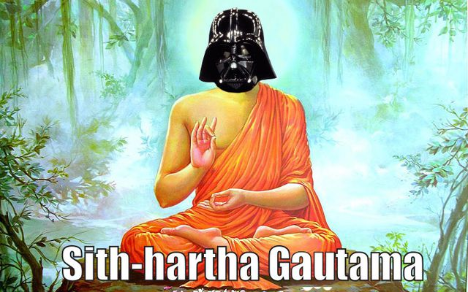

Slide 2
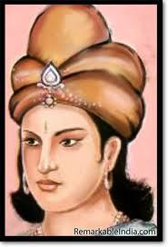
Ashoka and the Mauryan Empire

Slide 3
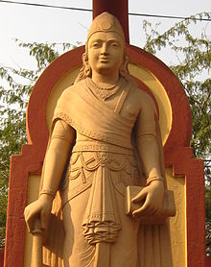
MAURYAN EMPIRE (326-184 BCE)
Founded by Chandragupta
Conquered previous empire
Attacked remnants of Alexander the Great’s empire (Seleucid) in India
Empire extended from Afghanistan to Bangladesh, and into Southern India

Slide 4
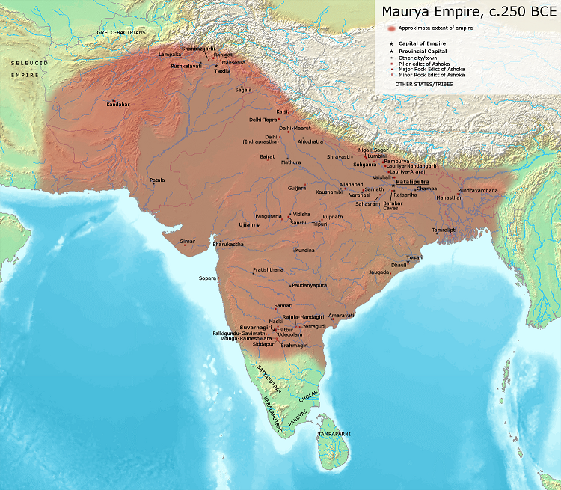

Slide 5
Mauryan Empire
Large military force
Large bureaucracy, spy network
State-run industries funded by high taxes
Chandragupta left power to attain moksha

Slide 6
Ashoka (268-232 BCE)
Most well-known Mauryan Emperor (grandson of Chandragupta)
Converted to Buddhism after waging brutal war
Advocated and spread Buddhism and message of peace
“What have I done? If this is a victory, what's a defeat then? Is this a victory or a defeat? Is this justice or injustice? Is it gallantry or a rout? Is it valor to kill innocent children and women? Did I do it to widen the empire and for prosperity or to destroy the other's kingdom and splendor? One has lost her husband, someone else a father, someone a child, someone an unborn infant.... What's this debris of the corpses? Are these marks of victory or defeat? Are these vultures, crows, eagles the messengers of death or evil?”

Slide 7
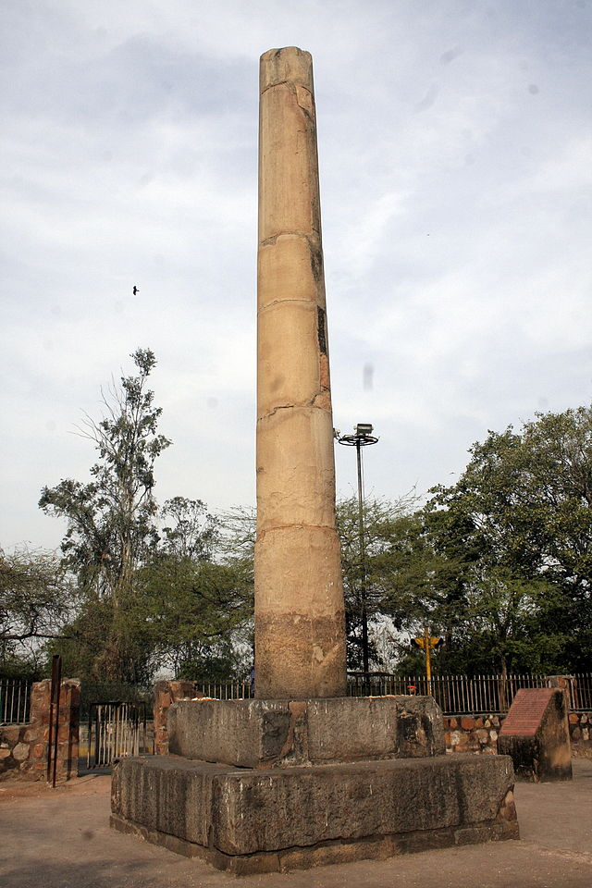
Ashoka’s Rock Edicts
Ashoka published his edicts (laws) on large pillars throughout his empire
Public display of laws
Ashoka’s Mauryan Empire broke apart after his death

Slide 8
Crash cOURSE
http://www.youtube.com/watch?v=8Nn5uqE3C9w

Slide 9
The Story of India
http://www.youtube.com/watch?v=63Jw0Ky6ZpQ
29:00-56:00 (maurya and ashoka)
42:00-56:00 (ashoka)

