Slide 1
Africa
Classical Civilizations
Do you hear the drums echoing tonight?
Or only whispers of some quite conversation?

Slide 2
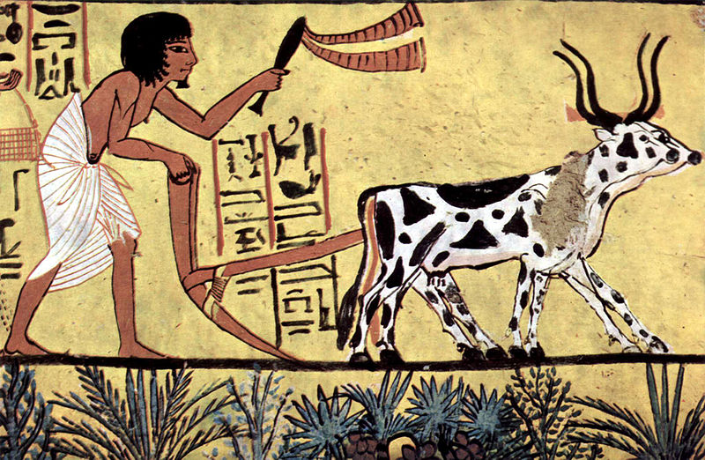
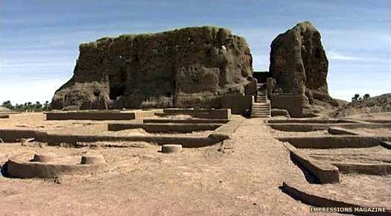
Early Civilizations

Slide 3
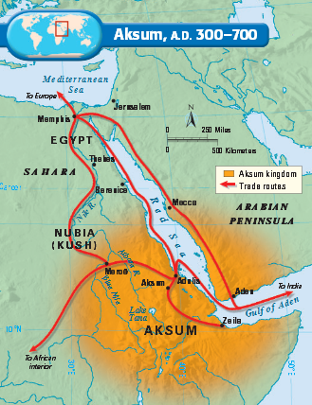
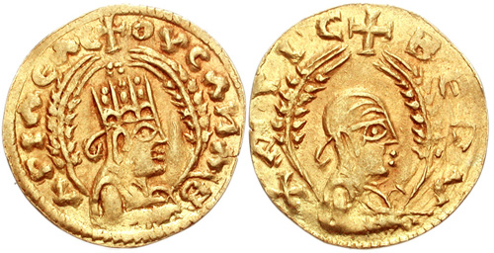
Classical Civilizations

Slide 4
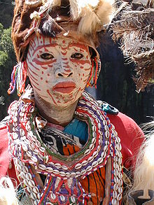
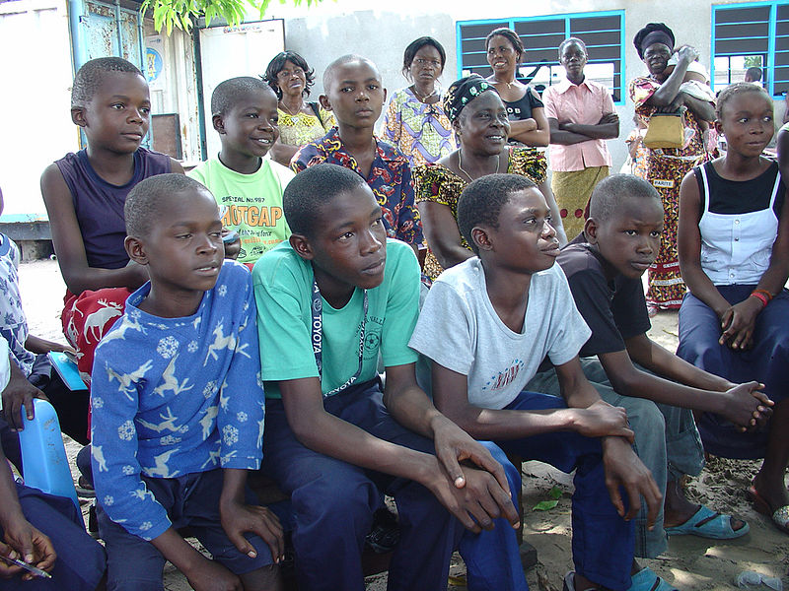
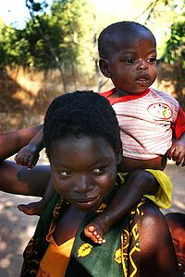
Bantu People
300-600 ethnic groups in Africa who speak Bantu languages
Zulu (~10 million people)
Swahili (~5-10 million people)

Slide 5
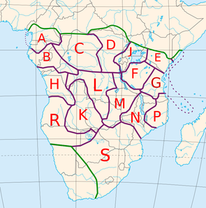
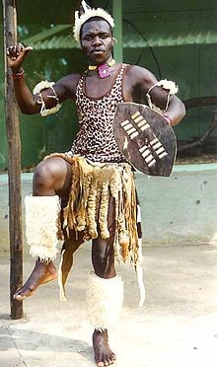
Bantu Expansion
1500BCE – 1000CE
Productive Agriculture
Iron Tools
Disease & Immunity

Slide 6
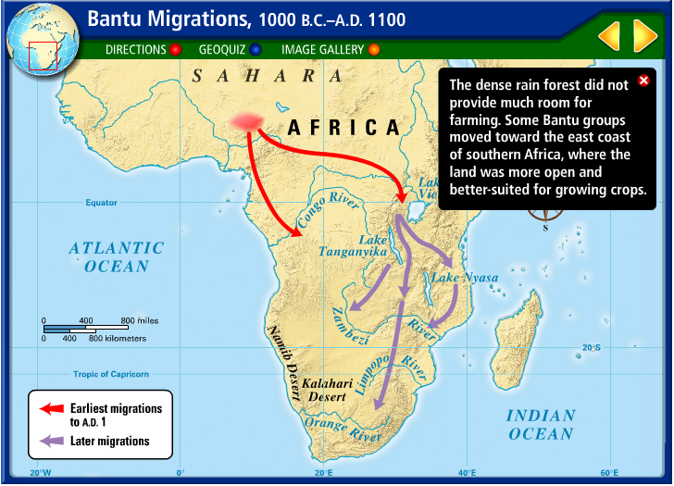
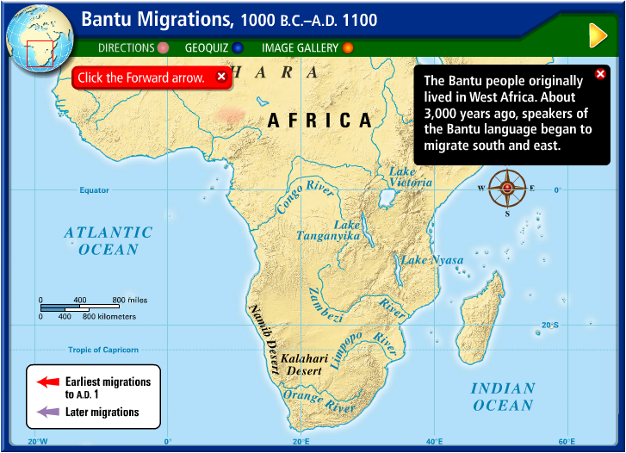
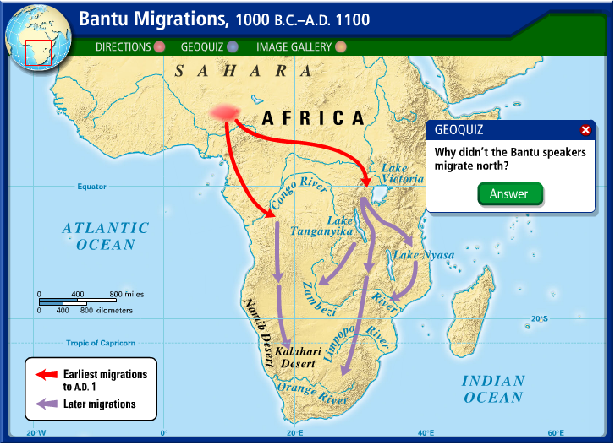
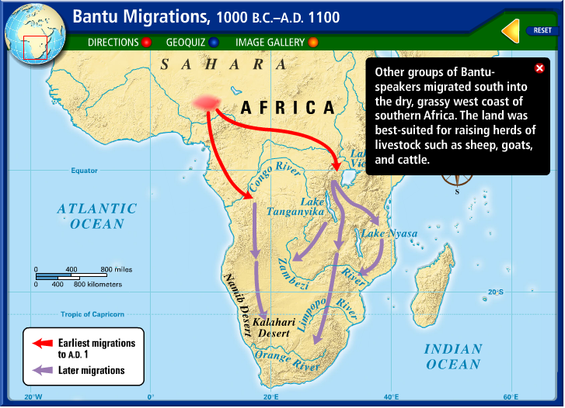
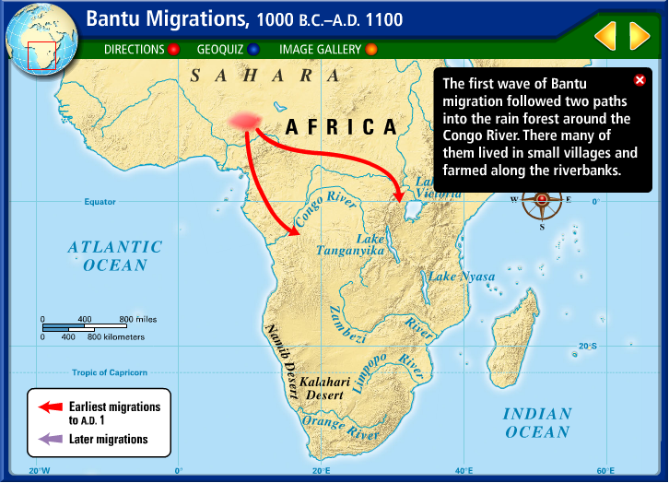
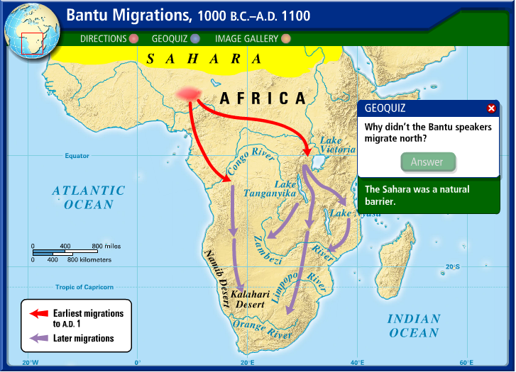
Notes:
http://www.eduplace.com/kids/socsci/ca/books/bkf3/imaps/AC_06_206_bantu/AC_06_206_bantu.html

Slide 7
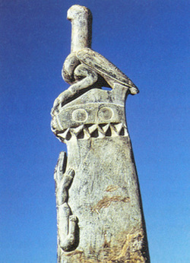
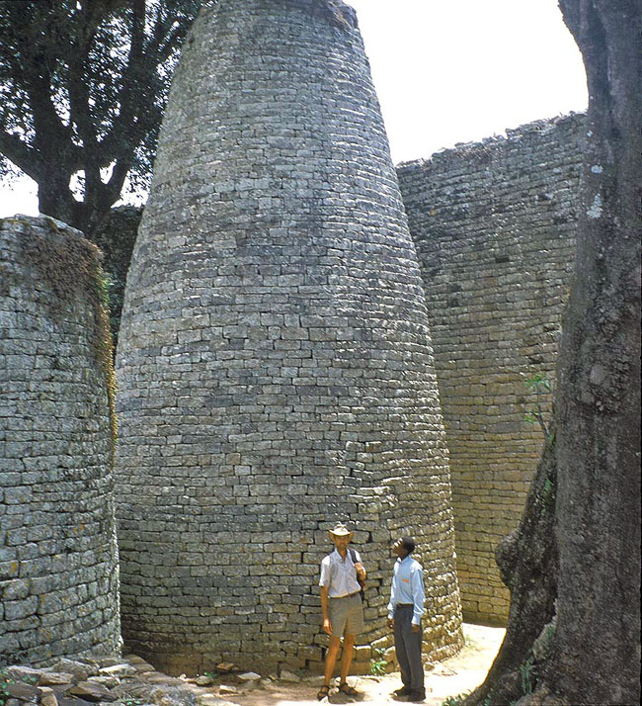
Great Zimbabwe (1100-1400 CE)
Complex of massive stone walls—largest structure south of the Sahara
Believed that it was created to separate the upper class from the commoners

Slide 8
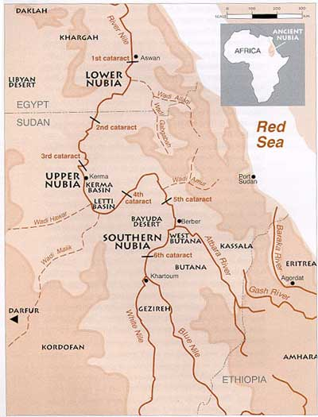
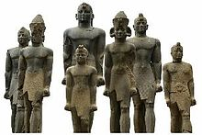
Nubia (Kush)
African Civilization
first kingdom ~3300BCE
Gold, Incense, Ebony, Copper, Ivory
Invaded by Egypt (~1500BCE)
Conquered Egypt (~700BCE)

Slide 9
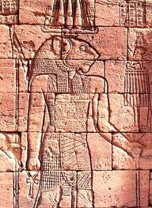
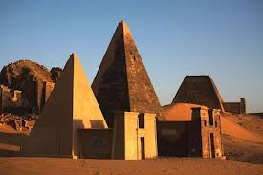
Meroe
~300 BCE – ~300 CE
Nubian civilization
City-state with all-powerful monarch (could be female)
Rainfall-based agriculture: less dependent on irrigation
Wealth and power dependent on Egyptian and long-distance trade
Lion-god Apedemak
Conquered by Axum after period of deforestation

Slide 10
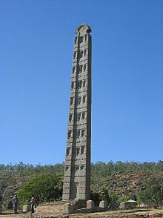
Axum (Aksum)
~50CE - 940CE
Plow-based Agriculture
Red Sea Trade
Polytheistic?
Christianized (~300CE): King converted first, people followed
Monumental Obelisks
Orthodox Church of Ethiopia:
Queen of Sheba and King Solomon???
Ark of the Covenant?

Slide 11
