Slide 1
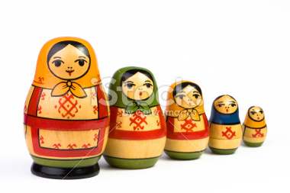
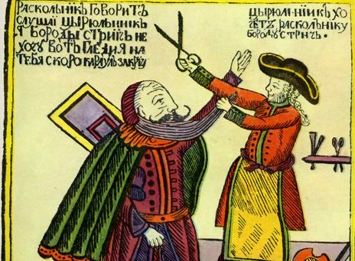
Russian History

Slide 2
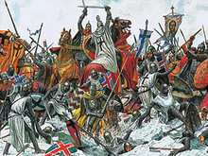
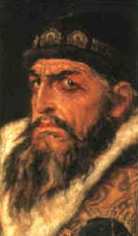
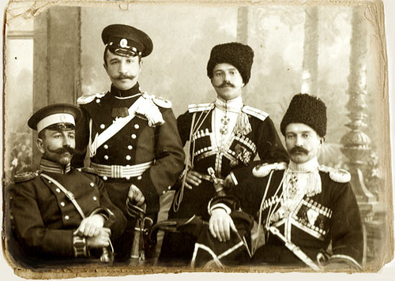
Three Main Periods of Russian History (before Communism!)
Kievan Rus (860-1240)
Tsardom of Russia (1547-1721)
Imperial Period (1721-1917)

Slide 3
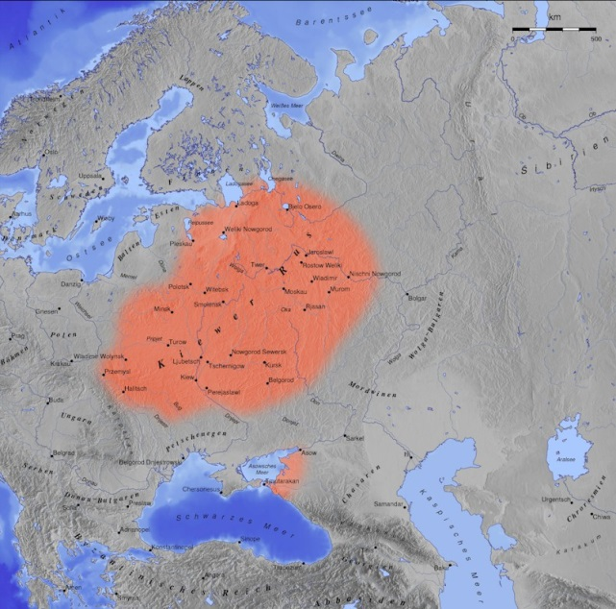
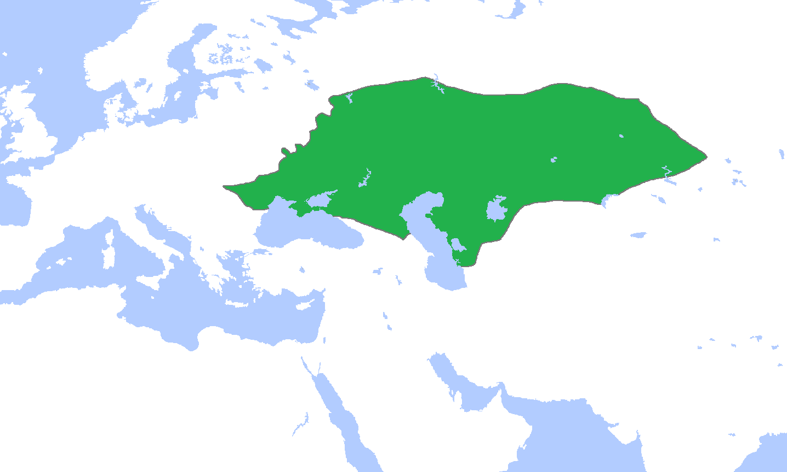
Kievan Rus
Centered in Western Russia (near Kiev, Ukraine)
Converted to Orthodox Christianity by Byzantines
Overrun by Golden Horde (Mongols) 13th-15th centuries

Slide 4
Tsardom of Russia/Muscovy (Moscow)
First ruler: Ivan IV (the Terrible) 1547-1584
And he didn’t get that name by being a bad leader!
Dubs himself “Tsar” (=Caesar)
By doing so, claims heritage to Rome and Byzantium
Claims Moscow to be “Third Rome”
Head of Orthodox Church

Slide 5
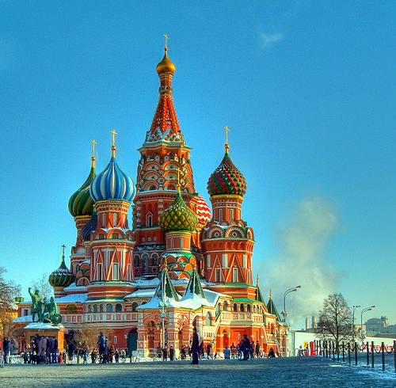
Accomplishments of Ivan the Terrible
Being terrible
Strengthening Russia’s monarchy
Reduces influence of landowners and clergy
Expands Russian state
Turns it into its modern-day multiethnic, multi-religious nation
Builds St. Basil’s Cathedral

Slide 6
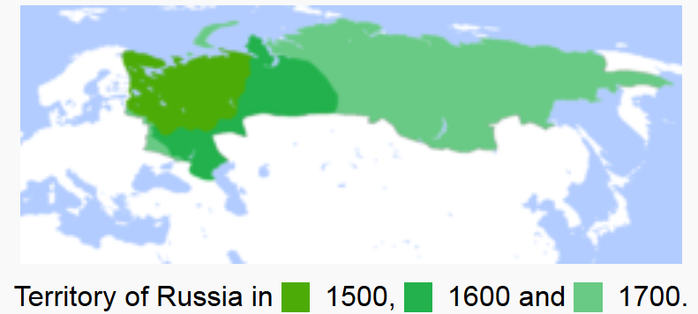
Territorial Expansion during the Tsardom

Slide 7
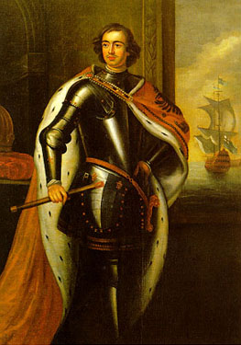
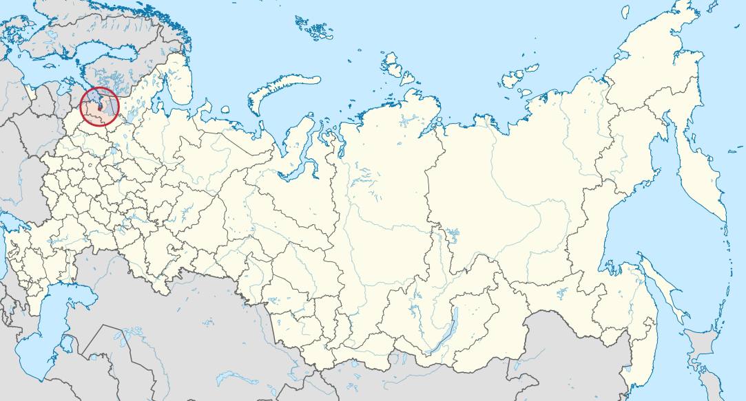
Empire of Russia
Created by Peter the Great (1682-1725)
Took Russia into the Modern Era and Westernized it
Moves capital to St. Petersburg (Window to the West)
Wanted to make Russia a strong EUROPEAN power

Slide 8
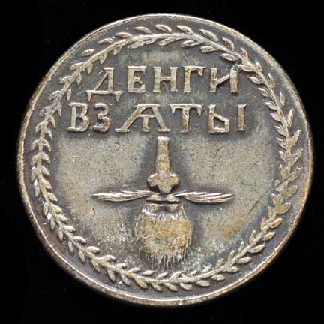
Reforms of Peter the Great
Standing Army and Navy
Major player in European trade & politics
Czar as Absolutists: Full monarchical control—no Parliament or other branch of gov’t, weakened the Church
Beard Tax: Most Europeans didn’t wear beards, so Peter encouraged Russians to shave theirs (or pay a tax)

Slide 9
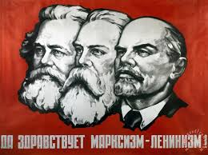
Absolutism to Revolution
Industrial Revolution in Russia → Formation of middle class
Middle class wants power, but Czar has all power
Russian workers only ~5% of population, but voice demands for better treatment
It will lead to a REVOLUTION!

