Slide 1
Religious and Cultural Change in Asia

Slide 2
Islamic Changes: Wahhabism
As Islam expanded throughout the world and adapted to local cultures, movements grew to purify and “bring back” the true Islamic faith
Muhammad al-Wahhab advocated for returning to pure Islam, blamed difficulties in Middle East on weakening faith
Supported by Muhammad al-Saud, Arabian ruler (founder of Saudi Arabia)

Slide 3
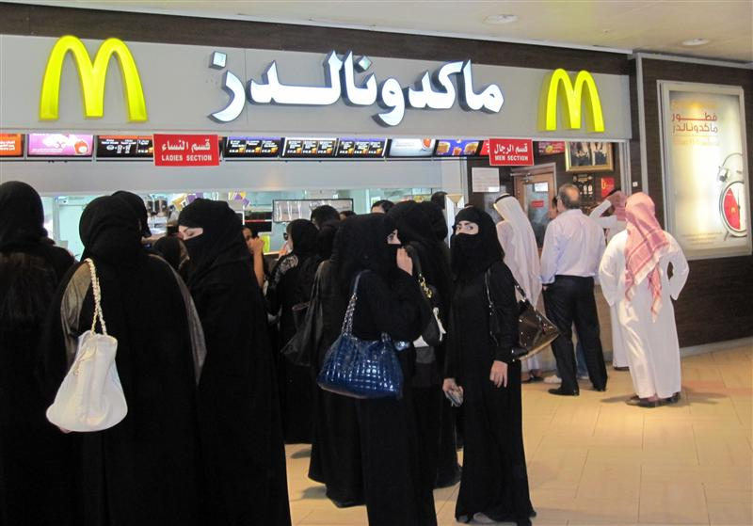
Wahhabism
Wahhabism: Destruction and outlawing of idols, large tombs, certain books, musical instruments, tobacco, alcohol
Male subjugation of women
Persisted throughout the Islamic world
Belief that less strict sects of Islam are heretical
Fundamentalist Islam today derives from Wahhabi ideals

Slide 4
Chinese Philosophy
Wang Yangming (1472-1579, late Ming Dynasty)
Don’t need to be a Confucian scholar and be constantly striving for perfection to live a good life—be introspective and moral and you can live a virtuous life
Similar to Martin Luther—by “faith alone”
Kaozheng: Emphasis on research and accuracy over speculation and philosophizing
A sort of Chinese Enlightenment in the sense of changing how knowledge was acquired
Critical view of Neo-Confucianism
This way of thinking allowed the Chinese to be open to the European Scientific Revolution

Slide 5
Indian Religious Change
What do you know about the social structure of India?
Caste System: Highly regimented
What do you know about the religious system in India?
Hinduism, Islam, and Buddhism
In Hinduism, belief in reincarnation—must move up in caste system until you finally attain moksha (enlightenment, escape from cycle of reincarnation)

Slide 6
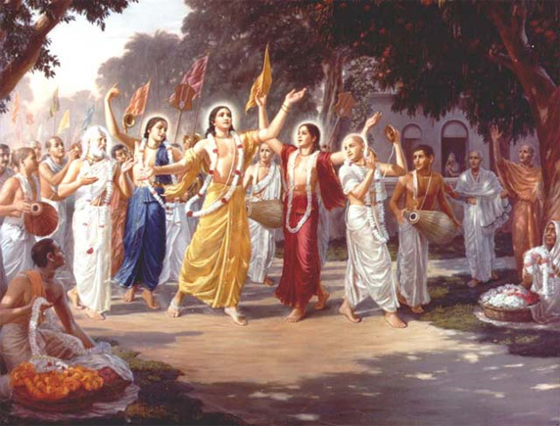
Bhakti Movement
Belief that moksha (true enlightenment) was attainable by EVERYONE, not just the Brahmin (priest class)
Belief in direct contact with the divine, no need for Brahmin class (priests)
Similar to Martin Luther’s “Faith alone”

Slide 7
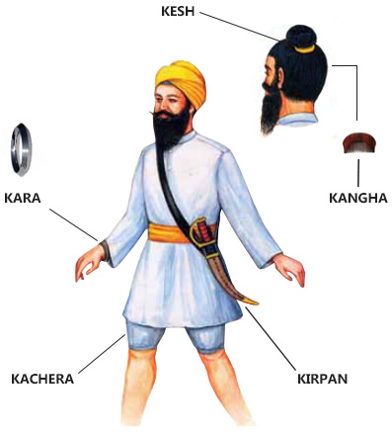
Sikhism
New Indian religion created in the 1500s
Founded by Guru Nanak—had been in the Bhakti movement
Believed “There is no Hindu; there is no Muslim; only God.”
Monotheistic
Equality of men and women, ignored caste distinctions
The Five K’s: Worn by members of the Sikh community
Kesh: Uncut hair
Kangha: Comb
Kara: Steel bracelet
Kachera: Cotton underwear
Kirpan: Dagger

Slide 8
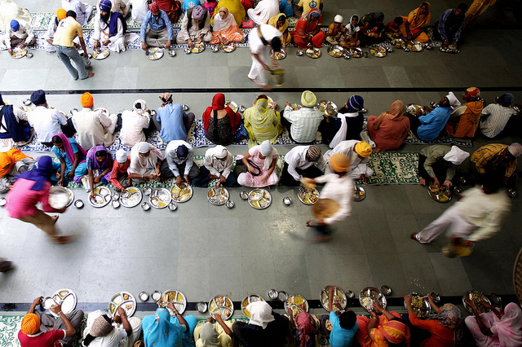
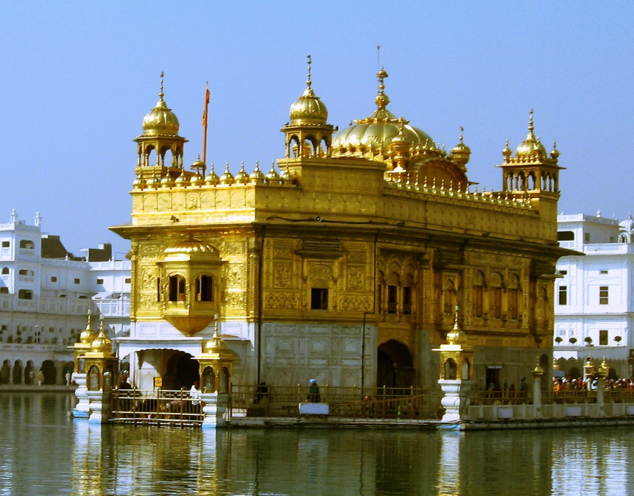
Practices of Sikhism
Guru Granth Sahib: Central religious text, treated as living guru
Langar: Free communal kitchen at every Sikh gurudwara (temple), meant to eliminate all caste distinctions
Militant Sikhism: To defend the Sikh community from the Mughal Empire (and intolerant rulers like Aurangzeb), Sikhs trained to protect against persecution
Golden Temple at Amritsar: Most famous Sikh gurudwara

Slide 9
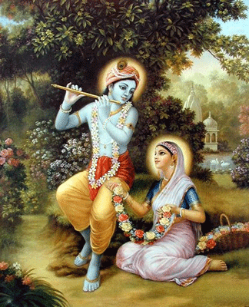
Mirabai Reading
What does Mirabai’s life reveal to us about changes in religion in India during the Early Modern Period?
Mirabai established a closeness to Krishna without being a priest —through faith alone

