Slide 1
Inca EMPIRE
Inca Empire

Slide 2
Aztec Empire
Circa 1325-1521
Inca Empire
Circa 1438-1533

Slide 3
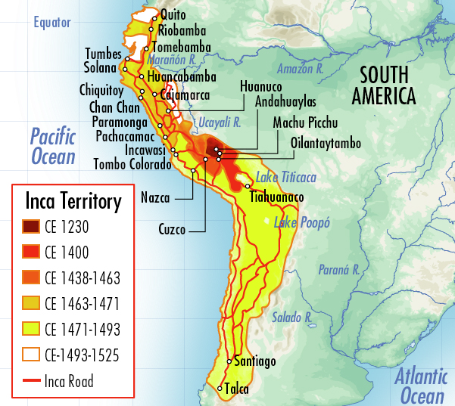
How did the empire begin?
Social
Political
Religious
Intellectual
Technological
Economic

Slide 4
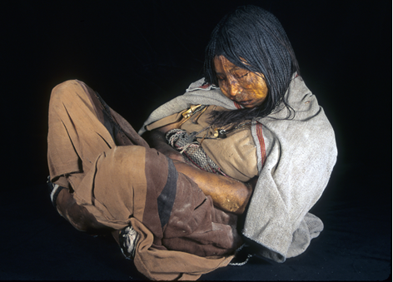
Inca Child Sacrifice
Done as a great honor, not frequent
Time of famine or new emperor
Children fattened and given gold and ornaments
Brought to mountaintop, left to die

Slide 5
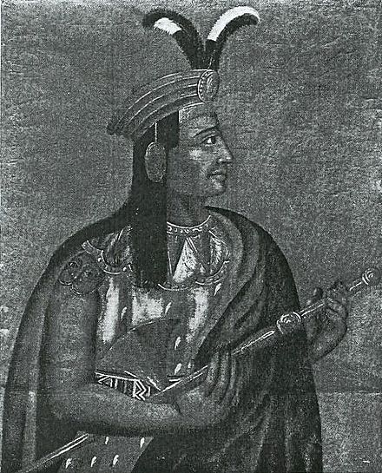
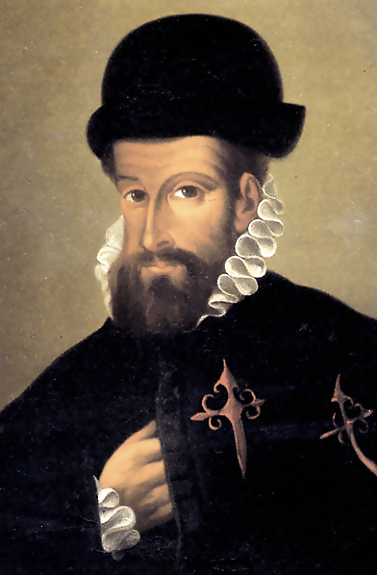
Francisco Pizarro
Spanish conquistador, had learned of gold in Peru
Brought ~400 soldiers in 1532
Not welcomed by Atahualpa, the Incan emperor

Slide 6
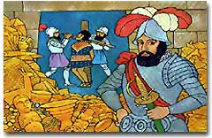
Pizarro and the Incas
Spanish leader Francisco Pizarro captured and ransomed the last Inca emperor, Atahualpa, for 24 tons of gold worth ~$850 million today. After receiving the ransom from the Inca people, the conquistadors strangled Atahualpa anyway.

Slide 7
End of the Inca Empire
In 1533, Pizarro brought reinforcements from Spain and partnered with native groups
Disease had also weakened Inca
Able to take over Cuzco
Inca Empire disintegrates (no threat of force holding together empire)

