Slide 1
The Aztecs (and the Conquistadors)

Slide 2
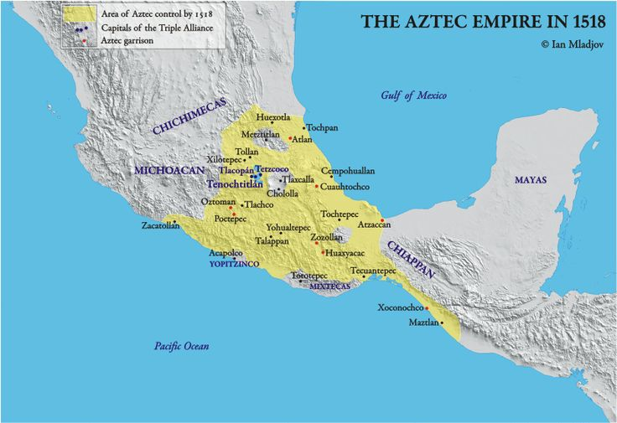
The Aztecs
How did the empire begin?
Social
Political
Religious
Intellectual
Technological
Economic

Slide 3
Tenochtitlan

Slide 4
Tenochtitlan

Slide 5
Tenochtitlan

Slide 7
Tenochtitlan

Slide 8
The Conquistadors
Soldiers and explorers who came after Columbus
Motivations
God!
Gold!
Glory!

Slide 9
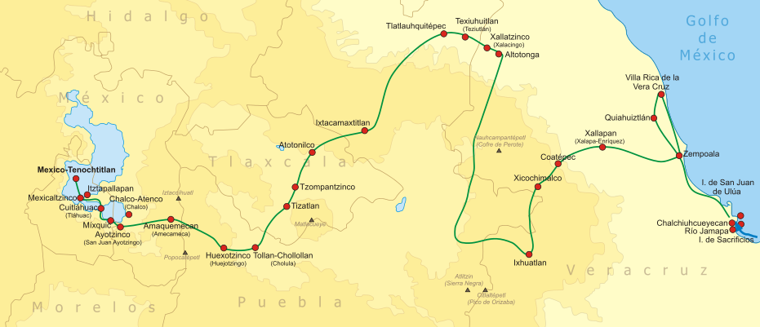
Hernan Cortés
Spanish conquistador
Allied with other native groups on march to Tenochtitlan

Slide 10
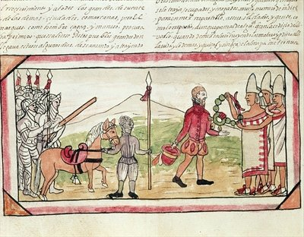
Moctezuma II (Aztec Emperor) and Hernan Cortés
Moctezuma II received Cortés
Quetzalcoatl or intimidation?
Presented gold and other gifts
Moctezuma was eventually killed, and despite resistance, Cortés conquered Tenochtitlan

Slide 11
Discuss
How would the world be different today if the Spanish had only destroyed the Aztec religion and its emphasis on human sacrifice, but allowed the Aztec Empire and Tenochtitlan to remain as they were before 1519?
Karl Marx said that the Spanish conquest of the Americas was the “greatest event in the history of the world.”

