Slide 1
Scientific Revolution & Enlightenment

Slide 2
Warm-Up
Logic, Science and Reasoning in the Middle Ages
https://www.youtube.com/watch?v=zrzMhU_4m-g

Slide 3
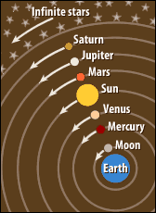
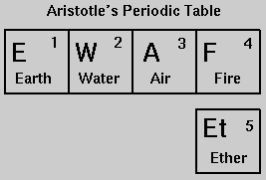
Before the Scientific Revolution
Europeans held a view of the world that derived from the Greek scholars Aristotle and Ptolemy (wrong about EVERYTHING).
Ptolemy: Geo-centric (Earth-centered) model of the universe
Aristotle: Only five elements, bad physics ideas

Slide 4
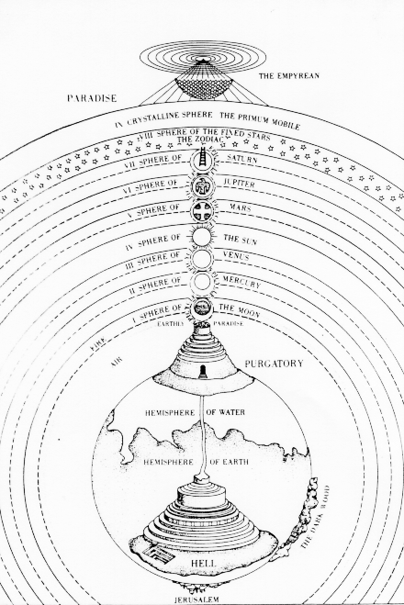
Astronomy before the Sci Rev
Europeans believed that the Earth was stationary.
Europeans believed that angels guided the hierarchically arranged spheres that made up the universe.

Slide 5
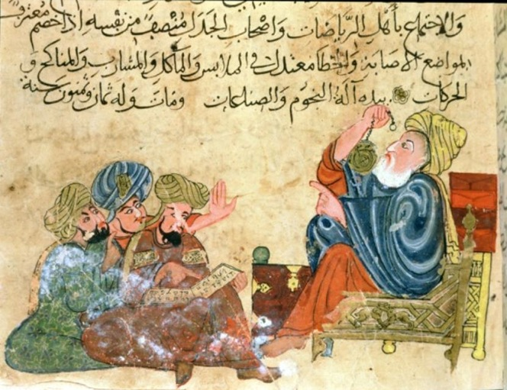
Scientific Revolution—Why Europe?
Euro Universities—provided educational freedom
Islamic universities concerned with the Quran
Chinese schools concerned with civil service exams
Drew upon Islamic scholarship and the classical texts preserved by Muslims

Slide 6
Scientific REVOLUTION AND ENLIGHTENMENT CARD SORT

Slide 7
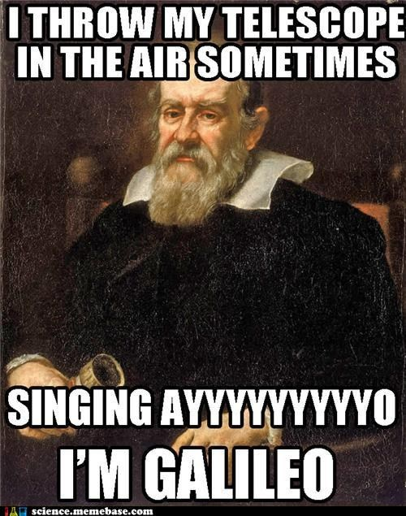

Slide 8
Catholic Church and the Scientific Revolution
Science represented a challenge to the Church!
Why would the Church want everything in the universe to revolve around Earth?
Because they believe God created the Earth, and He would put it at the center
Those who contested the Church’s ideas faced punishment
Giordano Bruno—burned at the stake for believing the Universe was infinite, there may be life elsewhere
Galileo Galilei—forced to recant his beliefs about the heliocentric (Sun-centered) model
Placed under house arrest

Slide 9
The Enlightenment
What was the Enlightenment?
Time of increased thinking, reasoning, questioning, and intellectual progress in Europe
John Locke and contesting the Divine Right of Kings, idea of the Social Contract (Remember it from government?)
Voltaire and the Good Brahmin

Slide 10
Impact of the Enlightenment
Gave European middle class new intellectual tools to critically analyze their society
Questioning of tyranny and absolute rulers
Ideals of a just society, natural rights
Will set the stage for the “Revolutions”
French, Haitian, American

