Slide 1
Chapter 18 Quiz
Just have a pen/pencil on your desk, no notes!
Turn in extra credit up front if you have it.

Slide 2
Capitalism, Socialism, and Communism

Slide 3
Capitalism is an economic theory that believes in the following:
Greed will motivate people to work hard.
People are free to work where and when they want.
The “competition” of companies to provide better goods and services will improve those goods & services
Government keeps its “hands off” of business (laissez faire)
Private ownership of capital ($).
Poor people can work to earn wealth, but there will always be poor and rich people.
Adam Smith, “Wealth of Nations” 1776

Slide 4
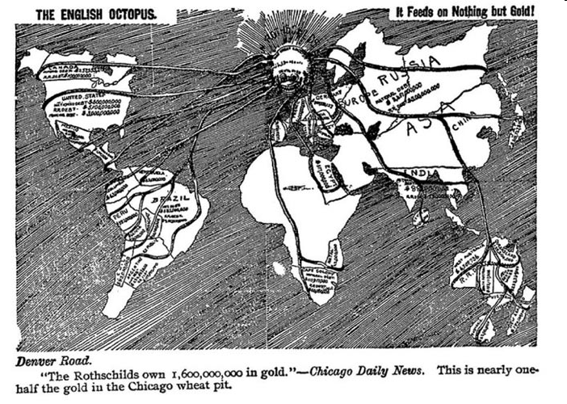
Capitalism helped push Great Britain, Europe, and the United States into incredible power and wealth.

Slide 5
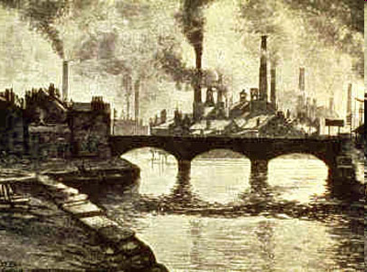
Industrialization was made possible by capitalism.

Slide 6
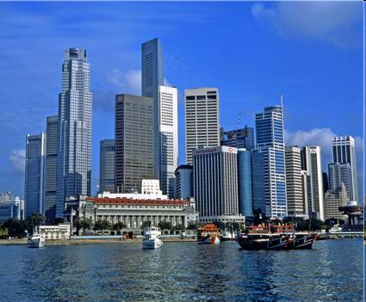
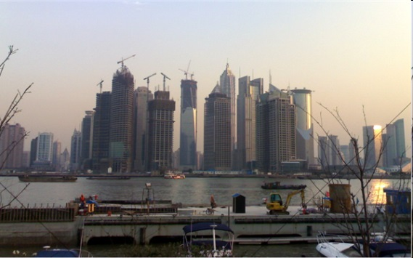
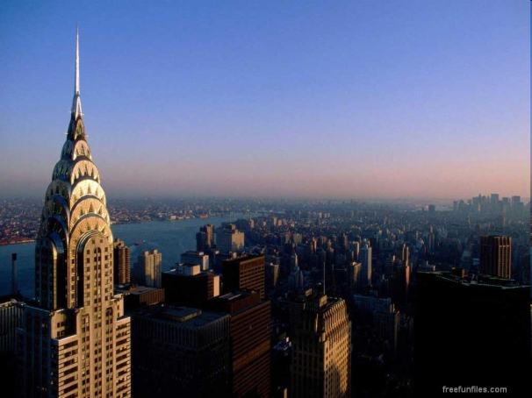
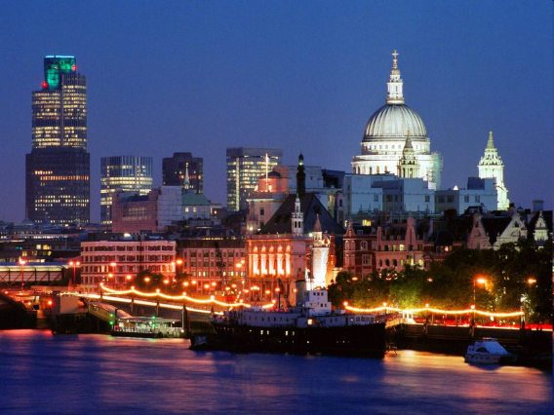
Capitalism funded the growth of the world’s greatest cities.
Shanghai
Singapore
London
New York
Hong Kong

Slide 7
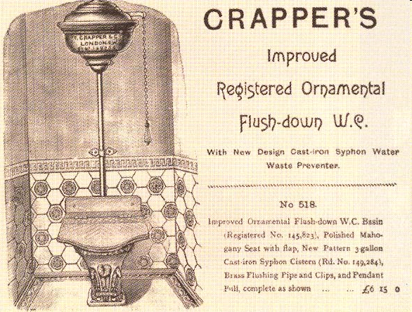
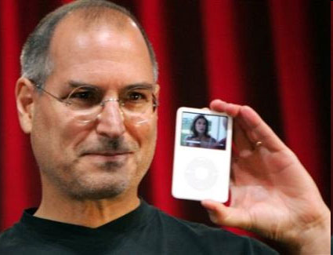
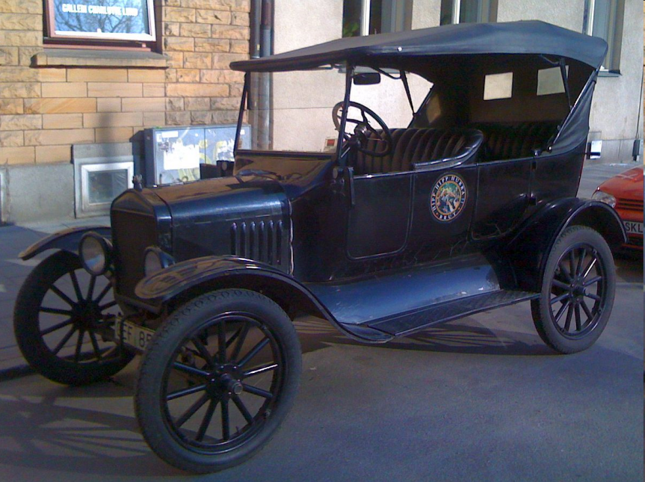
Capitalism pushed entrepreneurs to build ever more and better technologies.

Slide 8
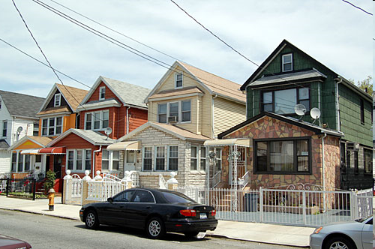
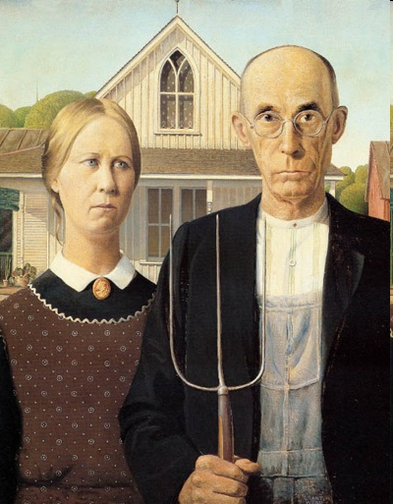
Capitalism enriched the lower classes, creating a vast middle class.

Slide 9
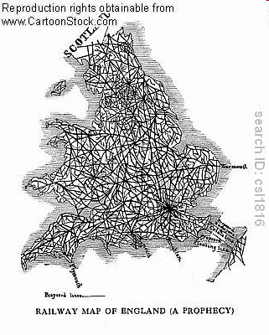
But the benefits of capitalist industrialization were not without cost.
(Political cartoon)

Slide 10
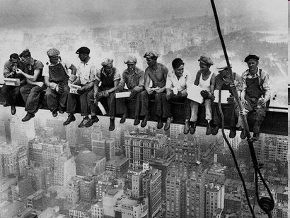
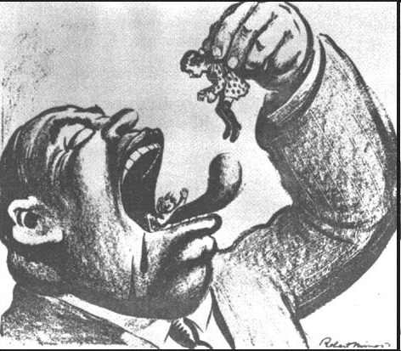
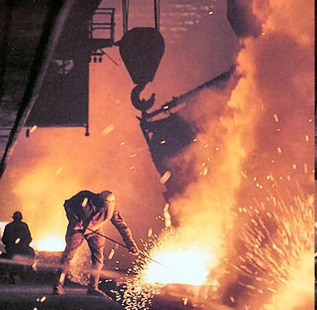
Often, working conditions were horrific and workers had no rights or protections.

Slide 11
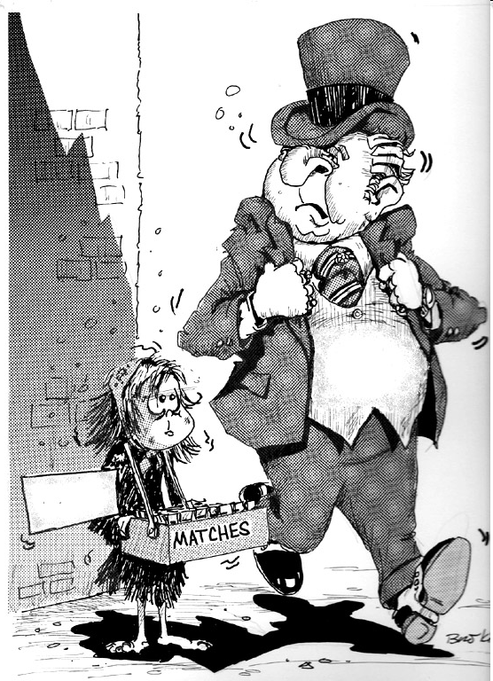
And Capitalism does not lift everyone equally.

Slide 12
Socialism
A social and economic doctrine that calls for public (the State) rather than private ownership or control of property and natural resources.
Living and working in cooperation, not competition
According to Socialists, the world is “owners” (rich people, bourgeoisie) versus “workers” (poor people/proletariat)

Slide 13
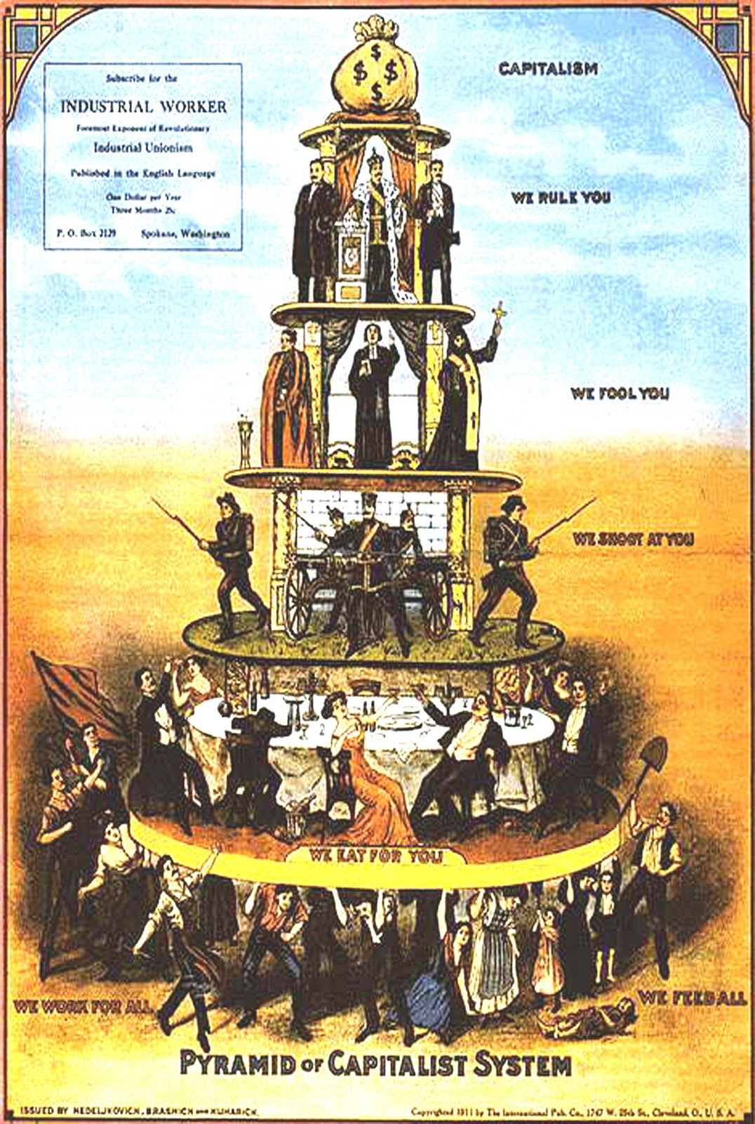
CAPITALISM
We rule you
We fool you
We shoot at you
We rule you
We work for all We feed all

Slide 14
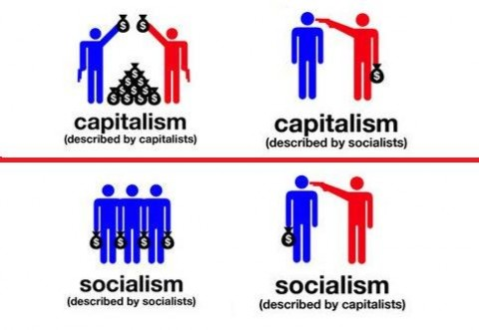

Slide 15
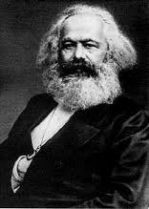
Communism
German philosopher Karl Marx criticized the economic and social disparities of capitalist society
Believed industrialism had only exacerbated historical class inequalities
“The history of all previously existing society is the history of class struggles”
Believed that the proletariat should unite, overthrow capitalism, set up a classless and propertyless society

Slide 17
The Internationale
https://www.youtube.com/watch?v=5DTbashsKic

Slide 18
Communist Manifesto Reading
What does Marx mean that history is “class struggle?”
Why is capitalism such a problem for Marx?
What happens to the “small” capitalists and business owners who aspire to be bourgeoise?
How does Marx feel about religion?

Slide 20
Crash Course
https://www.youtube.com/watch?v=B3u4EFTwprM

