Slide 1
Turn in your essay up front

Slide 2
Slave Revolutions and Abolition in the Modern Era

Slide 3
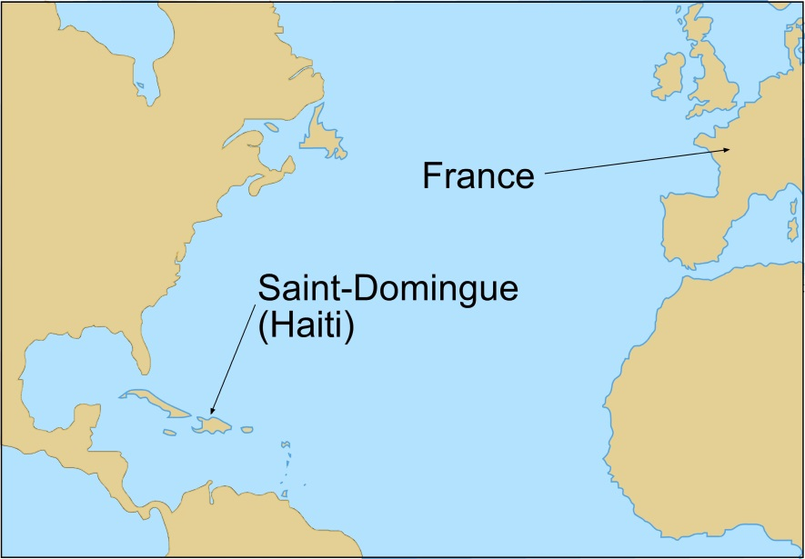
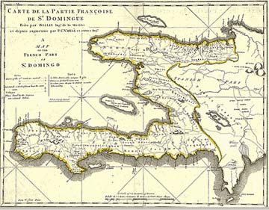
Haiti
Haiti was a French Colony known as Saint Domingue
Extremely profitable for France: thousands of plantations
40% of world’s sugar, 60% of coffee
500,000 black slaves to ~40,000 whites (rich and poor)

Slide 4
The Haitian Revolution (1791-1804)
Some owned slaves!
Grand Blancs
Gens de Couleur Libres
Rich white landowners
Saw FrRev as opportunity for colonial autonomy
Free blacks (some former slaves, some mulattoes)
25,000 (largest in Caribbean)
Saw FrRev as opportunity for equality and rights (for all races)
Petit Blancs
Slaves
Poor whites
Saw FrRev as opportunity for equality (among whites)
Enslaved blacks
Saw FrRev as opportunity for freedom

Slide 5
The Haitian Revolution
As the French Revolution descended in chaos, so did Haiti
Warring factions emerged (by race and class)
In 1791, first slave uprising began
National Assembly sent troops and granted rights to the free blacks in an attempt to end the uprising
Abolished slavery in mid-1790’s, but did not grant independence
British and Spanish forces got involved (due to France’s wars)

Slide 6
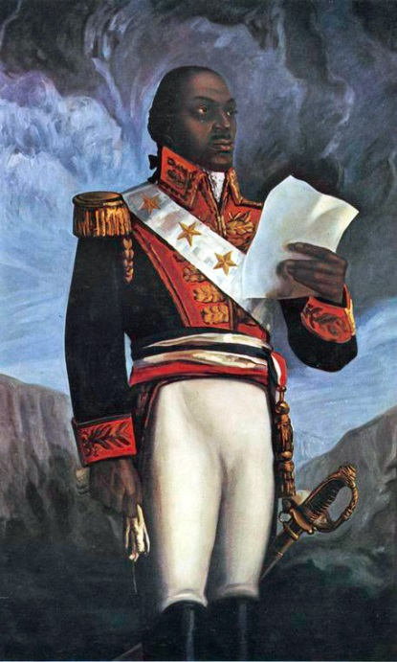
Toussaint L’Overture (The Black Napoleon)
“I was born a slave, but nature gave me the soul of a free man.”
Had been a free man for 20 years when revolution began
Fought for France in Haiti (against British and Spain) on condition of abolition
Made himself ruler of Haiti rather than ceding power to France
Napoleon sent troops in 1801, captured L’Overture, who died in 1802

Slide 7
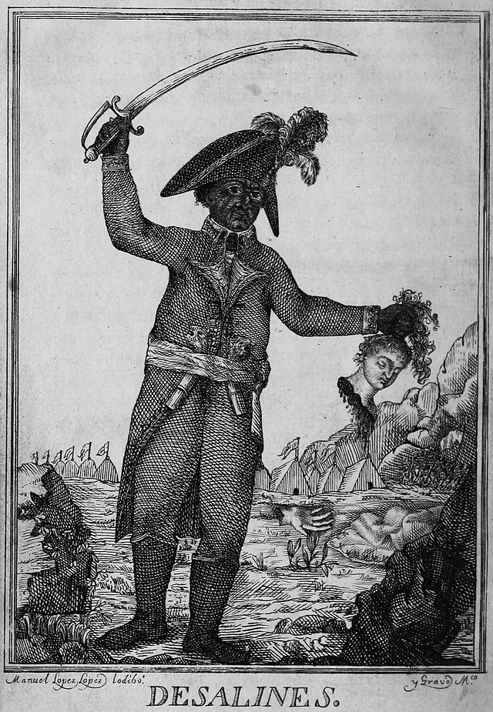
Haiti and Independence (1803)
Napoleonic forces intended to reinstate slavery
Sparked second round of successful slave rebellions
Caused Napoleon to sell off Louisiana Territory as well
Massacre of White Haitians in 1804
Legacy—
Fear of slave rebellions in U.S.
Poverty and racial tensions in Haiti continue today (forced to pay reparations to French slaveowners)

Slide 8
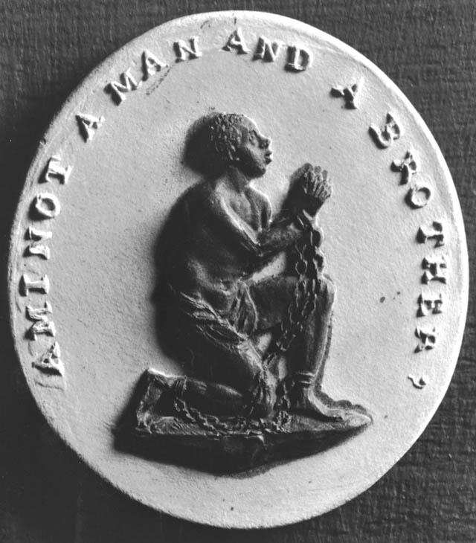
Abolition in England
Amazing Grace: written by John Newton, former slave trader
Abolition of the Slave Trade, 1807
Not abolished in British colonies until 1834
Amazing grace! How sweet the sound. That saved a wretch like me! I once was lost, but now am found; Was blind, but now I see.

Slide 9
William Wilberforce and the Slave Trade

Slide 10
Abolition in the United States
Abolitionist Press
Uncle Tom’s Cabin
The Liberator
U.S. Civil War, 1861-1865

Slide 11
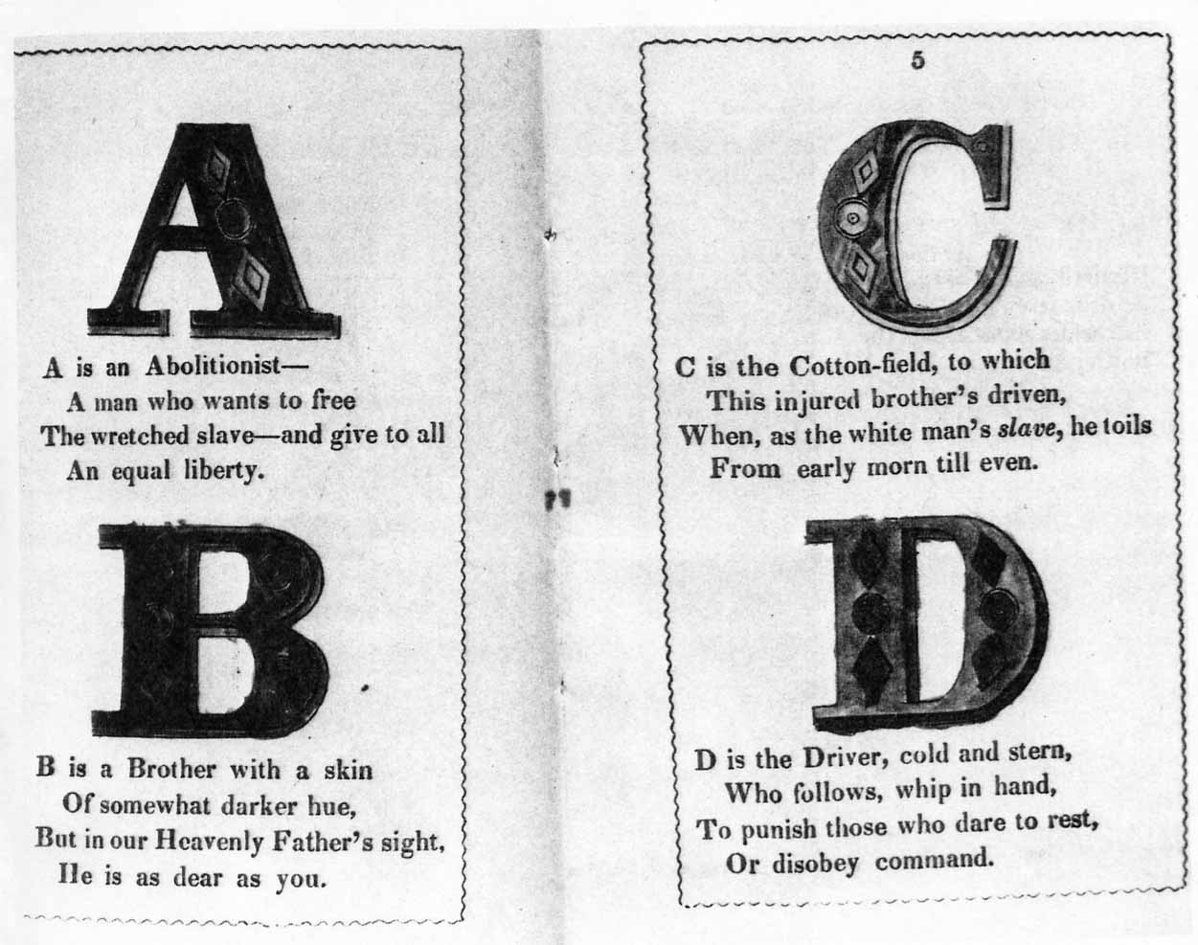
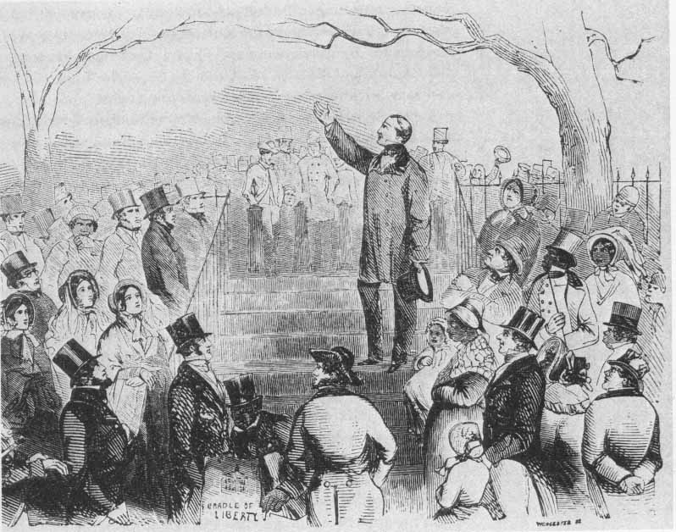
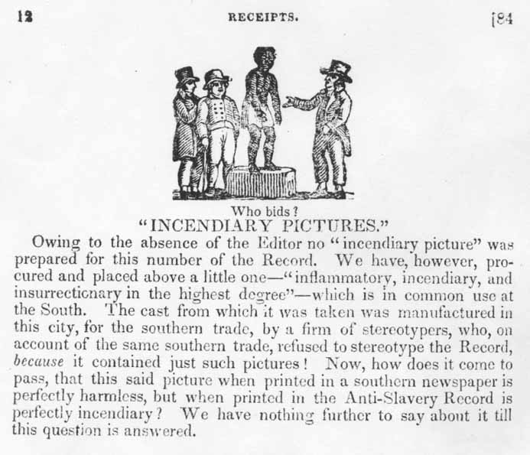
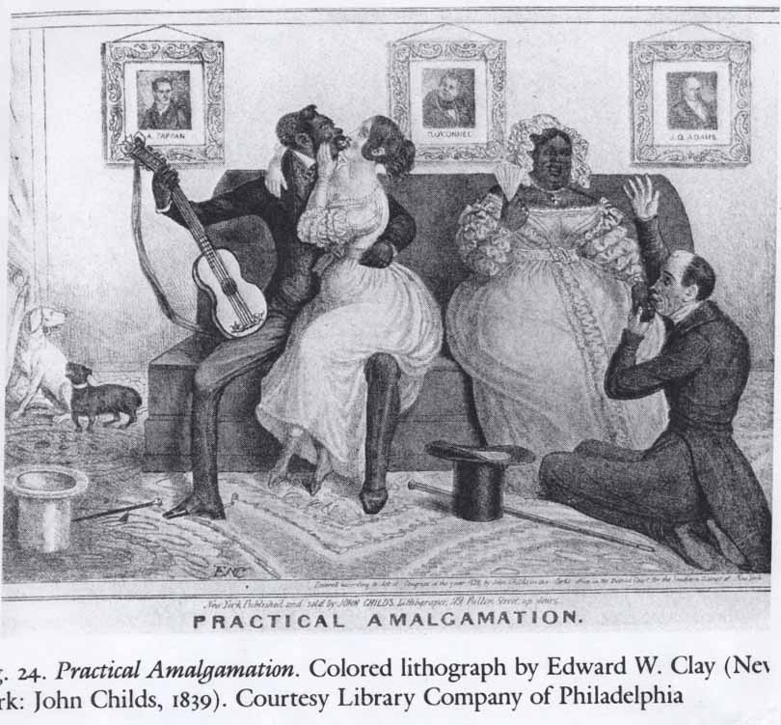
Abolitionist Images
Images were widely used to disseminate information about slavery and abolition
In groups of 4, examine the four U.S. abolitionists images and answer the corresponding questions on your organizer

Slide 12
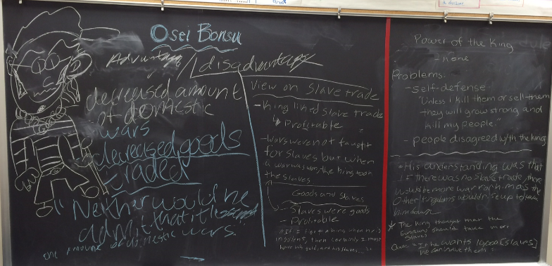
Abolition in Africa (Osei Bonsu)

