Slide 1
Protestantism, Society, and the North American Colonies

Slide 2
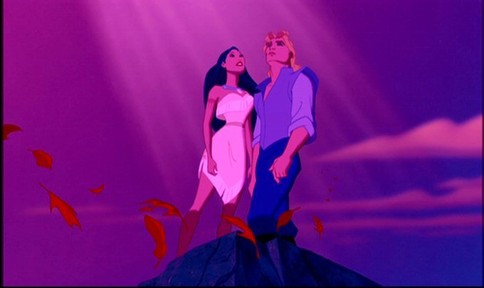
The Land
North America was originally seen as much less profitable and worthwhile than New Spain
Lack of urbanized civilization
Lack of wealth (gold, silver, climate for growing sugar)
Original colonists were sent by British crown, later followed by religious outcasts
Founding of Jamestown, VA (1607)

Slide 3
Comparing the Colonies
British North America
New Spain
Retained some aspects of English culture, but many sought to escape some part of European society
“Salutary Neglect” by British Crown towards colonies
By 1776, the colonies were 90% European, the rest Indian or African
Racial mixing uncommon
Few Africans in New England
Most slaves born in the colonies
Attempted to recreate European society in the Americas
Domineering power of the Spanish Crown
Relatively few Europeans
Racial mixing common
Millions of slaves
Most slaves were brought over from Africa to replace ones who were worked to death

Slide 4
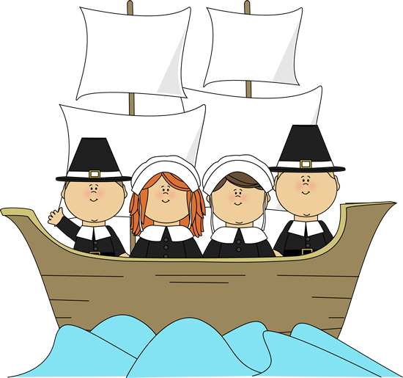
Puritans
Branch of very strict Protestantism (Calvinism)
Emphasized religious education, moral purity, and civic responsibility.
Faced hostile religious and political climate under Catholic English kings (1630s)
Decided to flee England: 20,000 each to Netherlands, Caribbean, Ireland, and New England
Founded Massachusetts Bay Colony

Slide 5
The Puritans in America
Very strict rules about religion and society—not proponents of religious freedom and tolerance
Banned dancing, Christmas, gambling
Did not seek to convert natives, unlike Spanish
Believed that God determined if you were going to heaven before you were born, so no reason to convert heathens.
Roger Williams, who preached religious toleration & separation of Church and State, was banished and founded Rhode Island Colony

Slide 6
The Trial of Anne Hutchinson
Why did the Puritans dislike Anne Hutchinson?
How did they address these problems?
What does this reveal about Puritan society?
-Think about SPRITE categories

Slide 7
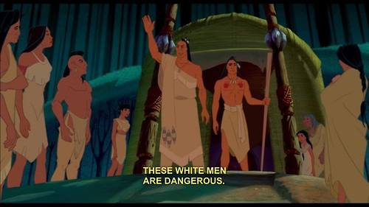
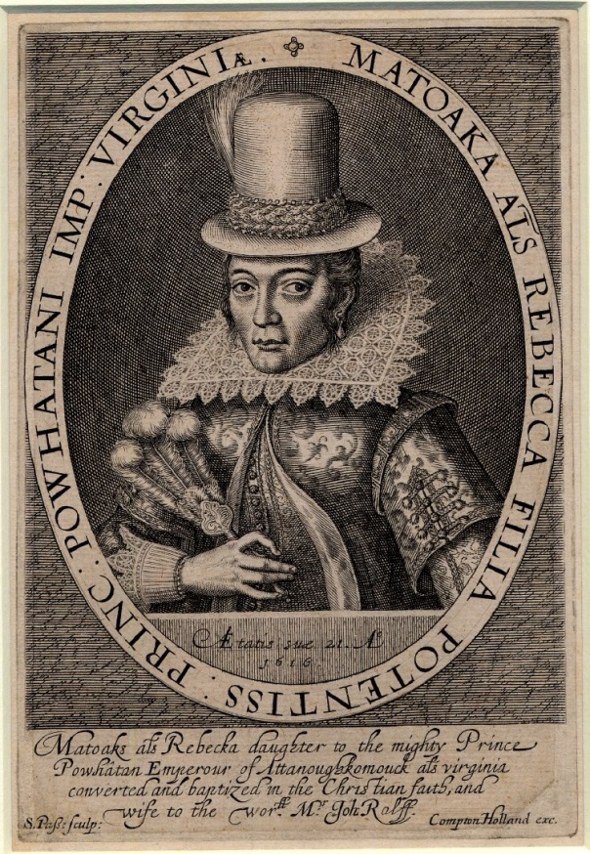
Colonial-Indian Relations
Mix of cooperation and conflict
Trading between groups enriched and strengthened those tribes that did trade with the colonists
Introduction of European diseases to native population
Skirmishes and wars over land
https://www.youtube.com /watch?v=2av9SQsMIi8

Slide 8
Look at the following European created images of Native Americans in Virginia from the 1600s.
What impression of Native Americans do these images give?
How useful are these images for studying Native American culture?

Slide 9
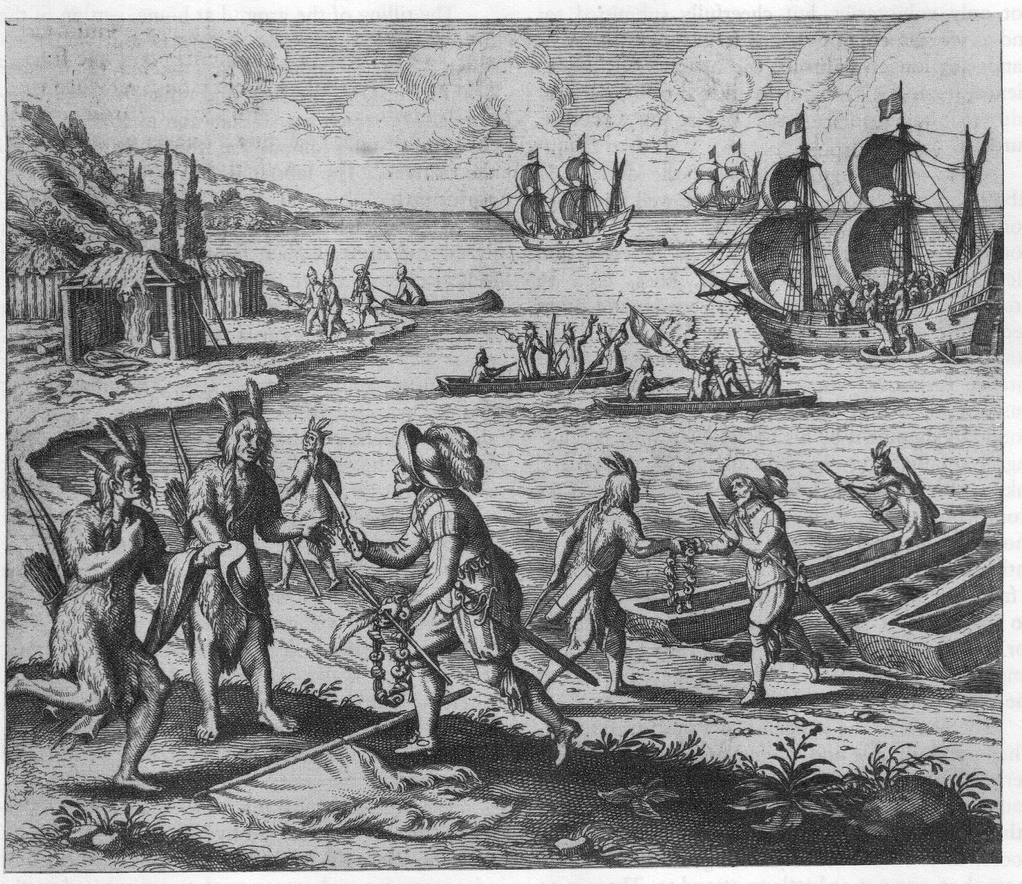

Slide 10
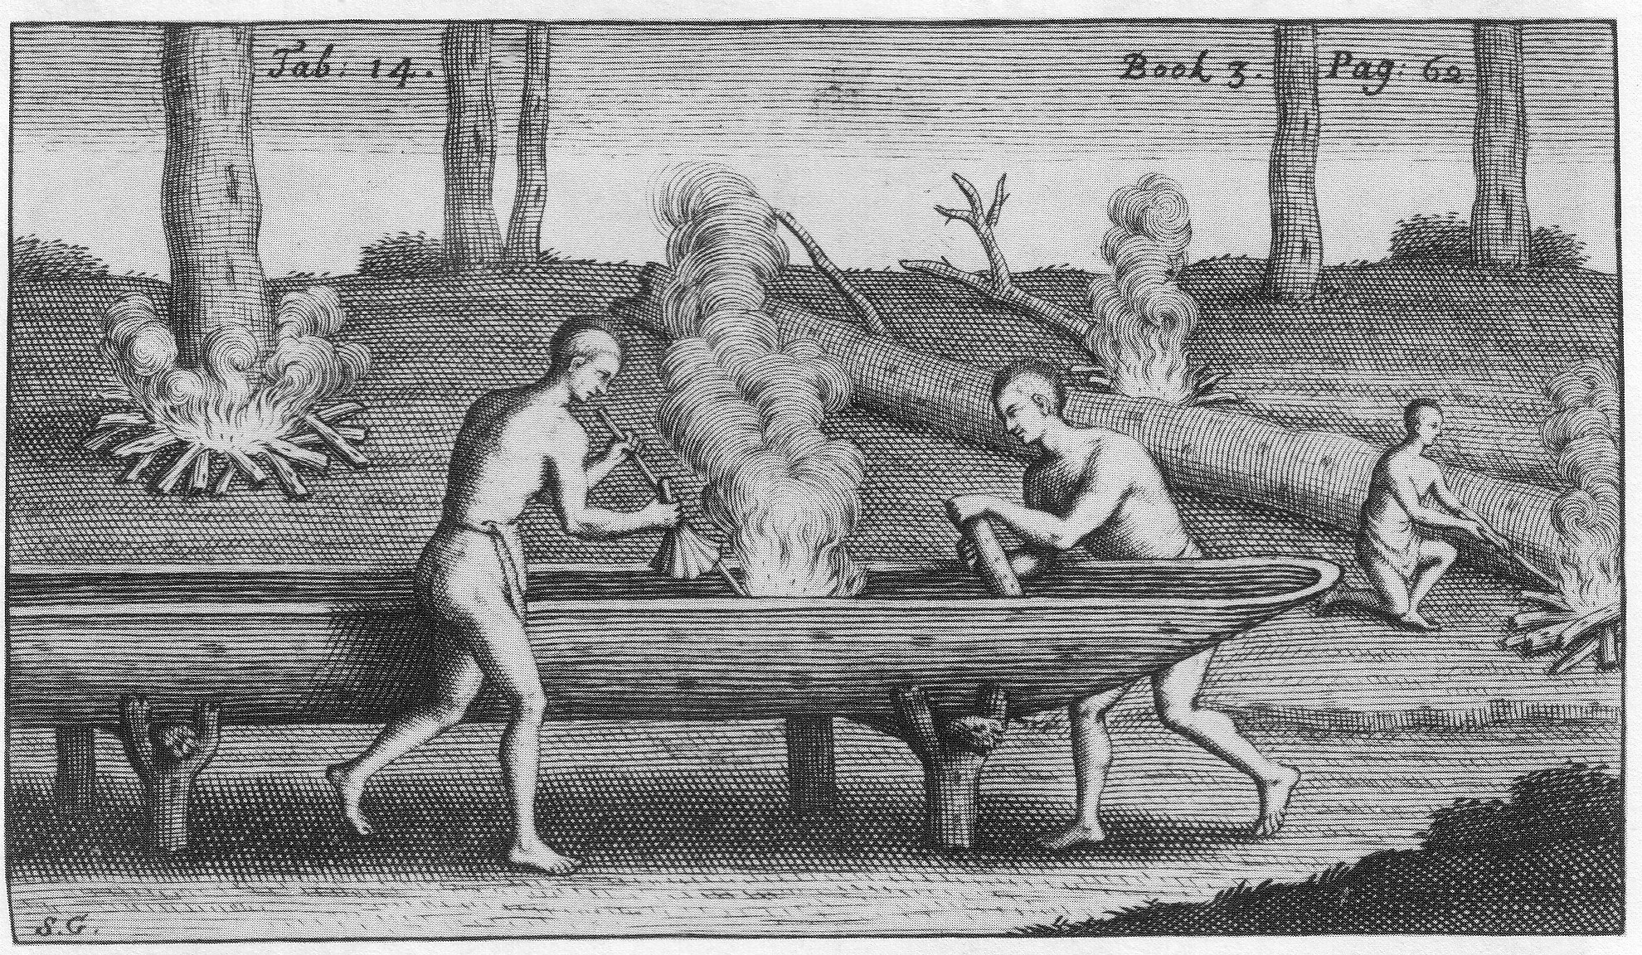

Slide 11
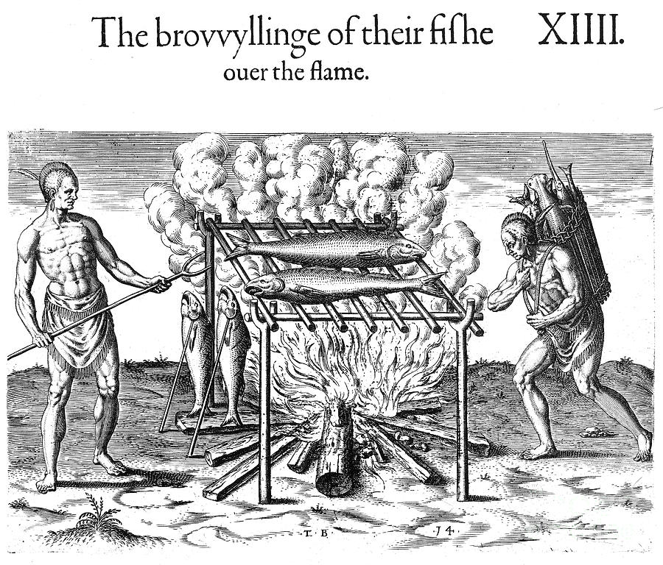
“The broiling of their fishes over the flame.”

Slide 12
