Slide 1
Industrialization in the Americas

Slide 3
Latin america in the modern period

Slide 4
Latin america in the modern period
In the next few weeks, we will look at revolutions and changes in Latin America during the modern period
As a preview: the social divisions in Latin America will remain (except for the abolition of slavery in 19th century)
Rich creoles (Europeans born in L. Am.) will continue to dominate society
Economic changes will occur as a result of industrialization

Slide 5
Latin america in the modern period
Will contribute to industrialization elsewhere, but L. Am. doesn’t experience its own Industrial Revolution
Why? More profit in land/crops than business
Steamships link Latin America more closely with European and U.S. economies
Large scale European & U.S. investments in L. Am.
Latin America will have export-driven economies
Ship out food, raw materials to industrialized countries
Silver, tin, guano, rubber, sugar, coffee, etc.
Will import the finished products
Only the rich truly benefit…

Slide 6
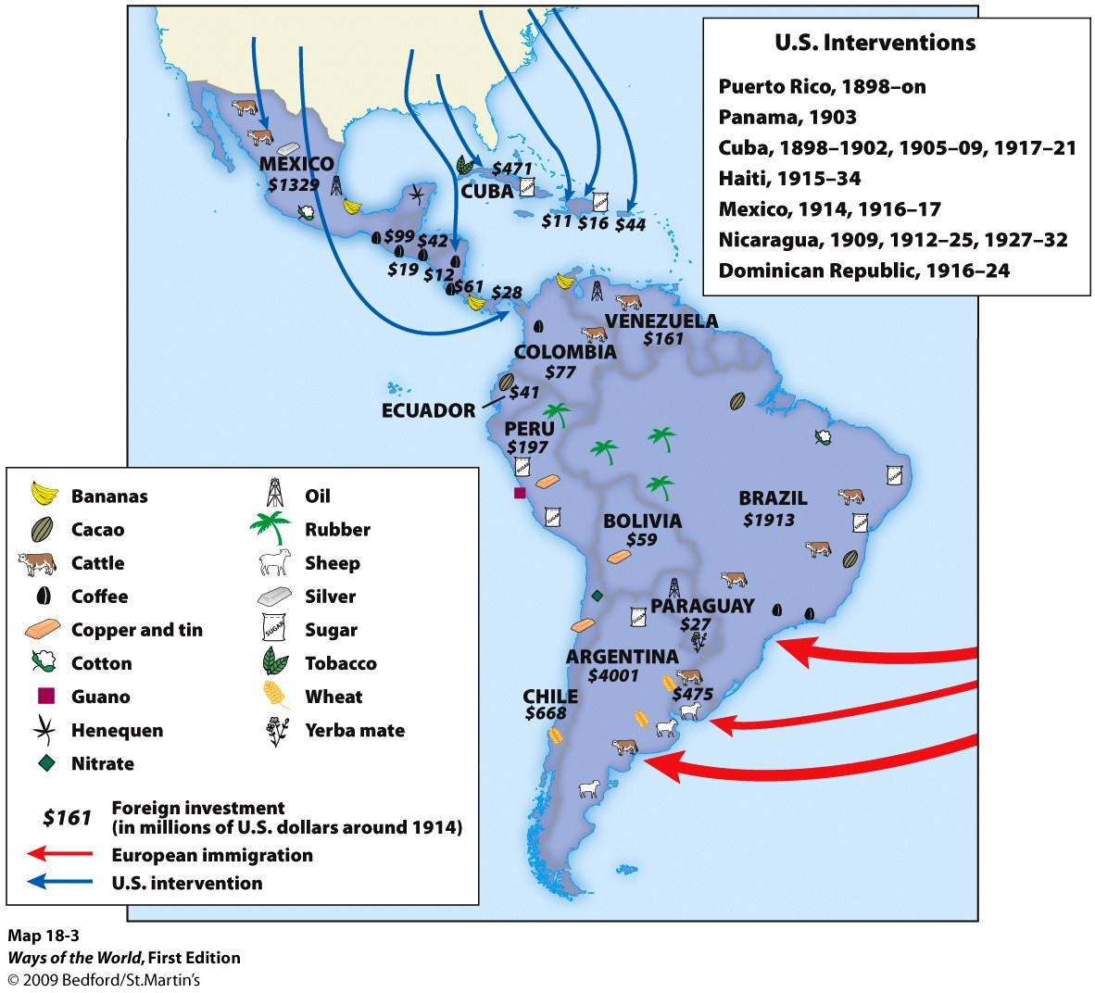

Slide 7
Latin american Economies over time
From (1750 - 1820)
Farming & Trade driven economies
Colonial dependent economies
Through (1820 - 1880)
Building of railroads
British investment
End of slavery (except Brazil) and encomienda (forced native labor)
To (1880 - 1914)
Some industrialization in Argentina & Mexico
Export boom due to European industrial demands
Economic imperialism by US companies in Latin America
Continuities:
Export driven economies
Land > business for wealth creation.

Slide 8
THE INDUSTRIAL REVOLUTION IN THE u.s.

Slide 9
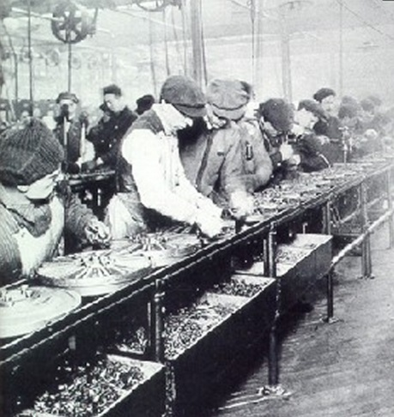
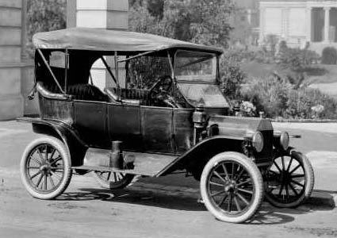
The united states
Like Britain…
Enters modern era as a mainly agrarian society
Industrialization leads to urbanization
Experienced wide class divisions
Formation of labor unions to protest against unfair working conditions
Pioneered mass production and the assembly line
Higher standard of living for working poor compared to Europe—socialism never truly takes root

Slide 10
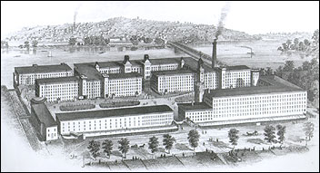
The Lowell Mills
One of the most productive and famous textile factories in the U.S. during the IR—located in Massachusetts
Employed young (single) women
Source 1: Rulebook
Source 2: Labor Investigation
Source 3: Description of Factory Life
Read through your group’s source and take notes/underline information about the rules and expectations of workers at the Lowell Mills.

Slide 11
Lowell mills
You will get into groups based on the color of the circle on your source (blue, green, or red)
Imagine that your group runs the Lowell Mills. Using the historical information from your sources, create a streamlined “Rules of the Lowell Mills” to be used to inform your workers.
Make it organized (Easy to follow!)
Use the ACTUAL information (don’t make stuff up!)

