Slide 1
The French Revolution

Slide 2
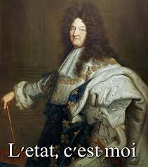
Absolutism in France
Louis XIV, The Sun King (1638-1715)
Absolute monarch of France (did not share power)
Revoked Edict of Nantes (had given rights and protection to Protestant minority)
Constructed Palace at Versailles
The period of absolute monarchy in France is known as the Ancien Régime

Slide 3
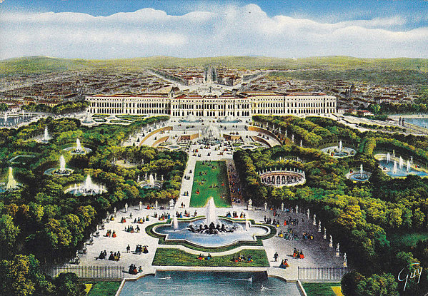
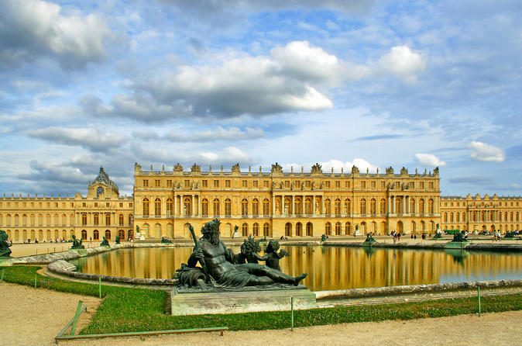
Versailles
Symbol of power and extravagance of the Ancien Régime

Slide 4
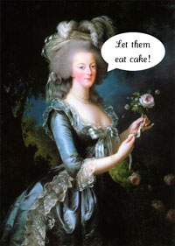
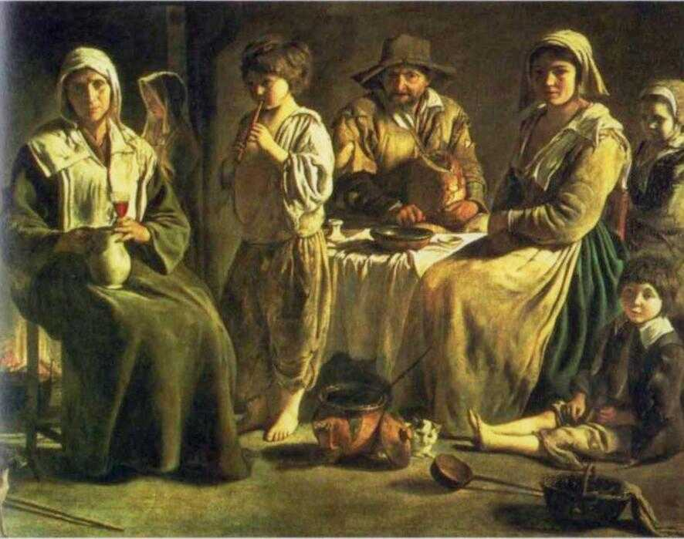
Financial Problems in France
Louis XIV and his son greatly increased the national debt
Fought series of wars in Europe
Seven Years’ War vs. Britain and other powers
Loss of some colonies
Helped fund American Revolution
Peasants usually bore most of the tax burden

Slide 5
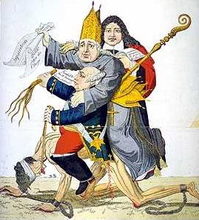
The Three Estates
In French society, people were divided into three “estates,” each with specific roles and privileges.
First Estate: Catholic clergy
Ties to Church legitimizes the monarch
Exempt from taxes, despite large land-holdings
Second Estate: Nobility (Duke, Counts, landowners)
Third Estate: the rest of society (peasants, commoners)
Poorest group, provided most tax $
Estates General: French Parliament, had very little power by 17th century

Slide 6
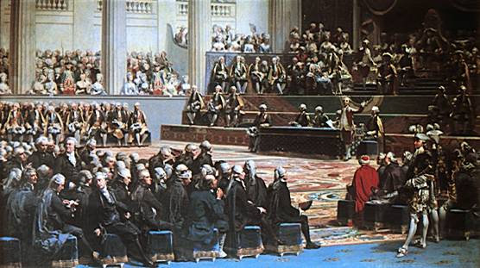
The Estates General
Convened in Versailles in 1789 to address grievances about taxation
One vote per estate (even though 3rd =97% of France)
King Louis XVI rejected proposal of 3rd Estate to give each delegate a vote

Slide 7
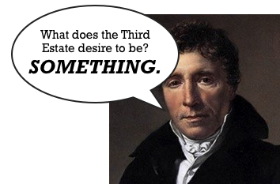
The Third Estate
“What is the Third Estate? Everything.
What has it been hitherto in the political order? Nothing.
What does it desire to be? Something.”
–Abbé Sieyès (French clergyman)

Slide 8
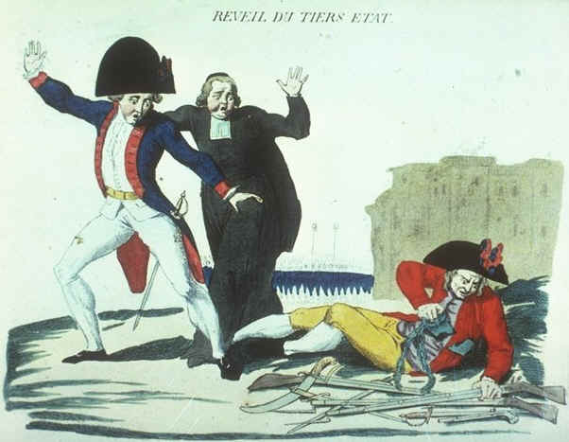
National Assembly
The Third Estate established its own government—claimed to be the true representative body of France.
On June 17, 1789, the National Assembly was formed.
Joined by some members of 1st and 2nd Estates.
“The Third Estate Awakens”

Slide 9
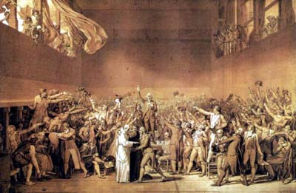
“Tennis Court Oath”
Louis XVI locked the National Assembly out of its meeting hall
Instead, met on a tennis court, vowed not to leave without writing a Constitution
King reversed his stance, but ordered troops to Paris

Slide 10
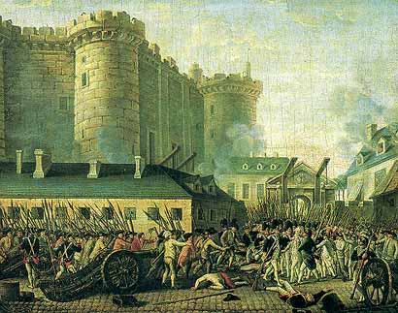
Storming of the Bastille
Mobs rioted in Paris in July 1789
Attacked the Bastille—prison and armory, symbol of royal power
French soldiers did not stop the attack
The Bastille was destroyed on July 14th, symbolized Louis losing power and authority
Rebellion will spread throughout France

Slide 11
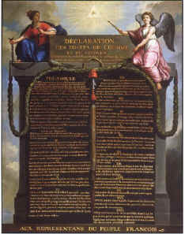
The Declaration of the Rights of Man and Citizen
Adopted by National Assembly on August 27th, 1789
Enlightenment ideals
Outlined basic freedoms held by all
Asserted the sovereignty of the people
“Liberté, Egalité, Fraternité”
Notes:
Just as the Declaration of Independence had laid out the ideals of the American Revolution, the Declaration of the Rights of Man and Citizen set forth the ideals of the French Revolution. Adopted by the new French National Assembly on August 27, 1789, the document embodied the Enlightenment concepts of freedom of speech, freedom of assembly, freedom of religion, and freedom from arbitrary arrest and imprisonment. The first three articles read:
1. Men are born and remain free and equal in rights. Social distinctions may be founded only upon the general good.
2. The aim of all political association is the preservation of the natural and imprescriptible rights of man. These rights are liberty, property, security, and resistance to oppression.
3. The principle of all sovereignty resides essentially in the nation. No body nor individual may exercise any authority which does not proceed directly from the nation.
Article 5 proclaimed limits on government authority, stating that, “The law has only the right to forbid those actions that are detrimental to society. Anything that is not forbidden by law may not be prevented, and none may be compelled to do what the law does not require.” Although the Declaration did not create a new constitution, it did create a new government with the King as a figurehead. Sovereignty now lay with the people rather than with the monarch. The principles of the Declaration were most clearly captured in the slogan of the French Revolution: “Liberté, Egalité, Fraternité” (“Liberty, Equality, Fraternity”).

Slide 12
U.S. Bill of Rights (Also in 1789!)
1. Freedom of religion, speech, press, assembly, and petition.
2 . Right to keep and bear arms in order to maintain a well regulated militia.
3. No quartering of soldiers.
4. Freedom from unreasonable searches and seizures.
5. Right to due process of law, freedom from self-incrimination, double jeopardy.
6. Rights of accused persons, e.g., right to a speedy and public trial.
7. Right of trial by jury in civil cases.
8. Freedom from excessive bail, cruel and unusual punishments.
9. Other rights of the people.
10. Powers reserved to the states.

Slide 13
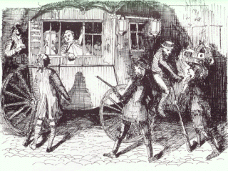
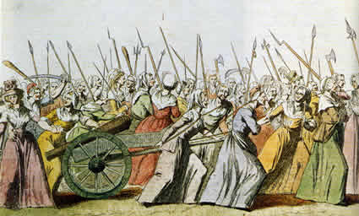
Women’s March of 1789 and Louis’ Flight
Louis XVI and the royal family fled Paris to Versailles
Mob of starving women and peasants marched to Versailles and forced him to return—kept under house arrest
Louis attempted to flee in 1791 with his family and wife, Marie Antoinette, to Austria, but were recaptured
Completely discredited his authority
Strengthened radical movement

Slide 14
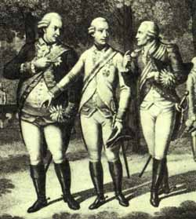
Reaction from Europe
Other European monarchs were on edge watching the turmoil in France
Fear of it destabilizing Europe and their own country
Many clergy and nobles fled France
Declaration of Pillnitz: Austria and Prussia threatened to intervene in France
France would go to war as a response in 1792, increasing revolutionary paranoia
Prussian King Frederick William III, Austrian Emperor Leopold II, and the Comte d’Artois, Louis XVI’s brother

Slide 15
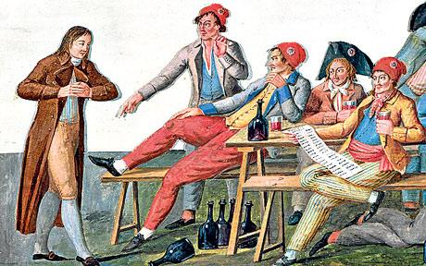
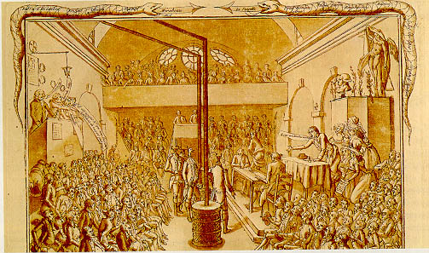
Sans-Culottes and Jacobins
Working men of Paris, symbolized by wearing pants instead of the breeches of the aristocracy (culottes)
Jacobins were a political group that increased revolutionary fervor and violence
Regina, you're wearing culottes. It's Monday.
You can't sit with us!

Slide 16
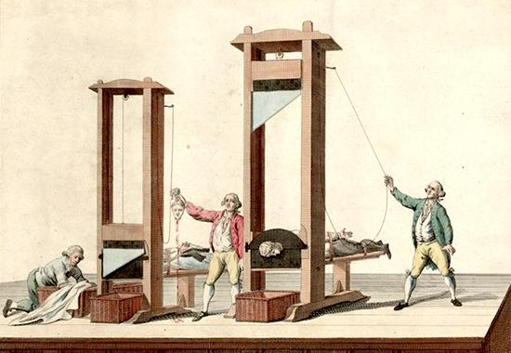
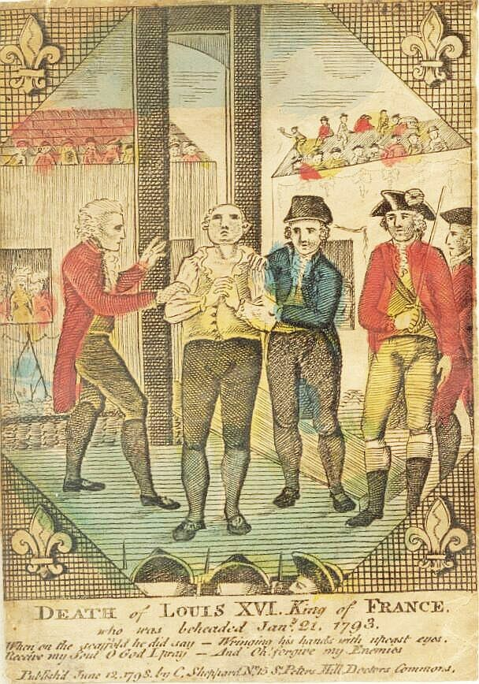
The Execution of Louis XVI and Marie Antoinette
The King was accused of being in league with France’s enemies and convicted of treason
He and his wife were executed via Guillotine in 1793
Guillotine: More “humane” execution device

Slide 17
DEATH OF KING LOUIS XVI

Slide 18
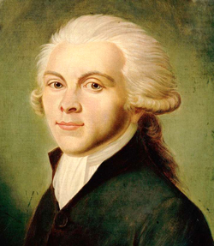
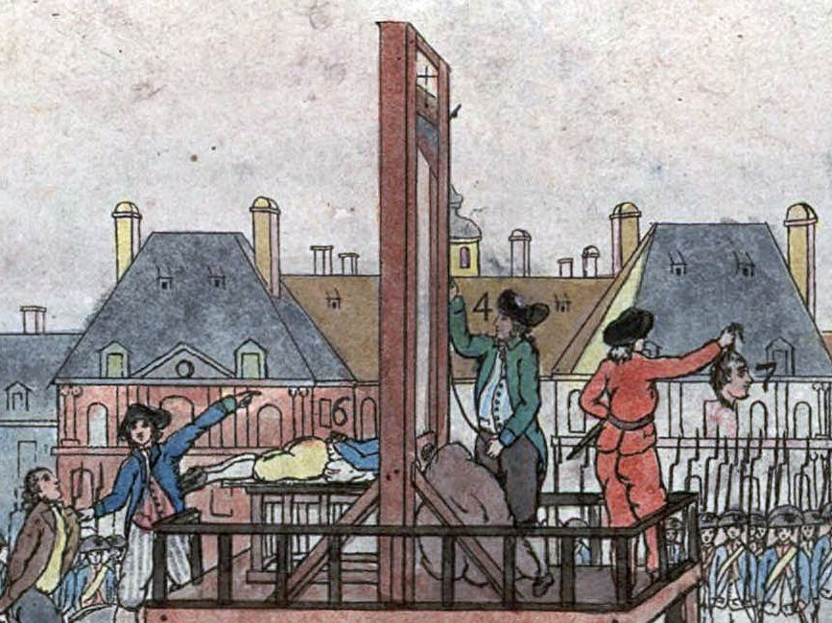
Robespierre and the Reign of Terror
With the monarchy ended, the Jacobins took over (1793-94)
Led by lawyer Maximillian Robespierre
Time of war, peasant unrest, and chaos
Seizure of Catholic Church land and power
Executed anyone considered to be against the revolution
Tens of thousands via guillotine
Eventually Robespierre himself would be executed for leading the Reign of Terror
End of the Revolution? Still more change to come…

Slide 19
The French Revolution (before The Directory and Napoleon)
https://www.youtube.com/watch?v=otnADq4Y0-A

Slide 20
The Directory (1795-1799)
After the fall of the Jacobins, executive power was placed in the hands of the Directory
Council of five men
Additional two legislative bodies
Annual elections would be held (only men with property eligible to vote and be elected)
Rather than addressing famines and problems of France, the Directory focused on keeping out radicals and royalists
Its overthrow in 1799 by Napoleon Bonaparte will mark the end of the French Revolution…

Slide 21
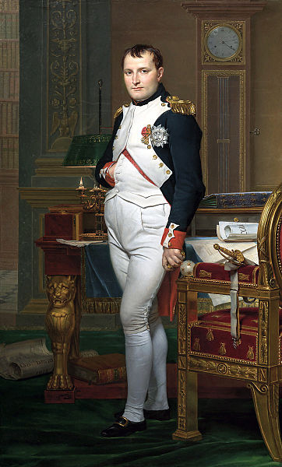
Napoleon Bonaparte
Not actually that short!
In French units he was 5’ 2’’
In standard units he was 5’ 7’’
Average height then? 5’ 5’’

Slide 22
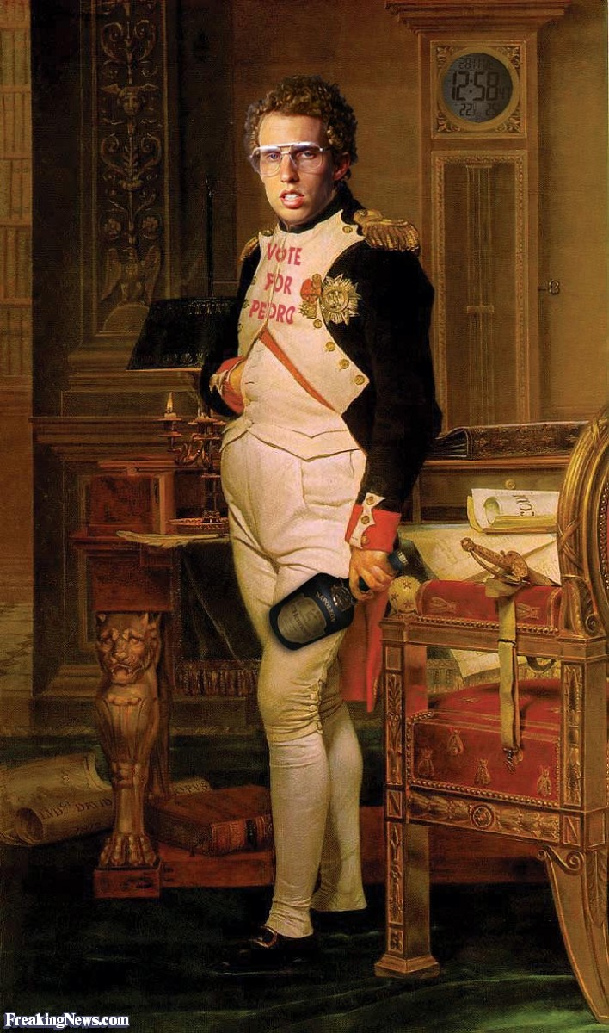
Napoleon card sort
Sacre bleu, where are my tots?!

Slide 23
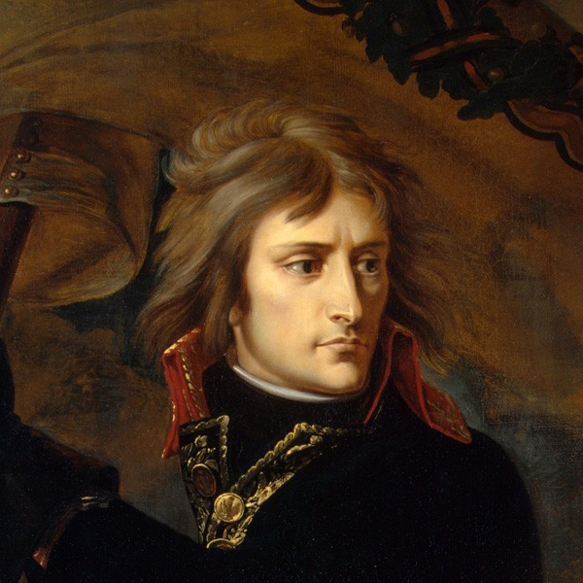
Early Life
Napoleon is born on the French province of Corsica in 1769.
Studied at the Royal Military School, becomes 2nd Lieutenant of Artillery.
Fought for France in Austria and Italy during the French Revolution, made a Brigadier General.

Slide 24
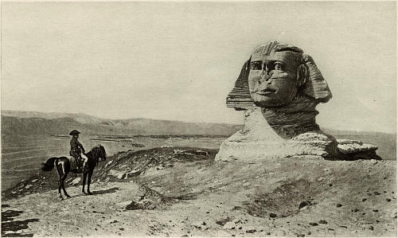
Egypt and Fall of the Directory
Gains popularity in France, sent by Directory to take Egypt and impede British contact with India via the Red Sea.
Abandons army in Egypt when news reaches of the Directory losing power, returns to France.
Stages a coup against the Directory, named one of three consuls in new government in 1799.

Slide 25
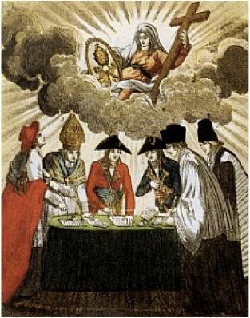
Changes in France under Napoleon
Institutes Concordat of 1801, heals rift between France and Catholic Church.
After years of continuous fighting, signed a temporary peace with Britain.
Sold France’s Louisiana Territory to the U.S. in 1803 in order to focus on affairs in Europe.

Slide 26
Napoleonic Code
Established the Napoleonic Code, foundation for Europe’s legal system.
Need for a unified legal code for France after Revolution.
Officially ended feudalism
Freedom, liberty, private property
Equality for all (male) citizens
Women still subjugated to men
Laws concerning marriage, divorce, civil rights, ownership, both civil and criminal law, punishment
Little freedom of the press
Similar law codes derived from Napoleon’s used throughout Europe and Latin America in the 19th century

Slide 27
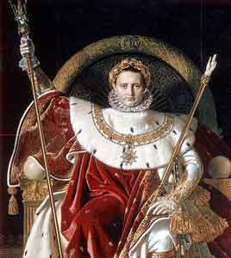
Napoleon as Emperor
Abolished the consulate government, crowned himself as Emperor.
He crowns himself, rather than the Pope placing the crown on his head.
Leads French army to control most of Western Europe (besides Spain).
Creates Continental System—bans importation of all British goods in Western Europe (little effect).

Slide 28
Downfall of Napoleon
Russia withdraws from Continental System, Napoleon goes to war (loses to Russian winter).
Loses to coalition of European armies in 1814, forcibly exiled to island of Elba.
Stages escape from exile and returns to France, mobilizing a new army.
Loses to coalition of European armies at Waterloo, forcibly exiled to island of St. Helena.
Dies in exile in 1821.

Slide 29
After Napoleon
Return to the Monarchy (albeit a Constitutional one)

Slide 30
French Revolution in a Song
https://www.youtube.com/watch?v=wXsZbkt0yqo

Slide 31
Crash course
https://www.youtube.com/watch?v=lTTvKwCylFY

