Slide 1
Commerce & Culture 500-1500 Sea Roads: The Indian Ocean
AP World History
Chapter 8

Slide 2
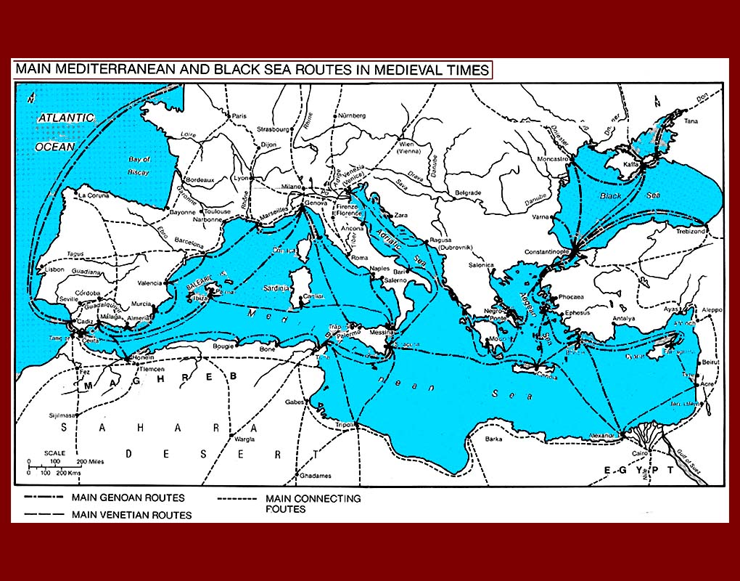
Sea Exchange—DON’T WRITE
Nothing new
Begins with Mediterranean Sea trade
Participants = Phoenicians, Greeks, Romans
Italian city of Venice = major center of commerce

Slide 3
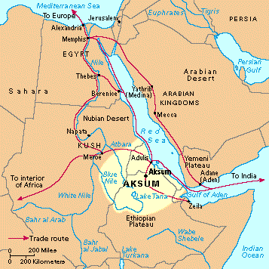
Sea Exchange—DON’T WRITE
Begins with Red Sea trade
Participants = Egyptians, Phoenicians, Greeks, Romans, Africans
Alexandria = major port and city of commerce

Slide 4
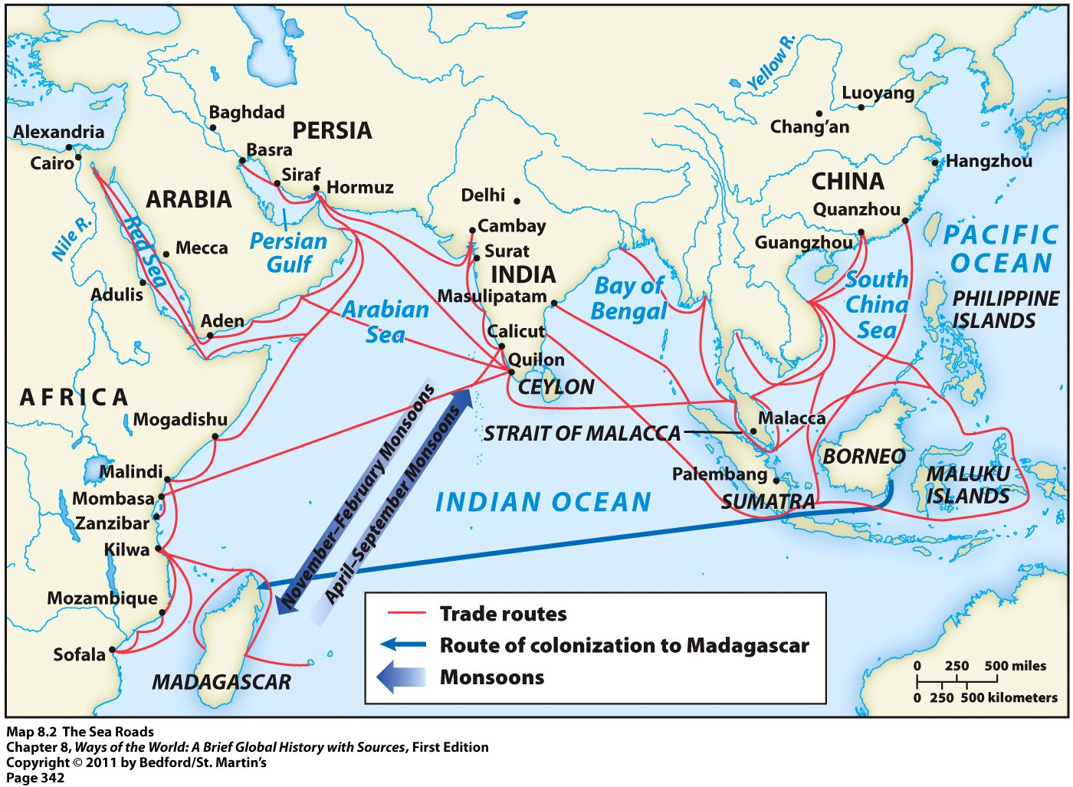
Indian Ocean Exchange

Slide 5
Indian Ocean Exchange
Like Silk Road, trade grew because…
Desire for goods not available at home
Some goods are the same as Silk Road
Ex: silk and porcelain from China
Unlike the Silk Road: transportation costs much lower
Ships could carry more goods than camels
Sea Roads carried more bulk and staple goods → not usually only luxury items like on the Silk Roads
Ex: food and timber

Slide 6
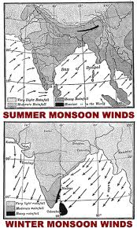
Monsoons
Made Indian Ocean exchange possible
Monsoons = alternating wind currents
Blow predictably eastward in summer months
Blow predictably westward in winter months

Slide 7
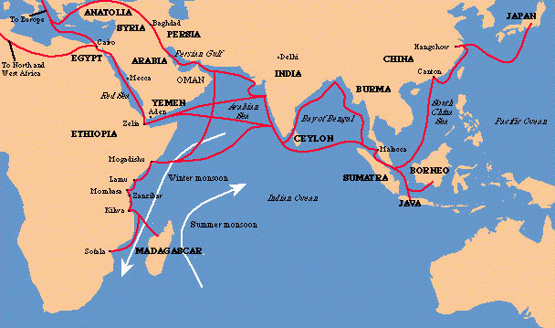
Indian Ocean Exchange
Not between countries
Not between entire regions
IS between individual merchant towns

Slide 8
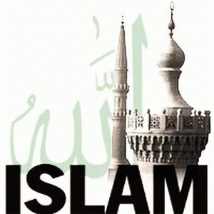
Growth of Indian Ocean Trade
2 major transformations (btwn 500—1500) that led to growth of the Indian Ocean trade network
Economic and political revival of China
Rise of Islam in the 7th century

Slide 9
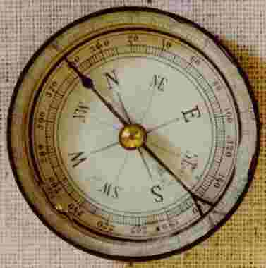
China’s Comeback
4 centuries after collapse of the Han
Reestablished a unified government
Encouraged sea trade
Economic growth = Chinese products pour into trade networks
Technological innovations = larger ships; magnetic compass

Slide 10
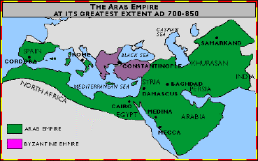
Rise of Islam
Islam = friendly to merchants
Creation of an Arab Empire
Stretching from Atlantic Ocean to India
Brought together wide range of economies in a single political system
Powerful and wealthy empire = continued to stimulate Indian Ocean trade

Slide 11
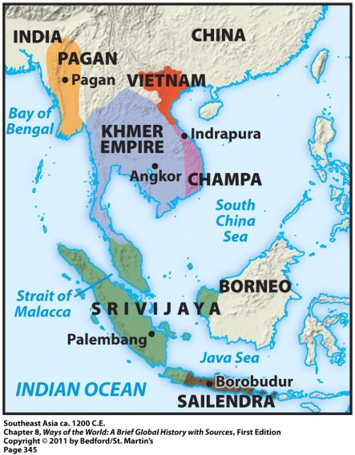
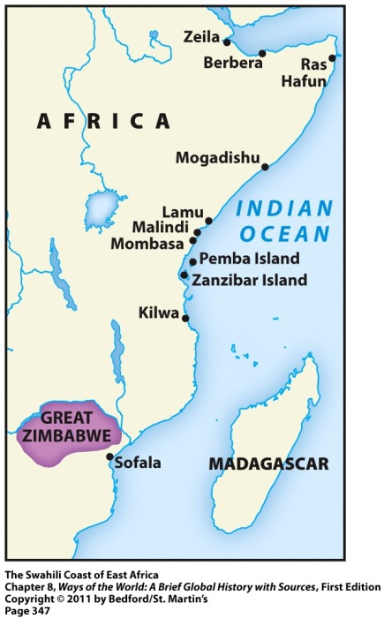
Sea Roads = Change
Major transformations to two regions:
Southeast Asia
East Africa
Both regions experienced:
Political change → rulers used wealth to construct larger states
Cultural change → exposure to new religions

Slide 12
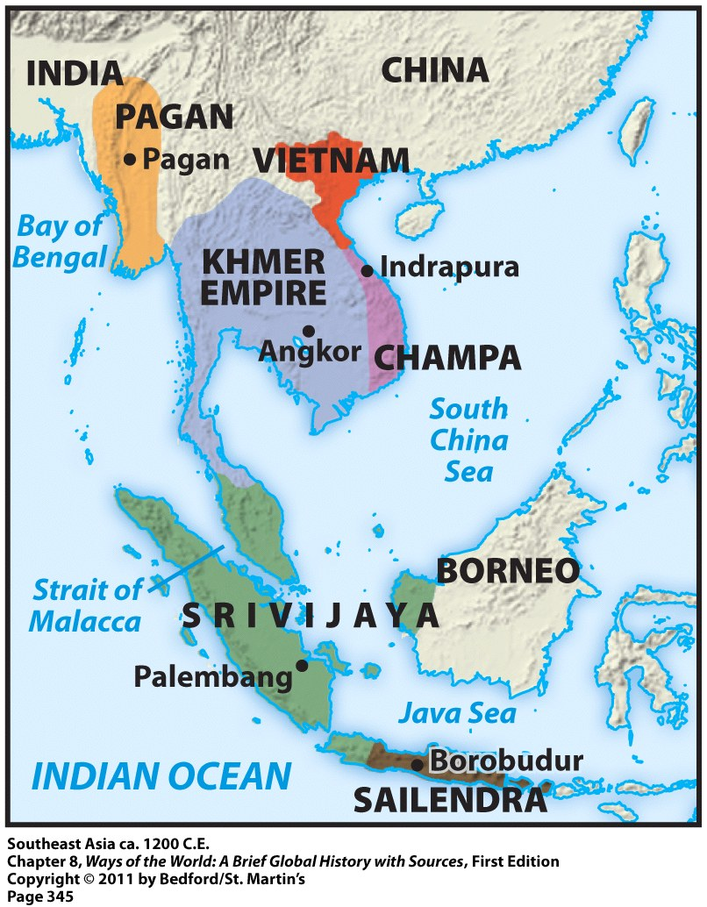
Southeast Asia & Srivijaya
Southeast Asia = between India and China
Its geography meant it played an important role in trade
350 CE = Malay sailors found a sea route between India and China through the straits of Malacca
more traders and travelers in the region
ports along Malaysian Peninsula competed to attract these traders

Slide 13
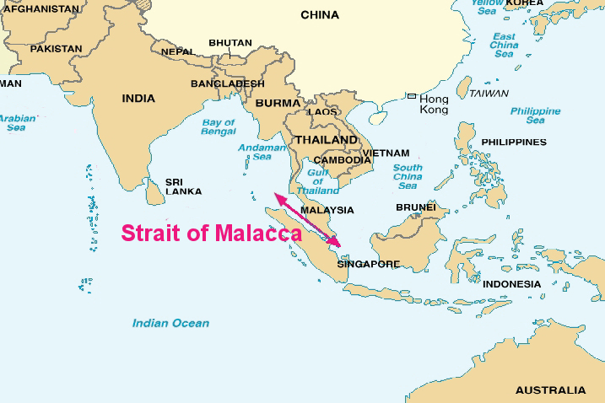

Slide 14
Southeast Asia & Srivijaya
From this competition emerged the Malay kingdom of Srivijaya
Dominated this region of Indian Ocean commerce from 670 to 1025
Its advantages:
Big supply of gold
Access to in-demand spices
Taxed passing ships

Slide 15
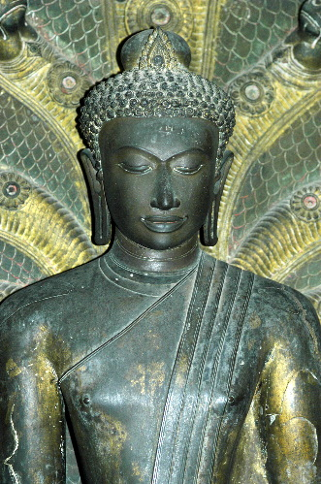
Srivijaya: Cultural Change
Influenced by Indian traders and adopted Buddhism
Rulers sponsored the creation of images of the Buddha and different bodhisattvas
Srivijaya = became a major center of Buddhist learning and culture

Slide 16
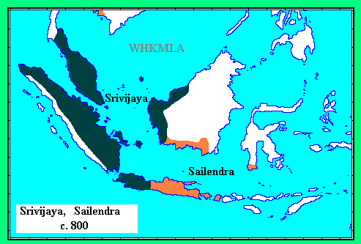
Sailendra Kindgom
Another kingdom in Southeast Asia influenced by Indian culture
Built huge Hindu temples and Buddhist monuments
Largest Buddhist monument anywhere in the world is located here = Borobudur

Slide 17
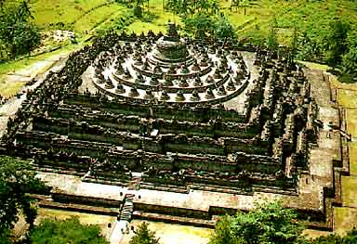
Borobudur
Mountain-shaped structure

Slide 18
East Africa & Swahili
Swahili civilization = set of commercial city-states stretching along the East African coast
Each city-state was politically independent with its own king
Big competition between each city-state
Sharp class distinctions in each city-state → big gap between the merchant elite class and the commoners

Slide 19
Swahili: Cultural Change
Arab, Indian, and Persian merchants = always welcome there
Swahili language = blend of Bantu and Arabic
Swahili civilization = quickly became Islamic

Slide 20
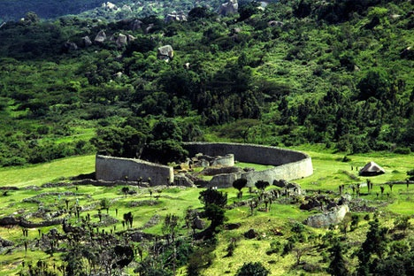
Coastal Cities = Intermediaries
Got valuable goods from interior of Africa, sold them to others
Allowed regions in the interior to become wealthy, even though they were not a part of the actual trade network
Example = Great Zimbabwe

Slide 21
Crash Course
http://www.youtube.com/watch?v=a6XtBLDmPA0

