Slide 1
Impact of the industrial revolution

Slide 2
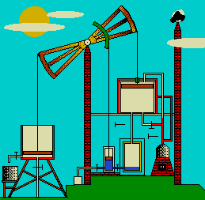
The steam engine
The MOST important invention of the IR
Perfected (?) by James Watt
Allowed for new machine-powered inventions in factories (instead of human-power at home)
Also new forms of transportation—railroads and steamships

Slide 3
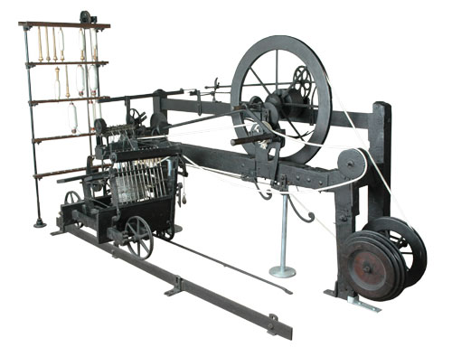
The Industrial revolution & Cotton
The textile (cloth) industry in Britain became the biggest in the world during the Indus. Rev.
Transition from cottage industry to textile factories
Banning of imported textiles (from India especially) to encourage domestic industry
Multiple new inventions helped speed up and mechanize the process:
Spinning Jenny
Flying Shuttle
Steam-Powered Loom

Slide 4
Video: Inventions of the IR
https://www.youtube.com/watch?v=hpwaVqTFteo

Slide 5
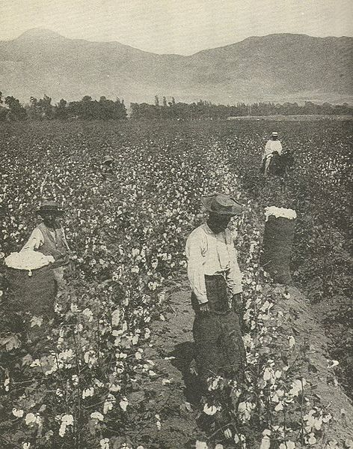
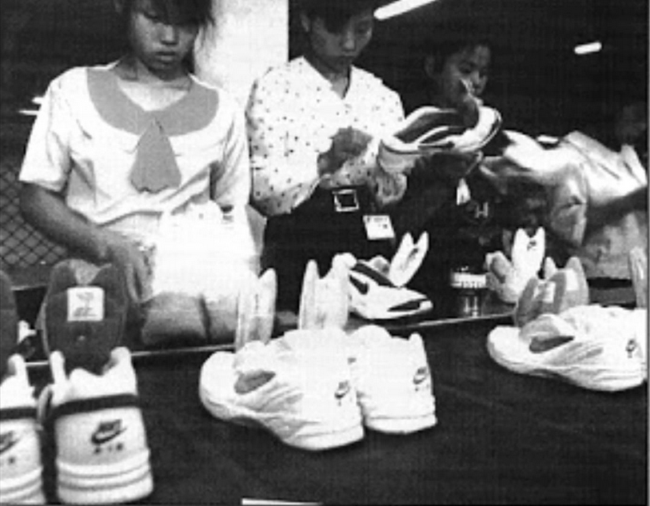
The Industrial revolution & Cotton
American Production of Raw Cotton, 1790-1860 (in bales)
Year | Production
1790 | 3, 135
1795 | 16,719
1800 | 73,145
1805 | 146,290
1810 | 177,638
1815 | 208,986
1820 | 334,378
1825 | 532, 915
1830 | 731,452
1835 | 1,060,711
1840 | 1,346,232
1845 | 1,804,223
1850 | 2,133,851
1855 | 3,217,417
1860 | 3,837,402
Cotton was imported from
Egypt (British colony 1882-1956)
India (controlled by British East India Company 1757-1858, British colony 1858-1948)
American South (produced by…?)

Slide 6
Iron and coal
IR would not have been possible without lots of iron ore & coal
Invention of more efficient methods of refining and smelting iron ore—cheaper AND stronger!
Construction, tools, shipbuilding, looms, steam engines and railroads
Invention of the steam engine helped pump water out of mines…allowed you to dig deeper to get more coal for steam engines!
Amount of Iron Produced in Great Britain
Amount of Coal Mined in Great Britain
Periods | Metric Tons of Pig Iron
1781-1790 | 69,000
1825-1829 | 669,000
1855-1859 | 3,583,000
1875-1879 | 6,484,000
1900-1904 | 8,778,000
Periods | Metric Tons of Coal
1700 | 2.7 million
1750 | 4.7 million
1800 | 10 million
1850 | 50 million
1900 | 250 million

Slide 7
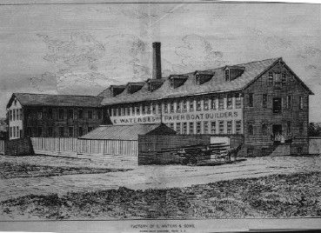
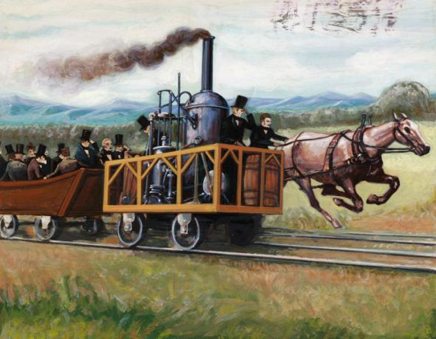
Factories and Railroads
How did each of these inventions fill the needs of the Industrial Revolution?
What economic and social changes did they bring?
Tom Thumb—first American locomotive (1830, Baltimore to Ellicott City)

Slide 8
Class in Britain

Slide 9
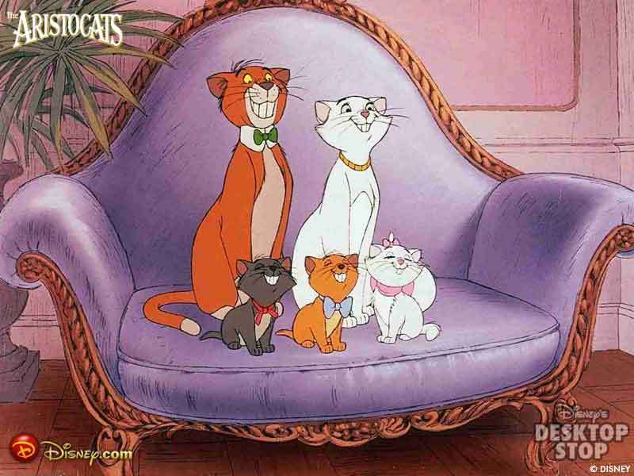
Aristocracy
Maintained wealth & holdings
A few thousand families still owned most arable land
Leased to tenant farmers
Had to begin to share political power with the “new money”—Businessmen, manufacturers, bankers

Slide 10
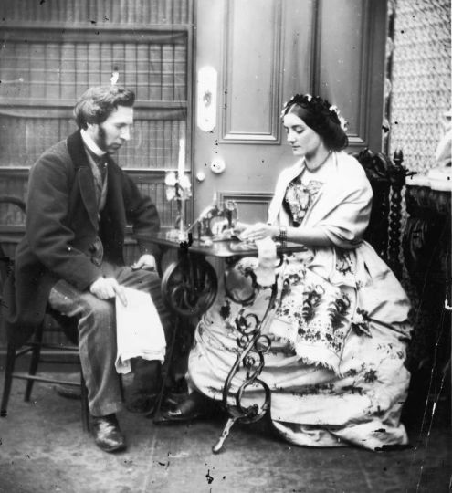
RISE of the Middle CLASS
Experienced most visible benefits of industrialization
Middle class=Professionals needed in an industrial society
Upper MC= Bankers, businessmen, doctors, teachers, scientists, etc.
Lower MC= Service sector (secretaries, police, clerks, etc.)
NOT manual labor
The vote was opened to many more British [men] in 1832
Women: Expected to be virtuous and homebound wives and mothers—should not work after marriage

Slide 11
Lower Class
70% of Britons in 19th Century were lower class
Suffered most, benefited least from IR
Manual Labor jobs: Mines, ports, factories, etc.
Most lived in newly urbanized areas
Dirty, poor, overcrowded
Long hours, low wages, child labor
Treated with contempt—poor seen as lazy and/or dumb

Slide 12
Environmental impacts: then and now

Slide 13
Industrial Revolution and Natural Selection
https://www.youtube.com/watch?v=LyRA807djLc

Slide 14
China’s industrial revolution

