Slide 1
Turn in your Opium Wars Documents if you did not yesterday
See me if you weren’t here yesterday

Slide 2
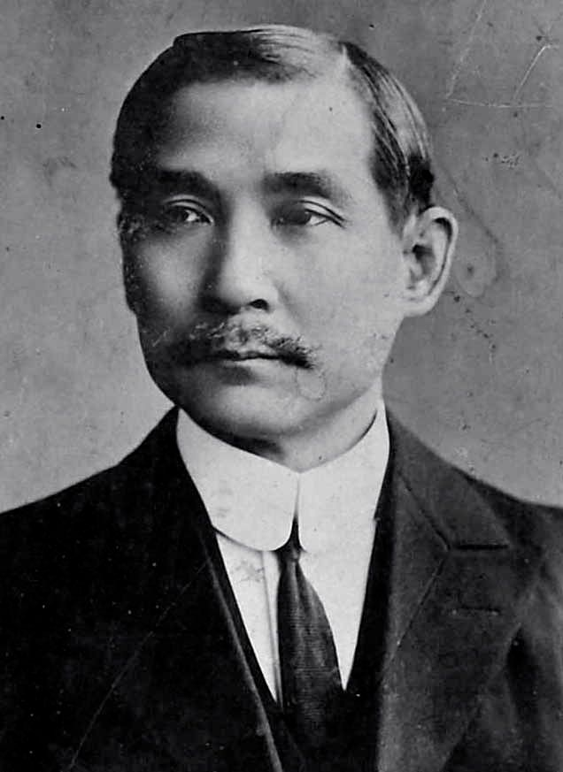
Collapse of the Qing (and the Chinese Dynasties)
The dynastic system, which had survived for millennia, ended in 1911
Series of small revolutions led to overthrow of the Manchu
Replaced with the Republic of China
First leader: Sun Yat-sen

Slide 3
Why Imperialism?

Slide 4
The East’s Encounters with the West
Western political ambition coupled with military might
Networks of trade from the capitalist West
Culture of the West (language, religion, etc.)
Western modernity (Science, technology, ideas like socialism and individualism)
Resist, accommodate, and/or adapt

Slide 5
Why Expand?
Need for raw materials
Markets for goods (huge populations!)
Nationalism: securing land for your country
New technology made it possible (steamships, telegraph, medicine)
“In order to save the 40 million inhabitants of the United Kingdom from murderous civil war, [we] must open up new areas to absorb the excess population and create new markets for the products of the mines and factories....
The British Empire is a matter of bread and butter. If you wish to avoid civil war, then you must become an imperialist.” –Cecil Rhodes

Slide 6
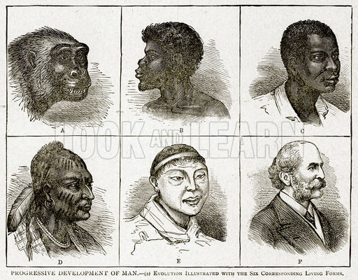
Racism and “THE OTHER”
Christian v. Others during the Crusades, now Whites v. Others
Development of theory of races—certain races are scientifically superior
Makes imperialism inevitable, humane, and a duty
“Take up the White Man’s burden—
Send forth the best ye breed—
Go send your sons to exile
To serve your captives' need
To wait in heavy harness
On fluttered folk and wild—
Your new-caught, sullen peoples,
Half devil and half child”

Slide 7
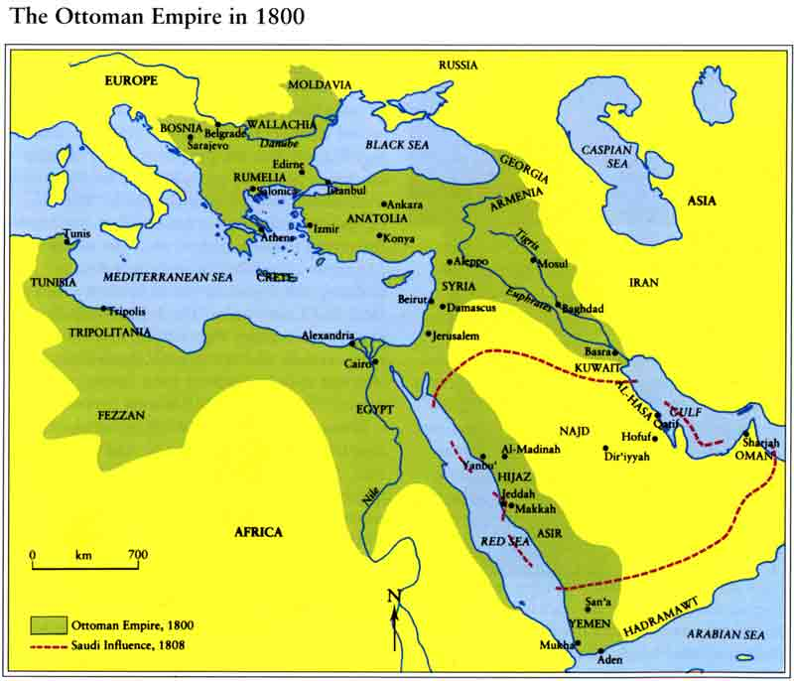
Europe and the ottoman empire

Slide 8
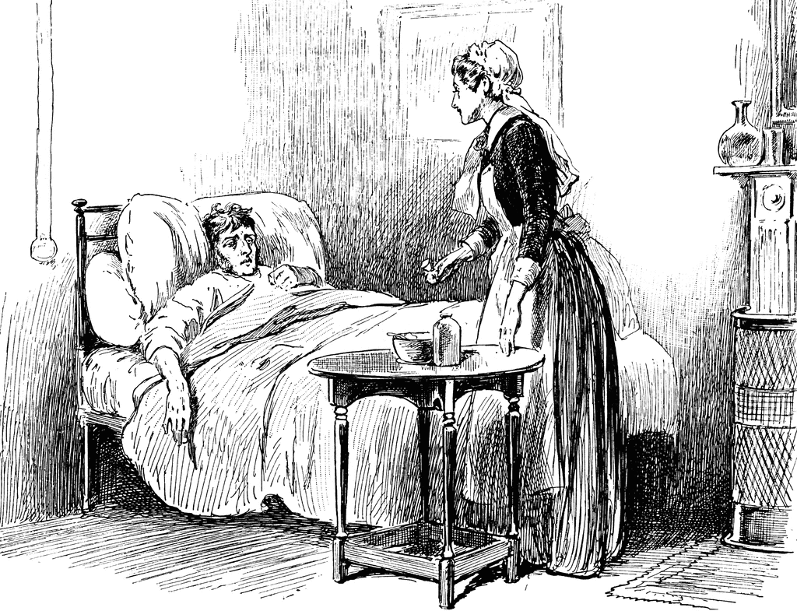
“The Sick Man of Europe”
Ottoman Empire (1299-1918) had been center of Islamic World, a fearsome opponent for European powers
By the end of the 19th century, was no longer equal (or superior) to Europe
Europeans had conquered many formerly Islamic and Ottoman territories
Egypt conquered by French (Napoleon) but then established own nation
Greece, Serbia, Bulgaria, Romania overthrew Ottoman rule (partly nationalism, partly British or Russian assistance)

Slide 9
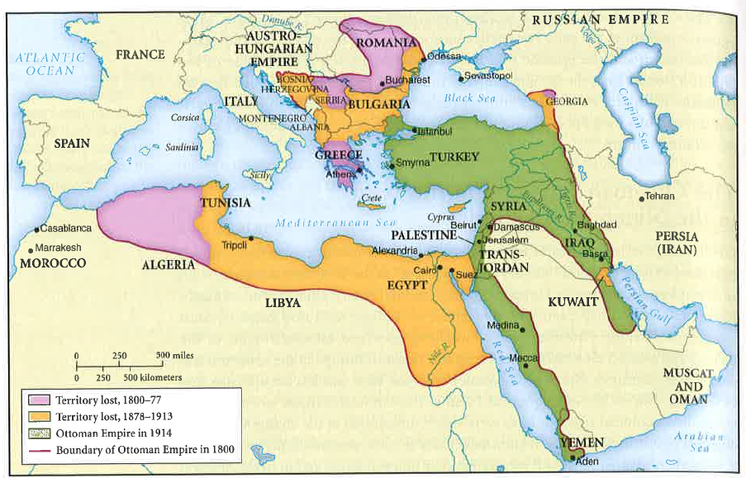

Slide 10
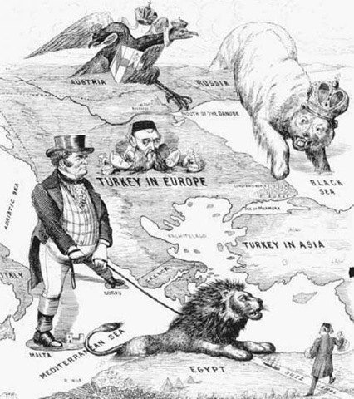

Slide 11
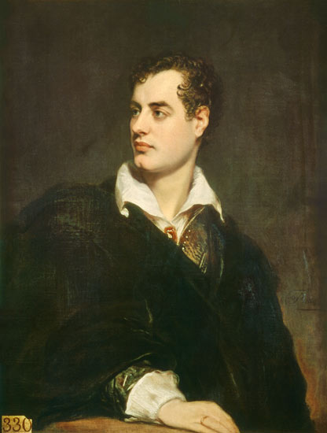
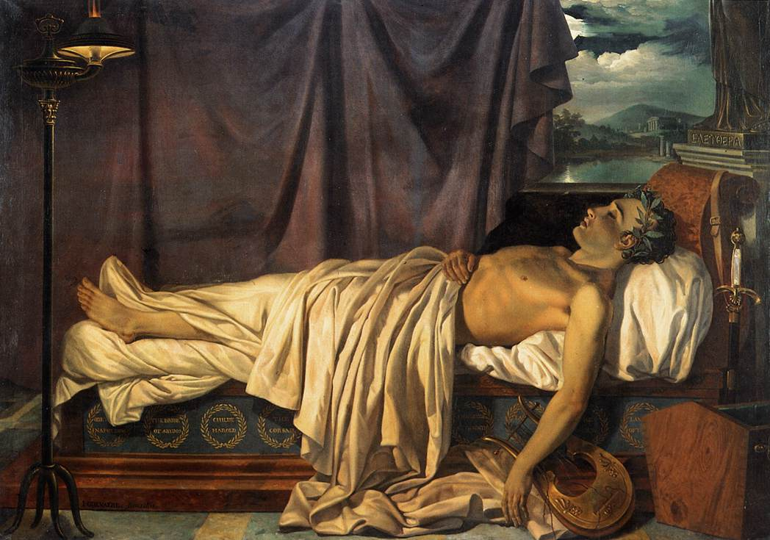
Lord Byron and the Greek War for Independence

Slide 12
Economic Troubles
Europeans could trade with Asia w/o the Middle East
Cheap European goods flooded Ottoman markets
Capitulations (agreements, like the unequal treaties) allowed Europeans favorable access in Ottoman economy
Reliance on foreign loans

Slide 13
Defensive Modernization
Ottoman attempts to fix its internal issues
Experienced nationalist uprisings, not peasant rebellions
Did not experience major population boom
Attempt to modernize the army and make it European
Met with resistance from Janissaries, Sultan assassinated
The Tanzimat: Mid-19th century reformist movement
Modern factories, technologies, law codes, schools
Attempts to modernize and Westernize the Ottomans
Move towards secularism, away from Islamism

Slide 14
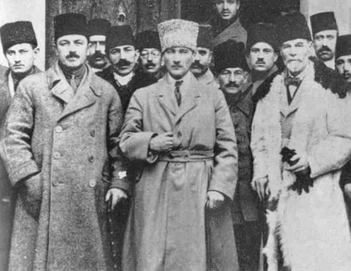
The Young Turks
Group of civilian and military elites that advocated for…
Secular, not Islamic, government
Modernization and Westernization
Seeing the Ottoman Empire as a Turkish nation
Gained power in 1908 via a military coup against Sultan
Established a Constitutional government
Secularized and modernized the country (see reading)

Slide 15
The YOUNG TURKS reading
What were the goals of the Young Turks?
What did they achieve?
How did their reforms help contribute to the downfall of the empire?

