Slide 1
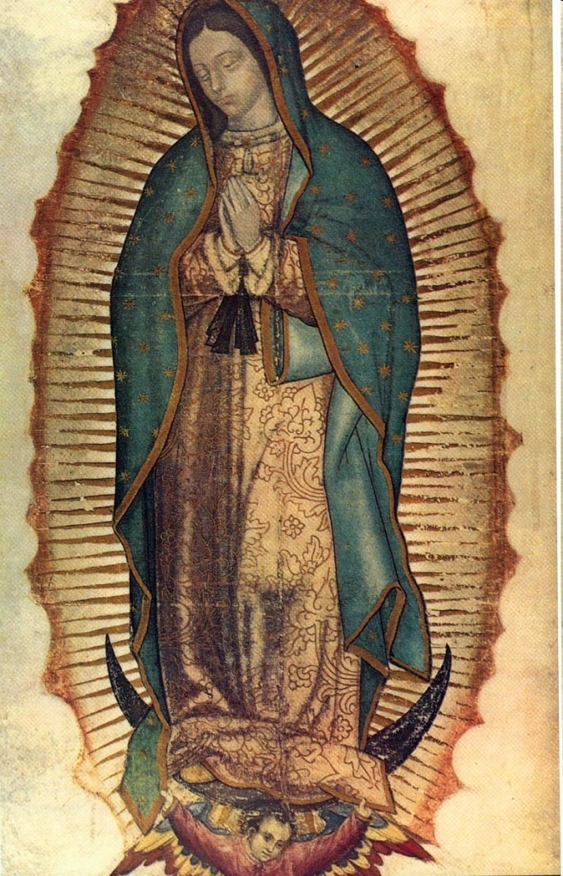
Catholicism, Society, and New Spain

Slide 2
New Spain and social hierarchy
The most urbanized and populated areas in the Americas were under Spanish control
Strict bureaucracy, ruled ultimately by Spanish crown abroad
Created a social hierarchy to accommodate the diverse range of people—Europeans, Africans, Indians, mixed race [mestizo=part-Indian, mulatto=part-African]
Peninsulares: New World Colonists who were born in Spain
Creoles: People of Spanish origin, born in the Americas
These two groups generally held the land and plantations
Peninsulares > Creoles > Mestizos > Mulattoes > Indians > African slaves

Slide 3
Mestizos
Mixed race group: Generally Spanish father, Indian mother
7:1 ratio of Spanish men to Spanish women (great if you’re a picky lady!)
Many Indian women sought the protection associated with having a Spanish husband
Spaniards married into elite Indian households—Cortés had children with TWO of Moctezuma’s daughters!
Looked down upon by Spaniards
Blended Spanish and Indian identities

Slide 4
SPREAD OF RELIGION IN THE AMERICAS

Slide 5
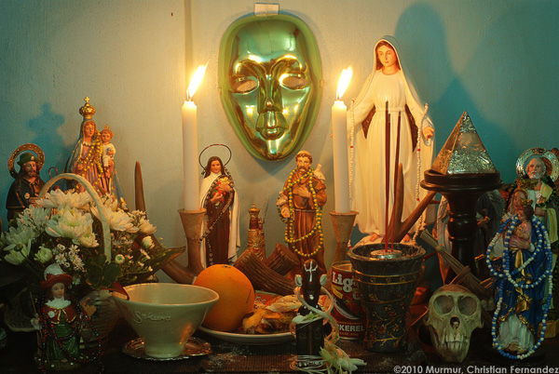
The Americas and cATHOLICISM
Spain remained a Catholic nation after the Reformation
Missionaries and priests arrived soon after the conquistadors
Many Indians converted to Christianity (willingly and forcibly)
They blended Christian Saints with local gods
Syncretic religions: Vodoo/Vodou, Santeria
Virgin Mary of Guadalupe

Slide 6
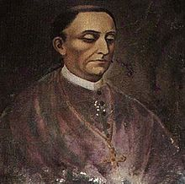
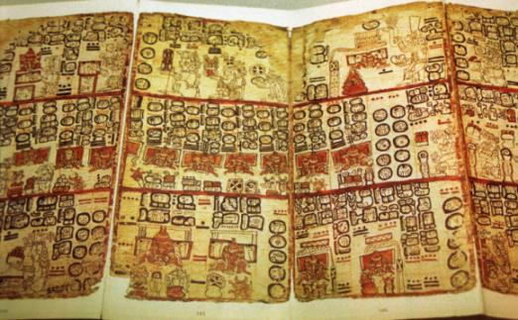
Fray diego de landa
How was Catholicism spread in Mexico?
How did the native population respond to the introduction of Catholicism?
Mayan Codex

Slide 7
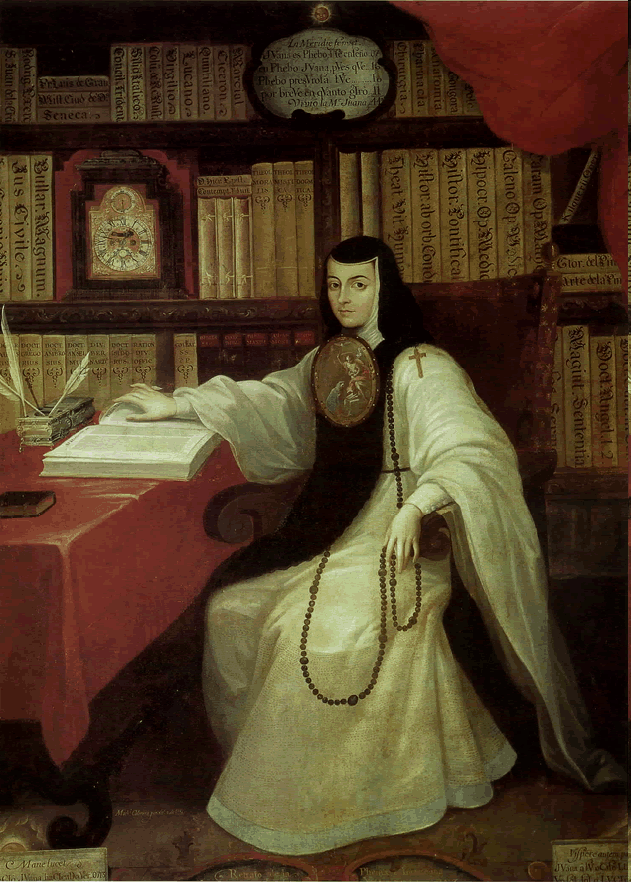
Sor Juana Inés de la Cruz
What aspects of her life seem “Spanish”?
Identify the role of the Catholic Church in her life.
Do you think that she found Catholic culture to be oppressive, neutral or liberating?

