Slide 1
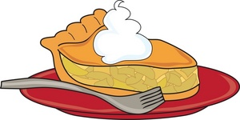
“Just for Fun” Warm-Up
In honor of Thanksgiving, let’s pretend that we are British pie-makers in the year 1470, just before European exploration opened up sea routes to the East and the West.
What sort of Pumpkin Pie could we have made?

Slide 2
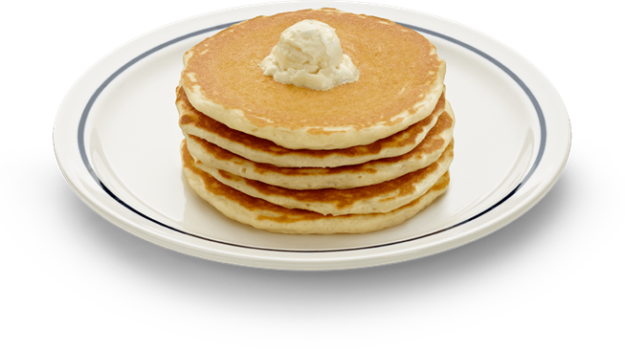
Ingredients in Pumpkin Pie
Crust:
1 cup of wheat flour
¼ tsp of salt
1/3 cup butter
Filling:
2 eggs
2 cups of cream
½ tsp salt
1
✔
✔
✔
1 pumpkin
✔
✔
½ cup sugar
✔
1 tsp cinnamon
1 tsp ginger
½ tsp nutmeg
1/8 tsp cloves

Slide 3
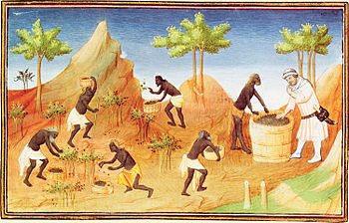
Today’s Objective: How did the spice trades stimulate European exploration of the globe?
Malabar pepper cultivation

Slide 4
Why did Europe begin its Age of Exploration?
Need for resources and cheaper goods
Especially spices…without the middleman!
New trade routes
Spread Christianity
Had new ship and navigational technology

Slide 5
Early Explorers
Portuguese: Small country, need for trade
Henry the Navigator: Established trade posts in Azores, Canary Islands (1418-1460)
Bartolomeu Dias: Southern Africa (1487-1488)
Vasco de Gama: Made it around Africa, to Swahili city-states, and to India (1497-1498)
Opened route to the Spice Islands (Indonesia) and India
Began conquering, not just trading

Slide 6
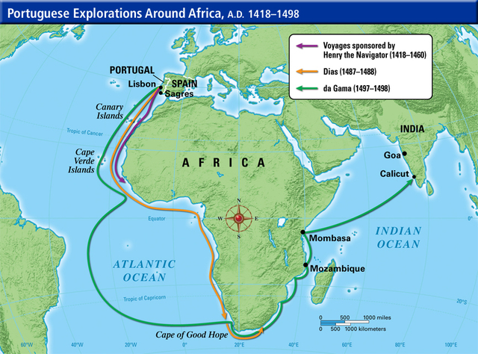

Slide 7
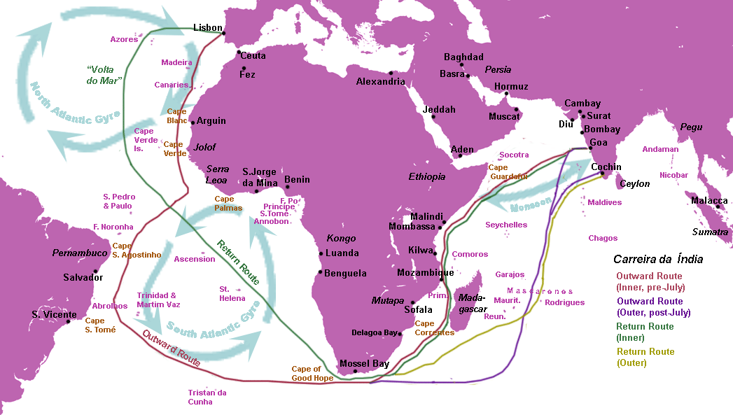
The Voyages of Vasco De Gama

Slide 8
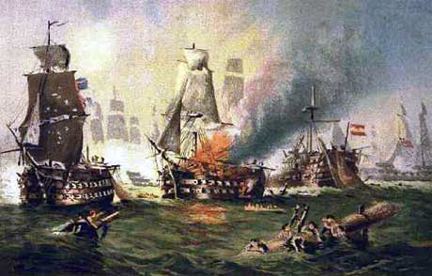
On a summer afternoon in 1592, the Madre de Deus, a Portuguese ship returning from the East was captured by English privateers. In the ship’s hold were riches almost beyond imagination…

Slide 9
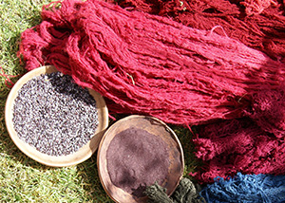
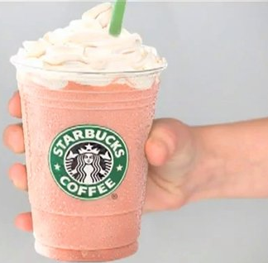
The Madre De Deus carried…
coins made with West African gold
coins made from Peruvian silver
pearls, amber, jewelry, musk, calico fabric
425 tonnes of pepper
45 tons of cloves
35 tonnes of cinnamon
25 tonnes of cochineal dye
3 tonnes of mace
3 tonnes of nutmeg
15 tonnes of rare ebony wood

Slide 10
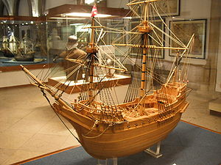
The value of the cargo from this one ship was worth half of ALL the money in England!

Slide 11
What were some of the spices that Europeans so coveted (desired)?
-- Pass the bags. Look. Carefully smell but don’t spill & don’t get pepper up your nose!
Notes:
P

Slide 12
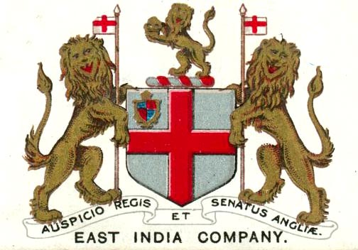
In response to the richness of the Madre De Deus, the British formed a company to explore and conquer the East Indies in the name of their king. Other European powers followed suit and a violent race to establish trade monopolies in the East began…

Slide 13
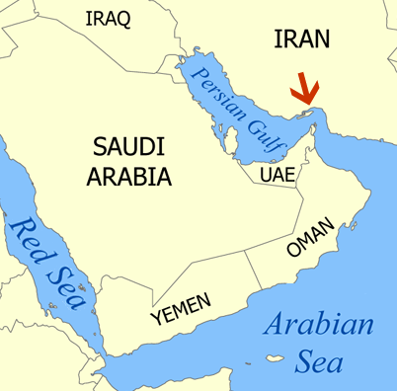
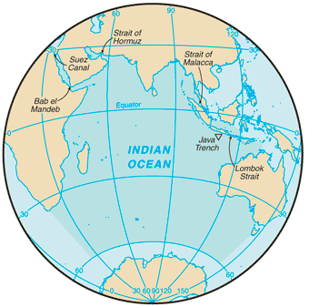
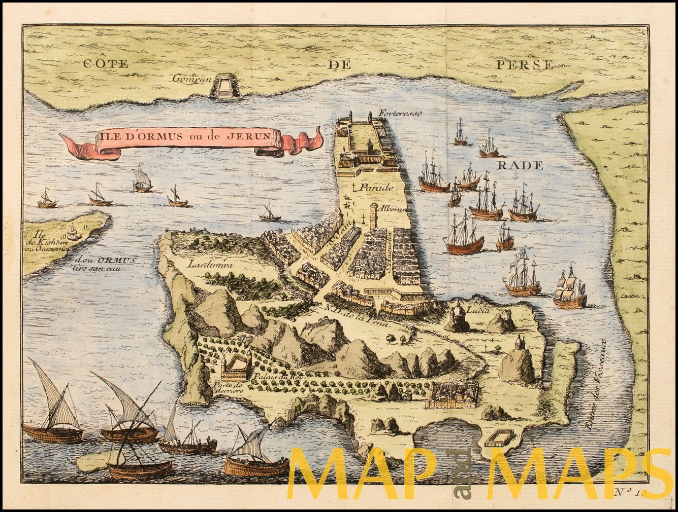
Read the article about the Portuguese attack on Hormuz – a key Arab trade center in the Indian ocean.

Slide 14
Words you might not know…
Afonso d’Alboquerque = Portuguese Admiral
artillery = cannons
vanquished = killed/destroyed
bucklers = shields
broadside = firing all your cannons at once
discomfiture = disarray

Slide 15
1. Describe the Battle of Hormuz

Slide 16
2. What advantages did the Arabs have in this battle?

Slide 17
3. What advantages did the Europeans have in this battle?

Slide 18
4. Why was it important for the Portuguese to capture it in their effort to control Indian Ocean trade?

Slide 19
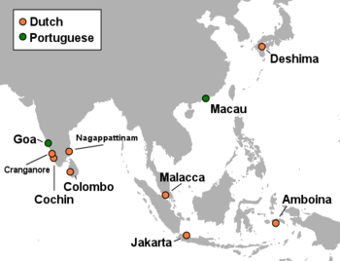
By the end of the 1600s the Portuguese, Dutch, British and French had all created empires to monopolize the East Indian Spice Trade.
How did European desire to monopolize the spice trade stimulate the growth of Asian empires during the 16th and 17th centuries?

Slide 20
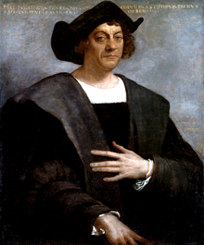
Christopher Columbus
Navigator from Italy, wanted to find Western route to China, Spice Islands, India
Sponsored by Ferdinand and Isabella of Spain
All experts said the ocean would be too big to get there…
Landed in Bahamas, believed it to be Indonesia
Spain would begin colonizing the continent, not just the islands

Slide 21
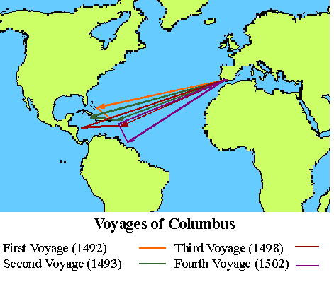

Slide 22
Crash Course
www.youtube.com/watch?v=NjEGncridoQ
Who do you think was the most influential explorer? The best explorer?

