Slide 1
Turn in your test corrections up front (staple your scantron to the test corrections)
Take out your notes from Chapter 8

Slide 2
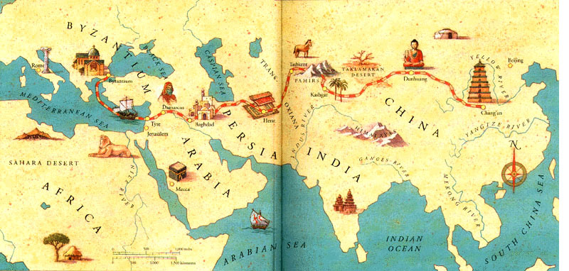
Trade and the Silk Road

Slide 3
How does trade change societies?
Alters consumption and production of goods
Focusing on distant markets, not local
Removes economic self-sufficiency
Method for social mobility
Creation and sustaining of states
Through taxation of trade
Vehicle for spreading ideas, religions, diseases, technologies, flora & fauna,

Slide 4
Silk Road
A “relay trade” with lots of middlemen
The classical civilizations were often linked by pastoral and nomadic people—this laid the groundwork for the Silk Road
Think about the Mongols, the Buddhist monks, the Uighurs…
Trade flourished when states were stable—provided security to traders
Think Rome and Han China
Usually only luxury and elite goods (no dollar-store caravans on the Silk Road)

Slide 5
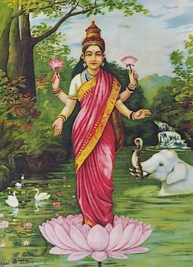
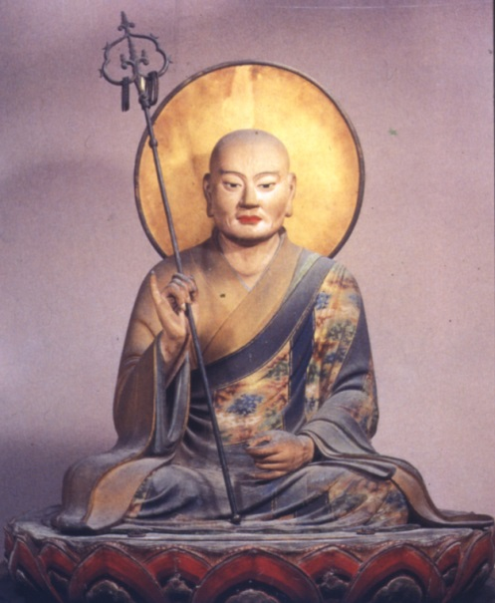
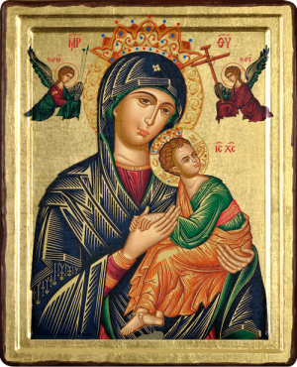
Goods on the Silk Road
High demand for cotton and silk textiles
Secrets to silk production eventually spread to other states along Silk Road
India, Persia, Byzantine, also Korea & Japan
Used as currency in Central Asia
Mark of high status in China, Byzantine
The original Jordans
Laws passed restricting silk to elites only
Religious usage in Buddhism, Hinduism, Christianity

Slide 6
Spread of Buddhism
Appealed to merchants (no hierarchy)
Linkage to Indian trade
Building of statues and monasteries along Silk Road
As pastoralists had more contact with trade and settled people, they were exposed to Buddhism
Buddhism became more materialistic
Mahayana Buddhism flourished
Incorporation of local gods as bodhisattvas

Slide 7
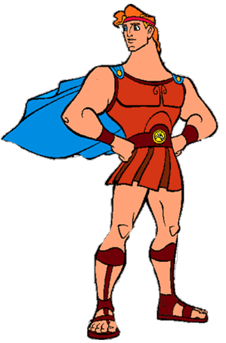
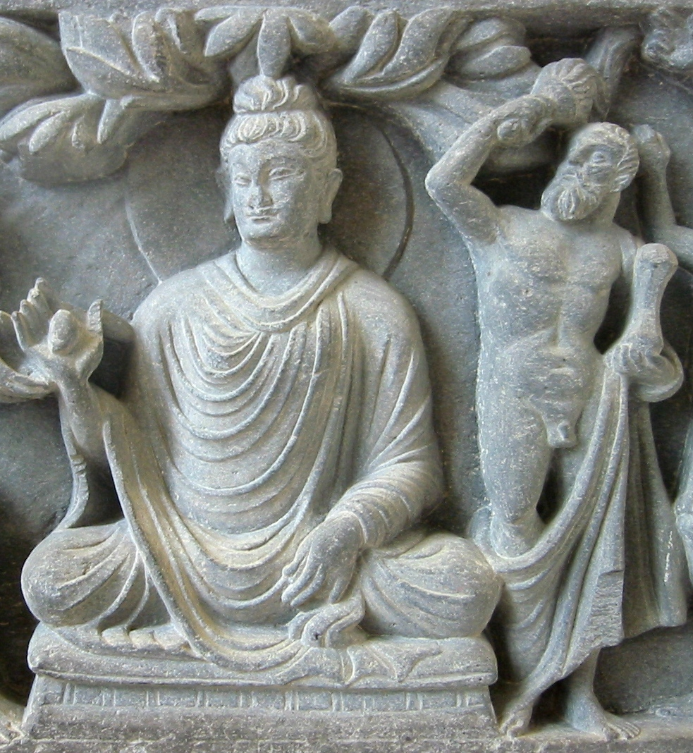
Hercules as Vajrapani

Slide 8
Spread of Disease
The silk roads made it easier for infectious and contagious diseases to spread
These diseases were exposed to populations who didn't have any immunity to them
Smallpox, measles, and bubonic plagues.
The famous Black Death of 1346-1353 killed hundreds of millions, particularly in Europe
http://www.youtube.com/watch?v=grbSQ6O6kbs

Slide 9
Crash Course
http://www.youtube.com/watch?v=vfe-eNq-Qyg

Slide 10
Marco Polo (Document 8.2)
Take notes on Marco Polo’s impressions of…
The City
The occupations/class structure
Customs
Women

