Slide 1
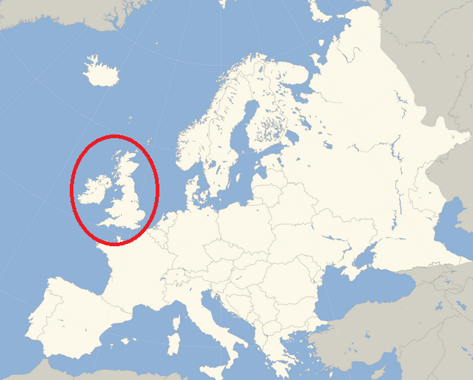
The Industrial Revolution
1780-1850 & beyond!

Slide 2
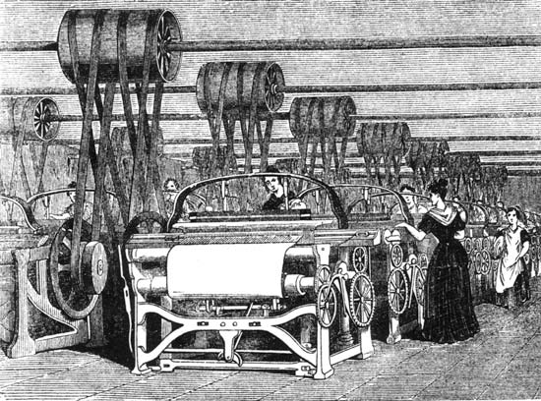
What is the industrial revolution?
Time when predominantly agrarian, rural societies in Europe and America became industrial and urban.
Industrialization marked a shift from hand-powered home production to powered machinery, factories and mass production.
Brought about many social and economic changes.

Slide 3
Why Europe?
Competition led to Capitalism and innovation
(Competing European states, that is)
Relied heavily on merchant class to fund the state
Capitalism: an economic and political system in which a country's trade and industry are controlled by private owners for profit, rather than by the state
Interconnected global trade network put Europe at economic advantage
Drawing on resources from elsewhere, especially New World colonies (and their slaves)
Also means bigger demand for goods from those colonies

Slide 4
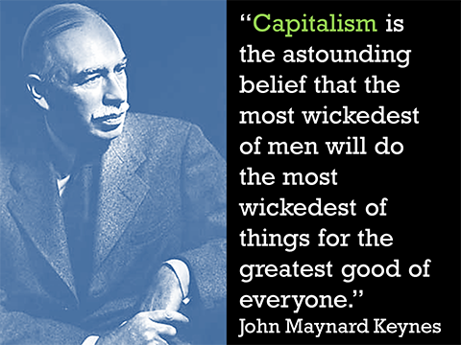
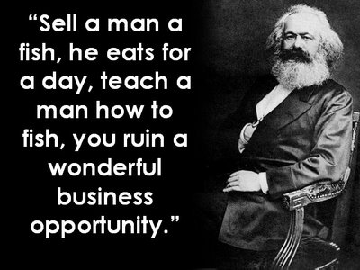
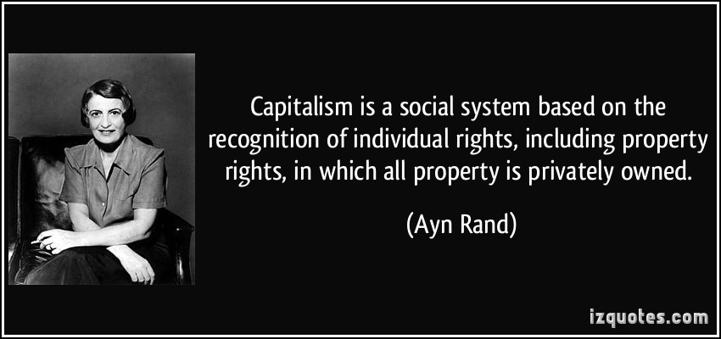

Slide 5
Why Britain?
Highly commercialized nation
Land owned by landlords, not small farmers
Surplus labor—not everyone was a farmer
End of the Guild System (organizations created to protect craftsmen from unfair practices)
Employers could treat workers however they wanted
Unique compared to other European nations
Religious tolerance and encouraging of business
Less monarchic power
Coal and Iron Ore supplies
Linking of inventors and scientists

Slide 6
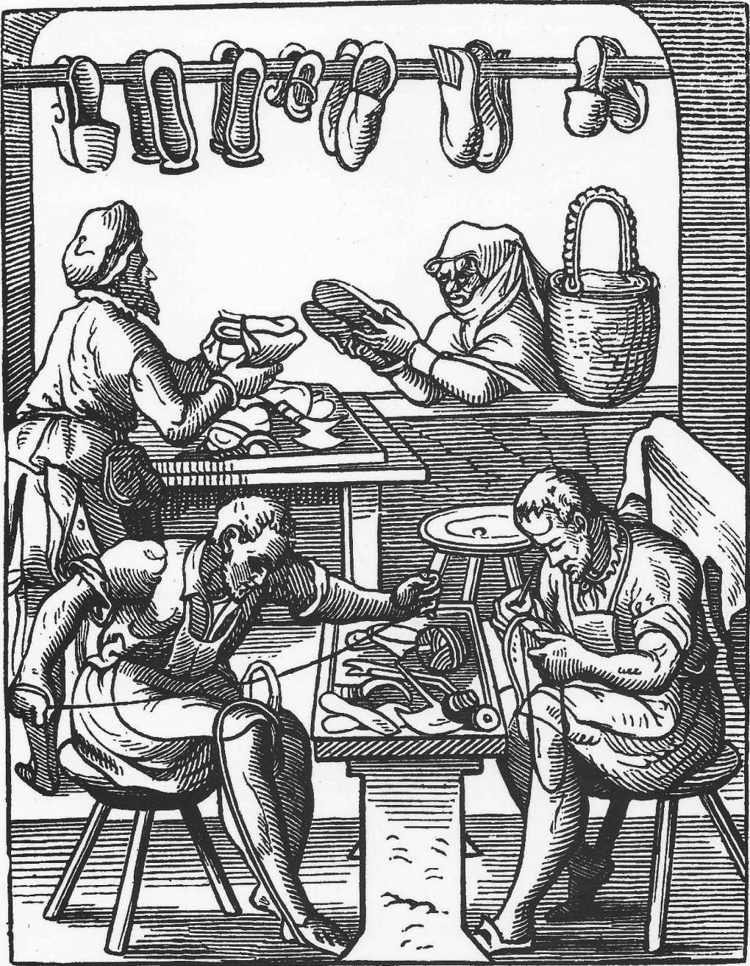
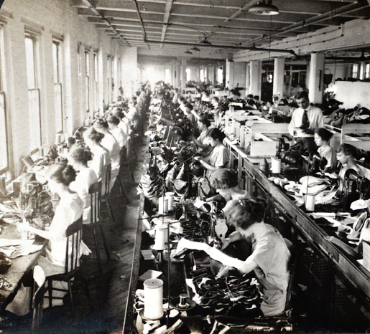
Guild vs. factory

Slide 7
Divide a piece of paper into 4 parts
Economics before the Industrial Revolution
Society before the Industrial Revolution
Economics after the Industrial Revolution
Society after the Industrial Revolution

Slide 8
http://llamafont.com/

