Slide 1
To-do
Have your Chapter 19 Notes on your desk so I can check them
Turn in your links to your groups’ Fakebook pages
You have until 2:10 TODAY to email them to me if you forgot.

Slide 2
Europe’s Domination of China

Slide 3
The East’s Encounters with the West
Western political ambition coupled with military might
Networks of trade from the capitalist West
Culture of the West (language, religion, etc.)
Western modernity (Science, technology, ideas like socialism and individualism)
Resist, accommodate, and/or adapt

Slide 4
Why Expand?
Need for raw materials
Markets for goods (huge populations!)
Nationalism: securing land for your country
New technology made it possible (steamships, telegraph, medicine)
“In order to save the 40 million inhabitants of the United Kingdom from murderous civil war, [we] must open up new areas to absorb the excess population and create new markets for the products of the mines and factories....
The British Empire is a matter of bread and butter. If you wish to avoid civil war, then you must become an imperialist.” –Cecil Rhodes

Slide 5
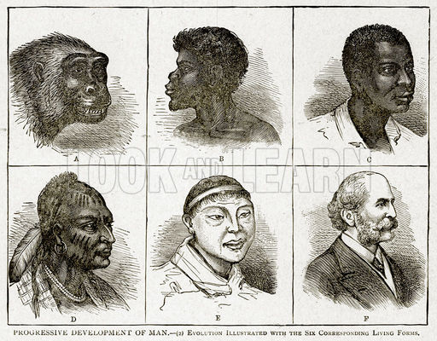
Racism and “THE OTHER”
Christian v. Others during the Crusades, now Whites v. Others
Development of theory of races—certain races are scientifically superior
Makes imperialism inevitable, humane, and a duty
“Take up the White Man’s burden—
Send forth the best ye breed—
Go send your sons to exile
To serve your captives' need
To wait in heavy harness
On fluttered folk and wild—
Your new-caught, sullen peoples,
Half devil and half child”

Slide 6
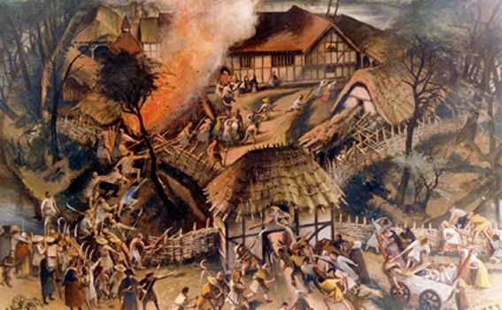
Problems within CHINA
Massive population growth (100 to 430 mil in 150 years)
Similar to Europe, but without Industrial Revolution or greater agricultural production
Less food for more people
Overwhelmed bureaucracy—less able to deal with tax collection, floods, welfare, etc.
Led to peasant rebellions (typical), due to the terrible situation and the ruling Qing (Manchu) Dynasty

Slide 7
Taiping Uprising (1850-1864)
Leader, Hong Xiuquan, claimed to be brother of Jesus
Movement rejected Confucianism, Daoism, Buddhism and traditional Chinese society
Gained millions of footsoldier followers
Wanted equality, to redistribute property, abolish foot-binding, opium, prostitution
Conquered much of Northern China, ~20 million deaths
Defeated by combined Qing and Western forces
Set up China for further Western exploitation

Slide 8
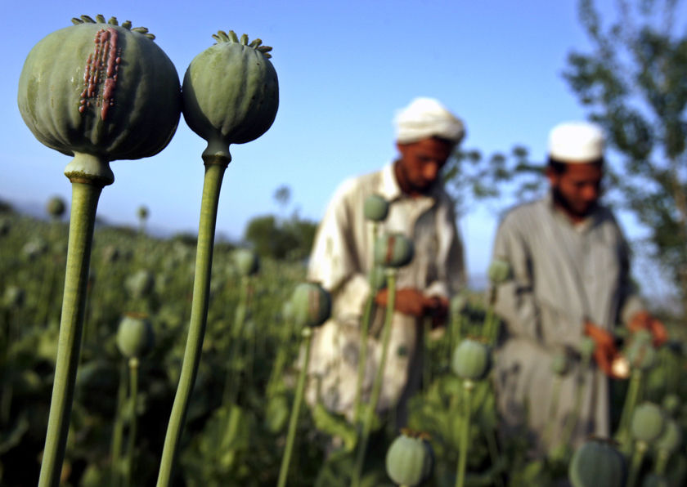
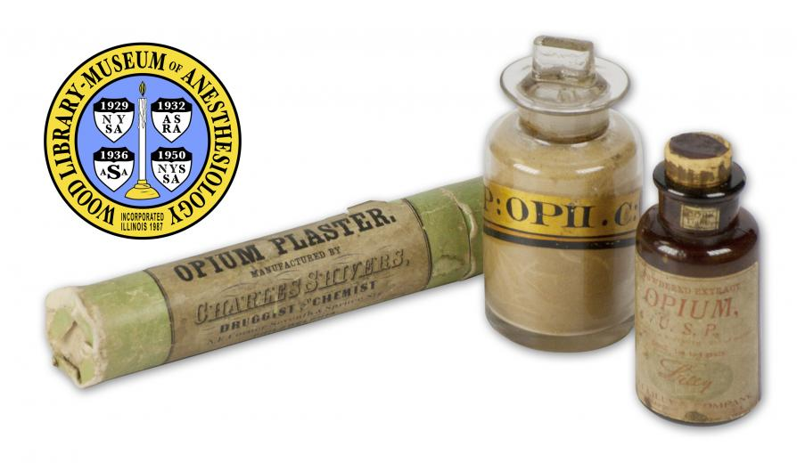
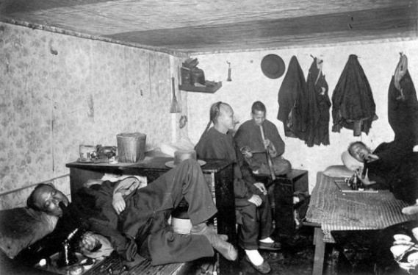
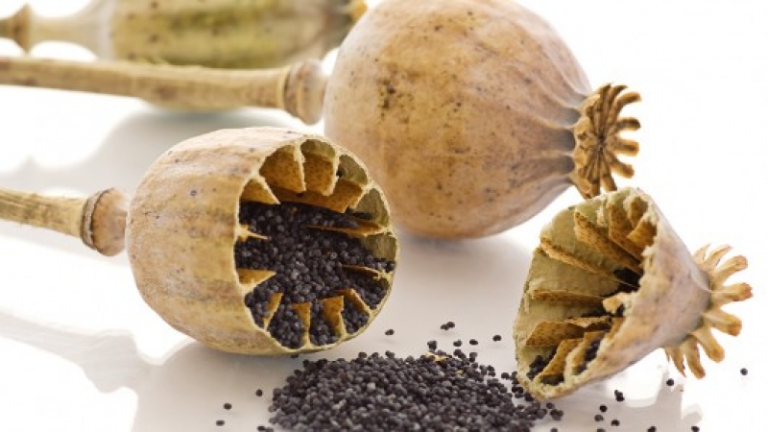
The opium wars

Slide 9
Opium Wars Reading
Why did Britain start selling opium to China?
How did this affect China?
What was China’s response?
How did Britain respond?
What did the “unequal treaties” do?
What was the effect on China?

Slide 10
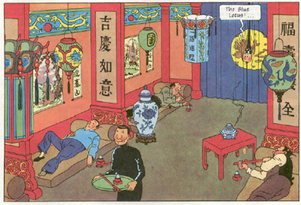
Opium Wars
Opium: An addictive narcotic & medicine
Britain had a trade imbalance with China (importing much more than exporting)
Started selling opium from India in 1770s
Enormously profitable from high demand from the Chinese
Now China was economically and socially imbalanced
Silver was flowing out of China
Millions of opium addicts

Slide 11
Opium Wars
Chinese gov’t began cracking down in 1836
Seized millions of pounds of opium, expelled Western traders
Britain responded by apologizing and putting the Chinese in drug treatment programs
Britain responded by sending their imperial Navy to China
First Opium War (1839-1842) forced China to accept “unequal treaties” for trade with West
Second Opium War (1856-1858) further humiliated China, opened it to foreign traders and landbuyers

Slide 12
Subjugation of China
China was now under the thumb of Europe
Forced to accept European industrial goods
Little establishment of Chinese industry or capitalism
“Self-Strengthening”—China’s attempts to modernize and compete
The Boxer Rebellion (1898-1901): Anti-foreign uprising, killing of Westerners and Chinese Christians
Put down by Europeans and Japan, forced China to pay $$$
Still, Chinese nationalism grew—wanted to harness Western political ideas but throw off Western control

Slide 13
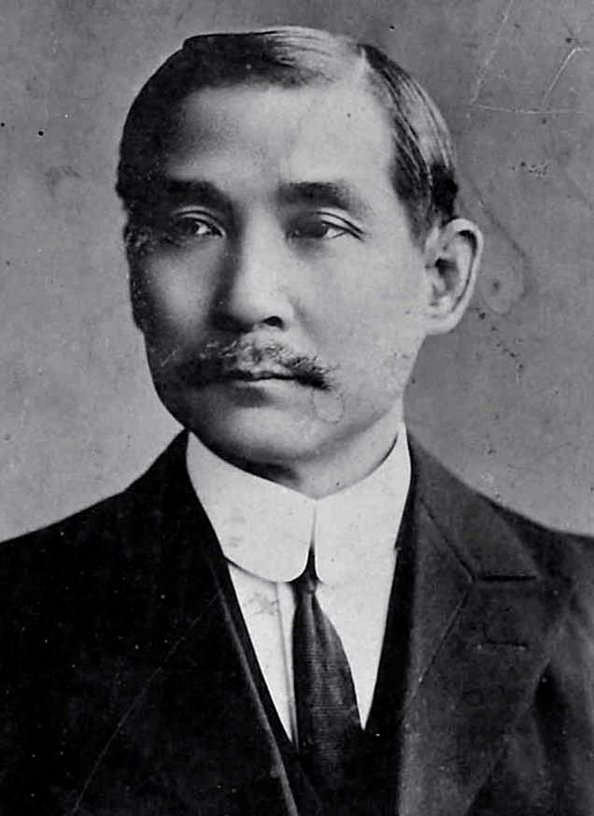
Collapse of the qing
The dynastic system, which had survived for millennia, ended in 1911
Series of small revolutions
Replaced with the Republic of China
First leader: Sun Yat-sen

