Slide 1
The Scramble for Africa (1870 – 1914)
Have your Chapter 20 notes on your desk!

Slide 2
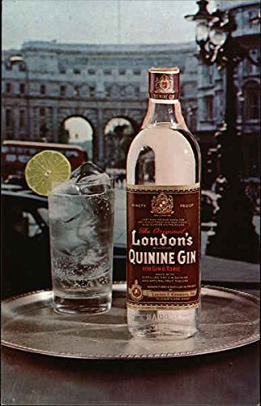
The Scramble for Africa
Most of the interior of Africa had not been explored (or exploited) by Europeans by 1870s, but…
Invention of steam engines made travel possible (railroads, steamships)
Invention of machine gun made conquering possible
Invention of quinine helped prevent malaria
Lack of unified governments made subjugation of natives more possible
European countries were prepared to fully conquer Africa in the 1880s, seeking raw materials
Gold, diamonds, cash crops (rubber, cocoa, cotton)

Slide 3
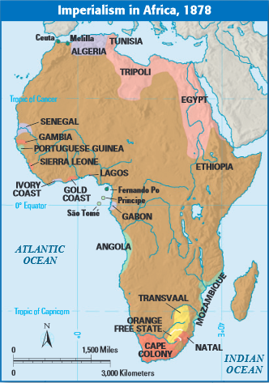

Slide 4
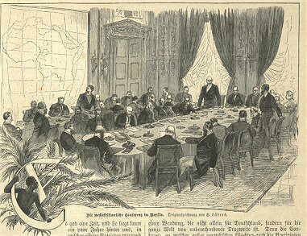
Scramble for Africa
Rather than fighting wars with each other, European powers divided up the remaining 80% of Africa together
The Berlin Conference (1884-85) included no African reps.
Divided up Africa along arbitrary lines—no thought given to ethnic or linguistic groups of people
Legitimized and formalized African colonization
90% of Africa colonized by 1900

Slide 5
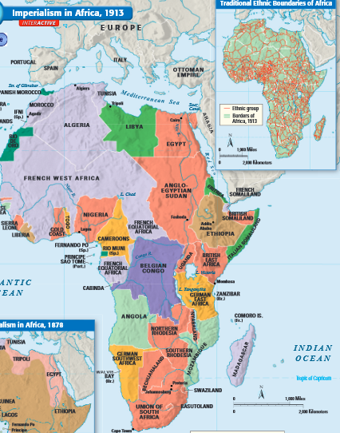

Slide 6
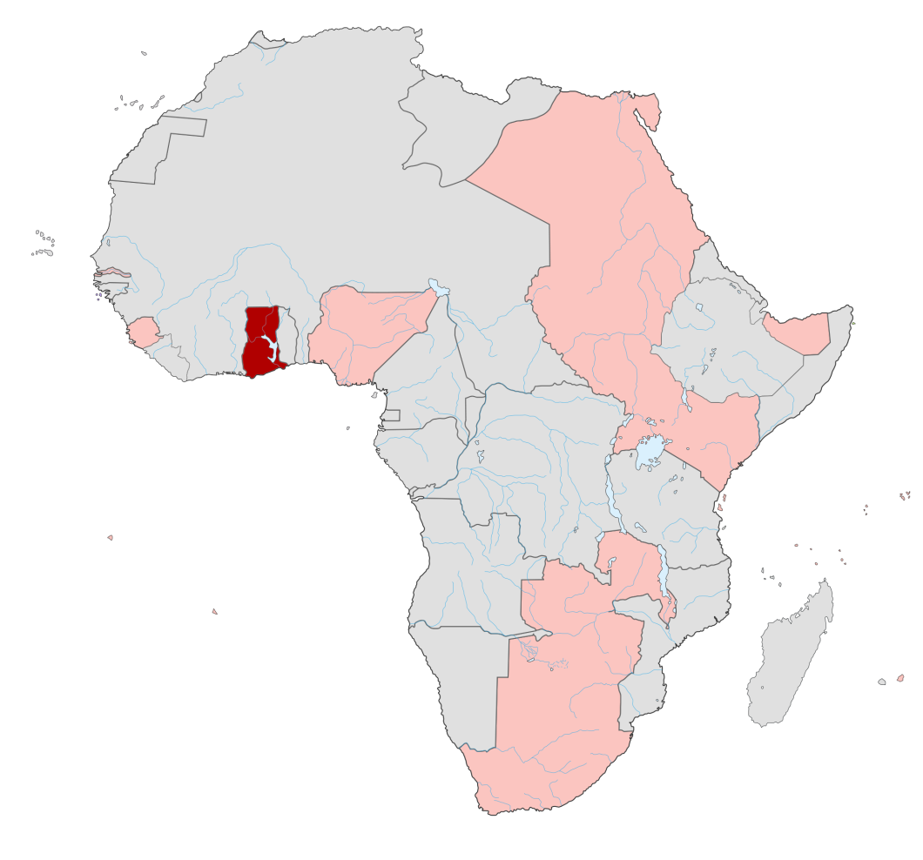
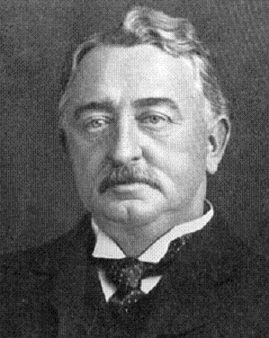
Cape-to-Cairo
British Imperialist Cecil Rhodes envisioned unbroken British control of East Africa
Including continent-long railroad line

Slide 7
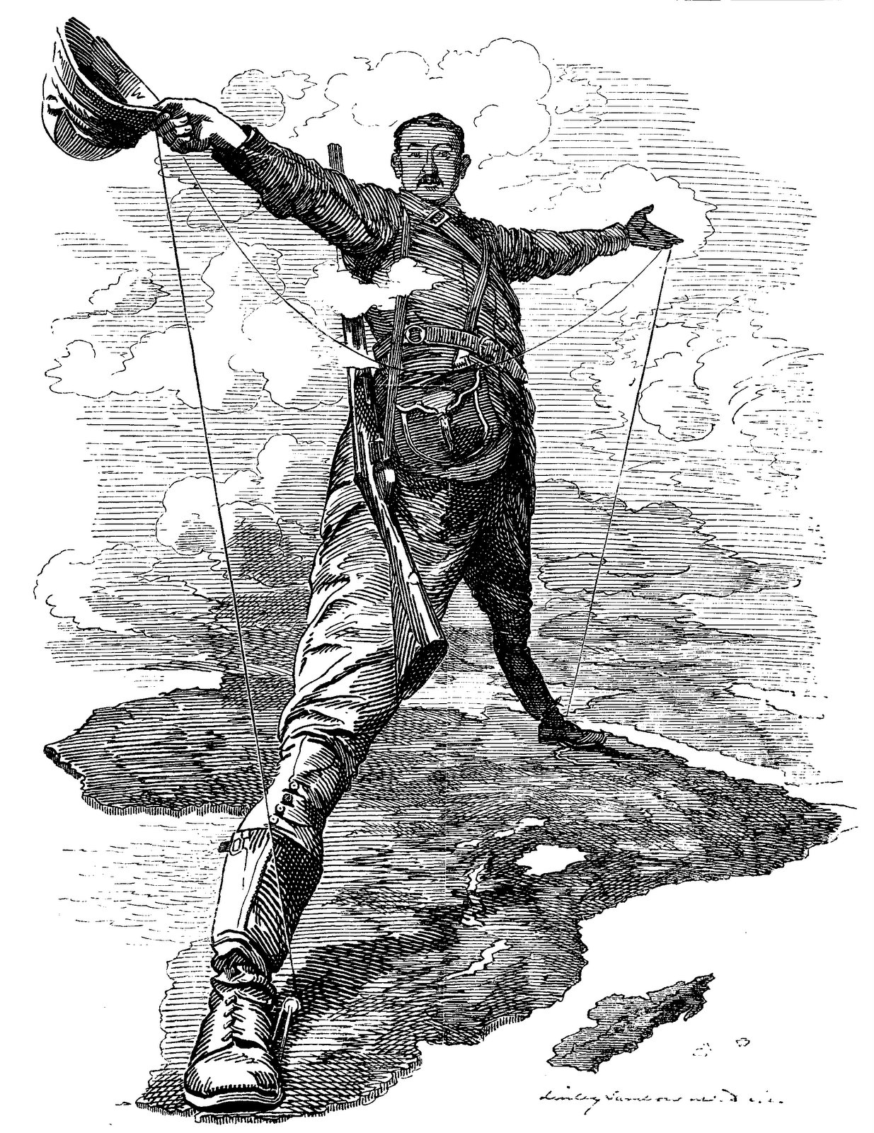
What objects do you see in this image?
What do these objects tell you about Rhodes’ method of achieving his goal?
How is the African continent portrayed? How are the African people portrayed?
What does this cartoon tell you about the motivations that drove men like Cecil Rhodes to imperialize?

Slide 8
Belgium and the Congo

Slide 9
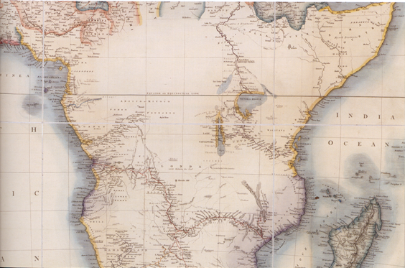
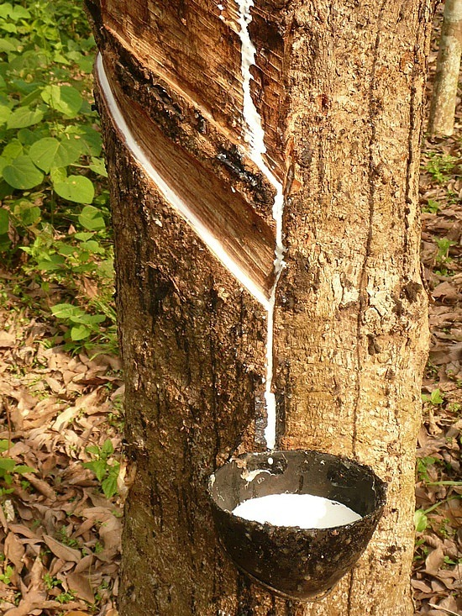
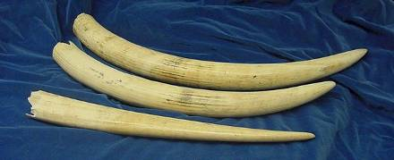
The interior of the Congo was a “blank spot” due to its harsh environment, disease, and hostile tribes, but it was known to be full of profitable natural resources such as ivory and rubber.
The Congo

Slide 10
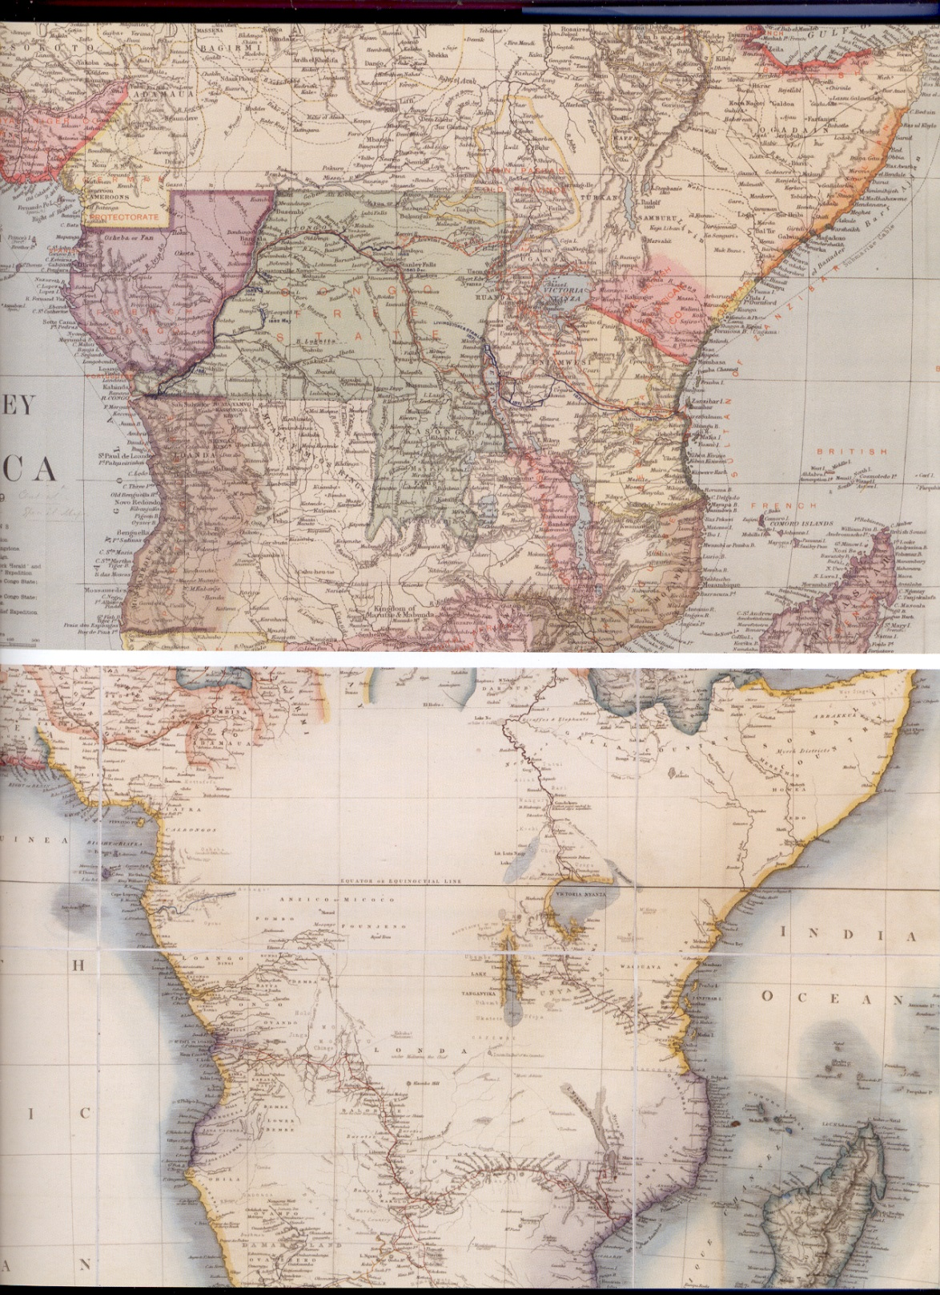
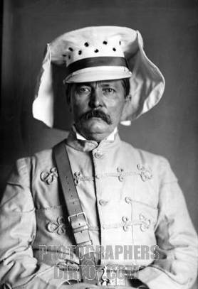
Explorations by men like Henry Stanley helped Europeans get their mind around the enormity of the territory.
After Stanley’s expeditions
(1870s)
“Dr. Livingston I presume?”
Before Stanley’s expeditions
(1850s)

Slide 11
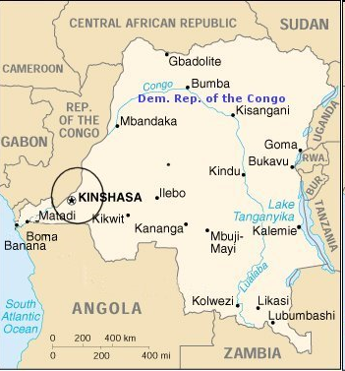
Stanley helped capitalist investors build a railroad to bypass the cataracts, greatly increasing the ability of outsiders to make money in the Congo.
The Congo
Stanley helped capitalist investors build a railroad to bypass the cataracts, greatly increasing the ability of outsiders to make money in the Congo.
Cataracts (Waterfalls)

Slide 12
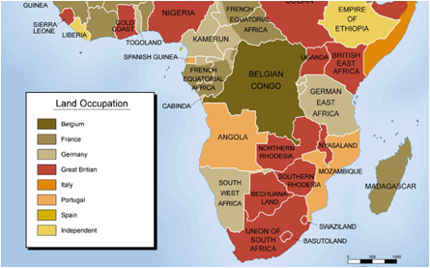
Yet with the “opening” of the Congo, a pressing question appeared:
?
Which European empire was going to gain control of Congo?
Slide 10 of 38

Slide 13
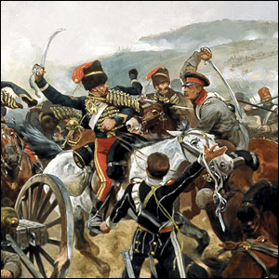
None of the Great Powers of Europe were willing to let any others have such a rich and important colony. Wars had been fought for far less.

Slide 14
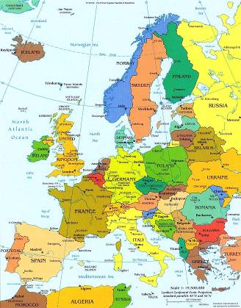
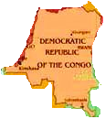
It was decided at the Congress of Berlin that Congo would go to Belgium, a small, powerless European nation so insignificant that it could not threaten the power of the others.
Stanley helped capitalist investors build a railroad to bypass the cataracts, greatly increasing the ability of outsiders to make money in the Congo.
The Congo
Belgium

Slide 15
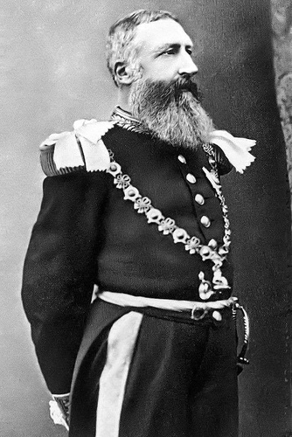
The king of that nation, Leopold II, made sweet-sounding promises.
But Leopold was no humanitarian...
“Through my efforts I hope to bring about…civilization to the peoples of the Congo region by means of scientific exploration, legal trade and war against Arabic slave traders…to pierce the darkness which hangs over entire peoples…”

Slide 16
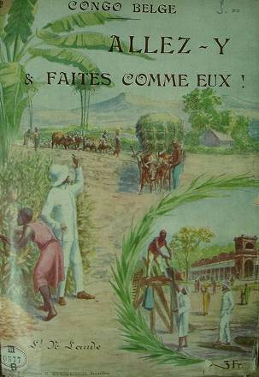
Once Congo was safely under Belgium’s control, Leopold began to exploit Congo for his own personal profit.
The Congo

Slide 17
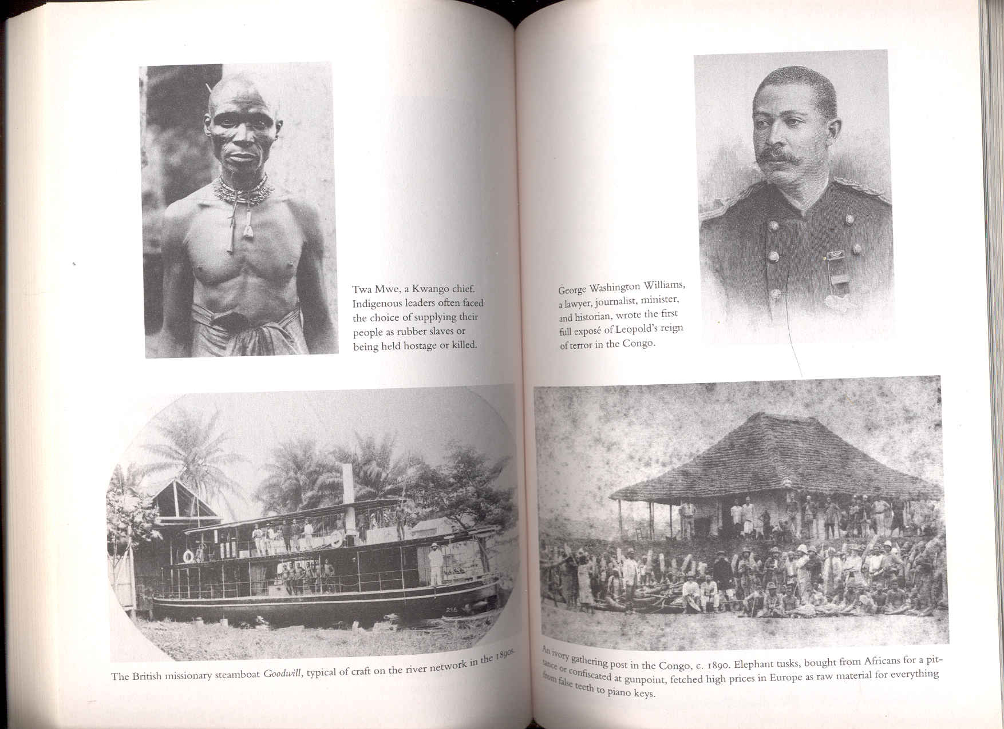
The “Congo Free State” was turned into a modern-day Belgian slave empire

Slide 18
Leopold maintained control over the territory through a variety of methods.
In this way, Belgium and Leopold gained a fortune from ivory and rubber, without any trade benefits to the Congo.
bribery
hostage taking
threats
Belgian methods of Control
Military force
misinformation and propaganda
assassination & murder
divide and conquer

Slide 19
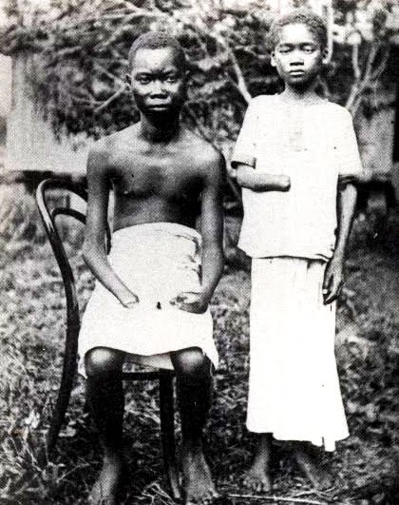
Economies of Coercion: Forced Labor and the Power of the State
Villagers had daily rubber quotas
If rubber quotas were not met, villagers were tortured and/or killed
Shot, ears/limbs cut off, tied up with ropes around their necks and dragged away, etc.

Slide 20
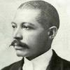
One activist discovered that in order to acquire the goodwill of the Congolese, Stanley’s men used a variety of tricks, such as fooling Africans into thinking they had supernatural powers to get Congo chiefs to sign their land over to Leopold.
For example…when shaking hands with chiefs they used batteries and wires to convince them that they had super strength...
Other times Stanley’s men would use magnifying glasses to light their cigars and thereby fool chiefs into thinking that they commanded the power of the Sun and could ask it set fire to villages.
Yet other times white men would visibly load a gun but slip the bullet into his pocket. Then he would ask the chief to shoot him and, when the shot did not appear to harm him, would produce the bullet at his feet and claim to be immune.
30 of 34
G.W. Williams

Slide 21
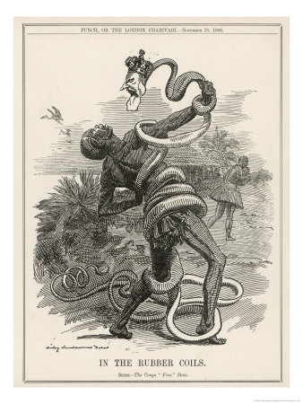
Historians estimate that during Leopold’s reign, the Congo lost between 4 to 8 million people due to violence and neglect. This makes it one of the worst genocides in world history. It is also largely forgotten.
Effect on Congo

Slide 22
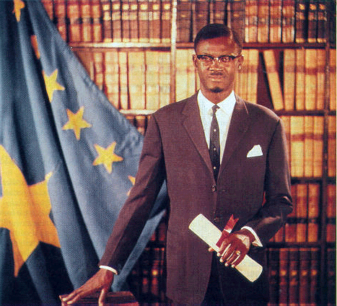
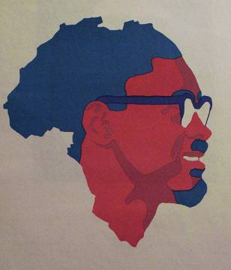
Leopold died in 1909, never having laid eyes on his beloved colony. After his death, the Belgian government took control. The situation improved greatly, but it wasn’t until Congolese nationalists began to actively revolt in the mid 20th century that Belgium finally granted Congo independence. But the tragedy did not end.
Effect on Congo
Patrice Lumumba, Prime Minister

Slide 23
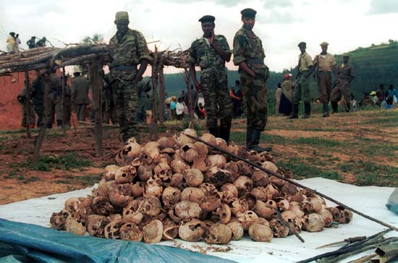
Effect on Congo
Despite having gained its independence, Congo had been left without lasting infrastructure or stable political structure,
resulting in many more decades of brutality and war at the hands of dictators, warlords, and corporations. Today it remains in the grip of a civil war that has killed more people than any conflict since WWII.

Slide 24
Assessing Colonial Development
Clear results of economic development within European colonies in the 19th-20th centuries:
(1) Colonial rule facilitated the integration of Asian and African economies into a global network of exchange
More land and labor = devoted to production for the global market
(2) Nowhere did a breakthrough to modern industrial society occur

Slide 25
Assessing Colonial Development
(3) The appearance of some elements of modernization
Modern administrative and bureaucratic structures
Schools → used to train the intermediaries that were so crucial to colonial rule
Communication and transportation → railroads, motorways, ports, telegraphs, postal services
Modest health care provisions → part of the “civilizing mission”

Slide 26
Economies of Coercion: Forced Labor and the Power of the State
Forced labor was often used to meet the demands of the colonial state → Examples:
Building railroads
Constructing government buildings
Transporting goods

Slide 27
Economies of Coercion: Forced Labor and the Power of the State
Several colonial states used “cultivation systems”
Peasants required to cultivate 20% or more of their land in cash crops such as sugar or tobacco to meet their tax obligation
Cash crops sold to government contractors at fixed, low prices
Cash crops resold in the world market for a very high profit

Slide 28
Economies of Cash-Crop Agriculture
In some places, colonial rule created conditions that facilitated and increased cash-crop production to the advantage of local farmers
Example: British authorities in Burma encouraged rice production among small farmers
Ended the prohibition on rice exports
Provided irrigation and transportation facilities
Passed laws that encouraged private ownership of small farms

Slide 29
Economies of Cash-Crop Agriculture
Results of these policies in Burma:
Population boomed → in Burma AND in other parts of Asia
Rice exports soared
Small farmers able to buy their own land, build nice homes, buy imported goods, etc.
Standards of living improved sharply

Slide 30
Economies of Cash-Crop Agriculture
Profitable cash-crop farming = in the southern Gold Coast
British territory in West Africa
Modern-day Ghana
African farmers themselves developed this export agriculture
Planted cacao trees in huge quantities and became the world’s leading supplier of cocoa by 1911

Slide 31
Economies of Cash-Crop Agriculture
Problems with cash-crops:
Labor shortage = led to employment of former slaves who were exploited
Labor shortage = led to migration of workers from the interior of Africa to the Gold Coast → caused ethnic and class tensions
Some men married women for their labor power, but didn’t take care of them
Many colonies only specialized in one or two cash-crops → hurt them when world market prices dropped

Slide 32
Economies of Wage Labor: Working for Europeans
Millions of colonial subjects across Asia and Africa sought employment in European-owned plantations, mines, construction projects, and homes
Needed money
Lost land they needed to support their families
Sometimes forced by colonial authorities

Slide 33
Economies of Wage Labor: Working for Europeans
European-financed plantations in Southeast Asia that grew sugarcane, rubber, tea, tobacco, and so on employed hundreds of thousands of workers
Workers = subject to very strict control
Often housed in barracks
Paid very little (and women made even less)
Disease was common → high death rates

Slide 34
Economies of Wage Labor: Working for Europeans
Even more land taken from local people in Africa than in Southeast Asia
Ex: South Africa in 1913 → whites were 20% of the population, but controlled 88% of the land
“Squatters” = Africans who stayed and worked for the new landowners as the price of remaining on what had been their own land

Slide 35
Economies of Wage Labor Working for Europeans
Another source of wage labor for many = mines
Major tin mines in Malaysia
Miners = mostly impoverished Chinese workers
Worked on strictly-controlled 3-year contracts
Horrible living conditions
Rampant diseases
Dangerous work = many accidents
High death rates

Slide 36
Economies of Wage Labor: Working for Europeans
Major gold and diamond mines in South Africa
Workers = mainly impoverished Africans
Recruited on short-term contracts
Lived in all-male prison-like barracks surrounded by barbed wire
Forced to return home periodically so they didn’t establish a permanent family life near the mines

Slide 37
Large Colonial Cities
Examples: Nairobi, Cairo, Singapore, etc.
Racially segregated
Often unsanitary
Greatly overcrowded
Seen as meccas of opportunity for people all across the social spectrum
Western-educated people found opportunities as: teachers, doctors, professional specialists, clerks in European business offices, workers in European government bureaucracies, etc.

Slide 38
Large Colonial Cities
Working-class elite = skilled workers on railways or in ports
Also included workers in factories that processed agricultural goods or manufactured products such as beer, cigarettes, furniture, etc.
Urban poor worked as: construction workers, rickshaw drivers, food sellers, domestic servants, prostitutes, etc.

Slide 39
African Women and the Colonial Economy
In pre-colonial times African women:
Were active farmers
Were responsible for planting, weeding, and harvesting
Prepared the food
Cared for the children
Were allocated their own fields with which they could feed their families
Were involved in local trade activity
Enjoyed some economic independence

Slide 40
African Women and the Colonial Economy
Under colonial rule = men moved into wage labor or cash-crop agriculture
This put A LOT more responsibility on women:
Total responsibility for domestic food production
Had to also supply food to men in the cities
Took over traditionally male tasks → breaking the ground for planting, milking cows, supervising the herds, etc.

Slide 41
African Women and the Colonial Economy
Result = many men and women began to live separate lives and develop different cultures
Men in the cities working for wages
Women in the villages focusing on subsistence agriculture
Many married couples no longer lived together
Women started to build closer relationships with their own family instead of their husband’s
Many women became the heads of their households

